Slide 1
TGah Channel Model Document Correction
Date: 2012-03-14
Authors:

Slide 2
Abstract
To discuss the technical typo in TGah channel model document (11-11-0968-02-00ah-channel-model-text.doc)

Slide 3
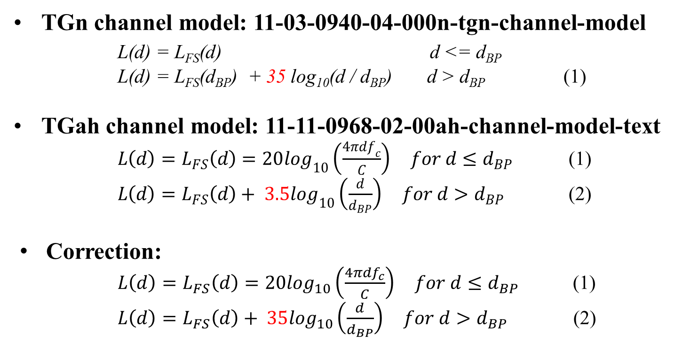
Correction of Equation (2)

Slide 4
Motion
Move to accept the following Equation (2) at the TGah channel model document (11-11-0968)
$L\left(d\right)=L_{FS}\left(d\right)+ 35\log_{10}\left(\frac{d}{d_{BP}}\right) for d>d_{BP}$ (2)

