Slide 1
PS-Poll Immediate ACK Enhancements
Date: 2012-03-12
Authors:

Slide 2
Accepted enhancement using Immediate ACK to PS-Poll Message
STAs in doze state most of time, may not check beacon/TIM frames
A STA wakes up at desired time and sends a PS-Poll message to AP to be informed of buffered data
AP responds to this STA with an immediate ACK that contains indication of pending BU
The ACK frame has 1bit BU field indicating (add ref)
1: traffic is buffered (as indicated in the TIM map), stay awake (i.e. a service period starts)
0: no traffic is buffered, go back to sleep

Slide 3
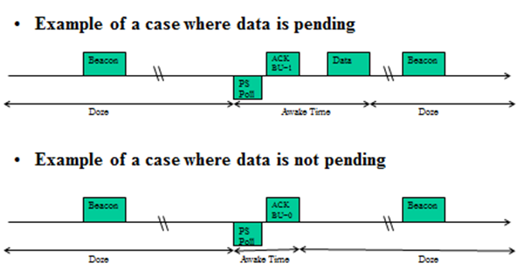
Accepted PS-Poll and Immediate ACK Signaling

Slide 4
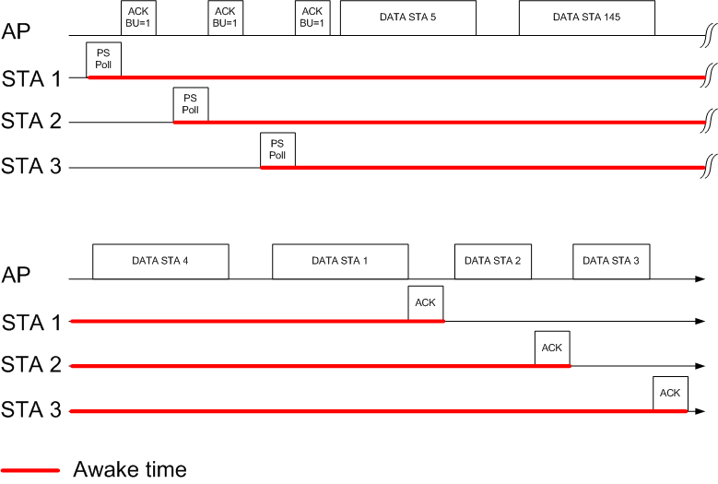
Motivation for Power Save Enhancements
In overload conditions:
AP may not be able to serve STA immediately
STA may need to stay awake for long time
If AP sends ACK BU=0 STA might go to sleep for long time

Slide 5
Proposed Field in Immediate ACK
Bits 2 … x: Duration until service period starts
Based on its buffer status and traffic priorities, AP estimates this duration
Allows the STA to enter Doze state again until the AP is ready to send data
If AP is unable to send data due to network overload, indicates BU = 0
Bit 1 | 1: traffic is buffered (as indicated in the TIM map) 0: no traffic is buffered, go back to sleep
Bit 2 … 15 | Duration until service period starts in units of 100 TUs

Slide 6
Flowchart for PS Enhancements

Slide 7
Summary
Having just BU field in immediate ACK may be not enough in cases where AP might not always be able to serve the traffic immediately
Inclusion of the duration until service period field allows a STA to enter Doze state again until the AP is ready to send data

Slide 8
Straw Poll
Do you agree to add a duration until service period field in the immediate ACK to a PS-Poll?

Slide 9
Reference
[1] IEEE 802.11-12/0127r0 Low Power Medium Access, January 2012

