Slide 1
Active Scanning Reply Window
Date: 2012-03-14
Authors:

Slide 2
Abstract
The presentation describes an improvement to the Active scan mechanism by scheduling a receive window for Probe Responses.

Slide 3
Conformance w/ TGai PAR & 5C
Conformance Question | Response
Does the proposal degrade the security offered by Robust Security Network Association (RSNA) already defined in 802.11? | No
Does the proposal change the MAC SAP interface? | No
Does the proposal require or introduce a change to the 802.1 architecture? | No
Does the proposal introduce a change in the channel access mechanism? | No
Does the proposal introduce a change in the PHY? | No
Which of the following link set-up phases is addressed by the proposal? (1) AP Discovery (2) Network Discovery (3) Link (re-)establishment / exchange of security related messages (4) Higher layer aspects, e.g. IP address assignment | 1,2

Slide 4
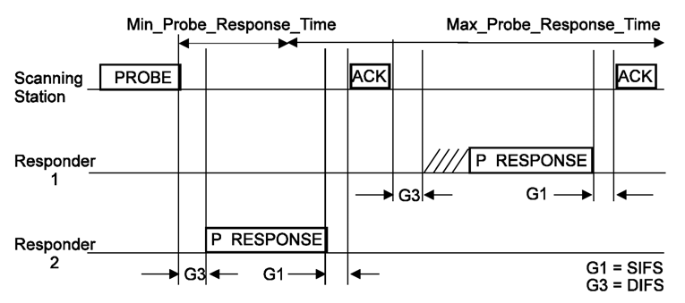
Recap, Active Scanning Procedure
Active scanning procedure is defined in 10.1.4.3.3:
After STA transmits a Probe Request the STA attempts decoding the WM is search of Probe Response.
Some APs react immediately while others are more slow to respond.

Slide 5
Recap, Active Scanning Procedure
Deficiencies of the current mechanism:
Max_Probe_Response_Time is not known to the STA and AP:
The STA may miss Probe Responses or may waist PWR for no reason.
The AP may send Probe Response while no STA is listening – WM occupancy.

Slide 6
Recap, Active Scanning Procedure
Deficiencies of the current mechanism:
DIFS is very short (~50usec) but the AP response time is far greater (2msec – 15msec) resulting in wasted waiting on channel for AP response (10-20%) waste.
The STA must focus on a single channel and cannot optionally perform other activities concurrently over multiple channels resulting in longer to complete scan procedure.

Slide 7
Suggested Improvement
Agree on the time window for Probe Response transmission:
Possibly as hard definition in the std or as a parameter in the Probe Request message.
Within the Probe Request the STA indicates the start and end of the window for Probe Response transmission.
AP sends a Probe Response only within this window.
AP
STA
No early than start of the response window, no later than end of the time window
Once or
More:
Probe Req inc. start and end Probe Response
Probe Response

Slide 8
Suggested Improvement - usage (con.)
Use the vacant time for Passive Scanning:
STA transmits Probe Req.
Switches to another channel and perform passive scanning.
STA returns to original channel to decode Probe Response in timely manner.
Channel N+1
802.11 WM activity
Channel N
802.11 WM activity
Probe Request defining reply window
STA Receive window
Reply window
Probe Request transmission
Possible Probe Response
AP1 Probe Response
AP2 Beacon

Slide 9
Suggested Improvement - usage (con.)
Channel N+3
802.11 WM activity
Channel N+2
802.11 WM activity
Channel N+1
802.11 WM activity
Channel N
802.11 WM activity
Probe Request defining reply window
Reply window
STA Receive window
Possible Probe Response
Probe Request transmission
AP n Probe Response
AP n Beacon

Slide 10
Suggested Improvement - usage (con.)
Benefits:
Enable passive scanning at another channel with 10-20% success rate (assuming light beacon 20-10msec):
Shorten average scanning duration.
Improved WM occupancy – no need for Probe Rsp.
Improve PWR consumption of 10-20% due to shortened Rx window.
De-facto delay already exists.
Channel N+1
802.11 WM activity
Channel N
802.11 WM activity
Probe Request defining reply window
Reply window of channel X
Possible Probe Response

Slide 11
Suggested Improvement - usage (con.)
Use the vacant time for Active Scanning:
STA transmits Probe Req.
Switches to another channel STA transmits Probe Req. indicating sufficient delay.
STA returns to original channel to decode Probe Response in timely manner.
STA return to channel N+1 to decode Probe Response.
Channel N+1
802.11 WM activity
Channel N
802.11 WM activity
Probe Request defining reply window
Reply window of channel X
Possible Probe Response

Slide 12
Suggested Improvement - usage (con.)
Channel N+2
802.11 WM activity
Channel N+1
802.11 WM activity
Channel N
802.11 WM activity
Probe Request defining reply window
Reply window of channel X
STA Receive window
Possible Probe Response
Probe Request transmission
AP1 Probe Response

Slide 13
References
[1] 12-0264r1 Spec Framework Proposal: Probe Response frame transmission interval
[2] 11-1414r4 Probe Request and Response in Tgai
[3] 12-207r1 Active Scanning related requirements for Specification Frame Work Document.

Slide 14
Framework document
Insert the following text on page 6 paragraph 1:
The amendment will define a mechanism to reduce the overall duration of Active Scanning (over multiple channels). This mechanism is based on an indication within Probe Req for the transmission window of the Probe Response and APs refraining from Probe Response transmission outside this window.

Slide 15
Strawpoll
Do you agree to make changes to the TGai framework specification as described on slide 8 of this submission.
Yes:
No:
Abstain:

