Slide 1
Active Scanning Reply Window
Date: 2012-03-12
Authors:

Slide 2
Abstract
The presentation describes an improvement to the Active scan mechanism by scheduling a receive window for Probe Responses.

Slide 3
Conformance w/ TGai PAR & 5C
Conformance Question | Response
Does the proposal degrade the security offered by Robust Security Network Association (RSNA) already defined in 802.11? | No
Does the proposal change the MAC SAP interface? | No
Does the proposal require or introduce a change to the 802.1 architecture? | No
Does the proposal introduce a change in the channel access mechanism? | No
Does the proposal introduce a change in the PHY? | No
Which of the following link set-up phases is addressed by the proposal? (1) AP Discovery (2) Network Discovery (3) Link (re-)establishment / exchange of security related messages (4) Higher layer aspects, e.g. IP address assignment | 1

Slide 4
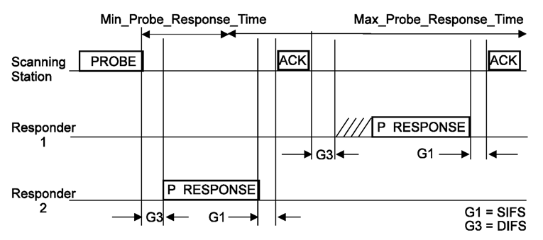
Recap, Active Scanning Procedure
Active scanning procedure is defined in 10.1.4.3.3:
After STA transmits a Probe Request the STA attempts decoding the WM is search of Probe Response.
Some APs react immediately while others are more slow to respond.

Slide 5
Recap, Active Scanning Procedure
Deficiencies of the current mechanism:
Max_Probe_Response_Time is not known to the STA and AP:
The STA may miss Probe Responses or may waist PWR for no reason.
The AP may send Probe Response while no STA is listening.

Slide 6
Recap, Active Scanning Procedure
Deficiencies of the current mechanism:
DIFS is wasted waiting on channel for AP response.
Different APs has different response times (Probe Req parsing and Probe Rsp creation) and different queues load creating additional PWR waste and delay.
The STA must focus on a single channel and cannot perform multiple concurrent Active Scan procedure over multiple channels.
Overall Active Scam procedure takes longer (than necessary) to complete.

Slide 7
Suggested Improvement
The STA indicates the time window for Probe Response transmission:
Within the Probe Request the STA indicates the start and end of the time window for Probe Response transmission.
AP sends a Probe Response only within this window.
AP
STA
start of the time window
No later than end of the time window
Once or
More:
Probe Req inc. start and end Probe Response
Probe Response

Slide 8
Suggested Improvement (con.)
The STA indicates the time window for Probe Response transmission:
The STA is than able to perform multiple concurrent Active scan procedures over multiple channels by that shortening the Active Scan duration.
Channel N+2
802.11 WM activity
Channel N+1
802.11 WM activity
Channel N
802.11 WM activity
Probe Request defining reply window
Reply window of channel X
Possible Probe Response

Slide 9
Framework document
Insert the following text on page 6 paragraph 1:
The amendment will define a mechanism to reduce the overall duration of Active Scanning (over multiple channels). This mechanism is based on an indication within Probe Req for the transmission window of the Probe Response and APs refraining from Probe Response transmission outside this window.

Slide 10
Strawpoll
Do you agree to make changes to the TGai framework specification as described on slide 8 of this submission.
Yes:
No:
Abstain:

Slide 11
References
[1] 12-0264r1 Spec Framework Proposal: Probe Response frame transmission interval
[2] 11-1414r4 Probe Request and Response in Tgai
[3] 12-207r1 Active Scanning related requirements for Specification Frame Work Document.

