Slide 1
Active Scanning Reply Window
Date: 2012-03-06
Authors:

Slide 2
Abstract
The presentation describes an improvement to the Active scan mechanism by scheduling a receive window for Probe Responses.

Slide 3
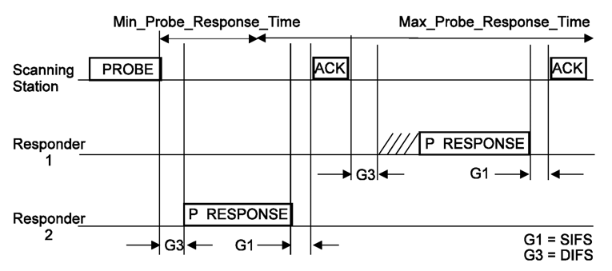
Recap, Active Scanning Procedure
Active scanning procedure is defined in 10.1.4.3.3:
After STA transmits a Probe Request the STA attempts decoding the WM is search of Probe Response.
Some APs react immediately while others are more slow to respond.

Slide 4
Recap, Active Scanning Procedure
Deficiencies of the current mechanism:
Max_Probe_Response_Time is not known to the STA and AP:
The STA may miss Probe Responses or may waist PWR for no reason.
The AP may send Probe Response while no STA is listening.

Slide 5
Recap, Active Scanning Procedure
Deficiencies of the current mechanism:
Min_Probe_Response_Time is not defined:
DIFS is wasted waiting on channel for AP response.
Different APs has different response times and different queues limitations due to complexity of constructing Probe Response.
The STA must focus on a single channel and cannot perform multiple concurrent Active Scan procedure over multiple channels – overallActive Scam procedure takes longer to complete.

Slide 6
Suggested Improvement
The STA indicates the time window for Probe Response transmission:
Within the Probe Request the STA indicates the Min_Probe_Response_Time and Max_Probe_Response_Time.
AP sends a Probe Response only within this window.
For resiliency provide the beacon interval (TBTT).
AP
STA
No early than Min Probe Response
No later than Max Probe Response
Once or
More:
Probe Req inc. Min and Max Probe Response Time
Probe Response

Slide 7
Suggested Improvement (con.)
The STA indicates the time window for Probe Response transmission:
The STA is than able to perform multiple concurrent Active scan procedures over multiple channels by that shortening the Active Scan duration.
Channel N+2
802.11 WM activity
Channel N+1
802.11 WM activity
Channel N
802.11 WM activity
Probe Request defining reply window
Reply window of channel X
Possible Probe Response

Slide 8
Framework document
Insert the following text on page 6 paragraph 1:
The amendment will define a mechanism to reduce the overall duration of Active Scanning over multiple channels. This mechanism is based on agreed scheduling window for the Probe Response.

Slide 9
Strawpoll
Do you agree to make changes to the TGai framework specification as described on slide 8 of this submission.

Slide 10
References
11-1414r4 Probe Request and Response in Tgai
12-207r1 Active Scanning related requirements for Specification Frame Work Document.

