Slide 1
802.11ai simulations
Date: 2012-03-05
Authors:

Slide 2
Abstract
The presentation provides simulation results for active and passive scanning.
The statistics of scanning overhead and scanning quality are explained and showed.
The benefits of the 802.11ai active scanning enhancements are clearly shown.

Slide 3
Simulation scenario
30m
A single room indoor scenario with 4 APs and 4 background traffic STAs
When background traffic was used, each background STAs transmitted and received 2Mbps data (4Mbps per STA)
802.11ac 40MHz, 2*2 MIMO
The TGac propagation model was used
10m
10m
10m
AP
STA
STA
AP
30m
10m
STA
STA
AP
3m
3m
AP
10m

Slide 4
Simulation scenario
10000 STAs were created to random positions within the room at random intervals
The STAs were created with mean of 1 ms, 10 ms and 100 ms intervals
This results to 3 different real time simulation lengths (10s, 100s and 1000s)
Following steps were taken for all the created STAs:
Performed scanning to discover AP with the best RxP level
Passive scanning STA listens to the channel for 100 ms
Active scanning STA listens to the channel for 10 ms after it has transmitted a Probe Request
After the scanning the STA transmits and receives a frame (200 octets) with one (the selected) AP
The STA is removed from the simulation

Slide 5
Simulation scenario
The management frames used AC 3, background data AC1
Default EDCA parameters were used
Beacon, Probe Request and Probe Response were transmitted at lowest MCS at 20 MHz transmission bandwidth (6 Mbit/s)
Beacon frame is 145 octets, TX ON 220 micro seconds
Probe Request is 101 octets, TX ON 156 micro saeconds
Probe Response is 165 octets, TX ON 240 microseconds
Additional information for one BSS increases frame size by 15 octets
Probe Delay is 6 ms

Slide 6
Simulated scanning mechanisms
The simulations benchmarked 4 different scanning mechanisms:
Passive scanning
Active scanning
Active scanning with enhancement set 1
Active scanning with enhancement set 1 and 2
The scanning mechanisms are described in more details in the following slides

Slide 7
1. Passive scannning
Beacons are transmitted on every 100 TU from each AP
Each AP selects random time to transmit the first Beacon, i.e. the Beacon transmission times between APs is not coordinated
The scanning STA listens to the channel for 100 TU and then selects the strongest AP from which it has received a beacon

Slide 8
2. Active scanning
When a STA is created, it starts Probe Delay (6tu) timer and listens to the channel
If a PHYRxStart.indication primitive is received or Probe Delay is elapsed, the STA transmits a Probe Request to broadcast address
All the APs that received the request will transmit Probe Response to the broadcast address
All STAs receive all beacons and probe responses to get information of all APs
When 10 ms has elapsed since the probe request is sent, the strongest known AP is selected
Please note that active scanning takes less than 20 ms

Slide 9
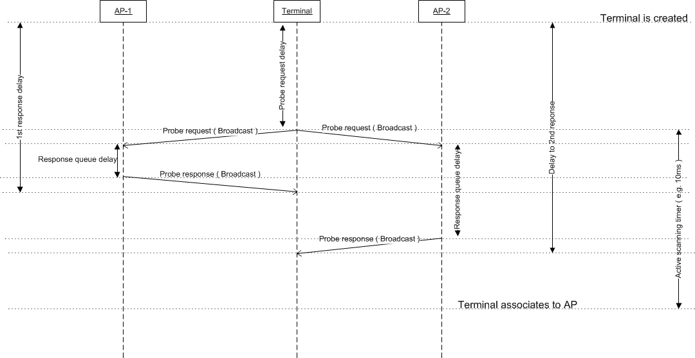
Active scanning example
Please note that in all active scanning modes only one probe request was transmitted per a scanning STA

Slide 10
3. Active scanning with enhancement set 1
This active scanning has enhancements to cancel the transmission of Probe Response:
The Probe Response transmission is cancelled, if TBTT is within the next 5tu, i.e. Beacon replaces the Probe Response
AP will respond to multiple similar Probe Requests with a single Probe Response
If terminal receives a Beacon or Probe Response during probe delay it will put the AP to filter list of the probe request
The APs in filter list shall not respond to the Probe Request

Slide 11
4. Active scanning with enhancement set 1&2
This scanning mechanism is able to cancel the Probe Response transmission as described in the previous slide AND:
When AP receives a probe request, it will reply with a probe response containing operation parameters of all 4 APs
When AP receives a Probe Response frame including its parameters, the AP cancels Probe Response transmission

Slide 12
Simulation results
The number of transmitted Probe Responses indicates the amount of overhead created by the scanning mechanism
The time needed to receive the operating parameters of the first and the last AP
The operating parameters include SSID, BSSID, capability, etc.
The number of operating parameters received within the scanning time
The number of APs from which a frame is received within the scanning time
The reception of frame enables the radio link assessment

Slide 13
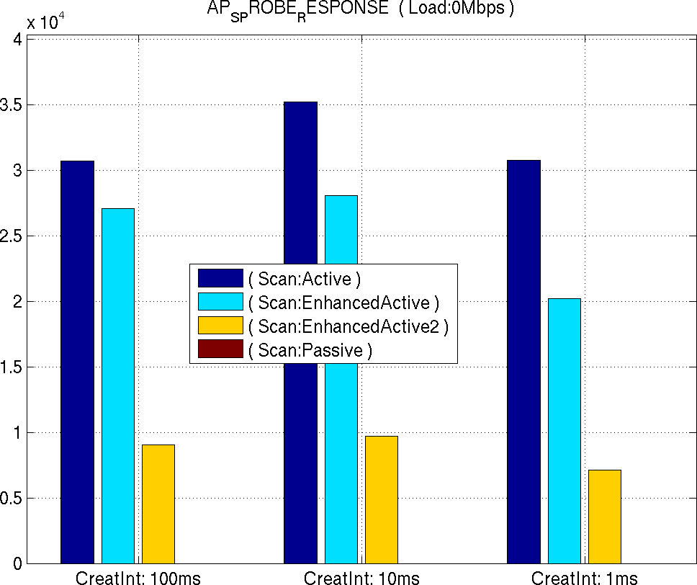
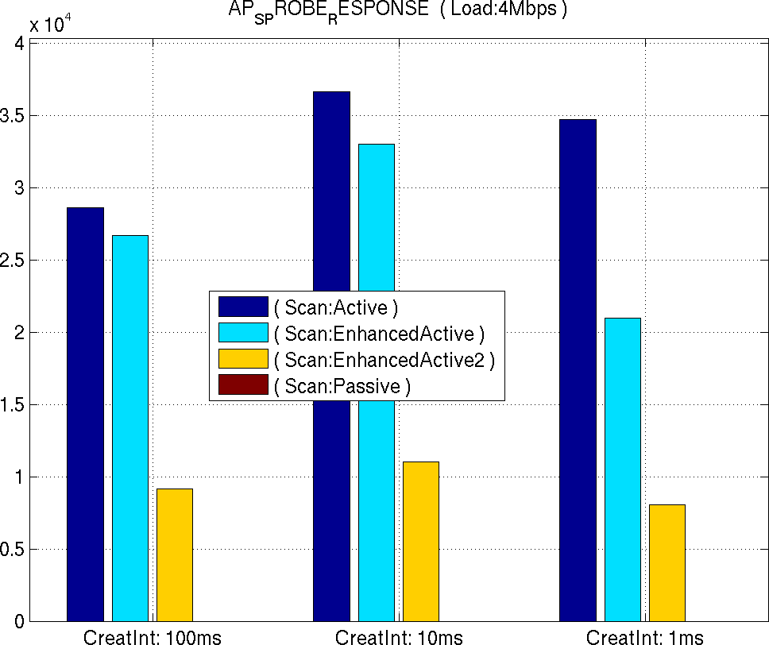
Number of transmitted Probe Responses
Without background load
With background load
Total number of transmitted Probe Responses
Total number of transmitted Probe Responses
Please note that active scanning enhancements reduce the number of transmitted Probe Response frames

Slide 14
Time needed to receive operating parameters of the AP
The time to receive AP operating parameters indicates the time from the creation of the STA to the first time the AP has received operating parameters of the AP
The operating parameters are SSID, BSSID, capabilities, etc.
The slide#9 shows the timing diagram of the active scanning
The operating parameters are transmitted in Beacon and Probe Response frames
Simulations of active scanning with enhancement set 2, the probe responses may contain parameters of many Aps
As described in slides 7 and 8, the simulations used constant durations to receive at channel
These durations define the duration of scanning operation

Slide 15
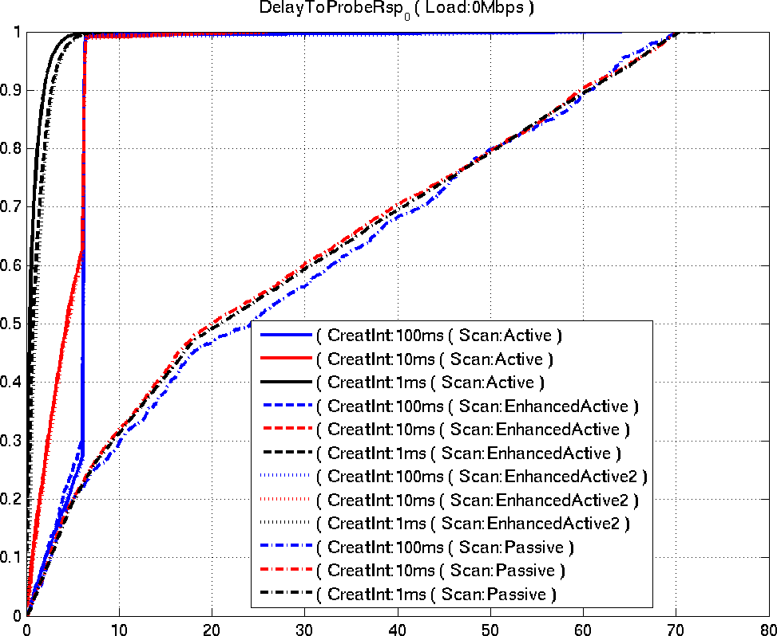
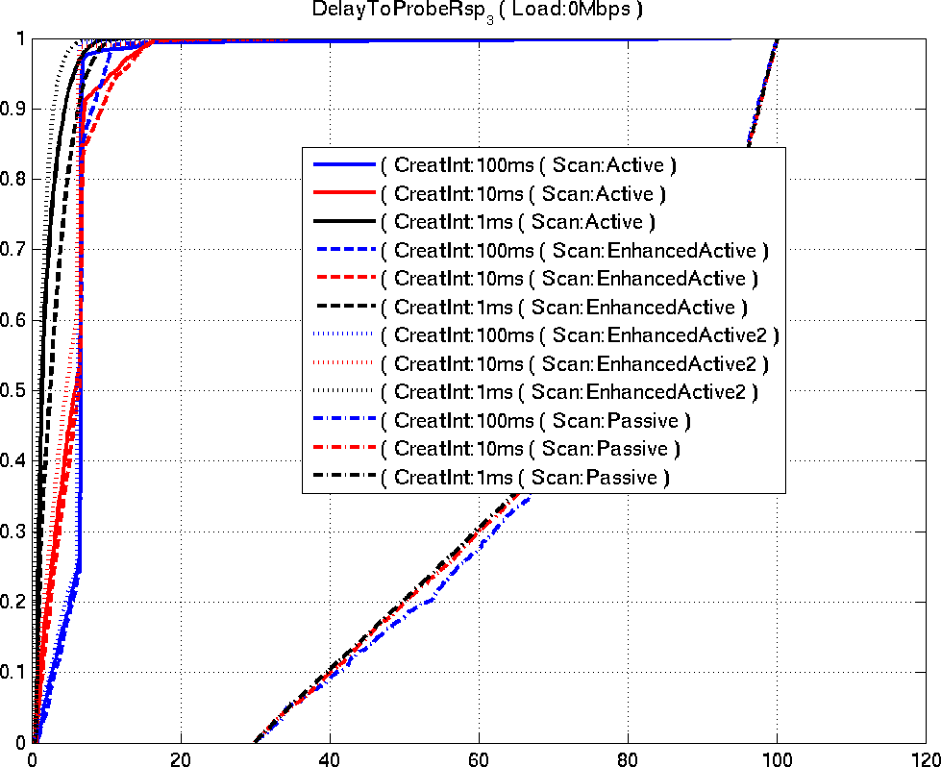
Time needed to receive operating parameters without background load
Time needed to receive the first operation parameters
Time needed to receive the last operation parameters
CDF, 1 = all scanning STAs
CDF, 1 = all scanning STAs
ms
ms
The passive scanning requires longer time than the active scanning.
The Probe Delay (6 ms) is visible in the active scanning.

Slide 16
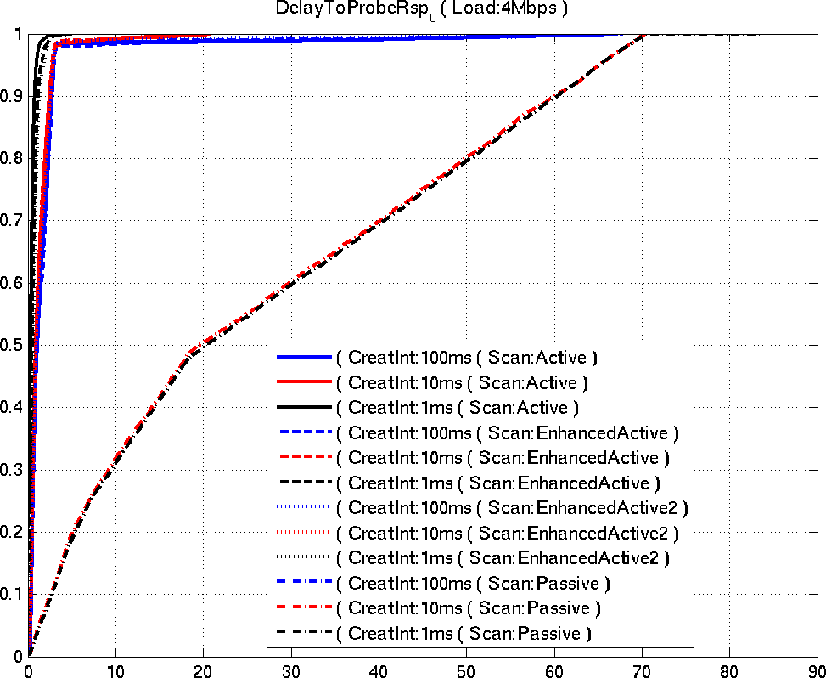
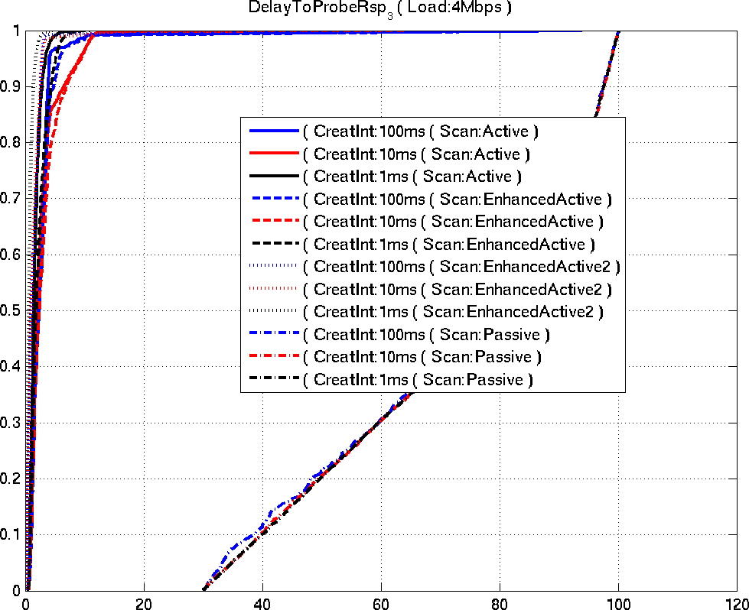
Time to receive AP operating parameters with background load
Time needed to receive the first operation parameters
Time needed to receive the last operation parameters
CDF, 1 = all scanning STAs
CDF, 1 = all scanning STAs
ms
ms
The passive scanning results are similar regardless of background traffic. The probe delay is no longer visible in active scanning.

Slide 17
Number of APs which operating parameters are received
The operating parameters transmission may have failed for many reasons:
The probe request, probe response and beacon frame are transmitted only once
With background traffic collisions in TXOP obtaining may occur
The Scanning STAs may have received probe responses that were transmitted as a response to probe request transmitted by other STA
When STA creation interval was 100 ms, retransmission logic for probe request and use of acknowledgements should increase the number of received operating parameters

Slide 18
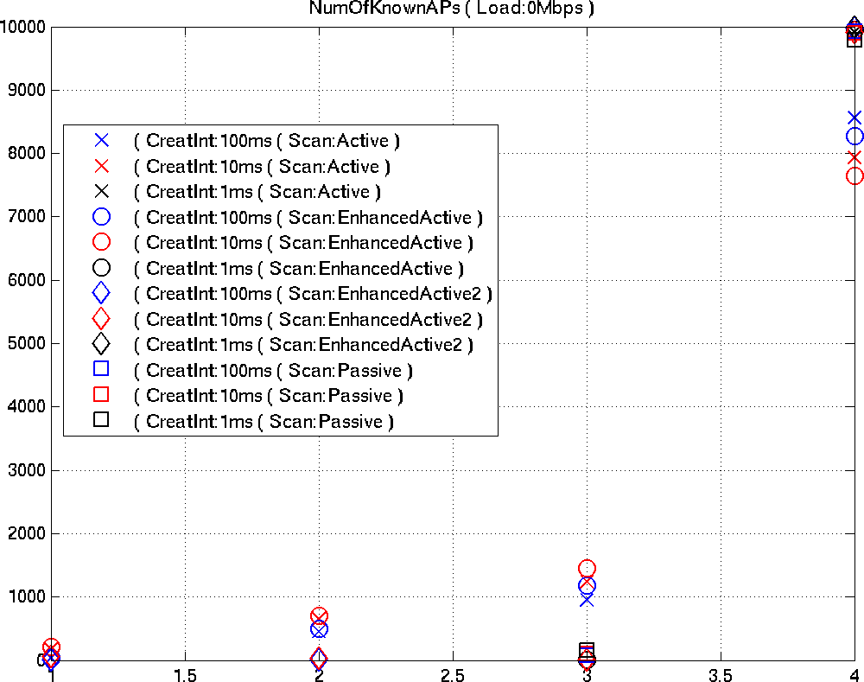
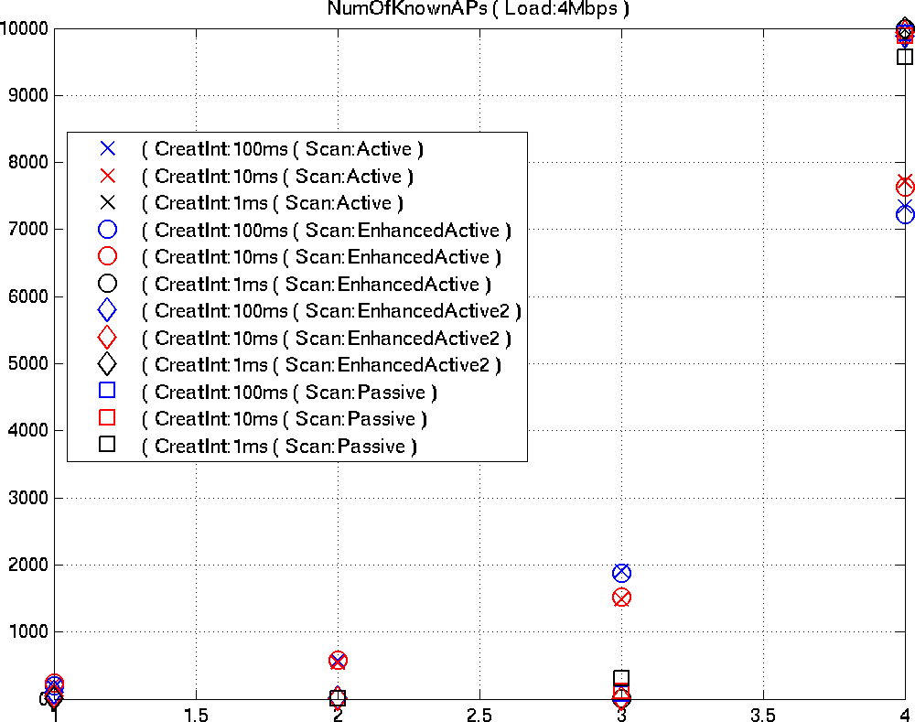
Number of APs from which the operating parameters are received
Without background load
With background load
Amount of scanning STAs
Amount of scanning STAs
Total number of APs which parameters are received
Total number of APs which parameters are received
The active scanning with enhancement sets 1&2 and passive scanning receive operating parameters. Perhaps the colliding probe responses are visible at other active scanning results.

Slide 19
Number of APs from which a frame is received
The number of APs from which a frame is received indicates the number of APs from which the STA has received a data, ack, probe response or beacon frame
If the value is smaller than four, the scanning STA has not received a frame from all Aps
The scanning STA transmits the probe request once
No additional operation to receive a frame or scanning information from all APs was present
Additional operations make the scanning results very difficult to understand

Slide 20
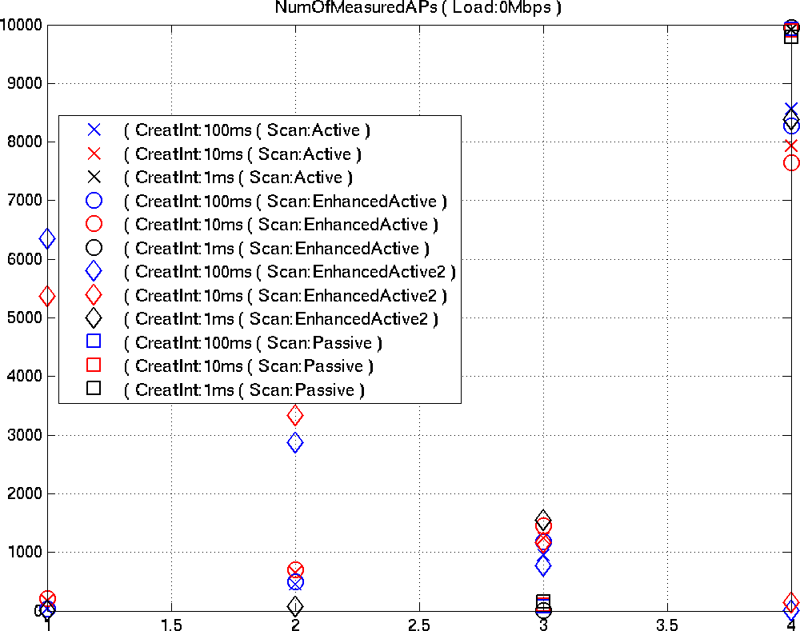
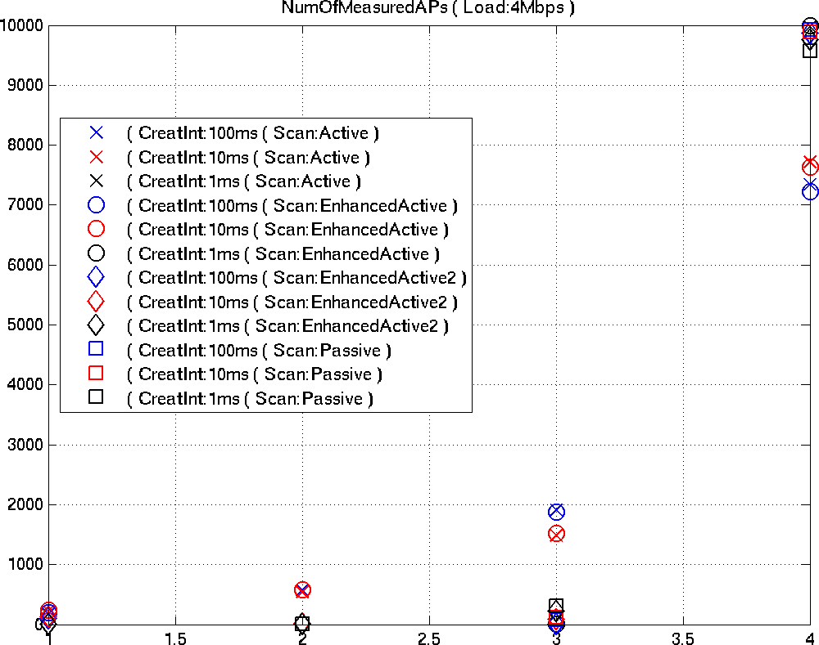
Number of APs from which a frame is received
Without background load
With background load
Amount of scanning STAs
Amount of scanning STAs
Total number of APs from which a frame is received
Total number of APs from which a frame is received
Active scanning with enhancement sets 1&2 does not receive a frame from all APs. With background traffic all scanning mechanisms perform nicely.

Slide 21
Conclusions
The active scanning and passive scanning have different delay
Measurement Pilot transmissions may reduce delays in passive scanning, but it is not sure will all BSSs transmit Measurement Pilots
The active scanning enhancements reduce the amount of transmitted probe responses
Without background logic, the scanning STA may need additional logic to receive a frame and assess the radio link
More advanced (re)transmission logic for probe requests and probe responses could have improved the results

