Slide 1
FILS presentation on High Level Security Requirements
Date: 2012-03-05
Authors:
Name | Affiliations | Address | Phone | email
Ping Fang | Huawei Technologies Co., Ltd. | Bldg 7, Vision Software Park, Road Gaoxin Sourth 9, Nanshan District, Shenzhen, Guangdong, China, 518057 | +86 755 36835101 | ping.fang@huawei.com
Rob Sun | Huawei Technologies Co., Ltd. | Suite 400, 303 Terry Fox Drive, Kanata, Ontario K2K 3J1 | +1 613 2871948 | Rob.sun@huawei.com
Zhiming Ding | Huawei Technologies Co., Ltd. | Bldg 7, Vision Software Park, Road Gaoxin Sourth 9, Nanshan District, Shenzhen, Guangdong, China, 518057 | +86 755 36835837 | dingzhiming@huawei.com

Slide 2
Abstract
From proposal 12/159r1 and 12/248r0, TGai shall include support of optimized EAP by concurrent association, authentication and key distribution to set up initial link and establish the FILS context, and the optimized FILS state machine which enable the parallel message processing.
This document describes a technical proposal of the optimized EAP and the FILS state machine.

Slide 3
Conformance w/ Tgai PAR & 5C
Conformance Question | Response
Does the proposal degrade the security offered by Robust Security Network Association (RSNA) already defined in 802.11? | No
Does the proposal change the MAC SAP interface? | No
Does the proposal require or introduce a change to the 802.1 architecture? | No
Does the proposal introduce a change in the channel access mechanism? | No
Does the proposal introduce a change in the PHY? | No
Which of the following link set-up phases is addressed by the proposal? (1) AP Discovery (2) Network Discovery (3) Link (re-)establishment / exchange of security related messages (4) Higher layer aspects, e.g. IP address assignment | 3,4

Slide 4
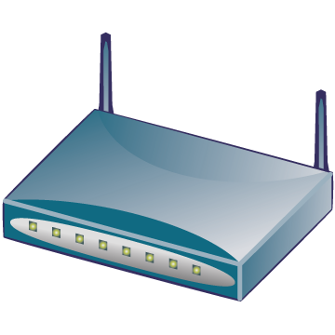
Why do we need FILS?
Cellular core
Internet
AAA
HA
WiFi access
Cellular access
BS
AP
Dual mode MS
BS
WiFi
interface
Cellular interface
Hot-Spot Pass-Through Internet Access: Users on vehicle/train passing near an AP with a mobile phone must have the ability to access various Internet services in a few seconds to his/her e-mail/twitter/facebook or to offload traffic carried by other networks e.g. 3G.
If a dual mode MS makes a seamless handoff from cellular network to WiFi network, the time of WiFi ILS should be minimized.
3GPP TS23.327(Mobility between 3GPP-WLAN, not support seamless HO yet) and WMF T37 (WiMAX WiFi Interworking, support seamless HO but effect is not proved, using pre-authentication) have supported this scenario.
Notes:
虽然offload不需要做到无缝切换，但尽快地完成切换总是有好处的，因为大量用户同时连接WiFi又很快离开。

Slide 5
Why keep EAP?
In 3GPP TS33.402（SAE Security aspects of non-3GPP accesses）, it is specified:
Access authentication for non-3GPP access in EPS shall be based on EAP-AKA (IETF RFC 4187) or on EAP-AKA’ (IETF RFC 5448).
In WiMAX NWG T37(WiMAX WiFi Interworking), EAP is also conducted by AAA server in WiMAX CSN during WiFi ILS.
Considering the MIP keys are derived from EMSK which is an outcome of an EAP procedure in current network specifications (see 3GPP TS33.402 and WMF T32), the EAP should be kept in FILS.

Slide 6
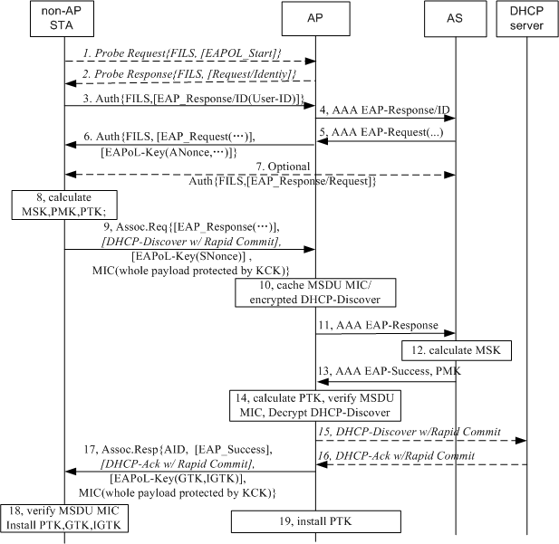
Optimized full EAP with concurrent IP address assignment
Optimized Full EAP is performed to setup initial link and EAP-ERP context and when EAP-ERP context expires.
Step 1 & 2 : EAPoL-Start and EAP-Request/ID are optionally carried in Probe Request & Response.
Step 6: ANonce from AP is carried to concurrently run the 4-way handshake with authentication.
Step 7 is optional for SIM based device
Step 9 : SNonce is carried and sent in Assoc-Req once STA get MSK. SME need to check the status of EAP. A MIC for whole MSDU protected by KCK are attached in Assoc-Req and Assoc-Resp.
Step 10 & 12: AP caches MSDU MIC before PTK is available. And once PTK is received , AP verifies MSDU MIC .
Step 15&16: DHCP is a optional example here. Other IP address allocation could be used, such as AP can be pre-assigned a IP pool. If IP address assignment server doesn’t respond within a certain period, then the AP may send Assoc Resp frame with indication of IP configuration unavailable/pending.

Slide 7
Modification to 802.11 Authentication and Association State Machine
State 1
Unauthenticated,
Unassociated
Class 1 Frames
FILS
Deauthentication
Successful
802.11 Authentication
Deauthentication
State 2
Successful
FILS Authentication
Authenticated,
Unassociated
Class 1 & 2 Frames
Successful
(Re)Association –RSNA Required
Deassociation
State 5
Unsuccessful
(Re)Association
(Non-AP STA)
FILS Authenticated/Unassociated
Class 1 & 2 Frames
With Selected Management &
Data Frames
State 3
Successful
802.11
Authentication
Authenticated,
Associated
(Pending RSN Authentication)
Class 1 ,2 & 3 Frames
IEEE 802.1X Controlled Port Blocked
Deauthentication
4- way Handshake Successful
Successful
FILS Association
Unsuccessful
(Re)Association
(Non-AP STA)
Deauthentication
State 4
Disassociation
Authenticated,
Associated
Class 1 ,2 & 3 Frames
IEEE 802.1X Controlled Port
UnBlocked
Successful
802.11 Authentication
Successful
(Re) Association
No RSNA required or
Fast BSS Transitions
Slide 7

Slide 8
Temporary State 5 (FILS Authenticated/Unassociated)
Upon successful FILS authentication, both the STA and AP shall transition to FILS Authenticated/unassociated state
STA at FILS Authenticated/Unassociated state , it allows Class 1,2 and selected Data frames piggybacked over Class 1 &2 frames to be transmitted
Upon receipt of a De-authentication frame from either STA or AP STA with reasons, the STA at the FILS Authenticated/Unassociated state will be transitioned to State 1. STA transitioned back to State 1 may retry with FILS authentication or use the RSNA authentication
Upon successful FILS Association, the STA shall transition to state 4 which allows full class 1, 2 and 3 frames to pass through.
Selected Management Frames and Data Frames | Reasons
EAPOL message with EAP Packet | To carry out the EAP full authentication
IP assignment | To enable the parallel IP assignment to take place

Slide 9
Appropriate FILS Authentication Properties
Mandatory Properties | 802.11i | FILS Security
Mutual Authentication with key agreement | Yes | Yes
Strong Confidentiality | Yes | Yes
RSNA Security Model | Yes | Yes
Key Confirmation | Yes | Yes
Key Derivation | Yes | Yes
Fast Re-authentication | Yes | Yes
Strong Session Key | Yes | Yes
Replay Attack Protection/MTIM protection/Dictionary Attack /Impersonation Attack Protection | Yes | Yes
Recommended Properties | 802.11i | FILS Security
Fast and Efficient | No | Yes
Forward Secrecy | Implementation Related | Implementation Related
Denial of Service Resistance | Implementation Related | Implementation Related

Slide 10
Authentication Algorithm Number Field
Insert the following FILS Authentication Algorithm Number
Authentication algorithm number = 0: Open System
Authentication algorithm number = 1: Shared Key
Authentication algorithm number = 2: Fast BSS Transition
Authentication algorithm number = 3: simultaneous authentication of equals (SAE)
Authentication algorithm number = 4: FILS Authentication
Authentication algorithm number = 65 535: Vendor specific use

Slide 11
Conclusion
Proposal Summary
A optimized EAP authentication, in which 4-way handshake is carried out concurrently with authentication and association
A modified 802.11 Authentication and Association State Machine, which enable the parallel message processing of existing authentication protocol

Slide 12
Questions & Comments

