Slide 1
Hybrid Scanning
Date: 2012-04-25
Authors:

Slide 2
Abstract
Doc. 11-12/277r3 (KDDI) provided “Hybrid scanning” concept in Hawaii meeting.
This submission provides analysis results between the 3 scanning modes, Active/Passive/Hybrid scanning.
Analysis is on:
energy consumptions,
air-time occupancy rate and
AP discovery time.
And also this submission includes proposed texts for SFD.

Slide 3
Proposed text for SFD - 1
DCN 11-12/0277r4
Title Hybrid Scanning
Author Katsuo Yunoki
Company KDDI R&D Laboratories
Scope AP Discovery
Motivation Slide page 31-32
Background information No described in this document
Clause to amend Clause 6
Add between line 7 and 8
6.1.3 Air-time Occupancy Reduction (11-12/0277r4)
802.11ai shall have mechanism to reduce the air time occupancy of MAC frames used for active scanning.
Motion Slide 13

Slide 4
Proposed text for SFD - 2
DCN 11-12/0277r4
Title Hybrid Scanning
Author Katsuo Yunoki
Company KDDI R&D Laboratories
Scope AP Discovery
Motivation Slide page 31-32
Background information Slide page 5-11
Clause to amend Clause 6
Add between line 24 and 25
6.1.X Passive Scanning Execution (11-12/0277r4)
TGai studies possibility to mandate passive scanning execution before active scanning for 11ai STAs in order to reduce air-time occupancy.
Motion Slide 14

Slide 5
Energy consumption
Comments about power consumption were received on the submission about Hybrid scanning in Hawaii meeting. Those were the passive scanning consumed much more power than the active scanning on a STA.
This submission demonstrates comparison of energy consumption. The formulas are as below:
Active scanning
Energy/probe instance [Joule]
= (Message Length/rate )[sec]* Tx PWR[W] + Rx PWR[W] * Rx Time[sec]
Sending Probe Request
Listening to Probe Response
Passive scanning
Energy/passive scanning instance [Joule]
= Rx PWR[W] * Rx Time[sec]
Listening to Beacon

Slide 6
Comparison of energy consumption
(Assumptions)
Power for probe transmission: 200mW
Power for beacon/probe listening: 40mW
260 bytes for probe request message
6Mbps for frame rate of probe request
100msec for beacon interval

Slide 7
Comparison of Energy consumption
(Summary)
Energy consumption of Hybrid scanning are competitive in some cases as the table below.
→ Further optimization may be considerable.
When the power for passive scanning is lower, Hybrid scanning will be more competitive.
Unit : uJ
Scanning mode | Scan all channels, stop 1st AP is found | Scan CH 1, 6 and 11, stop 1st AP is found | Scan only one CH
Active scanning | 1243 | 859 | 189
Hybrid scanning | 2020 | 835 | 366
Passive scanning | 22000 | 6000 | 2000
Calculation details are on Slide 15-27.

Slide 8
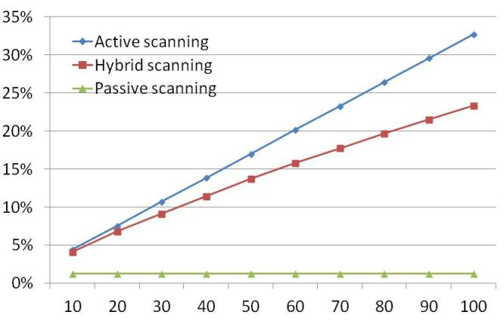
Air-time Occupancy Rate
Air-time occupancy rate will be suppressed in Hybrid scanning.
33%
23%
(Beacon Interval = 100msec)
1%
Associating STAs in a second

Slide 9
Comparison of AP discovery time
(No. of STAs = 100)
CH 1, 6 and 11 aren’t idle. The desired AP will be found on one of these channels.
Other channels are assumed as idle.
 | Scan all channels, stop after 1st AP is found | Scan only CH 1, 6 and 11, stop after 1st AP is found | Scan only 1 channel (STA knows operating channel of AP)
Active scanning | 20.7ms | 18.0ms | 3.0ms
Hybrid scanning | 31.1ms | 16.6ms | 6.4ms
Passive scanning | 550.0ms | 150.0ms | 50.0ms
→ Hybrid scanning may comply with FILS requirement from a perspective of the completion time.

Slide 10
Summary of analysis
Comparing with Active scanning,
Hybrid scanning provides:
lower energy consumption in some cases,
lower air-time occupancy rate and
AP discovery in shorter required time in some cases.
→ Hybrid scanning concept has possibilities to mitigate packet congestions without much performance degradations of AP discovery about energy consumptions and discovery time.

Slide 11
Supplemental comment
This is the question raised in Hawaii meeting.
Q: Is it acceptable to execute Passive scanning only when air environment is congested?
A: It is necessary to monitor surrounding circumstances in order to verify air-time occupation before Active scanning. It is Passive scanning.

Slide 12
Questions & Comments

Slide 13
Motion-1
Move to add the following text to the clause 6 of the specification framework document (11-12/0151r07):
6.1.3 Air-time Occupancy Reduction (11-12/0277r4)
802.11ai shall have mechanism to reduce the air time occupancy of MAC frames used for active scanning.
Moved:
Seconded:
Yes: No: Abstain:

Slide 14
Motion-2
Move to add the following text to the clause 6 of the specification framework document (11-12/0151r07):
6.1.X Passive Scanning Execution (11-12/0277r4)
TGai studies possibility to mandate passive scanning execution before active scanning for 11ai STAs in order to reduce air-time occupancy.
Moved:
Seconded:
Yes: No: Abstain:

Slide 15
Appendix-1
Calculation details

Slide 16
Comparison of energy consumption on a STA
Active vs. Passive scanning
(Calculations)
Active scanning
Energy/probe instance [Joule]
= (Message Length/rate )[sec]* Tx PWR[W] + Rx PWR[W] * Rx Time[sec]
Sending Probe Request
Listening to Probe Response
Passive scanning
Energy/passive scanning instance (Joule)
= Rx PWR[W] * Rx Time[sec]
Listening to Beacon

Slide 17
Comparison of energy consumption on a STA
Active vs. Passive scanning
(Case-a: Found desired AP)
Active scanning
Energy/probe instance (Joule)
= (260 * 8)bits/6Mbps * 200mW + 40mW * 3msec
= 69.3uJ + 120uJ = 189.3uJ
3msec is assumed in average to receive Probe Response after sending Probe Request.
Passive scanning
Energy/passive scanning instance (Joule)
= 40mW * 50msec = 2000uJ

Slide 18
Comparison of energy consumption on a STA
Active vs. Passive scanning
(Case-b: Not found desired AP)
Active scanning
Energy/probe instance (Joule)
= (260 * 8)bits/6Mbps * 200mW + 40mW * 15msec
= 69.3uJ + 600uJ = 669.3uJ
MaxChannelTime
Passive scanning
Energy/passive scanning instance (Joule)
= 40mW * 100msec = 4000uJ

Slide 19
Comparison of energy consumption on a STA
Active vs. Passive scanning
(Case-c: on idle channel)
Active scanning
Energy/probe instance (Joule)
= (260 * 8)bits/6Mbps * 200mW + 40mW * 0.67msec
= 69.3uJ + 26.8uJ = 96.1uJ
MinChannelTime
Passive scanning
Energy/passive scanning instance (Joule)
= 40mW * 100msec = 4000uJ

Slide 20
Comparison of energy consumption on a STA
Active vs. Passive scanning
(Summary)
Unit: uJ
 | Case-a Found desired AP | Case-b Not found desired AP | Case-c On idle channel
Active scanning | 189.3 | 669.3 | 96.1
Passive scanning | 2000 | 4000 | 4000
Active scanning consumes much less energy
in the current standard.

Slide 21
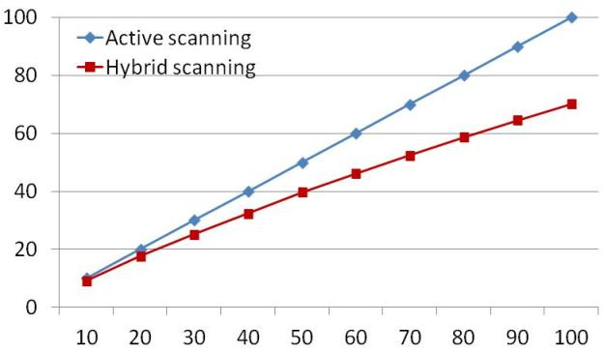
Transmission of Probe Request
Transmissions of Probe Request are suppressed in Hybrid scanning case.
-30%
No. of Probe Request
Associating STAs in a second
This means some STAs find the desired AP in passive scanning duration.

Slide 22
Average energy consumption of
Hybrid scanning
(Formula)
A [%] = Rate of STAs detecting the desired AP in passive scanning duration
* Maximum passive scanning duration is assumed as 5msec.
B [%] = Rate of STAs detecting the desired AP in active scanning duration
A + B = 100[%]
Average energy consumption (Joule)
Rx PWR[W] * Rx Time [s] * A[%] + (Tx PWR[W] * Tx Time[s] + Rx PWR[W] * Rx Time [s]) * B[%]
=
100
40mW * 2.5msec * A[%] + (200mW * (260bits*8/6Mbps) + 40mW * (5msec + 3msec)) * B[%]
=
100
Results are on the following slides:

Slide 23
Average energy consumption of
Hybrid scanning
(Results)
These values are for on the channel which the desired AP exists.
No. of STAs | 10 | 20 | 30 | 40 | 50 | 60 | 70 | 80 | 90 | 100
A (%) | 8.1% | 12.3% | 16.0% | 18.7% | 21.0% | 22.4% | 25.5% | 26.7% | 28.3% | 29.7%
B (%) | 91.9% | 87.7% | 84.0% | 81.3% | 79.0% | 77.6% | 74.5% | 73.4% | 71.7% | 70.3%
Energy (uJ) | 365.9 | 353.7 | 343.1 | 335.3 | 328.7 | 324.5 | 315.7 | 312.2 | 307.5 | 303.3
Value for comparison

Slide 24
Energy consumption of Hybrid scanning
(Results)
in case that a STA cannot find a desired AP
Energy/hybrid scanning instance (Joule)
=40mW * 5msec + (260 * 8)bits/6Mbps * 200mW + 40mW * 5msec
= 200uJ + 69.3uJ + 200uJ = 469.3uJ
on an idle channel
Energy/hybrid scanning instance (Joule)
=40mW * 5msec + (260 * 8)bits/6Mbps * 200mW + 40mW * 0.67msec
= 200uJ + 69.3uJ + 26.8uJ = 296.1uJ

Slide 25
Comparison of Energy consumption (1)
Scan full channels
APs exist on CH 1, 6 and 11. A STA finds the desired AP on one of these channels.
Other 8 channels are idle.
The followings are values in average.
Active scanning: (96.1uJ * 8Chs + 669.3uJ * 2Chs) / 2 + 189.3uJ * 1Ch
= (768.8uJ + 1338.6uJ) / 2 + 189.3uJ = 1243.0uJ
Hybrid scanning: (296.1uJ * 8Chs + 469.3uJ * 2Chs) / 2 + 365.9uJ * 1Ch
= (2368.8uJ + 938.6uJ) / 2 + 365.9uJ = 2019.6uJ
Passive scanning: (4000 * 8Chs + 4000uJ * 2Chs) / 2 + 2000uJ * 1Ch
= (32000uJ + 8000uJ) / 2 + 2000uJ = 22000uJ

Slide 26
Comparison of Energy consumption (2)
Scan specific channels
APs exist on CH 1, 6 and 11. A STA searches only on these channels.
Active scanning: (669.3uJ * 2Chs) / 2 + 189.3uJ * 1Ch
= 1338.6uJ / 2+ 189.3uJ = 858.6uJ
Hybrid scanning: (469.3uJ * 2Chs) / 2 + 365.9uJ * 1Ch
= 938.6uJ / 2 + 365.9uJ = 835.2uJ
Passive scanning: 4000uJ * 2Chs + 2000uJ * 1Ch
= 8000uJ / 2 + 2000uJ = 6000uJ

Slide 27
Comparison of Energy consumption (3)
Scan specific only one channel by pre-acknowledged info.
A STA knows the desired AP exists on CH 11.
So a STA scan only on CH 11.
Active scanning: 189.3uJ
Hybrid scanning: 365.9uJ
Passive scanning: 2000uJ

Slide 28
Appendix-2
Submission in Hawaii meeting
(Doc. 11-12/277r3)
Note: Graphs on Slide 36, 37 and 38 were revised. Because rate of probe request transmission was mistaken.

Slide 29
Abstract
This document provides the text for Specification Framework Document (SFD).
Area: Section 5 (AP/Network discovery)
Before showing the text, supporting explanations are provided.

Slide 30
Conformance w/ TGai PAR & 5C
Conformance Question | Response
Does the proposal degrade the security offered by Robust Security Network Association (RSNA) already defined in 802.11? | No
Does the proposal change the MAC SAP interface? | No
Does the proposal require or introduce a change to the 802.1 architecture? | No
Does the proposal introduce a change in the channel access mechanism? | No
Does the proposal introduce a change in the PHY? | No
Which of the following link set-up phases is addressed by the proposal? (1) AP Discovery (2) Network Discovery (3) Link (re-)establishment / exchange of security related messages (4) Higher layer aspects, e.g. IP address assignment | 1

Slide 31
Mathematical Comparison of Air-time Occupancy Rate (1)
Note:
Responding AP is only one.
Packet conflicts aren’t considered.
No. of STAs searching desired AP in a second.

Slide 32
Mathematical Comparison of Air-time Occupancy Rate (2)
Active scanning occupies much air-time proportionally to number of STAs.
Real condition is severer. Because responding AP isn’t only one.
Passive scanning doesn’t cause the air-time occupancy. But it takes longer time to discover a desired AP.
ref.: doc. 12/0276r0 (KDDI)
Hybrid scanning is proposed for an alternative for faster AP discovery as the following slides.

Slide 33
Concept of Hybrid Scanning
Passive scanning before executing Active scanning
To detect Beacons or Probe Responses (broadcasted)
Probe Responses are responding to Probe Requests from other STAs.
Transmitting Probe Request only after no detection of a desired AP in Passive scanning duration
Waiting time for Probe Response for each channel is MaxChannelTime. It may be shorter than the one in current Active scanning.
AP Transmitting Probe Response to broadcast address

Slide 34
Graphic of Hybrid Scanning
@2.4GHz
Passive+Active
* Scanning order is implementation dependent.
Active scanning duration = MaxChannelTime
CH1
t
CH2
CH3
:
:
CH11
Total scanning time

Slide 35
Behavior of Hybrid Scanning
Longer Passive scanning duration per each channel takes longer time to complete scanning in all channels.
Shorter Passive scanning duration increases number of Probe Requests and Responses.
Further studies are required.

Slide 36
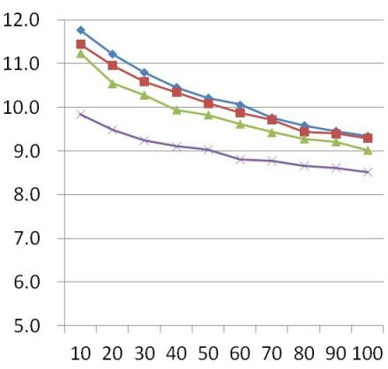
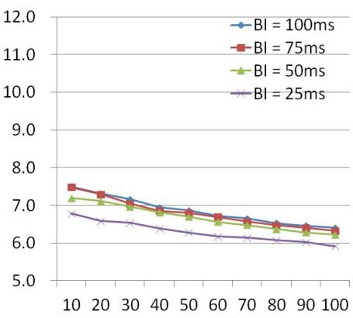
Example of Hybrid Scanning (AP discovery time on the channel which the desired AP exists)
Passive Scanning Duration = 10msec
Passive Scanning Duration = 5msec
(msec)
(msec)
Faster!!
5.9msec
8.5msec
No. of STAs searching the desired AP
No. of STAs searching the desired AP

Slide 37
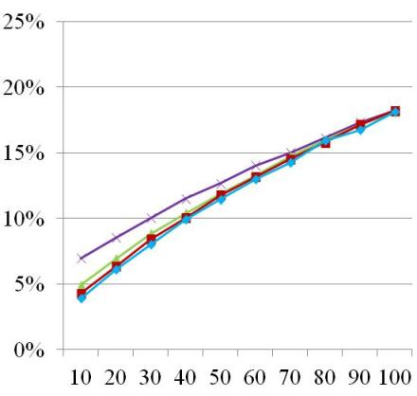
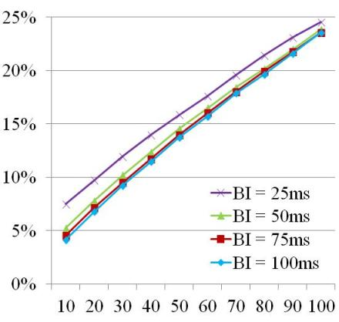
Example of Hybrid Scanning (Air time occupancy rate on the channel which the desired AP exists)
Passive Scanning Duration = 10msec
Passive Scanning Duration = 5msec
25%
18%
Higher!!
No. of STAs searching the desired AP
No. of STAs searching the desired AP

Slide 38
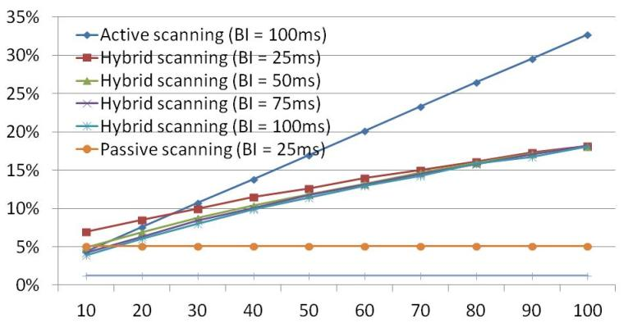
Air-time Occupancy Rate
Occupancy rate is reduced in Hybrid scanning compared with Active scanning.
Active scanning
33%
Hybrid scanning *
18%
Passive scanning
No. of STAs searching the desired AP
* Passive scanning duration of Hybrid scanning is 10msec.

Slide 39
Assumed Gains in AP Discovery Time (No. of STAs = 100)
 | Scan all channels, find all APs | Scan all channels, stop after 1st AP is found | Reduce number of scanning channels to 1 where AP are known to operate
Current passive scanning (x = 100) | 1100 ms | 550 ms | 50 ms
Passive scanning (x = 25) | 275 ms | 138 ms | 13 ms
Active scanning (y = 15) | 153 ms | 78 ms | 3 ms
Active scanning (y= 5) | 55 ms | 28 ms | 3 ms
Hybrid scanning (x = 100, y = 10, z = 10) | 209 ms | 99 ms | 9 ms
Hybrid scanning (x = 25, y = 10, z = 10) | 209 ms | 99 ms | 9 ms
Hybrid scanning (x = 100, y = 5, z = 10) | 156 ms | 74 ms | 6 ms
Hybrid scanning (x = 100, y = 5, z = 5) | 106 ms | 51 ms | 6 ms
x = Passive scanning duration (= BI)
y = MaxChannelTime
z = Passive scanning duration for Hybrid scanning

Slide 40
Assumptions For Comparison
[No. of channels]
11 channels.
[Desired AP]
Only 1 AP on one of the 11 channels.
[Passive scanning]
Scanning duration for each channel is BI.
[Active scanning]
Scanning duration for each channel is MaxChannelTime.
1 AP at least on every channel.
[Hybrid scanning]
Scanning duration for each channel is “Passive scanning duration” + MaxChannelTime.

Slide 41
More issues
Further studies are required for parameter tuning.
Methods for limitation of responding AP should be implemented in Probe Request.
Probe exchanges by Hybrid scanning also may cause packet flooding on channels which desired AP doesn’t exists.
Broadcast addressed Probe Response doesn’t have acknowledge of reception.
Methods for mitigating packet conflicts may be required.

Slide 42
Motion
Move to add the following text to the clause 5 of the specification framework document:
802.11ai shall mandate passive scanning execution before active scanning for 11ai STAs in order to reduce air-time occupancy.
Moved: Katsuo Yunoki
Seconded: Lei Wang
Yes: 5 No:21 Abstain:17
failed

Slide 43
References
IEEE802.11-03/416r0 Fast active scan for measurement and handoff (Moo Ryong Jeong, Fujio Watanabe and Toshiro Kawahara)
IEEE802.11-10/922r2 Achievable gains in AP discovery (Marc Emmelmann)
IEEE802.11-11/1413r3 Real air-time occupation by beacon and probe (Katsuo Yunoki)

