Slide 1
Hybrid Scanning
Date: 2012-03-11
Authors:

Slide 2
Abstract
This document provides the text for Specification Framework Document (SFD).
Area: Section 5 (AP/Network discovery)
Before showing the text, supporting explanations are provided.

Slide 3
Conformance w/ TGai PAR & 5C
Conformance Question | Response
Does the proposal degrade the security offered by Robust Security Network Association (RSNA) already defined in 802.11? | No
Does the proposal change the MAC SAP interface? | No
Does the proposal require or introduce a change to the 802.1 architecture? | No
Does the proposal introduce a change in the channel access mechanism? | No
Does the proposal introduce a change in the PHY? | No
Which of the following link set-up phases is addressed by the proposal? (1) AP Discovery (2) Network Discovery (3) Link (re-)establishment / exchange of security related messages (4) Higher layer aspects, e.g. IP address assignment | 1

Slide 4
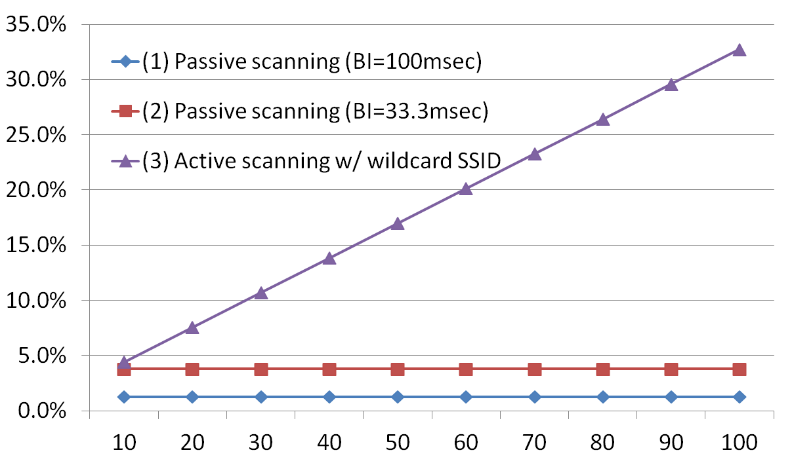
Mathematical Comparison of Air-time Occupancy Rate (1)
Note:
Responding AP is only one.
Packet conflicts aren’t considered.
No. of STAs searching desired AP in a second.

Slide 5
Mathematical Comparison of Air-time Occupancy Rate (2)
Active scanning occupies much air-time proportionally to number of STAs.
Real condition is severer. Because responding AP isn’t only one.
Passive scanning doesn’t cause the air-time occupancy. But it takes longer time to discover a desired AP.
ref.: doc. 12/0276r0 (KDDI)
Hybrid scanning is proposed for an alternative for faster AP discovery as the following slides.

Slide 6
Concept of Hybrid Scanning
Passive scanning before executing Active scanning
To detect Beacons or Probe Responses (broadcasted)
Probe Responses are responding to Probe Requests from other STAs.
Transmitting Probe Request only after no detection of a desired AP in Passive scanning duration
Waiting time for Probe Response for each channel is MaxChannelTime. It may be shorter than the one in current Active scanning.
AP Transmitting Probe Response to broadcast address

Slide 7
Graphic of Hybrid Scanning
@2.4GHz
Passive+Active
* Scanning order is implementation dependent.
Active scanning duration = MaxChannelTime
CH1
t
CH2
CH3
:
:
CH11
Total scanning time

Slide 8
Behavior of Hybrid Scanning
Longer Passive scanning duration per each channel takes longer time to complete scanning in all channels.
Shorter Passive scanning duration increases number of Probe Requests and Responses.
Further studies are required.

Slide 9
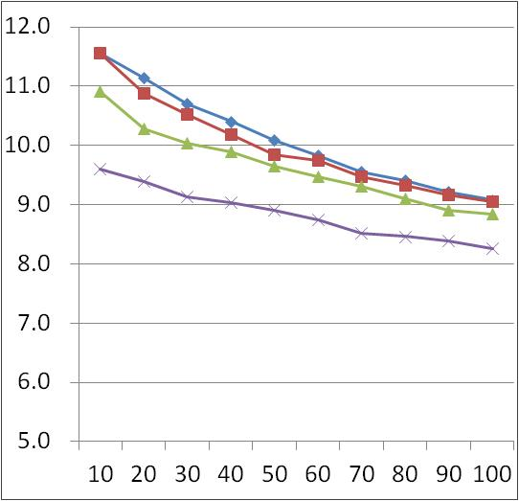
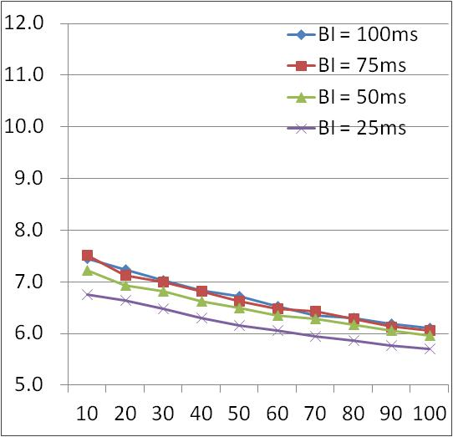
Example of Hybrid Scanning (AP discovery time on the channel which the desired AP exists)
Passive Scanning Duration = 10msec
Passive Scanning Duration = 5msec
(msec)
(msec)
Faster!!
5.7msec
8.3msec
No. of STAs searching the desired AP
No. of STAs searching the desired AP

Slide 10
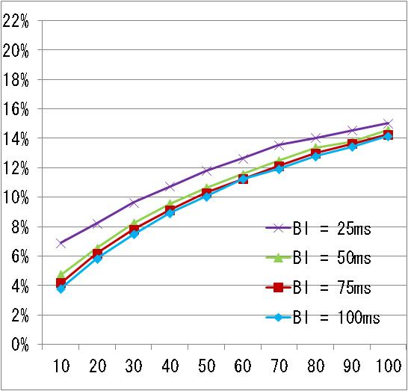
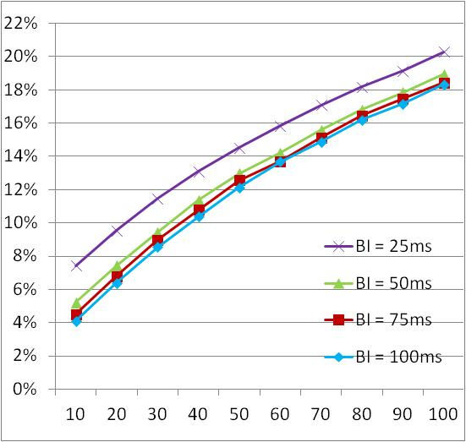
Example of Hybrid Scanning (Air time occupancy rate on the channel which the desired AP exists)
Passive Scanning Duration = 10msec
Passive Scanning Duration = 5msec
20%
15%
Higher!!
No. of STAs searching the desired AP
No. of STAs searching the desired AP

Slide 11
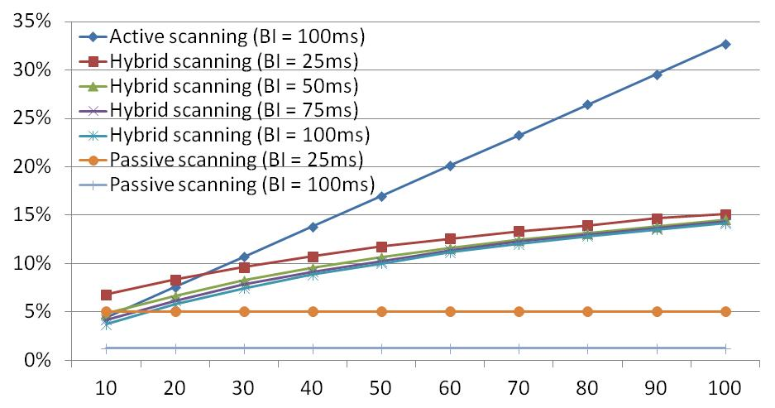
Air-time Occupancy Rate
Occupancy rate is reduced in Hybrid scanning compared with Active scanning.
Active scanning
33%
Hybrid scanning *
15%
Passive scanning
No. of STAs searching the desired AP
* Passive scanning duration of Hybrid scanning is 10msec.

Slide 12
Assumed Gains in AP Discovery Time (No. of STAs = 100)
 | Scan all channels, find all APs | Scan all channels, stop after 1st AP is found | Reduce number of scanning channels to 1 where AP are known to operate
Current passive scanning (x = 100) | 1100 ms | 550 ms | 50 ms
Passive scanning (x = 25) | 275 ms | 138 ms | 13 ms
Active scanning (y = 15) | 153 ms | 78 ms | 3 ms
Active scanning (y= 5) | 55 ms | 28 ms | 3 ms
Hybrid scanning (x = 100, y = 10, z = 10) | 209 ms | 99 ms | 9 ms
Hybrid scanning (x = 25, y = 10, z = 10) | 209 ms | 99 ms | 9 ms
Hybrid scanning (x = 100, y = 5, z = 10) | 156 ms | 74 ms | 6 ms
Hybrid scanning (x = 100, y = 5, z = 5) | 106 ms | 51 ms | 6 ms
x = Passive scanning duration (= BI)
y = MaxChannelTime
z = Passive scanning duration for Hybrid scanning

Slide 13
Assumptions For Comparison
[No. of channels]
11 channels.
[Desired AP]
Only 1 AP on one of the 11 channels.
[Passive scanning]
Scanning duration for each channel is BI.
[Active scanning]
Scanning duration for each channel is MaxChannelTime.
1 AP at least on every channel.
[Hybrid scanning]
Scanning duration for each channel is “Passive scanning duration” + MaxChannelTime.

Slide 14
More issues
Further studies are required for parameter tuning.
Methods for limitation of responding AP should be implemented in Probe Request.
Probe exchanges by Hybrid scanning also may cause packet flooding on channels which desired AP doesn’t exists.
Broadcast addressed Probe Response doesn’t have acknowledge of reception.
Methods for mitigating packet conflicts may be required.

Slide 15
Motion
Do you agree to include the following text in SFD?
Y/N/A =
Proposed text for SFD in Section 5
TGai will consider the possibility of mandating Passive scanning execution before Active scanning for 11ai STAs in order to reduce air-time occupancy.

Slide 16
References
IEEE802.11-03/416r0 Fast active scan for measurement and handoff (Moo Ryong Jeong, Fujio Watanabe and Toshiro Kawahara)
IEEE802.11-10/922r2 Achievable gains in AP discovery (Marc Emmelmann)
IEEE802.11-11/1413r3 Real air-time occupation by beacon and probe (Katsuo Yunoki)

