Slide 1
Passive Scanning Comparison
Date: 2012-03-08
Authors:

Slide 2
Abstract
This document provides the comparison result of Passive Scanning alternatives.
It was requested in discussion at Jacksonville meeting about performance analysis of the proposals, doc.12/0013r0(KDDI R&D Labs.) and doc.12/0042r0(Huawei).

Slide 3
Options for comparison
Option-1
Regular Beacon with BI = 100msec
Option-2
Regular Beacon with shorter beacon interval
Option-3
Regular Beacon + Sub-Beacon
Option-4
Regular Beacon + Measurement Pilot

Slide 4
Comparison scenarios
Transmission timings for each scenario are as graphics below.
Transmission interval of supplemental frames is 100/n msec.
(1) Regular Beacon (BI=100msec)
(2) Regular Beacon (BI=100/n msec)
R
R
R
R
R
R
100/3
100/3
100/3
(n = 3)
T
T
100msec
100msec
(3) Regular Beacon + Sub-Beacon
(4) Regular Beacon + M. Pilot
R
S
S
R
Option-3
in doc. 12/0042
(Huawei)
R
MP
MP
MP
R
(n = 3)
(n = 3)
100/3
100/3
100/3
100/3
100/3
100/3
T
T
100msec
100msec

Slide 5
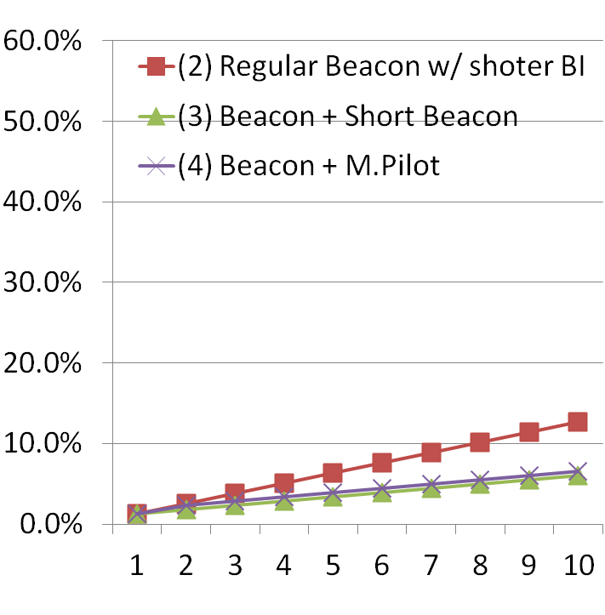
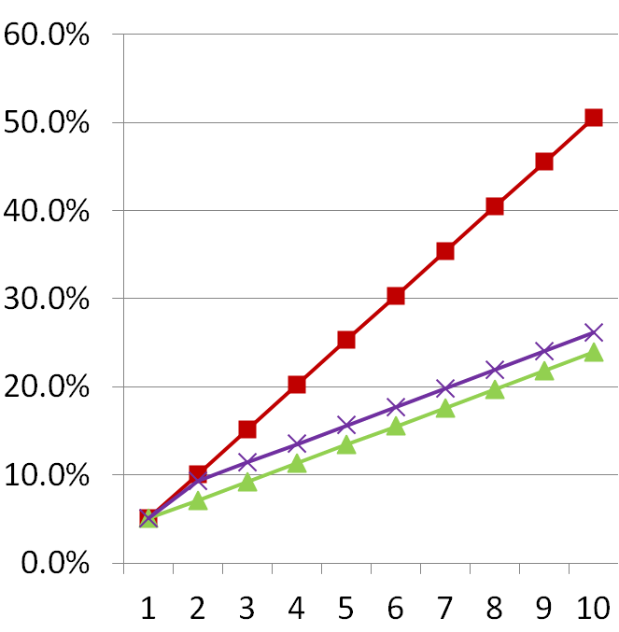
Calculated Occupied Air-time Rate
No. of AP = 1
No. of AP = 4
Sub-
n
n
The factor n is the denominator for dividing 100msec. See slide-4 for your understanding.

Slide 6
How much is air-time occupancy rate acceptable?
If we can allow air-time occupancy rate up to the percentage by the Regular Beacon with BI=50msec (10.1%),
2 Sub-Beacon or Measurement Pilot frames can be sent in one Regular Beacon interval for that case.
:at No. of AP = 4
n | 1 | 2 | 3 | 4 | 5
(1) Regular Beacon | 5.1%
(2) Regular Beacon w/ shorter BI |  | 10.1% | 15.2% | 20.2% | 25.3%
(3) (1) + Sub-Beacon |  | 7.2% | 9.2% | 11.3% | 13.4%
(4) (1) + M.Pilot |  | 9.3% | 11.4% | 13.5% | 15.6%

Slide 7
Scanning time for all channels (1)
Considering same occupancy rate for each method, the fastest passive scanning is method-(3).
(msec)
n | 1 | 2 | 3 | 4 | 5
(1) Regular Beacon | 1100
(2) Regular Beacon w/ shorter BI |  | 550 | 367 | 275 | 220
(3) (1) + Sub-Beacon |  | 599 | 432 | 349 | 299
(4) (1) + M.Pilot |  | 599 | 432 | 349 | 299
But it doesn’t comply with FILS requirement.

Slide 8
Scanning time for all channels (2) Average scanning time to discover 1st desired SSID
5.5 CHs will be scanned in average to discover 1st desired SSID.
(msec)
n | 1 | 2 | 3 | 4 | 5
(1) Regular Beacon | 550
(2) Regular Beacon w/ shorter BI |  | 275 | 183 | 138 | 110
(3) (1) + Sub-Beacon |  | 324 | 249 | 212 | 189
(4) (1) + M.Pilot |  | 324 | 249 | 212 | 189
It also doesn’t comply with FILS requirement.
If more frequent transmission is allowed, faster AP discovery will be achieved. But higher air-time occupancy is problem.

Slide 9
Summary
Introduction of Sub-Beacon will make Passive scanning faster.
But improved Passive scannings don’t comply with FILS requirement about required time for AP discovery by assumed conditions. It takes about 300 msec.
Faster Passive scanning is preferred in radar bands which Active scanning isn’t allowed.

Slide 10
Questions & Comments

Slide 11
Assumptions for Comparison

Slide 12
Frame compositions (Sub-Beacon & Measurement Pilot)
These frames uses the Action frame format.
* They are just for comparison. Detailed considerations are required for them.
(1) Sub-Beacon
Category
= Public
Action
= Sub-Beacon
Time to (Regular) Beacon
SSID Length
SSID
NW ID
Octets:
1
1
2
1
1-32
6
= 12 - 43
(2) Measurement Pilot
Optional subelements
Category
= Public
Action
=Measurement Pilot
Condensed
Capability
Information
Condensed Country String
Operating Class
Channel
Measurement Pilot Interval
Element ID
+
SSID Length
SSID
Element ID
+
NW ID Length
NW ID
Octets:
1
1
1
2
1
1
1
2
1-32
2
6
= 19 - 50

Slide 13
Assumptions for comparison
Beacon frame
Frame size = 89 octets
Data rate = 1Mbps
Sub-Beacon frame
Frame size = 21 octets (SSID length =10 octets [VeriLAN.1X])
Data rate = 11Mbps
Measurement Pilot frame
Frame size = 28 octets (SSID length = 10 octets)
Data rate = 11Mbps

Slide 14
Occupied air-time of each frame
Beacon frame
(50+310+144+48/1.0) + (89 * 8 / 1.0) = 1264 (usec)
Sub-Beacon frame
(50+310+144+48/11) + (21 * 8 / 11) = 524 (usec)
Measurement Pilot frame
(50+310+144+48/11) + (28 * 8 / 11) = 529 (usec)
Occupied Time = (DIFS + CW + aPreambleLength + aPLCPHeaderLength/DATARATE)
+ (Bytes * 8/DATARATE)
* Refer to doc. 11/1031r0 for calculation details.

Slide 15
Assumptions for scanning time comparison
11 channels for scanning. (2.4GHz band)
Scanning window (duration) for each channel is the interval of the Sub-Beacon.
AP with a desired SSID exists on only one channel.
When received a desired Sub-Beacon, the STA waits for the Regular Beacon on the same channel.
Even if received Beacons/Sub-Beacon/Measurement Pilot from a desired SSID, scanning all channels will be completed.
Off course, we can terminate AP scanning when a STA discover 1st desired SSID, as doc. 11/1521r2 (by Marc) proposed.

Slide 16
Pessimistic scenarios
Just right after the Regular Beacon, the scanning window starts and the desired Sub-Beacon is found,
R
S
R
Waits for the Regular Beacon
T
This waiting time is long.

