Slide 1
Reducing Probe Responses for faster AP discovery
March 2012
Authors:
Name | Affiliations | Address | Phone | email
Jaehyung Song | LG Electronics | LG R&D Complex 533, Hogye-1dong, Dongan-Gu, Anyang, Kyungki, 431-749, Korea | +82-31-450-7898 | jaehyung.song@lge.com
Giwon Park | LG Electronics | LG R&D Complex 533, Hogye-1dong, Dongan-Gu, Anyang, Kyungki, 431-749, Korea | +82-31-450-1879 | giwon.park@lge.com
Jinsam Kwak | LG Electronics | LG R&D Complex 533, Hogye-1dong, Dongan-Gu, Anyang, Kyungki, 431-749, Korea | +82-31-450-7902 | Jinsam.kwak@lge.com
Kiseon Ryu | LG Electronics | 10225 Willow Creek Rd, San Diego, CA, 92131, USA | +1 (858)-635-5209 | Kiseon.ryu@lge.com

Slide 2
Abstract
The submission proposes a general framework to improve the AP discovery for fast initial link set up.

Slide 3
Conformance w/ TGai PAR & 5C
Conformance Question | Response
Does the proposal degrade the security offered by Robust Security Network Association (RSNA) already defined in 802.11? | No
Does the proposal change the MAC SAP interface? | No
Does the proposal require or introduce a change to the 802.1 architecture? | No
Does the proposal introduce a change in the channel access mechanism? | No
Does the proposal introduce a change in the PHY? | No
Which of the following link set-up phases is addressed by the proposal? (1) AP Discovery (2) Network Discovery (3) Link (re-)establishment / exchange of security related messages (4) Higher layer aspects, e.g. IP address assignment | 1,2

Slide 4
Motivation
A number of proposals suggests methods to reduce the number of probe responses
Most of the proposals focus on filtering mechanisms based on the network identity that the AP of interest belongs to
While conflicting methods require a careful examination by the TG, most of the methods can be integrated in a structure manner
However, there are possibly more filtering items that need to be included, considering user’s preference
Two other filtering mechanisms are introduced in this perspective

Slide 5
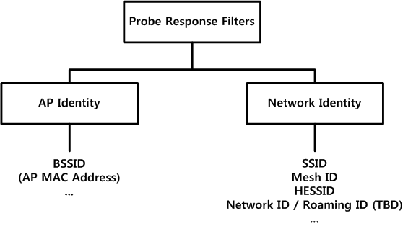
Probe Response Filtering
Proposals until today
Filtering criteria proposed until today can be categorized as following:
These filtering items can be coordinated so that they can be applied in a selective manner

Slide 6
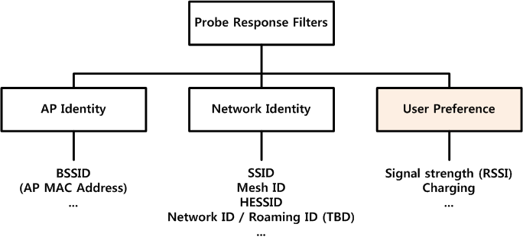
But, something is missing
A user applies his/her preference in AP selection, not only the identity of AP or Network
Such as the cost of the network usage and the strength of the signal
Thus, we need another category to incorporate this user behavior

Slide 7
Considering the user (or station) behavior
Considering the user (or station) behavior, an additional filtering item to filter out unnecessary probe responses is proposed:
A charging information – A user can select APs, which provide free-of-charge network access, to respond to the probe request.
Charging preference IE is included in probe request, when the STA discovers desired AP.
Another filtering item is proposed: RSSI based filtering – A STA can select APs, which provide a signal strength above the threshold that STA specifies, to respond to the probe request.
Signal strength (e.g., RSSI) threshold can be included in probe request, when the STA discovers desired AP.

Slide 8
Conclusion
Various proposals for filtering of probe response can be integrated in a structure manner.
Additional filtering item can be used to filter out unnecessary probe responses.
Charging preference information
Signal strength of STA

Slide 9
Strawpoll 1
Do you agree to make changes to the TGai framework specification as follow:
The draft specification shall support for a method to apply filtering mechanism(s) to reduce the number of wasted probe response frames, in a selective manner.
Yes:
No:
Abstain:

Slide 10
Strawpoll 2
Do you agree to make changes to the TGai framework specification as follow:
The draft specification shall support for a method to filter out unnecessary probe response frames based on the Non-AP Station’s preference.
Yes:
No:
Abstain:

Slide 11
Strawpoll 3
Do you agree to make changes to the TGai framework specification as follow:
The draft specification shall include support for the method to decide whether the AP transmits the probe response frame to STA or not by including the received signal strength (e.g., RSSI) threshold in probe request frame.
Yes:
No:
Abstain:

Slide 12
Strawpoll 4
Do you agree to make changes to the TGai framework specification as follow:
The draft specification shall include support for the method to decide whether the AP transmits the probe response frame to STA or not by including the charging information (e.g., free-of-charge network access) in probe request frame.
Yes:
No:
Abstain:

