Slide 1
Differentiate transmissions of probe responses
Date: 2012-03-15
Authors:
Name | Affiliations | Address | Phone | email
Jing-Rong Hsieh | HTC Corp. | 1F, 6-3 Baoqiang Road, Xindian district, New Taipei City, Taiwan |  | jing_hsieh@htc.com
ChaoChun Wang | MediaTek USA | 2860 Junction Ave, San Jose, CA USA |  | chaochun.wang@mediatek.com
James Yee | MediaTek, Inc. | No. 1, Dusing 1st Rd, Hsinchu, Taiwan |  | james.yee@mediatek.com

Slide 2
Abstract
This document describes a technical proposal for TGai which addresses the following phase
AP Discovery
Prioritizing the responses from preferred/selected APs can reduce the time for the scanning STA to discover suitable APs

Slide 3
Motivations (1/2)
Legacy active scanning can cause unnecessary packet exchange which increases the network traffic and causes link setup delay (12/0059r1)
12/0206r0
Probe request with wildcard SSID will bring severe packet flooding.
Reduction of Probe requests should be considered too.

Slide 4
Motivations (2/2)
802.11ai shall define a mechanism to optimise the MLME-SCAN.confirm primitive to indicate the discovered APs fast and without additional delays.
The transmitter of the Probe Request frame shall have means to indicate the time when it is no longer available to receive the Probe Response frames.
An FILS Capable AP may omit transmission of Probe Response frame to FILS capable STAs if the TBTT occurs within a predefined time interval.
(12/0153r9)

Slide 5
Probe Request
Three kinds of active scanning are defined in the current IEEE802.11 standard (12/257r1)
Broadcasted Probe Request
Unicasted Probe Request
Multicasted Probe Request
Containing SSID List, Wildcard BSSID in Probe Request
APs of which SSID is one of the SSID List in Probe Request should respond with Probe Response
There may be extra sub-type for Broadcasted Probe Request in current spec
When the SSID List element is present in the Probe Request frame, one or more of the SSID elements may include a wildcard SSID (10.1.4.1 REVmb12.0)
So one or more SSIDs can be included in either SSID element or in a SSID List element
Specific SSID(s) only
Wildcard SSID only
Specific SSID(s) + wildcard SSID

Slide 6
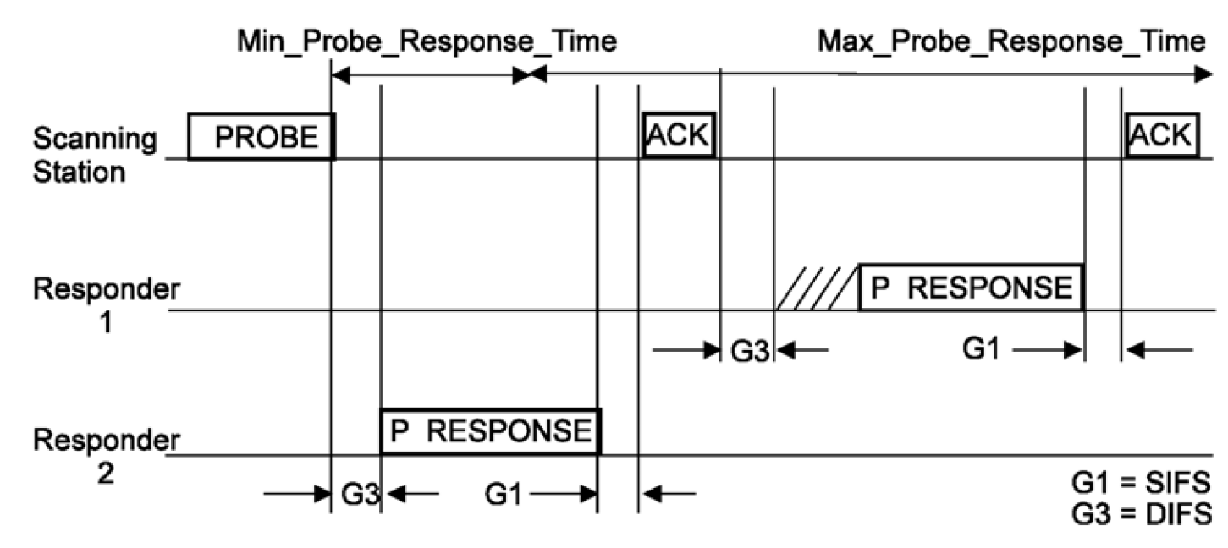
Current rules for sending probe responses
There is rule for which AP shall reply to the probe request
APs matching the address info criteria shall respond with a probe response
There is no rules for when and how an AP shall reply
Basic access procedures
10.1.4.3.3 in REV12.0mb

Slide 7
Prioritize preferred APs to respond
To help FILS, AP shall prioritize the timing of sending probe responses based on the ID addressing scheme in probe request frame
The probe requests with
Only specific SSID, BSSID, SSID list, HESSID, or …
Only broadcast/wildcard ID addresses
Both broadcast/wildcard ID addresses and specific SSID, BSSID, SSID list, HESSID, or …
Possible solution
Adopt EDCA parameters for giving higher priority to respond to probe request carrying specific ID address over wildcard SSID address.
Specific ID case uses parameters for AC_VO or AC_VI
The wildcard case remains the same or uses those for AC_BE
Replace DIFS with shorter inter-frame space, such as PIFS

Slide 8
AP behavior after receiving probe request
Specific ID(s) only
Send probe response using higher priority access parameter, such as AC_VO or AC_VI
A shorter IFS such as PIFS is also considered
Wildcard SSID only
Send probe response using original access parameter or AC_BE (as defined in TGae)
Specific ID(s) + wildcard SSID
If the AP is identified in one of the specific ID, it shall send probe response using higher priority access parameter, such as AC_VO or AC_VI. A shorter IFS such as PIFS is also considered
If the AP is not identified in any of the specific ID, it shall send probe response using original access parameter or AC_BE (as defined in TGae)

Slide 9
Summary
Prioritizing the responses from the preferred/selected APs can reduce the time for the scanning STA to discover suitable APs
The proposed idea generally complements the agreed straw polls about early/timely report of found BSSs and the whitelist/blacklist that the STA intending to join or not
A complementary mechanism to cancel pending (unnecessary) probe responses would further help alleviate congestion on wireless medium

Slide 10
Straw Poll 1
Concept
An AP shall respond to probe request with ID field having addresses known to the AP with higher priority over probe request with ID field having addresses unknown to the AP and wildcard ID.
Straw Poll
Do you support to add the above concept into Section 5 “Fast Network Discovery” of the TGai spec framework?
Yes
No
Abstain

Slide 11
Straw Poll 2
Concept
An AP shall respond to probe request with ID field having addresses known to the AP with higher priority EDCA parameters, such as those for AC_VO or AC_VI.
Straw Poll
Do you support to add the above concept into Section 5 “Fast Network Discovery” of the TGai spec framework?
Yes
No
Abstain

Slide 12
Straw Poll 3
Concept
An AP shall respond to probe request with ID field having addresses known to the AP with shorter inter-frame gap, shorter than DIFS such as PIFS.
Straw Poll
Do you support to add the above concept into Section 5 “Fast Network Discovery” of the TGai spec framework?
Yes
No
Abstain

Slide 13
Appendix
HTC, MediaTek

Slide 14
10.1.4.3.2 Sending a probe response
STAs, subject to the criteria below, receiving Probe Request frames shall respond with a probe response
only if:
a) The Address 1 field in the probe request is the broadcast address or the specific MAC address of the
STA, and either item b) or item c) below.
b) The STA is a mesh STA and the Mesh ID in the probe request is the wildcard Mesh ID or the
specific Mesh ID of the STA.
c) The STA is not a mesh STA and
1) The SSID in the probe request is the wildcard SSID, the SSID in the probe request is the
specific SSID of the STA, or the specific SSID of the STA is included in the SSID List
element, and
2) The Address 3 field in the probe request is the wildcard BSSID or the BSSID of the STA.
Additionally, STAs with dot11InterworkingServiceActivated equal to true, receiving Probe Request frames
containing an Interworking field in the Extended Capabilities element set to 1 shall examine the
Interworking element in the received Probe Request frame and respond with a probe response only if
d) The HESSID field, if present in the Interworking element, is the wildcard HESSID or the HESSID
of the STA, and
e) The Access Network Type field in the Interworking element is the wildcard Access Network Type or
the Access Network Type of the STA.
Probe Response frames shall be sent as directed frames to the address of the STA that generated the probe request.

Slide 15
10.1.4.3.2 Sending a probe response
Receive a Probe Request
Yes
Address 1:
broadcast or specific MAC add of the STA?
No
Yes
Mesh STA?
No
Yes
Mesh SSID:
wildcard Mesh ID or specific Mesh ID?
No
Yes
SSID:
wildcard or
specific SSID or specific SSID in SSID List?
No
Yes
Address 3:
wildcard BSSID or
BSSID of the STA ?
No
Respond with a directed probe response
Not respond

Slide 16
Definitions in REVmb/12.0
broadcast address: A unique group address that specifies all stations (STAs).
group: The entities in a wireless network, e.g., an access point (AP) and its associated stations (STAs), or all the STAs in an independent basic service set (IBSS) network.
group address: A medium access control (MAC) address that has the group bit equal to 1. Syn: multicast address.
group addressed: When applied to a medium access control (MAC) service data unit (MSDU), it is an MSDU with a group address as the destination address (DA). When applied to a MAC protocol data unit (MPDU), it is an MPDU with a group address in the Address 1 field. Syn: multicast.
wildcard BSSID: A BSSID value (all binary 1s) used to represent all BSSIDs.
wildcard SSID: A SSID value (null) used to represent all SSIDs.
4.3.13.15 SSID list
The SSID List element enables the non-AP STA to request information on a list of SSIDs. This is intended to reduce the number of Probe Request frames sent by the non-AP STA.

