Slide 1
Differentiate transmissions of probe responses
Date: 2012-03-12
Authors:
Name | Affiliations | Address | Phone | email
Jing-Rong Hsieh | HTC Corp. | 1F, 6-3 Baoqiang Road, Xindian district, New Taipei City, Taiwan |  | jing_hsieh@htc.com
ChaoChun Wang | MediaTek USA | 2860 Junction Ave, San Jose, CA USA |  | chaochun.wang@mediatek.com
James Yee | MediaTek, Inc. | No. 1, Dusing 1st Rd, Hsinchu, Taiwan |  | james.yee@mediatek.com

Slide 2
Abstract
This document describes a technical proposal for TGai which addresses the following phase.
AP Discovery
Prioritizing the responses from preferred/selected APs can reduce the time for the scanning STA to discover suitable APs

Slide 3
MLME-SCAN.request(
BSSType,
BSSID,
SSID,
ScanType,
ProbeDelay,
ChannelList,
MinChannelTime,
MaxChannelTime,
RequestInformation,
SSID List,
ChannelUsage,
AccessNetworkType,
HESSID,
MeshID,
VendorSpecificInfo
)
Example of Addressing info in Probe Request
10.1.4 Acquiring synchronization, scanning
10.1.4.1 General
…
To actively scan, the STA shall transmit Probe request frames containing the desired SSID or one or more SSID List elements. When the SSID List element is present in the Probe Request frame, one or more of the SSID elements may include a wildcard SSID (see 8.4.2.2).

Slide 4
Motivations (1/2)
Scanning time is one of the major cause of the delay in initial Link Setup (12/0059r1)
Legacy active scanning can cause unnecessary packet exchange which increases the network traffic and causes link setup delay (12/0059r1)
Exclusion list was proposed in 12/0059r1
12/0206r0
Probe request with wildcard SSID will bring severe packet flooding.
Reduction of Probe requests should be considered too.

Slide 5
Motivations (2/2)
The MLME-SCAN.confirm primitive shall be invoked to report every found BSS during the scan procedure.
Yes:13 No: 0 Abstain: 9
The probe request may restrict responses by indicating APs that should or should not respond
Yes:19 No: 0 Abstain: 3
The transmitter of the Probe Request frame may indicate the time when it is available to receive Probe Response frames.
Yes:17 No: 0 Abstain: 5
Responses to Probe Request may be cancelled by requesting STA
Yes:13 No: 2 Abstain: 8
(12/0153r5)

Slide 6
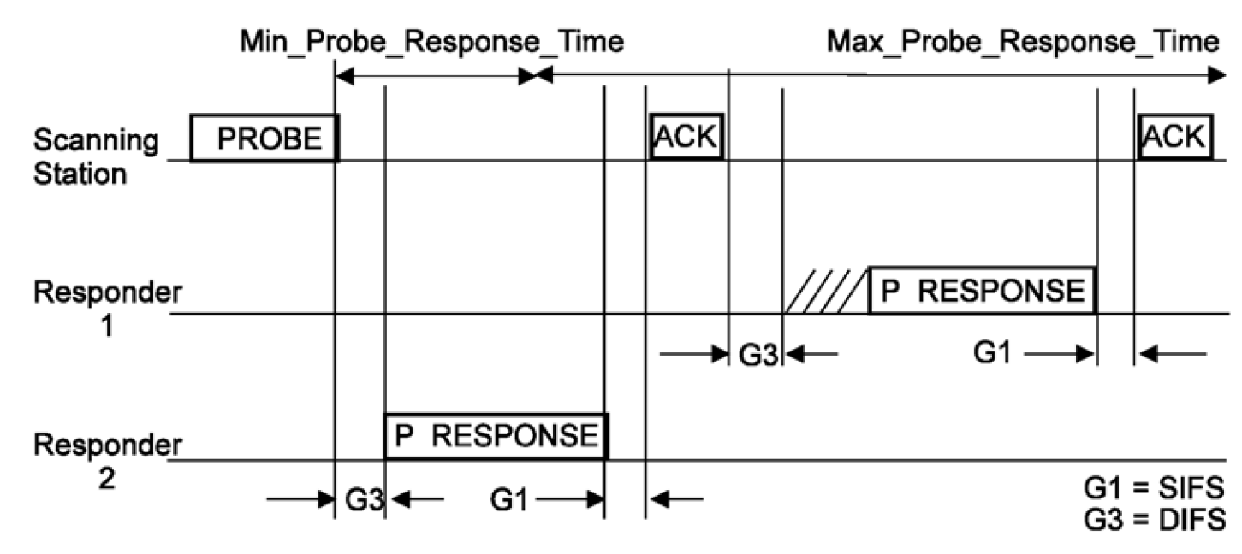
Current rules for sending probe responses
Only the rules for which AP shall reply to the probe request
APs matching the address info criteria shall respond with a probe response
No special rules for when and how do they reply
Basic access procedures
10.1.4.3.3 in REV12.0mb

Slide 7
Prioritize preferred APs to respond
To help FILS, should prioritize the APs which are preferred to the STA to respond
Two (TBD) groups of APs after receiving the Probe Request
APs identified by only broadcast/wildcard address
APs identified by specific SSID, BSSID, SSID list, HESSID, or …
Possible solution
Adopt EDCA parameters for transmitting Probe Response frame for these two groups of APs
CW range (using parameters for AC_VO or AC_VI)
The wildcard case will remain the same or use AC_BE
Replace DIFS with shorter inter-frame gap, such as PIFS or SIFS

Slide 8
Summary
Prioritizing the responses from the preferred/selected APs can reduce the time for the scanning STA to discover suitable APs
The proposed idea generally complements the agreed straw polls about early/timely report of found BSSs and the whitelist/blacklist that the STA intending to join or not
A complementary mechanism to cancel pending (unnecessary) Probe Responses would further help alleviate congestion on wireless medium

Slide 9
Straw Poll 1
Concept
An AP shall respond to probe request with ID field having addresses known to the AP with higher priority over probe request with ID field having addresses unknown to the AP and wildcard ID.
Straw Poll
Do you support to add the above concept into Section 5 “Fast Network Discovery” of the TGai spec framework?
Yes
No
Abstain

Slide 10
Straw Poll 2
Concept
An AP shall respond to probe request with ID field having addresses known to the AP with higher priority EDCA parameters, such as those for AC_VO or AC_VI.
Straw Poll
Do you support to add the above concept into Section 5 “Fast Network Discovery” of the TGai spec framework?
Yes
No
Abstain

Slide 11
Straw Poll 3
Concept
An AP shall respond to probe request with ID field having addresses known to the AP with shorter inter-frame gap, shorter than DIFS such as PIFS or SIFS.
Straw Poll
Do you support to add the above concept into Section 5 “Fast Network Discovery” of the TGai spec framework?
Yes
No
Abstain

Slide 12
Appendix
HTC, MediaTek

Slide 13
10.1.4.3.2 Sending a probe response
STAs, subject to the criteria below, receiving Probe Request frames shall respond with a probe response
only if:
a) The Address 1 field in the probe request is the broadcast address or the specific MAC address of the
STA, and either item b) or item c) below.
b) The STA is a mesh STA and the Mesh ID in the probe request is the wildcard Mesh ID or the
specific Mesh ID of the STA.
c) The STA is not a mesh STA and
1) The SSID in the probe request is the wildcard SSID, the SSID in the probe request is the
specific SSID of the STA, or the specific SSID of the STA is included in the SSID List
element, and
2) The Address 3 field in the probe request is the wildcard BSSID or the BSSID of the STA.
Additionally, STAs with dot11InterworkingServiceActivated equal to true, receiving Probe Request frames
containing an Interworking field in the Extended Capabilities element set to 1 shall examine the
Interworking element in the received Probe Request frame and respond with a probe response only if
d) The HESSID field, if present in the Interworking element, is the wildcard HESSID or the HESSID
of the STA, and
e) The Access Network Type field in the Interworking element is the wildcard Access Network Type or
the Access Network Type of the STA.
Probe Response frames shall be sent as directed frames to the address of the STA that generated the probe request.

Slide 14
10.1.4.3.2 Sending a probe response
Receive a Probe Request
Yes
Address 1:
broadcast or specific MAC add of the STA?
No
Yes
Mesh STA?
No
Yes
Mesh SSID:
wildcard Mesh ID or specific Mesh ID?
No
Yes
SSID:
wildcard or
specific SSID or specific SSID in SSID List?
No
Yes
Address 3:
wildcard BSSID or
BSSID of the STA ?
No
Respond with a directed probe response
Not respond

Slide 15
Definitions in REVmb/12.0
broadcast address: A unique group address that specifies all stations (STAs).
group: The entities in a wireless network, e.g., an access point (AP) and its associated stations (STAs), or all the STAs in an independent basic service set (IBSS) network.
group address: A medium access control (MAC) address that has the group bit equal to 1. Syn: multicast address.
group addressed: When applied to a medium access control (MAC) service data unit (MSDU), it is an MSDU with a group address as the destination address (DA). When applied to a MAC protocol data unit (MPDU), it is an MPDU with a group address in the Address 1 field. Syn: multicast.
wildcard BSSID: A BSSID value (all binary 1s) used to represent all BSSIDs.
wildcard SSID: A SSID value (null) used to represent all SSIDs.
4.3.13.15 SSID list
The SSID List element enables the non-AP STA to request information on a list of SSIDs. This is intended to reduce the number of Probe Request frames sent by the non-AP STA.

