Slide 1
Differentiate transmissions of probe responses
Date: 2012-03-
Authors:
Name | Affiliations | Address | Phone | email
Jing-Rong Hsieh | HTC Corp. | 1F, 6-3 Baoqiang Road, Xindian district, New Taipei City, Taiwan |  | jing_hsieh@htc.com

Slide 2
Abstract
This document describes a technical proposal for TGai which addresses the following phase.
AP Discovery
Prioritizing the responses from preferred/selected APs can reduce the time for the scanning STA to discover suitable APs

Slide 3
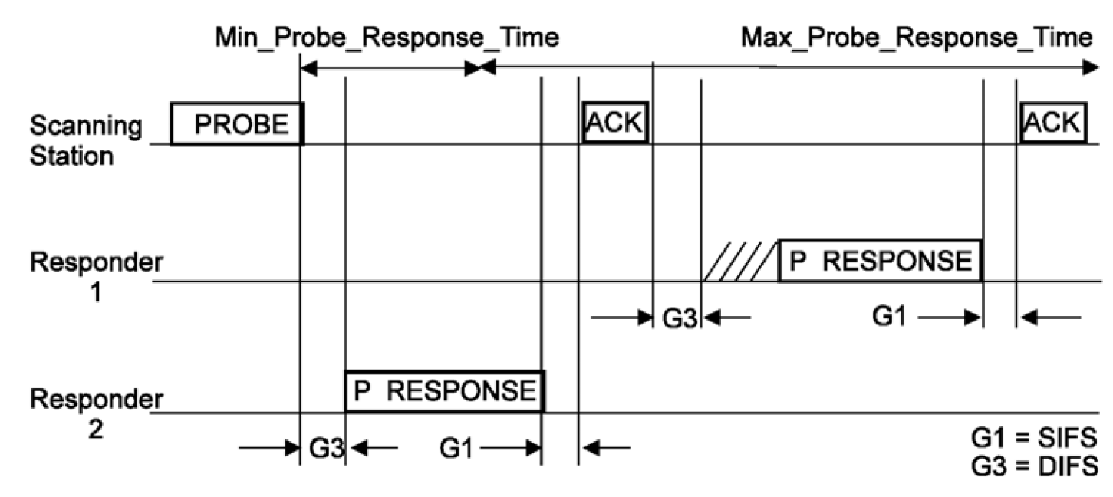
Active scanning and medium access
10.1.4.3.3 in REV12.0mb

Slide 4
MLME-SCAN.request(
BSSType,
BSSID,
SSID,
ScanType,
ProbeDelay,
ChannelList,
MinChannelTime,
MaxChannelTime,
RequestInformation,
SSID List,
ChannelUsage,
AccessNetworkType,
HESSID,
MeshID,
VendorSpecificInfo
)
Example of Addressing info in Probe Request

Slide 5
Motivations (1/2)
Scanning time is one of the major cause of the delay in initial Link Setup (12/0059r1)
Legacy active scanning can cause unnecessary packet exchange which increases the network traffic and causes link setup delay (12/0059r1)
Exclusion list was proposed in 12/0059r1
12/0206r0
Probe request with wildcard SSID will bring severe packet flooding.
Reduction of Probe requests should be considered too.

Slide 6
Motivations (2/2)
The MLME-SCAN.confirm primitive shall be invoked to report every found BSS during the scan procedure.
Yes:13 No: 0 Abstain: 9
The probe request may restrict responses by indicating APs that should or should not respond
Yes:19 No: 0 Abstain: 3
The transmitter of the Probe Request frame may indicate the time when it is available to receive Probe Response frames.
Yes:17 No: 0 Abstain: 5
Responses to Probe Request may be cancelled by requesting STA
Yes:13 No: 2 Abstain: 8
(12/0153r5)

Slide 7
Current rules for sending probe responses
Only the rules for which AP shall reply to the probe request
APs matching the address info criteria shall respond with a probe response
No special rules for when and how do they reply
Basic access procedures

Slide 8
Prioritize preferred APs to respond
To help FILS, should prioritize the APs which are preferred to the STA to respond
Two (TBD) groups of APs after receiving the Probe Request
APs identified by only broadcast/wildcard address
APs identified by specific SSID, BSSID, SSID list, HESSID, or …
Possible solution
Adopt EDCA parameters for transmitting Probe Response frame for these two groups of APs
CW range (using parameters for AC_VO or AC_VI)
The wildcard case will remain the same or use AC_BE

Slide 9
Summary
Prioritizing the responses from the preferred/selected APs can reduce the time for the scanning STA to discover suitable APs
The proposed idea generally complements the agreed straw polls about early/timely report of found BSSs and the whitelist/blacklist that the STA intending to join or not
A complementary mechanism to cancel pending (unnecessary) Probe Responses would further help alleviate congestion on wireless medium

Slide 10
Straw Poll 1
Concept
The APs responding Probe Requests to the Probe Request because of matching specific addressing information should be prioritized than those responding solely because of wildcard address
Straw Poll
Do you support to add the above concept into Section 5 “Fast Network Discovery” of the TGai spec framework?
Yes
No
Abstain

