Slide 1
Necessity of Probe Reduction
Date: 2012-02-13
Authors:

Slide 2
Abstract
This document raises warning alarm against heavy usage of probes for fast AP discovery.
TGai should consider methods for reducing probes in FILS use cases.

Slide 3
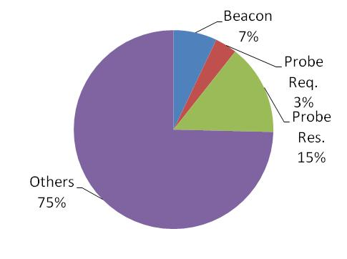
Review of doc. 11/1413r3 Occupied Time Calculation Result
Observation was executed at a train station in Tokyo.
Packet type | Occupancy rate (%) | Occupied time (sec)
Beacon | 7.06 | 21.17
Probe Req. | 3.58 | 10.75
Probe Res. | 14.74 | 44.22
Others | 74.62 | 223.86
Total | 100.00 | 300.00
Observed duration = 300 sec

Slide 4
From captured log data….
Beacons : 14275 frames/300sec (=47.0 frames/sec)
Probe Requests : 7139 frames/300sec (=23.5 frames/sec)
Probe Response : 24687 frames/300sec (=81.3 frames/sec)
These mean:
4~5 APs existing and
23.5 STAs searching AP by active scanning in a second
around observed location.

Slide 5
Imagining FILS use case,
100 STAs associate with AP in a second.
If 100 STAs execute active scanning in a second for fast AP discovery, about 4 times more probes will be exchanged.
* 4~5 APs are responding.
 | Observed occupancy rate (23.5 STA ) | Assumed occupancy rate (100 STA)
Beacon | 7.06% | 7.06%
Probe Request | 3.58% | 15.23%
Probe Response | 14.74% | 62.72%
Total | 25.38% | 85.01%

Slide 6
Considerations
This high occupancy rate (85%) breaks FILS requirement just by probe exchanges.

Slide 7
Conclusion
Persistently explaining,
Probe request with wildcard SSID will bring severe packet flooding.
Reduction of Probe requests should be considered too.
I’m thinking that:
Air-time occupancy rate should be demonstrated in coming contributions especially about fast AP discovery in order to achieve FILS requirement.

Slide 8
Questions & Comments
I’d like to invite your comments about the following issues to prepare some motions for Hawaii meeting.
Prohibition of indicating wildcard SSID in Probe Request
Methods for reducing Probe Requests

Slide 9
Supplementary Consideration

Slide 10
Mathematical consideration (1) Assumptions
 | Assumed frame length (octets) | Air-time occupancy (usec)
Beacon | 122 | 1528
Probe Request | 143 | 1696
Probe Response | 116 | 1794
* Method for air-time occupancy calculation is described in doc. 11/1031r0.
Frame lengths are from field experimentation in Tokyo.

Slide 11
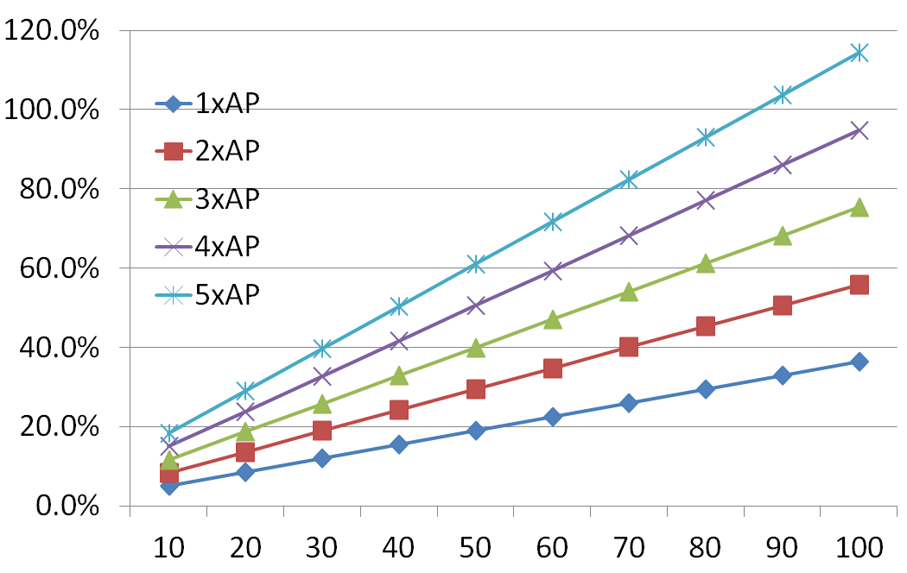
Mathematical consideration (2) Air-time occupancy by Probes
(Responding APs)
No. of probe request / sec
* Frame conflicts aren’t considered.

