Slide 1
802.11ah PHY Characteristics
Date: 2012-01-16
Authors:

Slide 2
Abstract
In our earlier contribution 1515r1 we presented offloading simulation results for the 11ah use Case 3, Wi-Fi offloading on 16Mhz channel width
10x downclocking from 160MHz
Downclocking increases the PHY overhead (Slot Time/SIFS&DIFS)
We further investigated the effect of PHY overhead due to the downclocking and reproduced the earlier simulations with new set of values
Initial values for slot time / SIFS are proposed
Notes:
doc.: IEEE 802.11-yy/xxxxr0

Slide 3
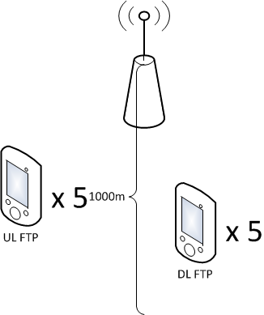
Simulation Parameters
10x downclocked PHY Characteristics in 1515r1
SIFS 160 us
DIFS 250 us
Slot Time 45 us
1515r1 simulations were reproduced with scaling of PHY characteristics from (1544r0 – 11af PHY contribution)
SIFS 80 us
DIFS 170 us
Slot time 45 us
Parameter | Value
Symbol Time | 40 us (32us + 8 us GI)
SIFS | 80 us
Slot time | 45 us
MCS | 0-7 (1/2 BPSK – 5/6 64 QAM)
Bandwidth and Frequency | 16 MHz at 900 MHz
Number of subcarriers TOT/PILOT/DATA | 484/16/468
Tx Power | 30 dBm

Slide 4
Simulation Results
Performance metrics measured on top of TCP/IP layer
With scaled values:
Average fairness (Jain’s index) = ~0.4
Average aggregated throughput = 3182 kbit/s
Highest STA rate seen = 2100kbit/s
With downclocked values (from 1515r1)
Average fairness (Jain’s index) = ~0.4
Average aggregated throughput = 2669 kbit/s
Highest STA rate seen = 1700kbit/s
~20% improvement by just decreasing the SIFS
Fairness: Jain’s Fairness Index is used
Measures fairness between the users and the index has maximum value when all STAs have the equal share of the resources ( The result ranges from 1/10 (worst case) to 1 (best case))

Slide 5
Conclusions
With shorter SIFS/DIFS the throughput is increased
But fairness is not improved
We propose initial values for the slot time and SIFS for the performance evaluation of 11ah
Slot time = 45us
SIFS time = 80us
-> DIFS time = 170us

