Slide 1
Process for Creating TGai Draft
Date: 2011-11-10
Authors:

Slide 2
Abstract
Suggestions from contributions to the draft for 802.11ai to submit to 802.11 Working Group for WG letter ballot

Slide 3
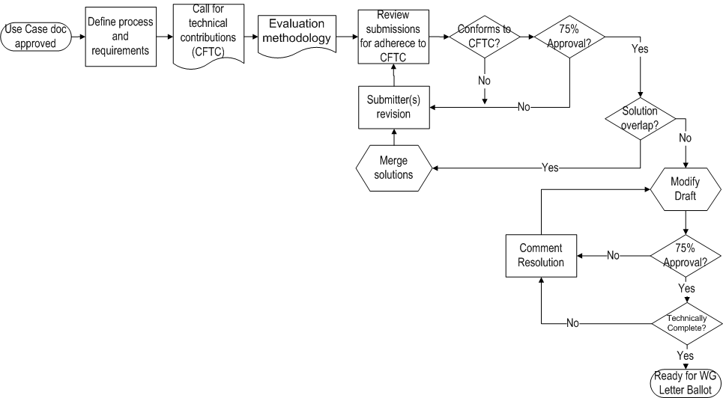
Process Flow
WE ARE HERE IN JANUARY
Description of the steps is in the flowchart are in the backup section of this presentation

Slide 4
Submissions
IEEE Language
Style Guide
Use (and overuse) of terms

Slide 5
IEEE Language -- definitions
Term | Equivalent | Use
shall | is required to | defines normative behavior
must | is a natural consequence of | describes unavoidable situations
will | it is true that | statement of fact not controlled by the text
should | is recommended that | indicates that among several possibilities one is recommended as particularly suitable, but not required
may | is permitted to | allows options
can | is able to | relates statements in a causal fashion
is | is defined as | further explains elements that are previously required or allowed
note | for your information only, | preface to informative text

Slide 6
IEEE Language – simple check
Use the table in the previous slide to check for correctness of usage by:
Insert the equivalent phrase in place of the IEEE term
Evaluate the resulting sentence for the intended meaning
If the sentence has the same meaning then the term is likely to have been used correctly.
Note:

Slide 7
Style Guide(s)
IEEE Standards Style Manual
Establishes preferred style for the preparation of IEEE standards drafts
11-09-1034-03-0000-802-11-editorial-style-guide.doc
Style guide supplement to the IEEE Standards Style Manual

Slide 8
Use (and overuse) of terms
“Shall” used at the beginning of a paragraph generally is sufficient
Consider that each “shall” is the equivalent of a line in the PICS
Specific exceptions should be in separate paragraphs
Any time the term “note” is used, the following text is considered to be informative
Do not mix informative and normative text in the same paragraph

Slide 9
Numbers
The following rules should be observed:
a) The decimal marker should be a dot on the line (decimal point). This applies even when the
standard in question is intended for international adoption (e.g., adoption by ISO/IEC); see
Clause 22.
b) For numbers of magnitude less than one, a zero should be placed in front of the decimal point (see
15.3.2).
c) In general text, isolated numbers less than 10 should be spelled out. However, in equations, tables,
figures, and other display elements, Arabic numerals should be used. Numbers applicable to the
same category should be treated alike throughout a paragraph; numerals should not be used in some
cases and words in others.
d) The value of a quantity shall be expressed by an Arabic numeral followed by a space and the
appropriate unit name or symbol. An upright (Roman) type font should be used for the unit symbol
even if the surrounding text uses a sloping (italic) font.
e) If tolerances are provided, the unit shall be given with both the basic value and the tolerance (150
m ± 5 mm). Ranges should repeat the unit (e.g., 115 V to 125 V). Dashes should never be used
because they can be misconstrued for subtraction signs.

Slide 10
BACKUP SLIDES

Slide 11
Description of steps
Define process and requirements
Call for Proposals (CFP)
Evaluation Methodology
Review submissions for adherence to CFP
Conforms to CFP?
Submitter(s) revision
Solution overlap?
Merge solutions
75% Approval? (Submissions)
Prepare Draft
75% Approval? (Drafts)
Comment Resolution
Technically Complete?
Ready for WG Ballot

Slide 12
Define process and requirements
Process
This document, when approved, describes the process TGai will use in processing potential solutions for the Amendment to 802.11 standard
Process may be amended by >50% vote of TGai
Requirements
Separate document
11-11-0745-05-00ai-TGai-functional-requirements.docx

Slide 13
2. Call for Technical Contributions (CFTC)
Requesting technical inputs for consideration
Example:
11-11-0198-00-00ah-call-for-technical-contributions.docx

Slide 14
Call for submissions (1 of 3)
Any individual intending to present a proposal must notify the IEEE 802.11ai Task Group chair, Hiroshi Mano, via email at hiroshi@manosan.org by July 1th, 2011. Presentations of introductory proposal submissions material shall be submitted to the IEEE 802.11 document server prior to July18th, 2011 for presentation and discussion during the July IEEE 802 Wireless Plenary session.
Final proposals and related documents shall be submitted to the IEEE 802.11 document server prior to September 9th, 2011 for presentation and discussion during the September plenary session.
Time permitting, proposals arising at or during meeting time and after the stated due dates may be allowed by the chair.

Slide 15
Call for submissions (2 of 3)
Background information is available in the following documents in document server is available at the following location, https://mentor.ieee.org/802.11/documents
11-10/1152r01: Fast Initial Link Set-UP Project Authorizaiton Request
11-10/1152r01: Fast Initial Link Set-Up PAR
11-10/0238: TGai Use Cases
11-11-0811: TGai Evaluation Methodology

Slide 16
Call for submissions (3 of 3)
All presenters should be familiar with the following documents regarding IEEE policies and procedures:
- IEEE Patent Policy - http://standards.ieee.org/board/pat/pat-slideset.ppt - Patent FAQ - http://standards.ieee.org/board/pat/faq.pdf - LoA Form - http://standards.ieee.org/board/pat/loa.pdf - Affiliation FAQ - http://standards.ieee.org/faqs/affiliationFAQ.html - Anti-Trust FAQ - http://standards.ieee.org/resources/antitrust-guidelines.pdf - Ethics - http://www.ieee.org/portal/cms_docs/about/CoE_poster.pdf - IEEE 802.11 Working Group Policies and Procedures - https://mentor.ieee.org/802.11/public-file/07/11-07-0360-04-0000-802-11-policies-and-procedures.doc

Slide 17
3. Evaluation Methodology
Evaluation
Separate document
11-11-0811-07-00ai-TGai-Evaluation-Methodology.docx
Estimated availability: earliest is end of July

Slide 18
4. Review submissions for adherence to CFTC
The chair, vice chair, and technical editor of TGai should review submissions to determine if they are in scope for the
See 0139r1

Slide 19
5. Conforms to Requirements?
Contributors will be notified by the chair if their submissions fall outside the scope of TGai and will be encouraged to modify them
Submitters who choose to present submissions which have been determined to be out of scope may ask for a vote of the TG membership to have their submission considered.
50% majority of attendees are required to approve.

Slide 20
6. Submitter(s) revision
Submissions which have had deficits identified during the TGai process will have the opportunity to modify their submissions and resubmit in a timely manner.

Slide 21
7. Solution overlap?
It is possible that more than one submission will be found to be acceptable to the WG
There must be a determination by the WG whether or not an overlap in functionality exists
The WG may express an preference for resolution of the duplication, but it is up to the submitters to resolve and merge the solutions

Slide 22
8. Merge solutions
Solution merging is generally an offline activity between submitters
Others may be included by mutual consent

Slide 23
9. 75% Approval? (Submissions)
Technical proposals are required to pass a TG vote by a 75% margin
In the submissions phase of the standards process, it is not necessary to be orthogonal with all other solutions
Overlaps may exist
Some or all features in an approved submission may be removed as a result of the merging process

Slide 24
10. Prepare Draft
The technical editor is responsible for accurately translating the material in approved submissions into a Draft Amendment
Members of TGai may be invited to assist
The work will be done in consultation with the WG technical editor and the editors

Slide 25
11. 75% Approval? (Drafts)
The TGai Draft is required to pass a TG vote by a 75% margin
This will not be a formal letter ballot process

Slide 26
12. Comment Resolution
Comment resolution may be done by the group as a whole or by a subset of TGai.
This activity may be performed during Interim, Plenary or Ad Hoc meetings
Ad Hoc meetings will be called in accordance with 802.11 rules

Slide 27
13. Technically Complete?
As part of the preparation for WG Letter Ballot, the Draft will have a final review for completeness and correctness
Technically complete
Able to pass 802.11 MEC or mechanisms defined for passing it

Slide 28
14. Ready for WG Ballot
Submit to WG ballot process

