Slide 1
TGai Sep 2011 Tutorial, Combined Slide Set
Date: 2011-09-13
Authors:

Slide 2
Abstract
This presentation combines the tutorial slides of the
TGai Tutorial
given at the September 2011 802.11 Interim

Slide 3
802.11 Template Instructions 1/4
To properly identify your PowerPoint presentation as an IEEE 802.11 Submission there are 7 steps that you must complete, and 12 data fields that you must fill in.
  Step 1. Obtain a document number (has the form yy/xxxx).
  Step 2. Title slide: Fill in the presentation subject title text, the full date (in ISO 8601 format of YYYY-MM-DD), and the complete author(s) details (a total of 3 data fields).
  Step 3. Abstract slide: Fill in the abstract text.
  Step 4. Menu select File, Properties. Fill in the 2 data fields:
    Author field = first author's name
    Affiliations field = first author’s company name

Slide 4
802.11 Template Instructions 2/4
  Step 5. Menu select View, Master, Slide Master. Place the document designator in the right hand side of the header.
    Document designator example "doc.: IEEE 802.11-04/9876r0" , or
    "doc.: IEEE 802.11-04/9876r2"
  Step 6. Menu select View, Header and Footer (5 data fields):
    Slide tab:
      Header = venue date (as Month Year, e.g. January 2005)
      Footer = first author, company
    Notes tab:
      Data and time, Fixed = venue date (as Month Year, e.g. January 2005)
      Header = document designator (e.g. “doc.: IEEE 802.11-04/9876r0”)
      Footer = first author, company
    Click "Apply to all".
  Step 7. Delete the four template instruction slides.

Slide 5
802.11 Template Instructions 3/4
PowerPoint Submission Preparation Summary:
  Things to do: 7
  Fields to fill in: 12

Slide 6
802.11 Template Instructions 4/4
Recommendations
  a) Always create a new presentation using the template, rather than using someone else's presentation.
  b) For quick and easy creation of new 802.11 submissions, place the 802.11 template files in the template folder area on your computer. Typical locations are:
    c:\Program Files\Microsoft Office\Templates\802.11, or
    c:\Documents and Settings\User Name\Application Data\Microsoft\Templates\802.11
  To create a new submission from within PowerPoint, menu select File, New, then select the appropriate 802.11 template file.
  c) When you update or revise your presentation, remember to check all 6 fields in steps 5 and 6 for the correct values.
  rev: de2004-11-18

Slide 7
[begin placing presentation body text here]

Slide 8
TGai Overview – PAR, Scope, Current Status

Slide 9
PAR overview 1/3
11-10/1152r1 Fast Initial Link Set-Up PAR
Scope of Proposed Standard:
  This amendment defines modifications to the IEEE 802.11 Medium Access Control Layer (MAC) to enable a fast initial link set-up of IEEE 802.11 stations (STAs)
Purpose of Proposed Standard:
  This amendment defines mechanisms that provide IEEE 802.11 networks with fast initial link set-up methods which do not degrade the security currently offered by Robust Security Network Association (RSNA) already defined in IEEE 802.11.

Slide 10
PAR overview 2/3
Need for the Project:
  The number of mobile devices incorporating IEEE 802.11 is steadily growing. Applications that are continuously running on those devices benefit from the high data rates of the IEEE 802.11 interface.
  The project’s primary need comes from an environment where mobile users are constantly entering and leaving the coverage area of an existing extended service set (ESS). Every time the mobile device enters an ESS, the mobile device has to do an initial link set-up to establish wireless local area network (LAN) connectivity. This requires efficient mechanisms that
    (a) scale with a high number of users simultaneously entering an ESS
    (b) minimize the time spent within the initial link set-up phase
    (c) securely provide initial authentication.
  The current IEEE 802.11 specification does not meet these requirements in some usage scenarios. An optimization of the link set-up is desirable. Optimizations may include improvements to
    access point / network discovery,
    secure authentication,
    mechanisms to support concurrency in the exchange of higher layer protocol messages during the authentication phase (for example assignment of IP addresses).

Slide 11
PAR overview 3/3
Additional Explanatory Notes:
  Scope:
    The project intends to amend the MAC only, thereby providing a fast initial link service to all IEEE 802.11 devices. The project does not intend to remove any existing mechanisms of IEEE 802.11 but to add additional, coexisting functionality enabling fast initial link set-up.
  5.4) Purpose:
    The amendment will not deprecate existing security mechanisms of IEEE 802.11.
  5.5) Need for the project
    IEEE 802.11 STAs may spend several seconds in secure initial link establishment including the time required to sequentially transmit messages for IP address assignment. Amending schemes to improve access point/network discovery and secure authentication may reduce this time to less than 100 ms in certain circumstances. Reducing the number of messages transmitted over the air per user during link set-up frees airtime and increases the number of users that may simultaneously enter an ESS.

Slide 12
Current status of TGai
Approved Use Case Scenario documentation
  TGai draftuse case reference list, 11/11-11-0238-18-00ai-use-case-reference-list-for-tgai.docx
Approved TGai requirement documentation
  requirement documentation, 11/11-11-0745-05-00ai-tgai-functional-requirements.docx
Approved Process for creating
  process for creating tgai draft, /11/11-11-0748-03-00ai-process-for-creating-tgai-draft.pptx
Approved Evaluation Methodology
  evaluation methodology, 11/11-11-0811-07-00ai-tgai-evaluation-methodology.docx

Slide 13
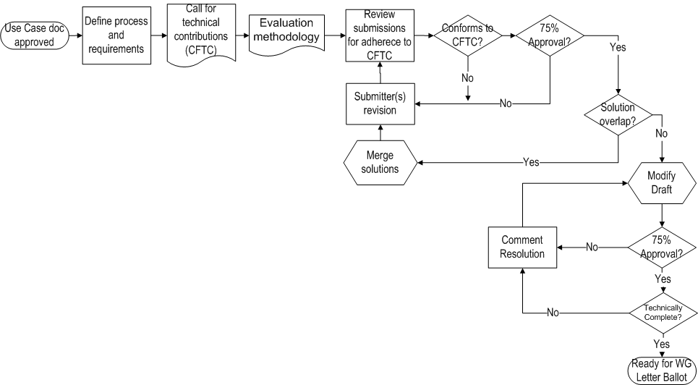
Process Flow
We are here!

Slide 14
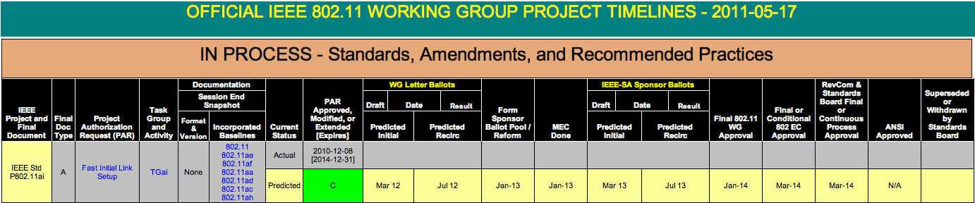
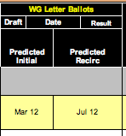
Time line

Slide 15
TGai Use Cases

Slide 16

What is 802.11ai?
802.11ai — Will define the way artificially intelligent robots overtake the world using Wi-Fi.*
Actually, that’s a lie.
No public info is yet available for 802.11ai.
*https://www.cwnp.com/cwnp_wifi_blog/802-11-alphabet-soup

Slide 17
Use Case Process
Prototypical use cases
  Establishes a small set reference use cases
  Provides summary all use cases accepted by TGai
  Sets criteria for 802.11ai submissions
Full set of use case in
  11-11-0238-19-00ai-Use-Case-Reference-List-for-TGai.docx

Slide 18


Slide 19

Definitions (1 of 2)
FILS = Fast Initial Link Setup
Device set
  mobile STA
  network access point
Use Case Differences
  Link-Attempt Rate
  Media Load
  Coverage Interval
  Link Setup Time

Slide 20
Definitions (2 of 2)
Link-Attempt Rate
  Connection attempts per second
Media Load
  “Busyness” of the medium
Coverage Interval
  Time within the range
Link Setup Time
  Tolerable time to connect

Slide 21

Tokyo Central Station

Slide 22
Tokyo Central Station Use Case
Very large number of pedestrians attempt to connect at virtually the same time
General internet access with graphics and video
  Link-Attempt Rate: 100s/second
  Media Load: 50%
  Coverage Interval <10 sec
  Link Setup Time 100 ms
Driver for the adoption of FILS

Slide 23


Drive-by Information

Slide 24
Drive-by Use Case
Large number of vehicles
  uploading/downloading a large amount of information
  only in range for a short time.
Includes text, graphics, video
  Link-Attempt Rate <10
  Media Load 10 to 50%
  Coverage Interval <1 second
  Link Setup Time <100 ms
FILS is required to make the use case viable for 802.11

Slide 25


Emergency Coordination

Slide 26
  Emergency Coordination Use Case
  Self Growing Use Cases
Establish a temporary infrastructure at an emergency
Includes: voice, text, graphics, video
  Link-Attempt Rate 10
  Media Load 10 - 50%
  Coverage Interval >10 sec
  Link Setup Time >2 seconds
Once FILS resides in the STA/AP, it will promote usage

Slide 27

Handover from Mobbile to Wi-Fi

Slide 28
Handover Use Case
Offload 3G/4G Mobile uses to WLAN
Includes: voice, text, graphics, video
  Link-Attempt Rate <10
  Media Load 10 - 50%
  Coverage Interval >10 sec
  Link Setup Time 200 milliseconds
Perhaps the “sleeper” application for FILS
Notes:
In an interactive session (for instance, Skype video) does not always survive when switching from 3G to WLAN because getting WLAN interface operational takes too long. FILS will allow parallelization of other configurations, such as IP address resolution. Use case is to switch off one interface then switch on the other so as to have only one radio on at a time. Pre-association has started, but no association or IP configuration done as yet.

Slide 29

Other Use Cases
Pedestrian
  Electronic Payment
  Traveller Information
  Pedestrian Signal System
Vehicle
  Electronic Payment
  Internet Access
  Emergency Services
  Inspections
  Resource Management
Transit
  Station arrival
  Passenger In-transit access
  Station Lobby
  Connection Protection
  Dynamic Transit Operations
Notes:
Pedestrian
Electronic Payment
Traveller Information
Internet Access
Mobile Accessible Pedestrian Signal System
Vehicle
Electronic Payment
Traveller Information
Internet Access
Emergency Services
Inspections
Resource Management
Transit
Station arrival
Passenger In-transit access
Station Lobby
Connection Protection
Dynamic Transit Operations

Slide 30
TGai Key Technical Requirements

Slide 31
Focus of TGai
TGai focuses on reducing the time spent in any phase of the initial link set-up
Phase |  |  |  | Auth. & Assoc.
Phase | AP Discovery | Network Discovery | TSF Sync. (1 additional scan) | Auth. & Assoc. | Higher Layer (DHCP / IP)
FIA has analyzed the performance of all link set-up phases (as imposed by IEEE 802.11-2007) and identified potentials for performance improvement
The following summary of this analyzes illustrates some initial technical approaches on how to reduce the time spent in the initial link set-up phase

Slide 32
Access Point Discovery: Today
Expected Mean
of time spent in
scanning for
No Assumptions
(scan all channels),
find all APs
Potentials for improvement:
  Return from scanning procedure after having found the 1st AP
  Use “external” knowledge on which channels to scan
  What about 5GHz operation—really only passive scanning or are there potential alternatives for faster AP discovery?
2.4 GHz
5 GHz
Passive scanning
1100 ms
2300 ms
Active scanning
102 ms
n/a
Note:
  Qi & Walker (11-10/853r1) provide worst case approximations of up to 3400ms.
  11-10/922r2 contains details how the assumptions behind the expected mean calculation for the values presented herein
  Source: 11-10/922r2

Slide 33
AP Discovery: Return after 1st AP is found
No Assumptions
(scan all channels),
stop after 1st APs
is found
Expected Mean
of time spent in
scanning for
No Assumptions
(scan all channels),
find all APs
2.4 GHz
5 GHz
2.4 GHz
5 GHz
Passive scanning
1100 ms
2300 ms
550 ms
1150 ms
Active scanning
102 ms
n/a
22 ms
n/a
Amendment required
Passive scanning
  Theoretically, this is possible: “shall listen to each channel scanned for no longer than a maximum duration defined by the MaxChannelTime“ [11REVmb-D4, Cls 11.1.3.1]
  BUT: currently, there is not option to the MLME-SCAN.request primitive forcing this behavior.
Active scanning:
  Not possible right now: “…. [scan until] ProbeTimer reaches MaxChannelTime, process all received probe responses“ [11REVmb-D4, Cls 11.1.3.2.2]
  Source: 11-10/922r2

Slide 34
AP Discovery: Reduction of number of channels to scan
No Assumptions
(scan all channels),
stop after 1st APs
is found
Reduce number
of channels (to 1)
where APs are
known to operate
Return after
1st AP Responses
(scan 1 channel)
Expected Mean
of time spent in
scanning for
No Assumptions
(scan all channels),
find all APs
2.4 GHz
5 GHz
2.4 GHz
5 GHz
2.4 GHz
5 GHz
2.4 GHz
5 GHz
Passive scanning
1100 ms
2300 ms
550 ms
1150 ms
100 ms
100 ms
50ms
50ms
Active scanning
102 ms
n/a
22 ms
n/a
17 ms
n/a
2 ms
Amendment required
Combine both:
Amendment required
11k may work, but not for initial link set-up
Amendment required
Moving from one BSS to another
(note: not in scope of FIA SG, but mentioned for completeness)
  11k neighbor report can provide information on which channels APs operate
Initial link-set up
  Not possible right now (STA is not within a BSS in order to query a neighbor report)
  Possible approach: allow input via management plane
  Source: 11-10/922r2

Slide 35
AP Discovery: Enablement of 5GHz active scanning via 2.4 GHz
No Assumptions
(scan all channels),
stop after 1st APs
is found
Reduce number
of channels (to 1)
where APs are
known to operate
Return after
1st AP Responses
(scan 1 channel)
Expected Mean
of time spent in
scanning for
No Assumptions
(scan all channels),
find all APs
Enablement at 5GHz via 2.4 GHz
2.4 GHz
5 GHz
2.4 GHz
5 GHz
2.4 GHz
5 GHz
2.4 GHz
5 GHz
2.4 GHz
5 GHz
Passive scanning
1100 ms
2300 ms
550 ms
1150 ms
100 ms
100 ms
50ms
50ms
50ms
50ms
Active scanning
102 ms
n/a
22 ms
n/a
17 ms
n/a
2 ms
n/a
2 ms
2 + ε ms
Amendment required
Combine both:
Amendment required
Amendment required
11k may work, but not for initial link set-up
Amendment required
APs with simultaneous dual-band operation are common (esp. in commercial environments)
AP has knowledge on the 5GHz channels it is operating on
Provide information on 5GHz operation / channels via 2.4GHz channel to STA → STA can immediately synchronize via active scan on 5GHz channel (if legislation permits)
  Source: 11-10/922r2

Slide 36
AP Discovery: Summary
No Assumptions
(scan all channels),
stop after 1st APs
is found
Reduce number
of channels (to 1)
where APs are
known to operate
Return after
1st AP Responses
(scan 1 channel)
Expected Mean
of time spent in
scanning for
No Assumptions
(scan all channels),
find all APs
Enablement at 5GHz via 2.4 GHz
2.4 GHz
5 GHz
2.4 GHz
5 GHz
2.4 GHz
5 GHz
2.4 GHz
5 GHz
2.4 GHz
5 GHz
Passive scanning
1100 ms
2300 ms
550 ms
1150 ms
100 ms
100 ms
50ms
50ms
50ms
50ms
Active scanning
102 ms
n/a
22 ms
n/a
17 ms
n/a
2 ms
n/a
2 ms
2 + ε ms
Amendment required
Combine both:
Amendment required
Amendment required
11k may work, but not for initial link set-up
Amendment required
Increase in (externally available) knowledge
Information on accessibility can be increasingly obtained from external sources in addition to the existing 802.11 schemes (e.g.: Offline WiFi Database for iPhone, location information in mobile devices, coverage maps, etc.)
Such information can reduce the time spent in AP discovery, but as of today …
802.11 does not provide all means to fully exploit this potential
Even without external information, scanning in 5GHz can be reduced from 2300ms down to 104ms (enablement via 2.4GHz; active scan of all channels at 2.4GHz, active scan of known channel w/ immediate return after 1st probe response on 5GHz channel)

Slide 37
Fast Initial Link Set-Up
Phase | AP Discovery |  | Network Discovery | TSF Sync. (1 additional scan) | Auth. & Assoc. | Higher Layer (DHCP / IP)
 | Active | passive
Today | 102 ms (not @ 5GHz) | 1100 to 2300 ms
Possible achievement (w/ knowledge) | 2 ms (possible at 5GHz) | 50 ms
Rel. document | 10/0922r2 |  | 802.11u
Next Slides

Slide 38
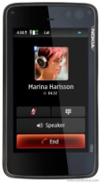

Network Discovery
Originally not further discussed during the SG phase.
Well covered by 11u
Ongoing presentations in TGai show potential for improving network discovery for a large number of STAs simultaneously attempting a network discovery
- ANQP is unicast
- Each SSID is queried until a suitable network is found.
- ANQP to be sent to the broadcast address
AP answers if it can satisfy the condition in the request
ANQP responses are sent unicast
SSID1
SSID2
SSID3
SSID1
SSID2
SSID3
Beacon
Beacon
Association Request
Network Selection (SSID2)
Association Request
Network Selection (SSID2)

Slide 39
Fast Initial Link Set-Up
Phase | AP Discovery |  | Network Discovery | TSF Sync. (1 additional scan) | Auth. & Assoc. | Higher Layer (DHCP / IP)
 | Active | passive
Today | 102 ms (not @ 5GHz) | 1100 to 2300 ms
Possible achievement (w/ knowledge) | 2 ms (possible at 5GHz) | 50 ms | Optimizations for large number of users simultaneously entering a network
Rel. document | 10/0922r2 |  | 802.11u
Next Slides

Slide 40
Fast Initial Link Set-Up
Phase | AP Discovery |  | Network Discovery | TSF Sync. (1 additional scan) | Auth. & Assoc. | Higher Layer (DHCP / IP)
 | Active | passive
Today | 102 ms (not @ 5GHz) | 1100 to 2300 ms | Optimizations for large number of users simultaneously entering a network | EAP-GPSK @ OFDM6: 6ms + 71ms processing time
Possible achievement (w/ knowledge) | 2 ms (possible at 5GHz) | 50 ms |  | EAP-GPSK w/ Piggyback@ OFDM6: 5ms + 35ms processing time (reduced number of messages require less processing time, further optimization might be possible)
Rel. document | 10/0922r2 |  | 802.11u | 10/988r0 & 10/1008r2 & 11-10/980r0
Total time for Link Set-Up for shown technical feasible solutions:
  Today per 802.11-2007: 179ms – 2377 ms
  With Fast Initial Link-Set Up: 38ms – 86ms
Considering all link set-up phases simultaneously results in largest performance improvement
→ Modified Scope to include all phases of initial link set-up
→ Required security level of RSNA in Scope
→ Review by security experts before letter ballot

Slide 41
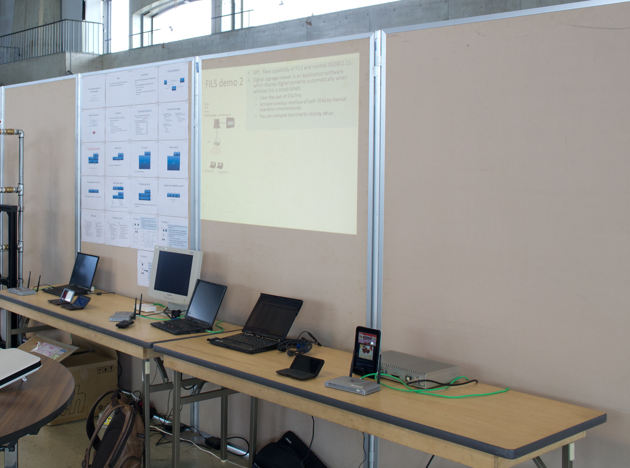
FILS Proof-Of-Concept Prototype
Some of the initial ideas have been implemented in a proof-of-concept prototype.
Note: The approaches found in the prototype do not reflect technical approaches endorsed by TGai.

Slide 42

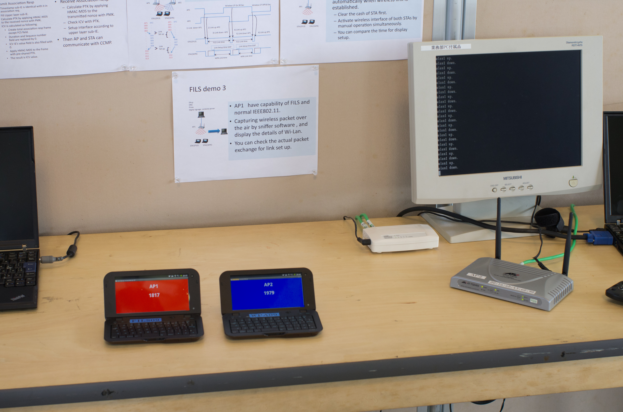
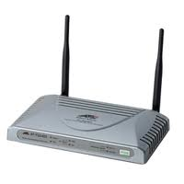
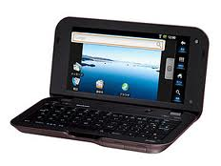
FILS demo 1
AP1,AP2 enable the wireless interface 90Sec with 60Sec interval.
Both AP have capability of FILS and normal IEEE802.11.
The STA establish link to another AP when current link was disconnected.
Web browser is providing automatic count up data by html.
The display on STA shows the latest count data , therefore the count number will be stopped during the gap of link setup period.
You can compare the difference between WPA and FILS
Dhcp
DNS
Web server
Proxy
AP1
AP2
Wireless I/F On 90 Sec
Wireless I/F Off 60 Sec
AP1
STA1(FILS)
STA2(WPA)
AP1000
001
002
:
:
:
:
:
:
:
010
011
012
013
AP2
:
:
:
:
004
005
006
007
008
:
:
:
AP1000
001
002
:
:
:
:
:
:
:
:
: 012
013
AP2
:
:
:
:
:
:
006
007
008
:
:
:
AP2
1) Link down AP1
2) Link up AP2
Link
Set up
4) Link up AP1
3) Link down AP2
5) Link down AP1
6) Link up AP1
STA1(FILS)
FILS Link time
Link
Set up
FILS Link time
Link Setup time GAP
Link Setup time GAP
STA2(WPA)
WPA Link time
WPA Link time

Slide 43
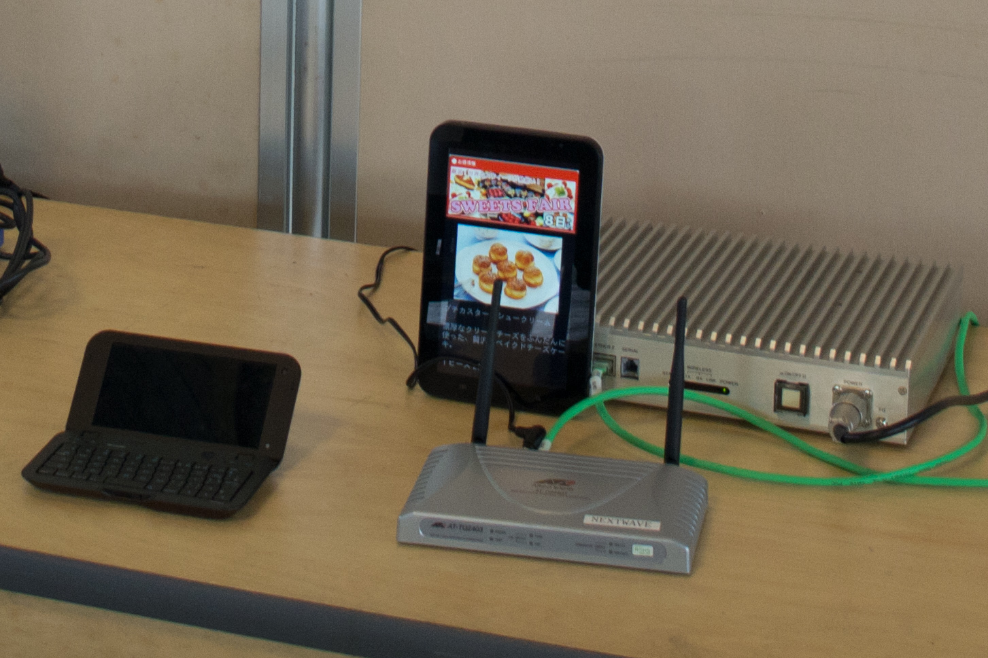

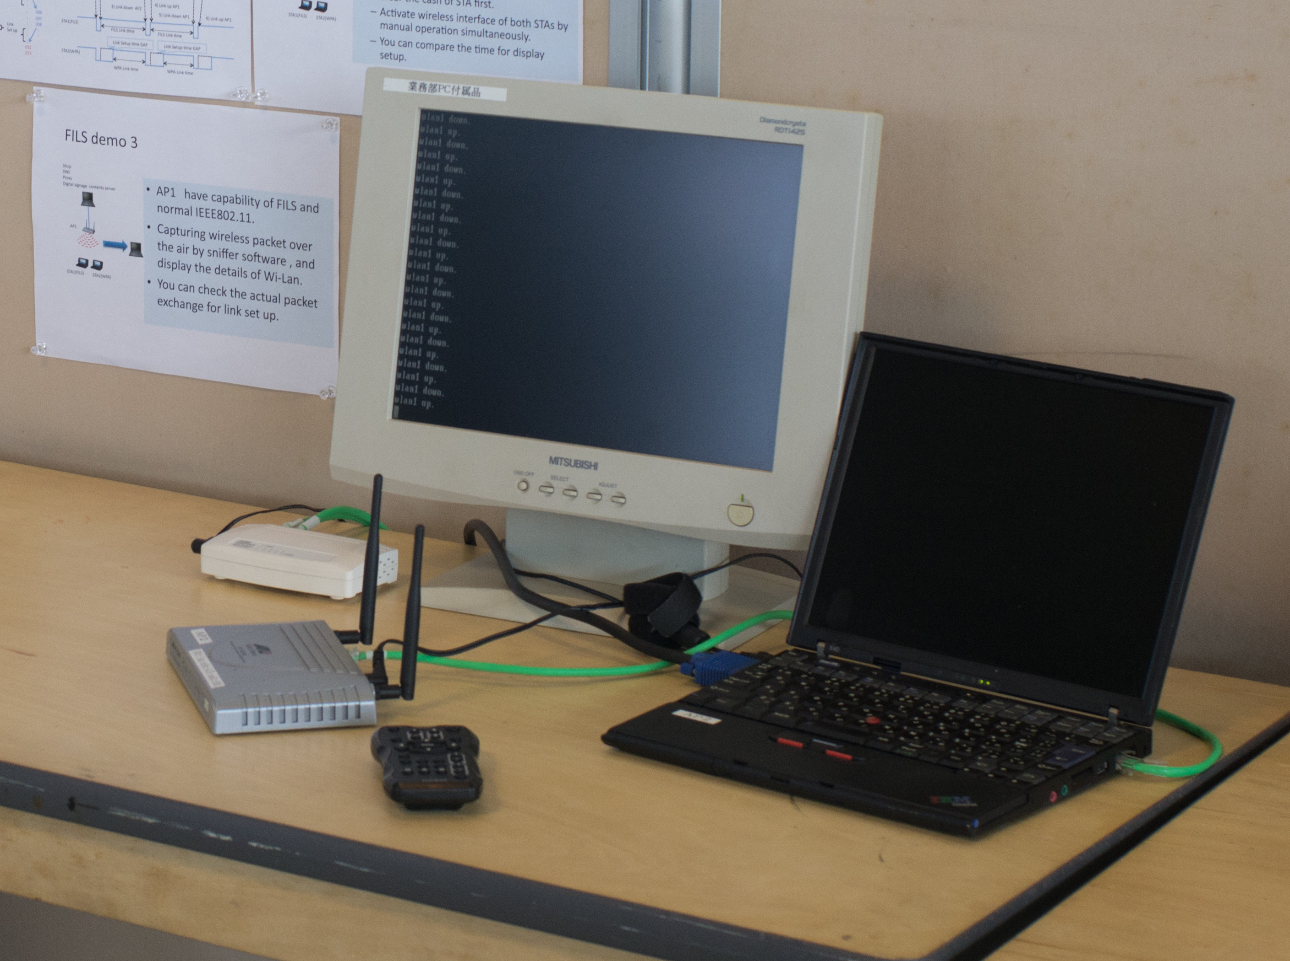
FILS demo 2
AP1 have capability of FILS and normal IEEE802.11.
Digital signage viewer is an application software which display digital contents automatically when wireless link is established.
  Clear the cash of STA first.
  Activate wireless interface of both STAs by manual operation simultaneously.
  You can compare the time for display setup.
Dhcp, DNS Proxy
Digital signage contents server
AP1
STA1(FILS)
STA2(WPA)
FILS demo 3
AP1 have capability of FILS and normal IEEE802.11.
Capturing wireless packet over the air by sniffer software , and display the details of Wi-Lan.
You can check the actual packet exchange for link set up.
Dhcp DNS Proxy
Digital signage contents server
AP1
STA1(FILS)
STA2(WPA)

Slide 44
Security Review and Recommendations for IEEE802.11ai Fast Initial Link Setup

Slide 45



Risk Analysis for 802.11 Networks
Risk = Vulnerability x Threat x Cost
  Vulnerability:
  is the probability of success of an attack for a particular threat category. The “value” of vulnerability in the risk equation can vary depending on the type of attacker, for example a government may have more resources to be successful than a single hacker.
  Threat:
  is the likelihood of an adverse event. It is based on a particular threat category (hacker, disgruntle employee, government agency)
  Cost:
  is the impact of an attack against the vulnerability by the particular threat. Breaking into an online banking account typically has a higher cost than a denial of service attack against a single user.

Slide 46
Going from Risks to Recommendations
Mitigating vulnerabilities is the easiest way to reduce Risk and improve security.
  Technical mechanisms that we put in the
Knowing the Risk of specific scenarios allows a balanced analysis to determine which vulnerabilities need to be fixed..
  Not all vulnerabilities need to be addressed for a particular market
    Example – denial of service attacks

Slide 47
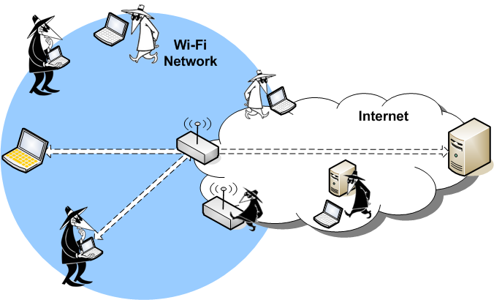
Attack Vectors for 802.11
Network Communications
The location and capabilities of an attacker in the network is a useful way to categorize vulnerabilities.

Slide 48
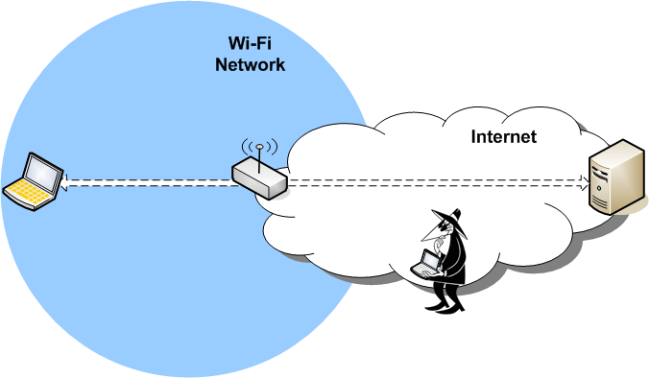
Internet Based Active Attacks
Vulnerabilities
- Default passwords
- Open ports
- Password cracking/guessing
- Stack Exploits
- viruses
- trojan horse programs
Prevention (in AP)
- Firewall in AP
- Intrusion Detection
- virus checking
A Wi-Fi network connected to the Internet
will be the target of network attacks.
Vulnerabilities
- Default passwords
- Open ports
- Password cracking/guessing
- Stack Exploits
Prevention
- Unique OOB passwords
- TLS for Management
- Strong unique authentication
- Hardened protocol stack
- Intrusion Detection
Not in scope for IEEE 802.11
- Recommendations on vulnerabilities
to wired interface of AP
- Firewall recommendations
for Internet traffic
- Intrusion detection

Slide 49
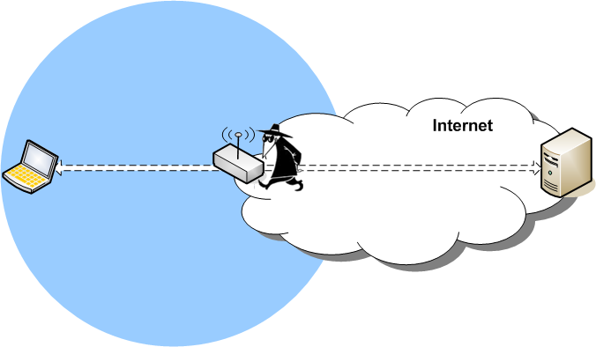
Physical Attacks on Network Equipment
Physical access to network equipment allows the device to be reset or modified.
.
Vulnerabilities
- Device reset
- WPS unauthorized join
- Disclosure of device
PW or PIN on labels
- insertion of monitoring
device
Prevention
- safe location
- restrict access to reset
- secure reset process
Not in scope for IEEE 802.11

Slide 50
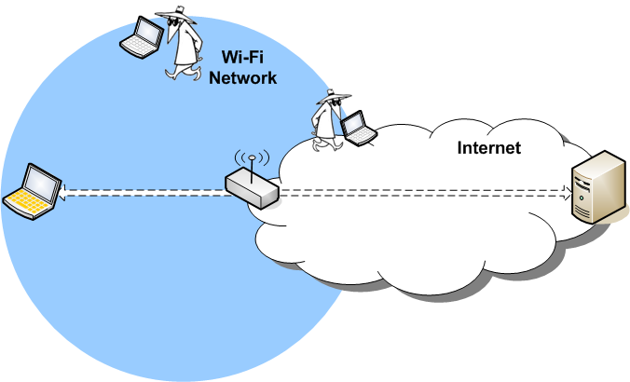
Passive Sniffing Attacks
Sniffing of “open” wireless communications or poorly encrypted communications (like WEP) is the most visible wireless vulnerability.
Threat: Anyone with a computer and bad intent
Vulnerabilities
- Wireless Sniffing
- WEP Cracking
- RSN Password Cracking
- Management Frame Monitoring
- credential capture
(e.g. Firesheep)
Prevention
- Use RSN Enterprise
- Use Management Frame Protection
Threat: Governments, Service Providers, IT Department personal, but NOT usually an average hacker.
IEEE 802.11 Recommendations:
- RSN Required
- Management Frame Protection Optional
Vulnerabilities
- Backhaul or Internet
Based Monitoring>
modification or spoofing
Prevention
- Use end-to-end security for STA traffic of value
(TLS, IPsec, or other VPN)
- Use end-to-end security for AP Management Traffic
(TLS, IPsec, or other VPN)
Not in scope for IEEE 802.11

Slide 51
802.11ai and Passive Sniffing Attacks
Sniffing of “open” wireless communications or poorly encrypted communications (like WEP) is the most visible wireless vulnerability.
Is device identity or location privacy a Risk?
IEEE 802.11 Recommendations:
- STA/AP-to-Authentication Server traffic
must be secure from modification
or impersonation
Is there any risk to exposing the existence of specific services?
Authentication traffic needs protetion.

Slide 52
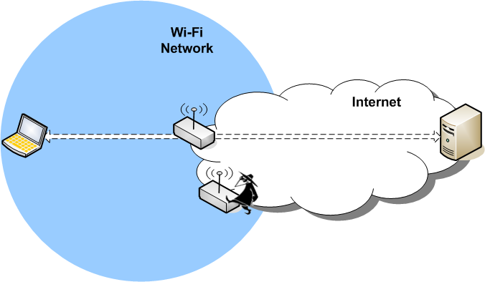
Evil Twin APs
A rogue AP tricks a user into connecting to a network controlled by the attacker.
IEEE 802.11 Recommendations:
- RSN Required
- STA authentication of AP/Network
- STA must authenticate and validate server
- binding of network/AP to expected
service required
Authentication is TBD in 802.11ai
Vulnerabilities Prevention
- SSID Confusion - intrusion detection
- open network - strong authentication
- weak or no authentication
Vulnerabilities Prevention
- Weak Authenticaiton - STAs MUST authenticate and validate server and AP
- SSID confusion - STA UI must be clear on connection type
- activity monitoring / intrusion detection
- binding of expected service to authentication

Slide 53
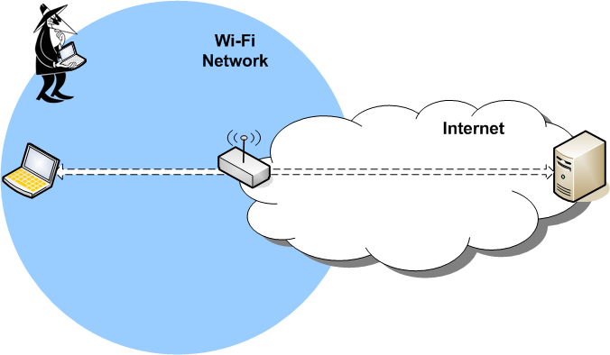
Active Wireless Attacks without Network Membership
The Attacker does NOT have keys for a secure connection, but can still cause problems.
Vulnerabilities Prevention
- Management Frame Spoofing - Use Management Frame Prot
- Wi-Fi Firmware Attacks - Vendor specific patches
- WPS 1.0 Cracking - Use WPS 2.0
- ANQP Unprotected
Vulnerabilities Prevention
- Management Frame Spoofing - Use 11w
(DoS generally used to help
bump STA to Rogue device)
- Wi-Fi Firmware Attacks - Vendor specific patches
- Active key cracking - Use RSN
- 11u/GAS/ANQP Unprotected -? Is this a Risk?
IEEE 802.11 Recommendations:
- RSN required
- Management Frame Protection optional

Slide 54
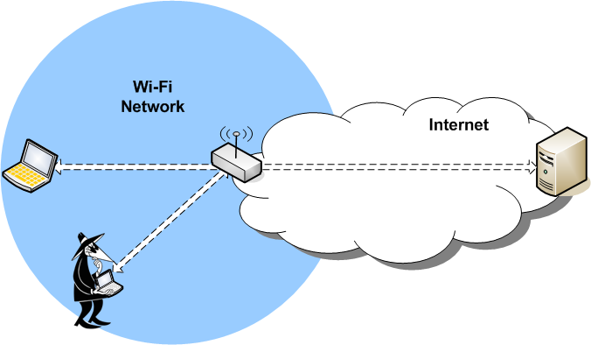
Attacks from Wi-Fi Users on the Same Secure BSS
This is a Hotspot specific attack vector.
In homes, you trust your peer devices and users. In a Hotspot there is no way to prevent malicious users from connecting to the network.
Vulnerabilities
- Attack from WLAN User
- from hacker or computer worms
- Traffic Monitoring
- ARP and DNS spoofing, MIM attacks
- credential capture (e.g. Firesheep)
- IPv6 neighbor discovery
Prevention
- Access network isolation of users traffic
(prevent inter-BSS communications)
- Use proxy ARP
Not in scope for IEEE 802.11

Slide 55
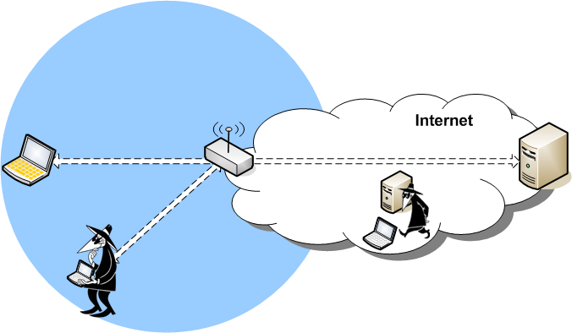
Attacks on the Same Secure BSS with AP Isolation
Even when a AP isolates users on a BSS
there are still know vulnerabilities for Hotspots.
Vulnerabilities
- STA accepts unicast IP frame encrypted
in RSN broadcast key (aka Hole 196)
Allows spoofing of ARP and DNS which leads to
Man-in middle attacks
Prevention (at STA)
- STA checking of key usage (not easy)
(broadcast key only for broadcast traffic)
Vulnerabilities
- Broadcast key shared by all users
Prevention (at AP)
- Don’t distribute a shared broadcast key
2
Threat:
Anyone with a computer and bad intent anywhere on the Internet
(and an accomplice at the Hotspot)
1
IEEE 802.11 Recommendations:
- AP optionally may NOT distribute a
shared broadcast key
- STA should check broadcast key usage

Slide 56
Preliminary IEEE 802.11ai Recommendations
Support only encrypted (RSN) traffic
Consider application of 11w management frame protection (mandate if risks identified)
Strong authentication must prevent spoofing of
  AP, STA and Authentication Server
  Must provide some binding to expected “service”
Use of all unprotected frames should be examined for risks when 11ai has stable draft
Task group should determine if they wish to address risks associated with “discovery”.
  Device / person identity and location privacy
  Service request or availability sensitivities
Analysis did not look at denial of service. Review is required after 11ai draft to ensure there is no leveraged attack

Slide 57
IEEE 802.11ai Security Requirements
Secure generation of PTK for RSN traffic
Authentication
  AP-to-STA
    Authentication must provide mapping to expeted network/services
  Authentication of STA-to-AP
  Mutual Authentication of AP and
  Authentication Server
Secure transfer of “upper layer information”
(prevent modification or spoofing)
  IP address, router address/announcement

Slide 58
IEEE 802.11ai Security – Scope Questions
What Authentication Credentials should be supported?
  Shared key / passphrase, SIM, USIM, certificate,
  Public Key
Denial of service protection – risk?
Security of discovered information – is this a risk?

Slide 59
References
Original Presentations
  11-11/1244 – TGai Overview
  11-11/1154 – TGai Use Cases
  11-11/1237 – TGai Key Technical Ideas
  11-11/1250 -- Security Review and Recommendations for IEEE802.11ai Fast Initial Link Setup
Additional Material
  11-10-1152-01-0fia-fast-initial-link-set-up-par.doc
  11-11-0281-00-00ai-proposed-dynamic-mobility-use-cases-for-tgai.docx
  11-11-0148-07-00ai-use-cases-for-tgai.docx
  11-11-0122-00-00ai-3g-wlan-handover.pptx
  11-11-0408-02-00ai-Use_Case_Characteristics_Discussion.pptx
  11-11-0023-02-00ai-use-case-senario-for-tgai.pptx
  11-11-0441-00-00ai-self-growing-use-cases-requiring-fast-initial-link-setup.docx
  11-11-0746-00-00ai-discussion-on-how-many-aps-to-cover.ppt
  11-11-0750-00-00ai-use-case-document-definitions.pptx
  11-11-0619-00-00ai-use-case-network-mobility.pptx
  11-11-0797-00-00ai-use-case-mobile-hotspot.pptx
  11-10/853r1: Some concerns about FIA (Emily Qi and Jesse Walker, Intel)
  11-10/922r2: Achievable gains in AP discovery (Marc Emmelmann, Fraunhofer FOKUS)
  11-10/965r1: Potential performance improvement with fast initial link set-up (Marc Emmelmann, Fraunhofer FOKUS & Root Inc.)
  11-10/988r1: Protocol comparison (Hitoshi Morioka, Root Inc.)
  11-10/1008r2: Parallel processing for upper layer (Hiroki Nakano, TNT Inc.)
  11-10/980r0: FIA Security Analysis Bob Moskowitz
  11-10/832r0: Comments to PAR & 5C (M. Emmelmann, Fraunhofer FOKUS & Root Inc.)
  11-10/1106: Transition from FIA to FILS (M. Emmelmann, Fraunhofer FOKUS)
  11-11/1015: Optimized network selection (Gabor Bajko, Nokia, Necati Canpolat, Intel)
  H. Mano et al: FILS Proof-of-Concept Demonstration – Documentation slide set, Okinawa, Japan, Sep 2011

