Slide 1
MAC considerations for 802.11ah (Probe and Pull MAC)
Date: 2011-11-07
Authors:

Slide 2
Abstract
DCF gives no guarantees for media access
Not suitable for event-driven applications with real-time/deterministic requirements (Use Cases 1c: Environment monitoring., 1d: Industry process automation, 1f: Healthcare, 1g: Home/Building Automation) [1]
Unfair [3,4] and inefficient [2, 3] in terms of throughput and energy when large numbers of STAs contend for media access at the same time
Contention-Free MAC should be considered for deterministic media access in 802.11ah
As a reference, 802.15.4e offers three contention-free MACs
802.11 PCF/HCCA is contention free but not suitable for large networks (up to 6000 STAs in 802.11ah)
This presentation introduces the contention-free Probe and Pull MAC (PP-MAC), an alternative to PCF

Slide 3
802.11 Contention Free MAC: PCF/HCCA
Benefits of contention-free MAC such as PCF/HCCA
Deterministic and fair
Efficient for both low duty-cycle and heavy/bursty traffic
Higher reliability and lower deployment cost
No hidden terminal problem
Energy efficient

Slide 4
PCF/HCCA is not suitable for large networks
Example: 802.11ah with 2MHz bandwidth, 6000 STAs
26 data bits/OFDM Symbol (BPSK 1/2), 40µs symbol duration
SIFS=160µs, PIFS=208µs
CF-Poll/-ACK message (28 bytes) ≅ 8.6 symbols (344 µs)
Data (250 bytes)=3076µs + PLCP(400 µs) + MAC Header(344µs)
If X% nodes have 1 uplink data packet, total time to collect all uplink data is approximately: 6000 * (1- X) * (CF-POLL + PIFS) + 6000 * X * (CF-POLL-ACK + SIFS + Data + SIFS)
Collect data from 6000 stations | X = 0% | X = 1% | X = 10% | X = 100%
Time (seconds) | 3.318 | 3.554 | 5.678 | 26.92
Overhead |  | 94.8% | 67.48% | 31.41%

Slide 5
Probe and Pull MAC (PP-MAC)
SIFS
SIFS
SIFS
SIFS
SIFS
SIFS
AP
Probe
Pull
ACK
ACK
Partition STAs into groups
Send Probe to a group of STAs
STAs with data to send will ACK (P-ACK) concurrently (in time-aligned manner)
AP resolves parallel ACKs with the use of Zadoff-Chu sequences [5]
AP initiates and schedules data transmissions with PULL
have data to send
STA1
P-ACK
Data
STA2
STA3
have data to send
STA4
P-ACK
Data

Slide 6
Overview of Parallel ACKs (P-ACKs) [5]
ZC sequence for STA1
STA1
P-ACK
PART 1 | PART 2 | … | PART 8
ZC sequence for STA2
STA2
P-ACK
PART 1 | PART 2 | … | PART 8
(a) Map a part of ZC sequence
to OFDM subcarriers
(a)
(a)
(a)
(b)
(b)
(b)
(b) IFFT and add cyclic prefix (CP)
…
P-ACK_STA1
CP | part 1
…
CP | part 8
Parallel ACKs to AP
P-ACK_STA2
CP | part 1
CP | part 8

Slide 7
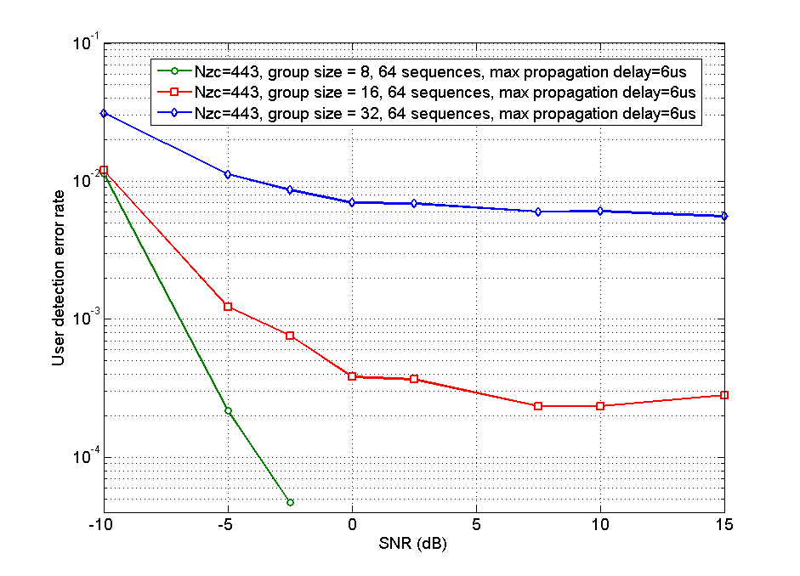
Parallel ACKs Detection Accuracy [5]

Slide 8
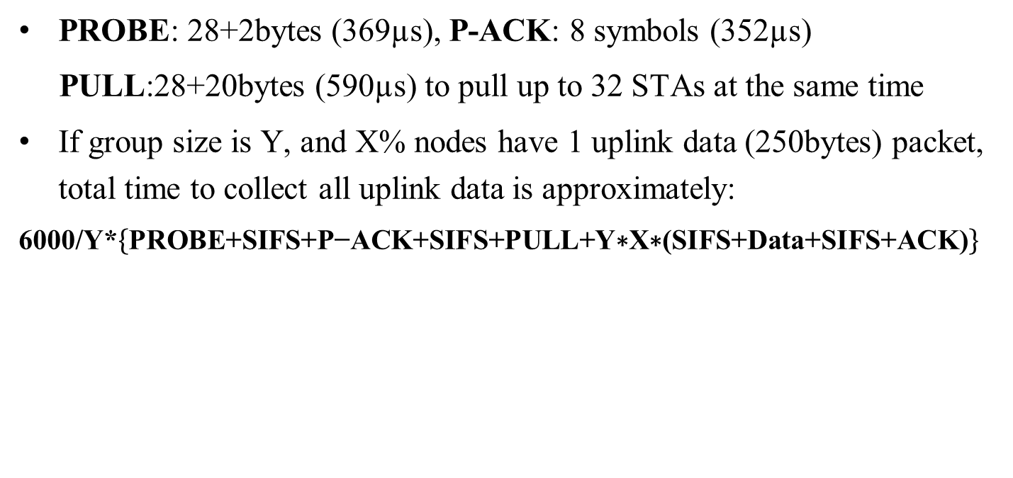
PP-MAC Performance
PROBE: 28+2bytes (369µs), P-ACK: 8 symbols (352µs)
PULL:28+20bytes (590µs) to pull up to 32 STAs at the same time
If group size is Y, and X% nodes have 1 uplink data (250bytes) packet, total time to collect all uplink data is approximately:
6000/Y*$\left\{\text{P}\text{ROBE}\text{+}\text{SIFS}\text{+}\text{P}\text{−}\text{ACK}\text{+}\text{SIFS}\text{+}\text{PULL}\text{+}\text{Y}\text{∗}\text{X}\text{∗(}\text{SIFS}\text{+}\text{Data}\text{+}\text{SIFS}\text{+}\text{ACK}\text{)}\right\}$
Collect Data from 6000 stations | X = 0% Y=32 | X = 1% Y=32 | X = 10% Y=32 | X = 100% Y=32
Time (seconds) | 0.108 | 0.509 | 2.756 | 25.22
Gain over PCF | 96.73% | 85.66% | 51.45% | 6.28%
Overhead |  | 63.76% | 33.01% | 26.81%
Gain Over PCF |  | 32.74% | 51.07% | 14.65%

Slide 9
Throughput comparison (PER=1%)
The probability that a node
has data to transmit is 10%
The probability that a node
has data to transmit is 90%

Slide 10
Conclusion
Based on the concept of parallel ACK, PP-MAC is a more efficient alternative to PCF for 802.11ah

Slide 11
References
[1] 11-11-0457-00-00ah: potential-compromise-of-802-11ah-use-case-document
[2] 11-11-1248-00-00ah: Simulation Study of the Performance of DCF Under Heavy Traffics for 802.11ah
[3] 11-11-1019-01-00ah: simulation-large-number-of-stas-support
[4] 11-11-1511-00-00ah: Fairness of DCF
[5]

Slide 12
Straw-poll 1
The specification framework should include a contention free MAC mechanism.
Y/N/A

Slide 13
Straw-poll 2
The specification framework should include a mechanism to group STAs.
Y/N/A

Slide 14
Straw-poll 3
The specification framework should include a mechanism to probe a group of STAs.
Y/N/A

Slide 15
Straw-poll 4
The specification framework should include a mechanism to receive traffic indications from a group of STAs in parallel.
Y/N/A

Slide 16
Motion 1
The specification framework should include a contention free MAC mechanism.
Y/N/A

Slide 17
Motion 2
The specification framework should include a mechanism to group STAs.
Y/N/A

Slide 18
Motion 3
The specification framework should include a mechanism to probe a group of STAs.
Y/N/A

Slide 19
Motion 4
The specification framework should include a mechanism to receive traffic indications from a group of STAs in parallel.
Y/N/A

