Slide 1
GAS Query Optimization in 11ai
Date: 2011-10-24
Authors:
Name | Affiliations | Address | Phone | email
Phillip Barber | Huawei Technologies Co., Ltd. | 1700 Alma Rd, Ste 500 Plano, Texas 75075 USA | +1 972-509-5599 | pbarber@huawei.com
Zongming Yao | Huawei Technologies Co., Ltd. | Bldg C8, Software Park, Road Tianfu 801, Gaoxin District, Chengdu, Sichuan, China, 610041 | +86 28 65972966 | yaozongming@huawei.com
Ping Fang | Huawei Technologies Co., Ltd. | Bldg 7, Vision Software Park, Road Gaoxin Sourth 9, Nanshan District, Shenzhen, Guangdong, China, 518057 | +86 755 36835101 | ping.fang@huawei.com
Yunbo Li | Huawei Technologies Co., Ltd. | Huawei Bantian Industrial Site ,Longgan District, Shenzhen, Guangdong, China, 518129 | +86 755 28977573 | liyunbo@huawei.com

Slide 2
Abstract
This document describes a technical proposal for TGai. In this proposal, a method for GAS Query optimization will be provided to reduce FILS processing time by accelerating Network Discovery procedure.

Slide 3
Conformance w/ Tgai PAR & 5C
Conformance Question | Response
Does the proposal degrade the security offered by Robust Security Network Association (RSNA) already defined in 802.11? | No
Does the proposal change the MAC SAP interface? | No
Does the proposal require or introduce a change to the 802.1 architecture? | No
Does the proposal introduce a change in the channel access mechanism? | No
Does the proposal introduce a change in the PHY? | No
Which of the following link set-up phases is addressed by the proposal? (1) AP Discovery (2) Network Discovery (3) Link (re-)establishment / exchange of security related messages (4) Higher layer aspects, e.g. IP address assignment | 2

Slide 4
GAS/ANQP
GAS/ANQP protocol introduced in 802.11u is designed for aiding network discovery and selection, enabling information transfer from external networks, enabling emergency services, and interfacing Subscription Service Provider Networks (SSPN) to 802.11 Networks that support Interworking with External Networks.
GAS/ANQP protocol may be used to retrieve locally stored or information remotely available from an AS (Advertisement Server); retrieved information could be Network Authentication Type information, Roaming Consortium list, IP Address Type Availability information, NAI Realm list, 3GPP Cellular Network information, AP Geospatial Location, Domain Name list, Emergency Call Number information, Vendor Specific Information .etc.
STA (especially when in public places like subway, airport, .etc) will use GAS/ANQP to retrieve information from AS for authentication/association, service discovery, .etc.
Notes:
虽然offload不需要做到无缝切换，但尽快地完成切换总是有好处的，因为大量用户同时连接WiFi又很快离开。

Slide 5
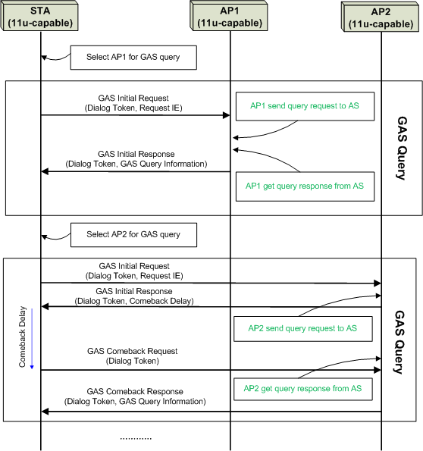
Current GAS Query Procedure
Currently, STA can retrieve information of only one AP at a time with GAS query procedure. If there are multiple APs, the STA should do multiple GAS query procedures respectively.
With current solution, STA might need to try multiple GAS query procedures before selecting the ‘right’ AP (e.g., the STA’s most favorite AP, .etc) for association. Inefficiency may be optimized, especially for those STAs that want to benefit from FILS in public places like airport, subway, .etc.

Slide 6
Our considerations
Single operator: GAS is an optional method for obtaining more information from AP/network, information not available in Beacon/AP broadcast. GAS/ANQP query is not necessary for the single-NSP model.
MVNO/RAN sharing/wholesale: one RAN operator A manages AP to provide access service for two or more operators. RAN operator A may have agreements with operators B, C, and D but doesn't necessarily have its own subscriber set. Operators B,C,D have terminal customers. APs of Operator A will broadcast information sufficient such that STA customers of operators B,C,D,E…can determine suitability for connection. If there are more than 4 operators, GAS is more useful in this use case. This business type is popular in the US and Europe.
Operators with roaming agreement: a customer may have a subscription with operator A. Operator A has a roaming agreement with operator B allowing the customer to roam on operator B network. Operator A is prioritized favorably when roaming in B due to inter-carrier charging agreement even though operator A may also have agreements with one or more other operators that may also have APs present. GAS is useful for terminal to select the favored connection opportunity.
Notes:
虽然offload不需要做到无缝切换，但尽快地完成切换总是有好处的，因为大量用户同时连接WiFi又很快离开。

Slide 7
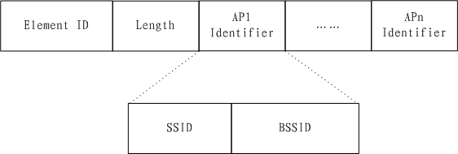
Proposed IE
Based on those considerations above, we propose the following AP List IE to indicate identifiers of all those APs whose information on AS the STA want to retrieve:
The AP List IE could be carried by the GAS Initial Request to any 11u-capable AP around that could be reached by STA, and the AP receiving the GAS Initial Request will be responsible to retrieve information from AS for all those APs indicated by those AP Identifiers.
Success partially depends on STA flexibility set those AP Identifiers for the AP List IE based on actual needs. APs identified by those AP Identifiers might not necessarily have the same SSID. A responding AP and AS may not have connectivity nor information for one or more APs identified in the request, thus also limiting success of response.
Notes:
虽然offload不需要做到无缝切换，但尽快地完成切换总是有好处的，因为大量用户同时连接WiFi又很快离开。

Slide 8
Possible Protocol Detail

Slide 9
Key changes to normative text
An information element for encapsulating selected APs whose network information on AS should be retrieved from AS will be defined. GAS Initial Request should carry this AP List IE.

Slide 10
Questions & Comments

Slide 11
Remedy Variants
Nov 2011
Slide 11
Huawei

Slide 12
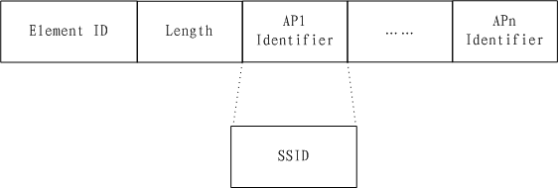
Proposed IE (.cont)
Remedy variant#2: Based on those considerations above, we can propose the following AP List IE to indicate identifiers of all those APs whose information on AS the STA want to retrieve. This variant is a little bit different than first variant proposal since it only chooses SSID as AP Identifier:
The AP List IE could be carried by the GAS Initial Request to any 11u-capable AP around that could be reached by STA, and the AP receiving the GAS Initial Request will be responsible to retrieve information from AS for all those APs indicated by those AP Identifiers.
It depends on STA to flexibly to flexibly set those AP Identifiers for the AP List IE based on its actual needs. And APs identified by those AP Identifiers might not necessarily have the same SSID.
Notes:
虽然offload不需要做到无缝切换，但尽快地完成切换总是有好处的，因为大量用户同时连接WiFi又很快离开。

Slide 13
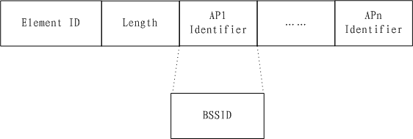
Proposed IE (.cont)
Remedy variant#3: Based on those considerations above, we can propose the following AP List IE to indicate identifiers of all those APs whose information on AS the STA want to retrieve. This variant is a little bit different than first variant proposal since it only chooses BSSID as AP Identifier:
The AP List IE could be carried by the GAS Initial Request to any 11u-capable AP around that could be reached by STA, and the AP receiving the GAS Initial Request will be responsible to retrieve information from AS for all those APs indicated by those AP Identifiers.
It depends on STA to flexibly to flexibly set those AP Identifiers for the AP List IE based on its actual needs.
Notes:
虽然offload不需要做到无缝切换，但尽快地完成切换总是有好处的，因为大量用户同时连接WiFi又很快离开。

