Slide 1
11ah Data Transmission Flow
Date: 2012-01-16
Authors:

Slide 2
Authors continued:
Slide 2

Slide 3
Abstract
This presentation proposes the data transmission flows for 11ah PPDUs, including 1MHz, 2MHz, and 4 / 8/ 16MHz packets.

Slide 4
Overview
TGah decided to have 2/4/8/16MHz signals that are basically down clocked versions of 11ac 20 / 40 / 80 / 160 MHz, also an 1MHz signal based on 32FFT was introduced.
Both 2MHz and 1MHz receptions are mandatory.
We propose the 11ah data transmission flow in this presentation.
Flow for regular MCS.
Flow for a new MCS0- 2x Repetition mode for range extension.

Slide 5
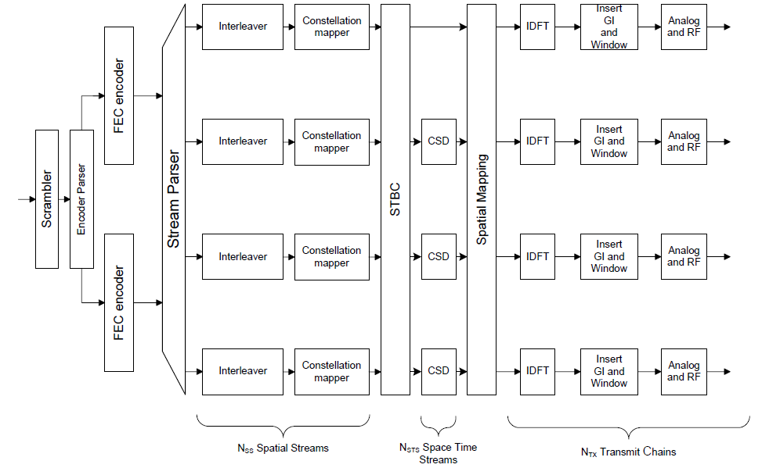
I. Transmission Flow for Regular MCSs
Apply the same Tx flow as in 11ac in the data tones.

Slide 6
Tone Plans
>=2MHz follows the same tone plans as the corresponding FFT sizes in 11ac.
Define the 1MHz tone allocation as: 24 Data tones, 2 Pilot tones at tone indices +/-7, 3 Guard tones on left and 2 guard tones on right, and 1 DC tone.
…..
…..
-16
-15
-14
-13
-2
-1
0
1
2
2
13
14
14
15
Data (pilot at -7)
Data (pilot at +7)

Slide 7
Discussions
Each block is the same as or similar to the corresponding part of 11ac.
The 11ah stream parser is the same as 11ac.
The 11ah encoder parser and segment parser (16MHz only) are the same as 11ac; N_{ES} in the MCSs of 2/4/8/16MHz is the same as the corresponding values in 11ac; and N_{ES} = 1 in all the MCSs of 1MHz.
Up to 4 space-time streams (refer to [3]).
The draft specification shall support following MCSs:
For 1MHz, 11ac MCS0~9, as well as an MCS0-rep2 mode.
For >=2MHz, the MCS tables for BBC are the same as the corresponding tables in 11ac before downclocking, i.e. same MCS exclusions for BCC as in 11ac.
In 1MHz, interleaver is applied for all MCSs incl. MCS0-Rep2, Ncol=8, Nrot TBD. (refer to [4])

Slide 8
II. MCS0 Rep2 Mode in 1MHz
An MCS0-Rep2 mode in 1MHz is needed to improve the range (refer to [1]).
Lead to the lowest data rate ~150Kbps, reach the longest range
~6dB gain compared with MCS0 of 64FFT mode.
Similar to the gap between 1Mbps (DSSS) and 6Mbps (11g) in 2.4GHz.
We propose a simple 2x repetition mode that imposes minimal Tx and Rx design change from regular MCSs.

Slide 9
MCS0 Rep2 Tx Flow
IDFT
GI &
Window
Analog
& RF
Ncol = 8
FEC
BPSK
mapper
Scrambler
Interleaver
:
:
2x Block-Wise Repetition
Spatial Mapping
After repetition,
NCBPS = 12 (same as 1SS-MCS0) bits
per symbol
IDFT
GI &
Window
Analog
& RF

Slide 10
Discussions
MCS0 Rep2 is applied only for single space-time stream.
NSS=1, no STBC
The “2x block-wise repetition” performed on a per-OFDM symbol basis:
Cout=[C1….C2NDBPS , C1….C2NDBPS ], where [C1….C2NDBPS] are the FEC output bits per symbol.
Interleaver parameters are the same as regular MCS0.
Ncol = 8
Receiver may conduct MRC combining to improve SNR.

Slide 11
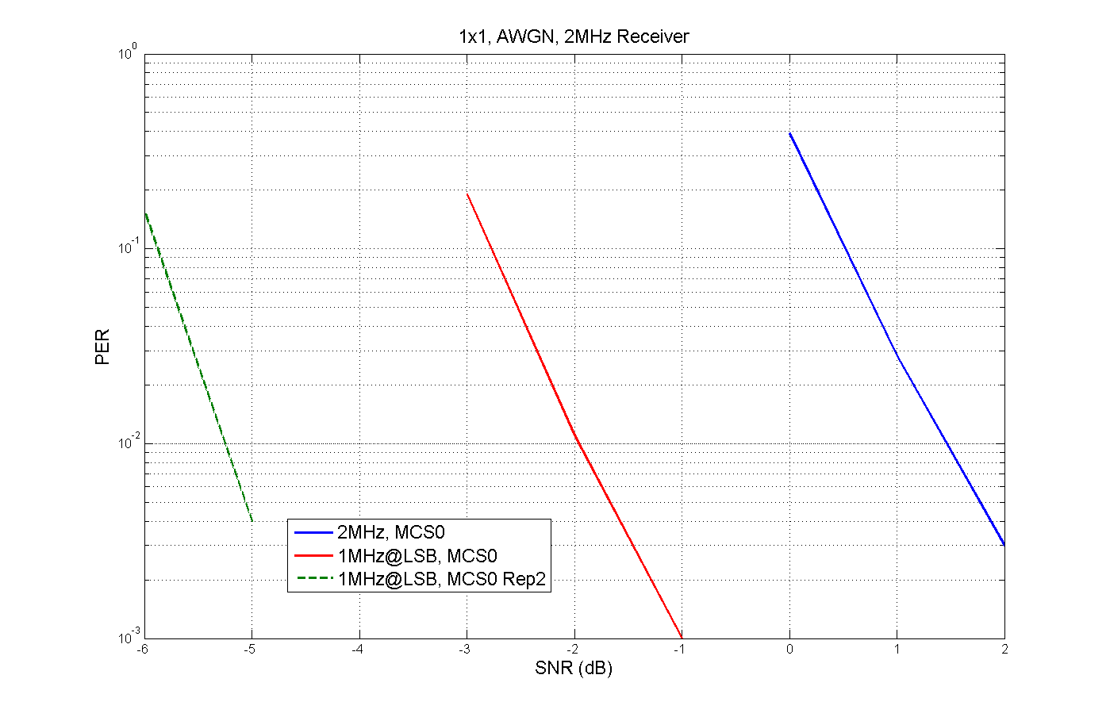
Performance in AWGN, 2MHz Receiver
Assumptions:
4 LTF1 repetitions in 1MHz Preamble (refer to [1])
1MHz with 24 data tones, Intlv Ncol=8
SNR is time domain: avg received power over noise in 2MHz

Slide 12
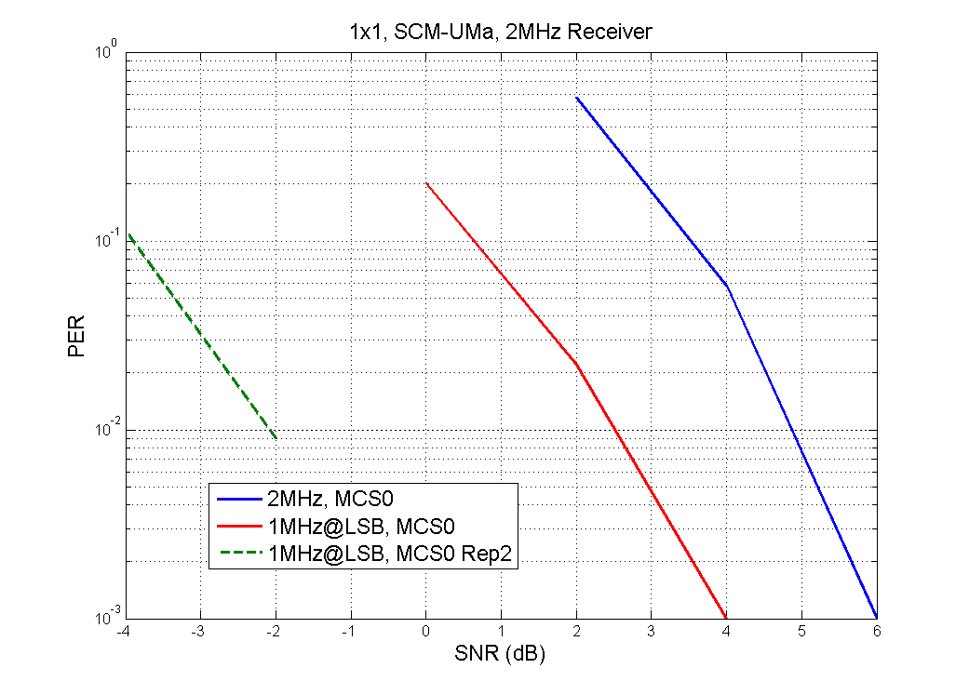
Performance in SCM-UMa, 2MHz Receiver

Slide 13
III. Short GI Support
In [1][2] we propose a green field type of preamble for single user packets.
Note that in 11n Green Field preamble, Short GI is not allowed if NSTS=1, due to the decoding delay for the HTSIG field.
In 11ah, most of the traffic will be SU 1SS, not allowing Short GI loses about 10% of peak throughput.
It is also easier to support SGI than in 11n/ac, because even SGI (4us) is much longer than a typical indoor channel multipath delay.
Propose that in any 11ah short GI packet, short GI starts from the 2nd Data symbol, and the 1st Data symbol is always long GI.
Include Multi-stream or MU packets.
For a unified receiver processing.
HT-STF
HT-LTF1
HT-SIG
DATA1
DATA2
DATA3
…..
Decoding delay
…..
STF
LTF1
SIG
Data1
Data2
Data3
Data4
Indicates SGI
(LGI)
(SGI)
(SGI)
(SGI)

Slide 14
Straw Poll - 1
Do you support the general transmission flow for 11ah regular MCSs as in slide 5?

Slide 15
Straw Poll - 2
January 2012
Do you support the 11ah tone plans as specified in slide 6?

Slide 16
Straw Poll—3
Do you support the followings regarding parsers?
The 11ah stream parser is the same as 11ac.
The 11ah encoder parser and segment parser (16MHz only) are the same as 11ac; N_{ES} in the MCSs of 2/4/8/16MHz is the same as the corresponding values in 11ac; and N_{ES} = 1 in all the MCSs of 1MHz.

Slide 17
Straw Poll –4
Do you agree with the followings regarding 11ah MCS table?
For 1MHz, 11ac MCS0~9, as well as an MCS0-rep2 mode.
For >=2MHz, the MCS tables for BBC are the same as the corresponding tables in 11ac before downclocking, i.e. same MCS exclusions for BCC as in 11ac.

Slide 18
Straw Poll - 5
Do you support the MCS0-Rep2 mode as specified in slides 9~10?

Slide 19
Straw Poll - 6
Do you support that in any 11ah short GI packet, short GI starts from the 2nd Data symbol, and the 1st Data symbol is always long GI?
Include Multi-stream or MU packets.

Slide 20
References
[1] 11-11-1482-00-00ah-preamble-format-for-1-MHz
[2] 11-11-1483-00-00ah-11ah-preamble-for-2MHz-and-beyond
[3] 11-11-1275-01-00ah-spatial-stream-support
[4] 11-12-0113-00-00ah-32FFT-Interleaver

