Slide 1
11ah Data Transmission Flow
Date: 2011-11-07
Authors:

Slide 2
Abstract
This presentation proposes the data transmission flows for 11ah PPDUs, including 1MHz, 2MHz, and 4 / 8/ 16MHz packets.

Slide 3
Overview
TGah decided to have 2/4/8/16MHz signals that are basically down clocked versions of 11ac 20 / 40 / 80 / 160 MHz, also an 1MHz signal based on 32FFT was introduced.
Both 2MHz and 1MHz receptions are mandatory.
We propose the 11ah data transmission flow in this presentation.
Flow for regular MCS.
Flow for a new MCS0- 2x Repetition mode for range extension.

Slide 4
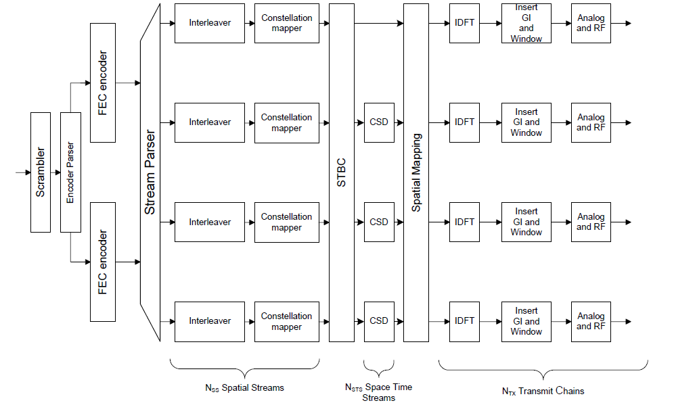
I. Transmission Flow for Regular MCSs
Apply the same Tx flow as in 11ac in the data tones.

Slide 5
Discussions
Each block is the same as or similar to the corresponding part of 11ac.
Up to 4 space-time streams (refer to [3]).
Regular MCS table is the same as 11ac, therefore 256QAM rates are optionally supported (MCS 8, 9 in 11ac).

Slide 6
II. MCS0 Rep2 Mode in 1MHz
An MCS0-Rep2 mode in 1MHz is needed to improve the range (refer to [1]).
Lead to the lowest data rate ~150Kbps, reach the longest range
~6dB gain compared with MCS0 of 64FFT mode.
Similar to the gap between 1Mbps (DSSS) and 6Mbps (11g) in 2.4GHz.
We propose a simple 2x repetition mode that imposes minimal Tx and Rx design change from regular MCSs.

Slide 7
MCS0 Rep2 Tx Flow
IDFT
GI &
Window
Analog
& RF
FEC
BPSK
mapper
Scrambler
Interleaver
:
:
2x Block-Wise Repetition
Spatial Mapping
After repetition,
NCBPS (of 1SS-MCS0) bits per symbol
IDFT
GI &
Window
Analog
& RF

Slide 8
Discussions
MCS0 Rep2 is applied only for single space-time stream.
NSS=1, no STBC
The “2x block-wise repetition”:
Cout=[C1….C2NDBPS , C1….C2NDBPS ], where [C1….C2NDBPS] are the FEC output bits per symbol.
Interleaver parameters are the same as regular MCS0.
Receiver may conduct MRC combining to improve SNR.

Slide 9
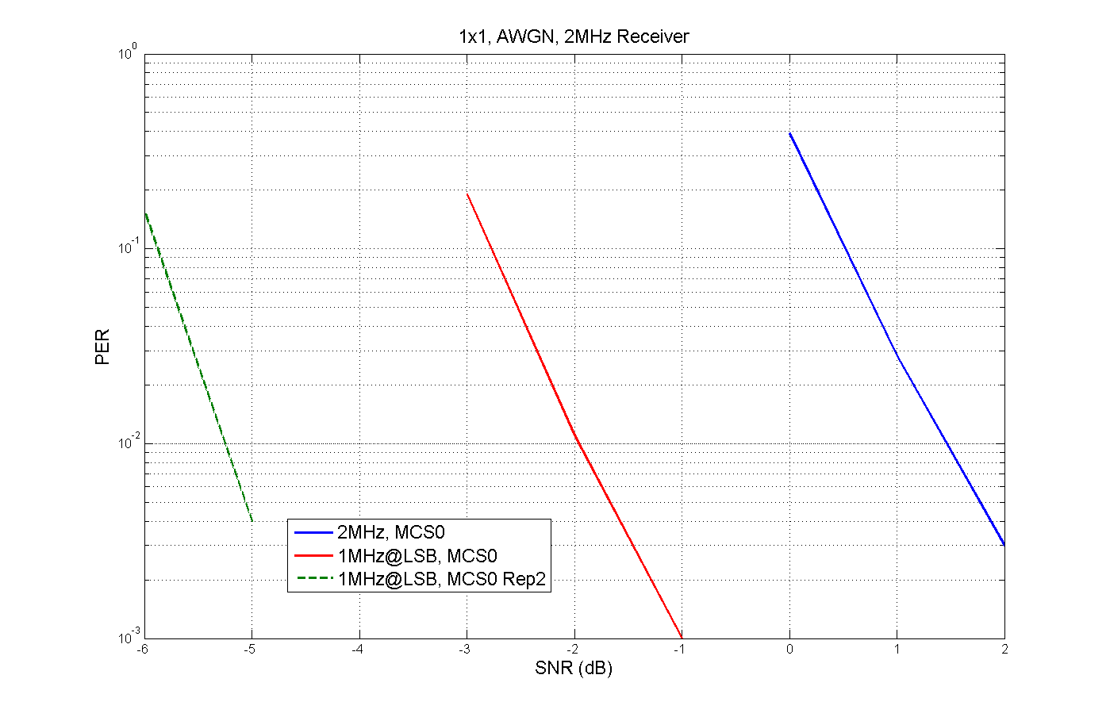
Performance in AWGN, 2MHz Receiver
Assumptions:
4 LTF1 repetitions in 1MHz Preamble (refer to [1])
1MHz with 24 data tones, Intlv Ncol=8

Slide 10
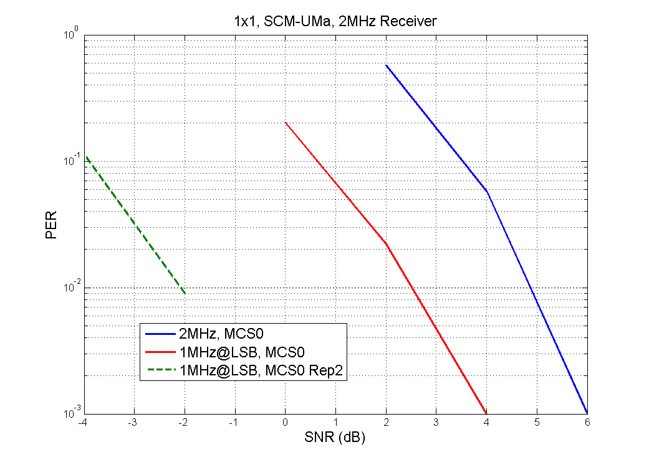
Performance in SCM-UMa, 2MHz Receiver

Slide 11
III. Short GI Support
In [1][2] we propose a green field type of preamble for single user packets.
Note that in 11n Green Field preamble, Short GI is not allowed if NSTS=1, due to the decoding delay for the HTSIG field.
In 11ah, most of the traffic will be SU 1SS, not allowing Short GI losses about 10% of peak throughput.
It is also easier to support SGI than in 11n/ac, because even SGI (4us) is much longer than a typical indoor channel multipath delay.
Propose that in any SU packet with NSTS=1, the 1st Data symbol is always long GI, i.e. start short GI from the 2nd Data symbol in this case.
…..
HT-STF
HT-LTF1
HT-SIG
DATA1
DATA2
DATA3
Decoding delay
…..
STF
LTF1
SIG
Data1
Data2
Data3
Data4
Indicates SGI
(LGI)
(SGI)
(SGI)
(SGI)

Slide 12
Straw Poll - 1
Do you support the general transmission flow for regular MCSs as in slide 4~5, which is similar to 11ac?

Slide 13
Straw Poll - 2
Do you support the general transmission flow for MCS0 Rep2 mode in 1MHz, as shown in slide 7~8?
Applied only for 1MHz single space-time stream.

Slide 14
Straw Poll - 3
Do you support short GI in single stream packets using the method as in slide 11, when SIG field is the last OFDM symbol in the preamble?

Slide 15
References
[1] 11-11-1482-00-00ah-preamble-format-for-1-MHz
[2] 11-11-1483-00-00ah-11ah-preamble-for-2MHz-and-beyond
[3] 11-11-1275-01-00ah-spatial-stream-support

