Slide 1
Early Key Generation by ECDH and PKC
Date: 2011-09-22
Authors:
Name | Affiliations | Address | Phone | email
Hiroki Nakano | Trans New Technology, Inc. | Sumitomo Seimei Kyoto Bldg. 8F, 62 Tukiboko-cho, Shimogyo, Kyoto 600-8492 JAPAN | +81-75-213-1200 | cas@trans-nt.com

Slide 2
Possible threats
Mutual Authentication
Unauthorized STAs
User authentication function should have responsibility.
done by EAP or something
Fake APs
steal security credentials and/or users’ id.
MITM (Snooping)
monitor and steal security credentials and/or users’ id
This proposal is for MITM and Fake APs.
Authorization of non-STA by AP should be done by another framework, such as EAP-RP.

Slide 3
Common sequence
non-AP STA
AP
Auth. Server
This should include ID of non-AP STA or its user. AP needs this information at least to know which authentication server should be used.
In case of EAP-RP, this includes EMSKname-NAI token to identify EMSK key (= EAP session).
Beacon
Assoc. Request
Auth. Request
Auth. Response
Assoc. Response

Slide 4
What’s the problem?
To reduce time, the next frame of Beacon, which may be Association Request, should include identifications of non-AP STA and/or its user.
At least, AP has to know which authentication server is suitable for this user.
There is possibility of steal of ID.
Attackers may try to gather stolen IDs.
IDs can be mail addresses, telephone numbers, IMEI, etc.
To protect ID:
ID has to be encrypted and signed.
STA has to be able to know if AP is authorized or faked.

Slide 5
Protection against MITM (for ID)
Almost all frames should be encrypted and signed.
Except for beacons?
Beacons can be encrypted using public key cryptography…?
The target in this presentation is the second frame, which is next to a beacon.
Before that, we have to exchange a key.
Use Elliptic Curve Diffie-Hellman algorithm.
ECDH can produce a smaller key with the same strength.
Smaller beacons and other frames are preferable.

Slide 6
Early key generation by DH/ECDH
gx and gy can be
reused for a while.
non-AP STA
AP
generate gy
generate gx
Beacon
gx, IEs
generate k from (gx, gy)
encrypt IEs
Any mgmt. frame
gy, E(k, IEs)
generate k from (gx, gy)
This may include user ID.
decrypt IEs

Slide 7
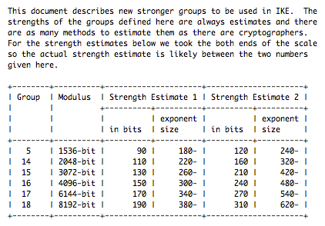
Length and strength of DH key
RFC3526 mentions as below (published in 2003).

Slide 8
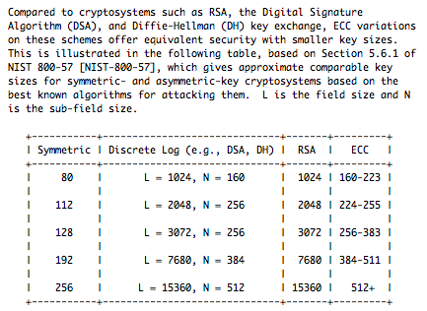
Length and strength of ECDH key
RFC5656 mentions as below (published in 2009).

Slide 9
Benefits of early key generation
Almost all frames can be encrypted and signed.
All packets sent by STA
All packets sent by AP except for beacons
Threats
A malicious STA/AP can let another STA/AP use its computation power.
A malicious STA can hijack a MAC address of another STA.
Because of lack of MAC address protection
User authentication function should kick out such keys after this process.
Fake APs can steal information from STAs.
Costs
beacon size
In case of ECDH, additional 64 byte is enough.
For example, the length of beacons for VeriLAN.1x is 202 byte.
computation power

Slide 10
Protection against faked APs
Can no-AP STA know only from a beacon if the AP is not faked?
Impossible…?
Combination of key generation and public key cryptography can prevent faked APs from getting correct information.

Slide 11
Early key generation w/ public key crypto.
non-AP has Kp only.
AP has Kp and Ks.
non-AP STA
AP
generate gy
generate gx
Beacon
(Kp, Ks) is a pair of public and secret keys of AP.
generate k from (gx, gy)
gx
encrypt IEs by k
This may include user ID.
encrypt gy by Kp
Any mgmt. frame
E(Kp, gy), E(k, IEs)
decrypt gy by Ks
generate k from (gx, gy)
decrypt IEs by k

Slide 12
In case of faked AP’
non-AP has Kp only.
AP’ has Kp only.
non-AP STA
AP’
generate gy
generate gx
Beacon
generate k from (gx, gy)
gx
encrypt IEs by k
AP’ can not obtain gy because AP’ does not have Ks.
This may include user ID.
encrypt gy by Kp
Any mgmt. frame
E(Kp, gy), E(k, IEs)
decrypt gy by Ks
generate k from (gx, gy)
decrypt IEs by k
This may include user ID, but faked AP’ can’t obtain this.

Slide 13
Another candidate of sequence
non-AP has Kp only.
AP has Kp and Ks.
non-AP STA
AP
generate gy
generate gx
Beacon
(Kp, Ks) is a pair of public and secret keys of AP.
check Sign(Ks, gx) by Kp
gx, Sign(Ks, gx)
generate k from (gx, gy)
encrypt IEs
Any mgmt. frame
This may include user ID.
gy, E(k, IEs)
generate k from (gx, gy)
decrypt IEs

Slide 14
Replay attack by faked AP’
non-AP has Kp only.
AP’ has Kp only.
non-AP STA
AP’
AP’ can not produce by itself correct Sign(Ks, gx) from gx because of lack of Ks.
But AP’ can obtain a pair of gx and Sign(Ks, gx) by monitoring.
generate gy
Beacon
check Sign(Ks, gx) by Kp
gx, Sign(Ks, gx)
generate k from (gx, gy)
encrypt IEs
Any mgmt. frame
This may include user ID.
gy, E(k, IEs)
generate k from (gx, gy)
decrypt IEs
This may include user ID.

Slide 15
Benefits of early key generation w/ PK
Almost all frames can be encrypted and signed.
All packets sent by STA
All packets sent by AP except for beacons
Threats
A malicious STA/AP can let another STA/AP use its computation power.
A malicious STA can hijack a MAC address of another STA.
Because of lack of MAC address protection
User authentication function should kick out such keys after this process.
Fake APs can steal information from STAs Solved.
Costs
beacon size
In case of ECDH, additional 64 byte is enough.
For example, the length of beacons for VeriLAN.1x is 202 byte.
computation power

Slide 16
Conclusion
Elliptic Curve Diffie-Hellman key exchange and public key cryptography enables secure transmission of the second frame including user ID transmission.
Of course, this can be used to protect another type of frames such as ANQP, etc.
This scheme needs additional IE in beacons and computation power.
ECDH enables acceptable size of beacon. Old DH method makes beacon too fat.

Slide 17
Discussion

