Slide 1
Considerations for Cellular-Offloading Use Case
Date: 2011-09-xx
Authors:

Slide 2
Abstract
This presentation provides some consideration for the use case of Cellular offloading

Slide 3
Use Case 3b: 802.11ah Outdoor Wi-Fi for cellular traffic offloading Use Case [1]
Traffic offloading by 802.11 WLAN is considered as good solution of mobile traffic explosion
However, current 802.11(a, g, n, ac) WLAN have short coverage and assume indoor environment
TGah has large coverage (~1km), so it can be used for mobile traffic offloading in outdoor environment

Slide 4
802.11 Uplink/Downlink Performance
Reference: Novarum Inc. Report, 2010 “Guidelines for Successful Large Scale Outdoor Wi-Fi Networks”
“smartphones have much more limited coverage and performance due to their lower transmitter power and minimal antennas”
Tested 175 wireless networks in 36 North American Cities
Clients:
11g laptop client 30mW o/p power, high power 11g laptop – 200mW o/p power, 2x2 MIMO 11n client – 30mW o/p power, iPhone WIFI – 11g
Difference could be due to uplink signalling
Mismatch in UL/DL throughput

Slide 5
Observation
Based on previous slide, TGah should consider carefully design of uplink transmission for more power challenged device like mobile phones
Uplink MAC layer DATA transmission (during uplink traffic)
Uplink signalling, e.g. CTS/ACK (during downlink traffic)
Unlike cellular networks, each 802.11 downlink MAC data transmission requires uplink signalling (e.g. CTS/ACK)
Even if we provide a long range downlink, uplink range will be shorter in power challenged devices
especially when there’s a mismatch in output power between BS and STA

Slide 6
Link budget example (handphones)
Difference in UL and DL power budget

Slide 7
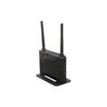
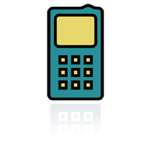
Current Use Case
3G base station
802.11 AP
TGah UL/DL
3G UL/DL
STA
STA

Slide 8
Observations
3G coverage is good & longer than 11ah and can be used as a candidate uplink transmission
We should not exclude the case where more than 1 connection are up (e.g Cellular and 802.11ah operating simultaneously)

Slide 9
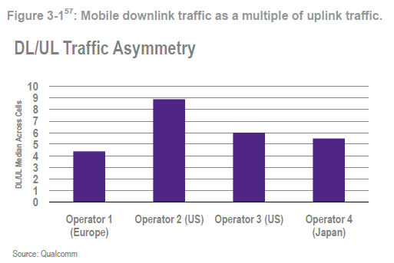
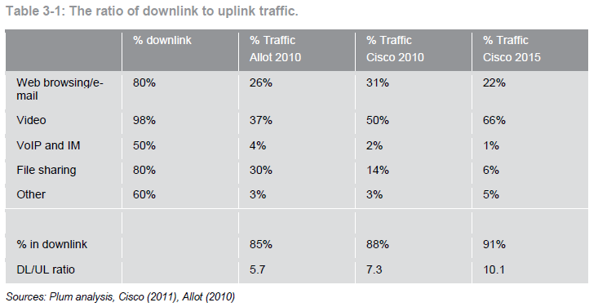
Traffic Asymmetry
Reference: Plum Consulting, June 2011 “Economic study of the benefits from use of 1452-1492 MHz for a supplemental mobile downlink for enhanced multimedia and broadband services”

Slide 10
Other sub-Use Case
3G base station
3G base station
12%
802.11ah AP
3G UL
88%
3G UL/DL
TGah DL
STA
STA

Slide 11
Observation
No modification to cellular networks signalling required
Traffic routing done at IP layer
Only enhancement of UL signaling for TGah DL traffic required

Slide 12
Other sub-Use Case
Co-located APs
802.11ah AP
802.11g/n AP
3G base station
TGah (UL Traffic
& TGg/n DL signalling)
11g/n DL
3G UL/DL
STA
STA

Slide 13
Observation
UL/DL Traffic routing done at IP layer
TGah bands maybe be BW limited and we can benefit from still using the 2.4GHz band for offloading
Use of TGah for TGg/n signaling design required

Slide 14
Conclusion
Current use case of the Cellular offloading should consider concurrent operation of multiple bearers and clever use of TGah for enhanced performance

Slide 15
References
[1] Rolf de Vegt, “Potential Compromise for 802.11ah Use Case Document,” 11-11/457r0.
[2] Novarum Inc. Report, 2010 “Guidelines for Successful Large Scale Outdoor Wi-Fi Networks”
[3] Plum Consulting, June 2011 “Economic study of the benefits from use of 1452-1492 MHz for a supplemental mobile downlink for enhanced multimedia and broadband services”

