Slide 1
Simulation Study of the Performance of DCF Under Heavy Traffics for 802.11ah
Date: 2011-09-15
Authors:

Slide 2
Abstract
In this report, we present simulation results that show the performance of DCF in “802.11ah Environmental and Agriculture Use Cases” [1] under heavy bursty traffics.

Slide 3
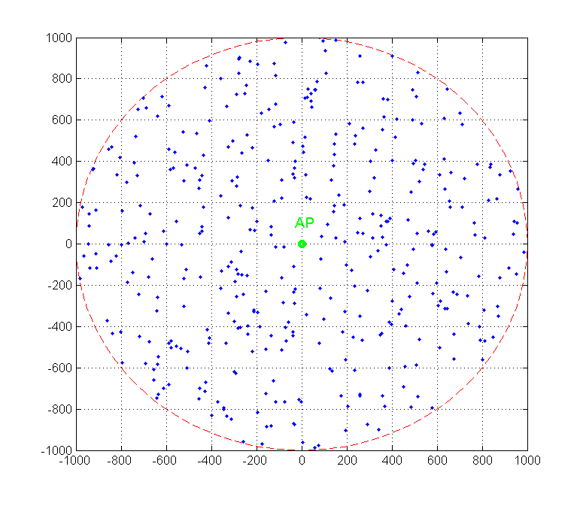
Simulation Scenarios
Num of AP: 1
Num of Stations:100, 200, 300, 400
Topology:
Disk with a 1000 meter radius
AP at the center of the disk
Stations uniformly within the disk

Slide 4
Simulation Parameters 1
Channel Bandwidth | 20MHz
Symbol Duration | 4µs
Bursty Data Rate | 50kbps/station (uplink)
TX Power | 30dBm
Antenna Gains | 3dB
MCS | BPSK, 1 over 2
Max Communication Range | 1012 Meters (-88dBm)
Max Carrier Sensing Range | 1293 Meters (-92dBm)
Packet Size | 1250Bytes
DIFS | 34µs
SIFS | 16µs
Slot Time | 9µs
CWmin | 15
CWmax | 1023

Slide 5
Simulation Parameters 2
Pathloss model
Outdoor Macro [2]: PL(d) =8+37.6log10(d)
Station to Station model [3]: PL(d)=16.90 + 42.4*log10(d)
Traffic Model
For each station
Bursty-Window = 16 Seconds
#Packets = Busty-Window * Data Rate / Packet Size
TX time for each packet is randomly selected in the Bursty-Window
Bursty-Window

Slide 6
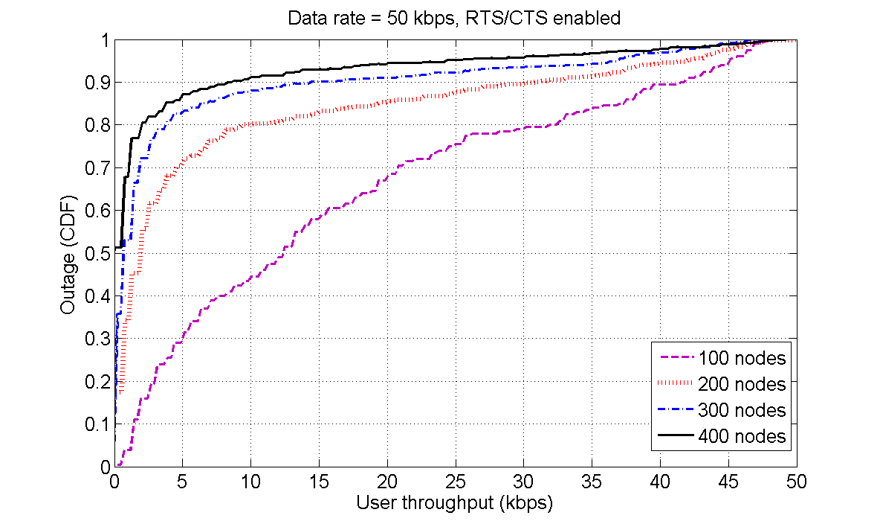
Simulation Result: Uplink Outage
For 200-400 stations, 15% of stations have almost 0 throughput and about 5% of
stations achieved a throughput of 40-47kbps

Slide 7
Discussion
With DCF, heavy bursty traffics may cause
Increased energy consumption
Unfairness in terms of throughput
Compare performance to non-contention based MACs such as PCF
Further study

Slide 8
References
[1] Potential Compromise for 802.11ah Use Case Document, IEEE802.11-11/0457r0
[2] TGah channel model – proposed text, IEEE802.11-11/0968r1
[3] STA-STA Pathloss Model, IEEE802.11-11/1263r0

