Slide 1
802.11ah M2M Channel Access Performance
Date: 2011-09-19
Authors:

Slide 2
Abstract
This presentation provides simulation results to show existing 802.11 CSMA/CA is sufficient to support machine-to-machine channel access (e.g. sensor use case) in 802.11ah.

Slide 3
802.11ah Sensor Use Case
Sensor applications traffic [1]
Data packet size: few hundred bytes
Low duty-cycle: transmits data every few minutes
Number of stations could be as large as 6000 stations

Slide 4
Simulation Deployment Setting
6000 machines uniformly distributed within a 1km radius circle around the AP.
Each machine selects its MCS based on the received signal strength.
E.g., machines within the inner ring operate at the highest MCS.
Outdoor channel model [2]:
Macro deployment path-loss model: PL(d) =8+37.6log10(d)
(MCS0=6.5Mbps/8)
(MCS7=
65Mbps/8)

Slide 5
Simulation Parameters
Parameter | Value
Operating frequency | 900 MHz
Bandwidth | 2.5 MHz
Sensor packet size | 256 bytes
Sensor transmission period | 2 minutes
Sensor Tx power | 30 dBm
Antenna gain | 3 dBi
Slot time | 37 µs
SIFS | 128 µs
Data rates used in the simulation:
MCS Index | Modulation | R | 2.5MHz (1/8 down-clocking) Data rate (Mb/s)
 |  |  | 6.4 us GI
0 | BPSK | 1/2 | 0.8125
1 | QPSK | 1/2 | 1.625
2 | QPSK | 3/4 | 2.4375
3 | 16-QAM | 1/2 | 3.25
4 | 16-QAM | 3/4 | 4.875
5 | 64-QAM | 2/3 | 6.5
6 | 64-QAM | 3/4 | 7.3125
7 | 64-QAM | 5/6 | 8.125
Data rate for control frames: MCS0
Access delay performance measurement
Total amount of time required from packet generation till successful ACK reception.
= (defer + backoff + retransmissions including the final successful packet transmission + SIFS + ACK)

Slide 6
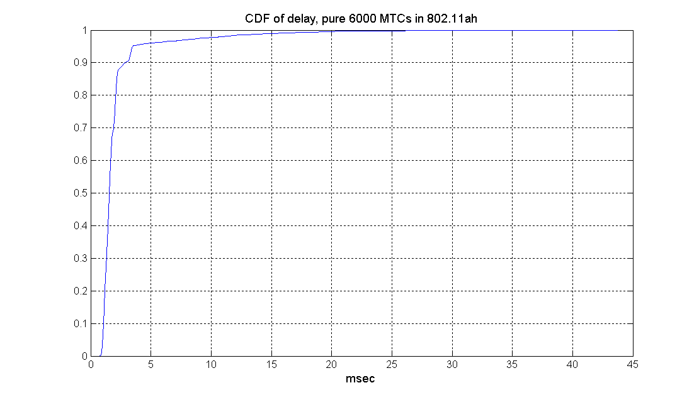
Simulation Results
Over 95% of users are with less than 5ms delay.
→ Access delay is not an issue for sensors.
Avg. access delay of all machines: 2092.4 usec
Avg. access delay of machines with the highest data rate (8.125Mbps): 1204.7 usec
Avg. access delay of machines with the lowest data rate (812.5Kbps): 4799.0 usec

Slide 7
Conclusion
Under reasonable traffic intensity, e.g., transmission of 256 bytes every 2 minutes, access delay is not an issue even with large number (6000) of sensor deployment.

Slide 8
References
[1] Rolf de Vegt, “Potential Compromise for 802.11ah Use Case Document,” 11-11/457r0.
[2] Ron Porat et. al., “TGah channel model – proposed text,” 11-11/0968r1.

