Slide 1
FILS Association
Date: 2011-09-20
Authors:
Name | Affiliations | Address | Phone | email
Jihyun Lee | LG Electronics | LG R&D Complex 533, Hogye-1dong, Dongan-Gu, Anyang, Kyungki, 431-749, Korea | +82-31-450-1860 | Jihyun1220.lee@lge.com
Eunsun Kim |  |  |  | Esun.kim@lge.com
Yongho Seok |  |  |  | Yongho.seok@lge.com

Slide 2
Abstract
This presentation proposes to reduce the frame length of Association Response

Slide 3
Conformance w/ Tgai PAR & 5C
Conformance Question | Response
Does the proposal degrade the security offered by Robust Security Network Association (RSNA) already defined in 802.11? | No
Does the proposal change the MAC SAP interface? | No
Does the proposal require or introduce a change to the 802.1 architecture? | No
Does the proposal introduce a change in the channel access mechanism? | No
Does the proposal introduce a change in the PHY? | No
Which of the following link set-up phases is addressed by the proposal? (1) AP Discovery (2) Network Discovery (3) Link (re-)establishment / exchange of security related messages (4) Higher layer aspects, e.g. IP address assignment | 3

Slide 4
Motivation
Association protocol
Association Response contains both STA-dependent and STA-independent information elements.
STAs can obtain the STA-independent information ahead of association (e.g. from Beacon or Probe Response)

Slide 5
Motivation
Association Response management frame format
Order | Information (length in octets)
2 | Status code (2)
3 | AID (2)
7 | RCPI (3)
8 | RSNI (3)
10 | Mobility domain (5)
11 | Fast BSS transition (84-257)
13 | Timeout Interval (Association Comeback time) (7)
STA-dependent information
1 | Capability (2)
4 | Supported rates (3-10)
6 | EDCA Parameter Set (20)
5 | Extended Supported Rates (3-257)
9 | RM Enabled Capabilities (7)
12 | DSE registered location (22)
14 | HT Capabilities (28)
15 | HT Operation (24)
16 | 20/40 BSS Coexistence (3)
17 | Overlapping BSS Scan Parameters (16)
18 | Extended Capabilities (3)
Last | Vendor Specific (3-257)
STA-independent information :
Beacon and Probe Response frame also contains this.
* The order of information changed for better understanding.

Slide 6
Proposed association protocol
Shedding off extra weight from Association Response
Association Response shall include STA-independent information if the non-AP STA have not gotten them. Otherwise, it may NOT include STA-independent information.
Checking the validity of information
Association Request shall indicate when it obtained STA-independent information from AP so that AP STA would be able to check the validity of the information on the non-AP STA side.

Slide 7
STA behavior
Non-AP STA
Non-AP STA transmits Association Request frame to the AP STA. it sets the value of validity field in Association Request frame to the lower order of 3 octets of timestamp in the most recently received Beacon or Probe Response frame.
On the receipt of Association Response with status code set to 0(successful), it finishes association procedure.
If the status code is set to other than 0, it either retry or goes back to the previous procedure.

Slide 8
STA behavior
AP STA
The AP shall cache the latest TSF value of when an update to the STA-independent information occurs.
On receipt of Association Request frame from a non-AP STA with the state is other than 1, it proceed the following procedure.
The AP shall check the value of validity field in the Association Request and compare it with its cached TSF value
If the value of validity is less than the lower order of 3 octets of the TSF value, the AP respond with Association Response.
If the value of validity is greater than or equal to the lower order of 3 octets of the TSF value, the AP respond with Association Response which may NOT include the following information elements
Capability, Supported Rates, EDCA Parameter Set, Extended Supported Rates, RM Enabled Capabilities, DSE Registered Location, HT Capability, HT Operation, 20/40 BSS Coexistence, Overlapping BSS Scan Parameters, Extended Capabilities

Slide 9
Frame format
Association Request frame format
Insert the following row in Table 8-22:
Validity
Validity contains 24 LSBs of the 64 bit timestamp in the Beacon or Probe Response sent from the AP
Order | Information | Notes
 | validity | The Sequence ID element may be present if dot11FILSActivated is true.
 | Element ID | Length | Validity
Octets: | 1 | 1 | 3

Slide 10
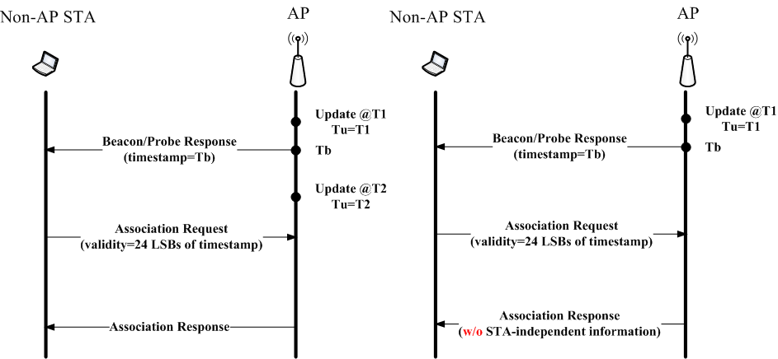
Proposed association protocol
validity< lower order of 3 octets of Tu? (1): (2)
(1)
(2)

Slide 11
Numerical analysis
802.11n
Transmission time of Association Response reduced by 59%
Time consumption for Association reduced by 26~16 %
Time consumption for Association = backoff+request+SIFS+response
 |  | Original | Proposed
Frame length (octet) | Min | 113 | 11
 | Max | 379 | 11
Tx time (us) | Min | 229.3333 | 93.33333
 | Max | 584 | 93.33333
 |  |  | Original | Proposed
Tx time (us) | Number of users = 1 | Min | 531.5 | 395.5
 |  | Max | 1267.5 | 776.5
 | Number of user =50 | Min | 853.4284 | 717.4284
 |  | Max | 1589.428 | 1098.428

Slide 12
Numerical analysis
802.11n + k/r/v
Transmission time of Association Response reduced by 38%
Time consumption for Association reduced by 22~14%
 |  | Original | Proposed
Frame length (octet) | Min | 241 | 127
 | Max | 731 | 351
Tx time (us) | Min | 400 | 248
 | Max | 1053.333 | 546.6667
 |  |  | Original | Proposed
Tx time (us) | Number of users = 1 | Min | 702.1667 | 550.1667
 |  | Max | 1752.833 | 1246.167
 | Number of users = 50 | Min | 1024.095 | 872.0951
 |  | Max | 2074.761 | 1568.095

Slide 13
Numerical analysis
6Mbps Tx rate
aSIFSTime=16us, aSlotTime=9us, aCWmin=15, aCWmax=1023

Slide 14
Conclusion
By eliminating unnecessary duplicate IEs from Association Response
Reduce transmission time of Association Response frame
Make room for other IEs to be delivered in Association Response frame

Slide 15
Reference
1000r1
1170r0
Hai L.Vu and Taka Sakurai, “Collision probability in saturated IEEE 802.11 networks” , ATNAC, Dec 2006

