Slide 1
Fast Authentication in TGai
Date: 2012-01-16
Authors:
Name | Affiliations | Address | Phone | email
George Cherian Santosh Abraham Hemanth Sampath Jouni Malinen Menzo Wentink | Qualcomm | 5775 Morehouse Dr, San Diego, CA, USA | +1 (858)-651-6645 | gcherian@qualcomm.com sabraham@qualcomm.com hsampath@qualcomm.com jouni@qca.qualcomm.com mwentink@qualcomm.com
Hitoshi MORIOKA Hiroshi Mano | Allied Telesis R&D Center. | 2-14-38 Tenjin, Chuo-ku, Fukuoka 810-0001 JAPAN | +81-92-771-7630 | hmorioka@root-hq.com hmano@root-hq.com
Mark RISON | CSR | Cambridge Business Park, Cowley Road, Cambridge CB4 0WZ UK | +44-1223-692000 | Mark.Rison@csr.com
Marc Emmelmann | Fraunhofer FOKUS | Kaiserin-Augusta-Alle 31 10589 Berlin Germany | +49-30-3463-7268 | emmelmann@ieee.org
Ping Fang Zhiming Ding Phillip Barber Rob Sun | Huawei Technologies Co., Ltd. | Bldg 7, Vision Software Park, Road Gaoxin Sourth 9, Nanshan District, Shenzhen, Guangdong, China, 518057 | +86 755 36835101 | ping.fang@huawei.com dingzhiming@huawei.com pbarber@huawei.com Rob.sun@huawei.com
Chengyan Feng Bo Sun | ZTE Corporation |  |  | feng.chengyan@zte.com.cn sun.bo1@zte.com.cn

Slide 2
Abstract
This document proposes optimizations for full authentication, EAP-RP based Fast authentication, and simultaneous IP address acquisition for FILS.

Slide 3
Conformance w/ TGai PAR & 5C
Conformance Question | Response
Does the proposal degrade the security offered by Robust Security Network Association (RSNA) already defined in 802.11? | No
Does the proposal change the MAC SAP interface? | No
Does the proposal require or introduce a change to the 802.1 architecture? | No
Does the proposal introduce a change in the channel access mechanism? | No
Does the proposal introduce a change in the PHY? | No
Which of the following link set-up phases is addressed by the proposal? (1) AP Discovery (2) Network Discovery (3) Link (re-)establishment / exchange of security related messages (4) Higher layer aspects, e.g. IP address assignment | 3, 4

Slide 4
Background
Previous contributions such as 11/1160r3 to 11ai for FILS feature:
Single pair of messages of authentication using EAP-RP for concurrent authentication and IP address acquisition
Use of Beacon/ProbeResp to send Anonce
Use of Association Req/Resp to send ULI
11/1047r6 have proposed using EAP framework for FILS
Defines the format for Upper Layer Message IE
Concurrent use of Authentication & IP address acquisition using EAP
Use of authentication frames for EAP/EAPOL exchange
This proposal combines the above proposals as follows:
Use of optimized full EAP in 11/1047r6 when EAP-RP context is not setup, or has expired
Otherwise use EAP-RP based fast authentication in 11/1160r4

Slide 5
An example of how the solution is applied for FILS
Use case: Hot-spot pass through:
A user passes by (several, non overlapping) publicly accessible WiFi hot-spots (e.g. ATTwifi at Starbucks)
While having connectivity, the user up-&downloads e-mails, twitter / facebook messages etc
Step-1: User buys an STA, performs FILS using optimized full EAP authentication as part of out-of-the-box setup with a network (say, ATTwifi )
Step-2 [this step repeated afterwards]: The user passes by (several, non overlapping) publicly accessible WiFi hot-spots (e.g. ATTwifi at Starbucks)
STA will perform Fast-Initial-Link setup with the ATTwifi network using EAP-RP

Slide 6
Proposal Summary
Concurrent Authentication with IP address Assignment
DHCP with Rapid commit is used as an example for IP address assignment
Allows protection (integrity check & encryption) for IP address assignment message
based on STA choice
Use of EAP
Optimized full EAP authentication when EAP-RP context is not setup or expired
4 or more (depending on EAP method) over-the air messages after beacon
Uses home Authentication Server
EAP-RP based authentication during subsequent link setup
2 over-the-air messages after beacon
Can use visited authentication server
Optimized full EAP & EAP-RP are complementary to each other and doesn’t depend on each other
Optimized full EAP and EAP-RP may be deployed one without the other, but a combination would yield the best results
Following slides present the case where both are used
Builds on existing EAP framework in 802.1X security architecture
RSNA security
The proposal meets the RSNA security requirement

Slide 7
Benefits of using EAP/EAP-RP for FILS
EAP/EAP-RP allows multiple authentication protocols to be supported
Allows authentication server to control which authentication protocol is used without the authenticator(Access Point) being fully configured
Authenticator can act as a “pass through”
Authenticator acts only on the outcome of authentication (say, deny access etc.)
Allows reuse of subscriber credentials defined for interworking with 3GPP EPC
No additional standardization effort needed for AP-AS communication
No CPU intensive cryptographic computation required at the AP
Minimal air interface occupancy
Proposal reduces link setup including secure IP address assignment to 1.5 roundtrip (including beacon) when EAP-ERP is used
Allows encryption of IP address assignment req/resp

Slide 8
EAP-RP Overview

Slide 9
Key Hierarchy for EAP-RP
rRK, rIK is maintained by Authentication Server and STA (not passed to Access Point)
rMSK is passed to AP during ERP

Slide 10
Overview of EAP-RP
STA
Auth1
Auth2
AS
EAP Req/Identity
Full EAP Exchange
EAP Resp/Identity
Full EAP Method Exchange
MSK, EMSK
rRK, rIK
MSK, EMSK
rRK, rIK
EAP Success
EAP Success
MSK
(MSK)
EAP-RP Exchange
EAP Re-auth Initiate (authenticated with rIK)
rMSK
rMSK
EAP Re-auth Finish (authenticated with rIK)
EAP Re-auth Finish (authenticated with rIK)
rMSK
(rMSK)
ERP is specified in RFC 5295/5296
Re-authentication is completed using a single pair of messages

Slide 11
Proposal Details

Slide 12
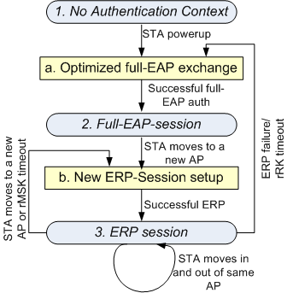
State Machine & Key storage: Conceptual Level
State-1: No Auth Context
AS: RK
AP: None
STA: RK
State-2: Full EAP session
AS: RK, EMSK, DSRK, rRK, rIK, MSK
AP: MSK
STA: RK, EMSK, DSRK, rRK, rIK, MSK
State-3: ERP session
AS: RK, EMSK, DSRK, rRK, rIK, rMSK
AP: rMSK
STA: RK, EMSK, DSRK, rRK, rIK, rMSK
Action-a: Optimized Full EAP Exchange
Optimized full EAP procedure can be used
A new rRK, rIK is generated
Action-b: New EAP-ERP Session
A new rMSK is generated

Slide 13
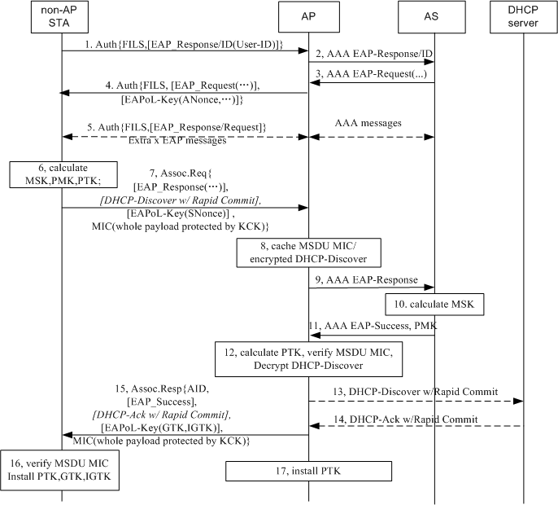
Optimized full EAP with concurrent IP address assignment
Optimized Full EAP is performed when EAP-ERP context (EMSK, rRK, rIK) is not setup or has expired.
Different IP address assignment mechanism could be used, depending on the network deployment.
Step-1: EAPoL-Start and EAP-Request/ID are skipped. An EAP-Response/ID is carried in IEs.
Step-5 is optional for SIM based device
Step-7 and 15: A MIC for whole MSDU protected by KCK are attached in Assoc Request and Assoc Response.
Step 8: AP caches MSDU MIC before PTK is available.
Step 12: AP verifies MSDU MIC once PTK is received from AS.
Step 13,14: A full DHCP procedure could be used if the DHCP server doesn’t support Rapid Commit Option.
Other IP address allocation could be used, for example AP can be pre-assigned a IP pool.
If IP address assignment server doesn’t respond within a certain period, then the AP may send Assoc Resp frame with indication of IP configuration unavailable/pending.

Slide 14
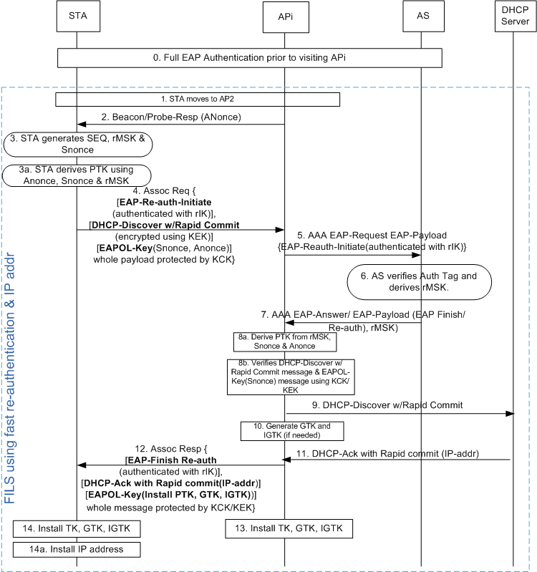
EAP-RP with concurrent IP address assignment
Used when EAP-RP context is setup (rRK, rIK, EMSK)
[Step-0] Full authentication may happen using an AP or using a cellular system. Use of optimized full-EAP (proposed in slide-13) is preferred
[step 2] AP transmits the Beacon/Probe Resp. which includes .11ai capability indicator for ERP & simultaneous IP addr assignment. AP changes Anonce frequent enough
[step-3] STA generates rMSK using [RFC 5296] before sending Assoc-Req
rMSK = KDF (K, S), where K = rRK and
S = rMSK label | "\0" | SEQ | length
[step-4] STA packs the following messages as IEs of Association-Request
EAP Re-auth Initiate [Message Integrity using rIK]
DHCP Discover with Rapid Commit [Encrypted using KEK]
EAPOL-Key (Snonce, Anonce)
[step-4] STA applies message integrity on the combined payload that include EAP-Re-Auth, DHCP-Discover & EAPOL-Key using KCK
[step-5] AP holds the DHCP & EAPOL-Key message until it receives rMSK from AS
[step 8b] AP performs MIC for DHCP & EAPOL Key messages and decrypt DHCP

Slide 15
Optimized Full EAP/EAP-RP selection
Optimized Full EAP is performed when:
No EAP was performed with the network prior to this association OR
rRK of the EAP session has expired
Default Full EAP can be used if optimized-full-EAP is not supported
rRK session timer determination
STA can include “lifetime flag” in the EAP-Initiate/Re-auth message to request rRK lifetime
rRK lifetime passed to STA in EAP-Finish/Re-auth message
RFC says: “The peer can use the rRK lifetime to know when to trigger an EAP method exchange and the rMSK lifetime to know when to trigger another ERP exchange”

Slide 16
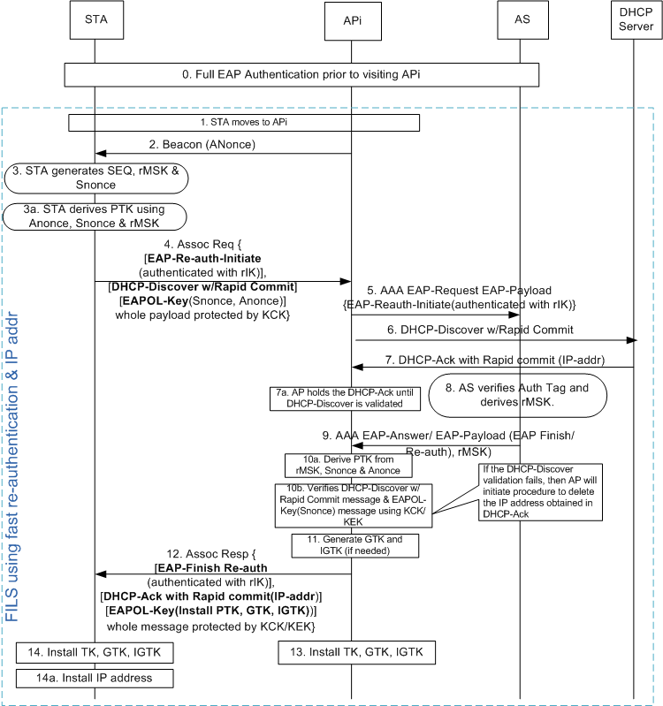
EAP-RP with simultaneous IP address assignment
Similar to slide-15 except the following:
Step-2: AP may advertise the capability that DHCP-request can be encrypted
Step-4: STA decides if the DHCP message should be encrypted or not. Several factors are taken into consideration by STA, such as if DHCP Discover contains any private information etc. If the STA decides to encrypt DHCP-discover request, then AP will hold the message [as described in option-2 & option-2a], Otherwise following steps are performed
Step-4: DHCP-Discover message IE is only Message-Integrity protected
Based on step-4, AP2 sends DHCP-Discover-With-Rapid-Commit (step 6) without waiting for response for EAP-Reauth-Initiate-Request (step-9)
This process makes the IP address assignment to take place in parallel to EAP-(re)authentication procedure
At step-7a, AP holds the DHCPACK that came from DHCP server until step-10b, where DHCP-Discover is validated
If the message integrity fails, then the AP initiates procedure to delete the IP address assigned using DHCP-Ack

Slide 17
Upper Layer message transport
Several proposals are submitted that enables carrying of upper layer messages such as DHCP, Authentication messages
See 12/0032r2, 11/1047r6
This proposal doesn’t depend on the specific choice of transport mechanism.

Slide 18
Backup

Slide 19
Straw polls
1. Do you support using a pre-established FILS context to improve the authentication time during association?
Yes:
No:
Abstain:
2. Do you support the concurrent 4-way handshake with EAP setup to pre-establish the FILS context?
Yes:
No:
Abstain:

Slide 20
Straw polls
3. Do you support sending ANonce in beacon (assuming ANonce can be changed in every beacon if needed)?
Yes:
No:
Abstain:
4. Do you support Implicit key confirmation using successful reception of MAC layer acknowledgement
Yes:
No:
Abstain:

Slide 21
Response to Questions

Slide 22
Question 1: How does the proposal compress the 4-way handshake for 11ai into just 1 round-trip, and still doesn’t compromise the security ?
The proposal reduces 4-way handshake to 3-way handshake
Steps | Current Message | New Message | Procedure upon receiving the message
Step-1: ANonce sent from AP to STA | EAPOL-Key | Sent in the beacon. | [same for both methods] STA calculates PTK using ANonce & SNonce
Step-2: SNonce sent from STA to AP | EAPOL-Key (protected using MIC) | EAPOL-Key as an IE of Association Request (protected using MIC) | [same for both methods] AP calculates PTK using Anonce & Snonce [New procedure] AP installs the keys
Step-3: Key-Install information sent from AP to STA | EAPOL-Key (protected using MIC) | EAPOL-Key as an IE of Association Response (protected using MIC) | [Current procedure]: STA installs the key. Also, STA sends EAPOL-Key message to AP confirming temporal key is installed [New procedure] STA installs the key.
Step-4: Send confirmation of key-install from STA to AP | EAPOL-Key (protected using MIC) | Not sent (addressed in step 2) | [Current procedure] AP installs the keys

Slide 23
Question-2: Are the IP address assignment messages protected?
Yes.
DHCP-Discover message (sent in Association Request message) and DHCP-Ack are protected by both encryption (using KEK) and message integrity (using KCK)
Question-3: What is the latency experienced for messages sent between AP & AS?
There is only one round of messaging between AP & AS. Depends on deployment.
Additional latency introduced by holding DHCP message can be reduced by performing address assignment and security validation simultaneously
See the call flow in the next page

Slide 24
Question-4: Can you transfer state information across networks so that you don’t have to repeat EAP, every time you switch networks?
STA may have a large interval (with no WiFi connectivity) after leaving the first AP (where the STA had a connectivity) before it connects to a new AP
Caching the information for a large number of STAs over a large period of time is not scalable
Question-5: What happens if EAP-RP fails?
Falls back to full-EAP
Question-6: What to do if AP has multiple AS’s? How does the STA know which key to use ?
Even though AP may be connected to multiple AS’s, only one AS should be used for an STA.
AP forwards EAP messages to the appropriate AS based on the identity sent by the STA in “keyName-NAI” sent in the ERP-Initiate/Re-auth message

Slide 25
Question-7: How does STA know the full-authentication timer so that STA may proactively perform full authentication?
STA can include “lifetime flag” in the EAP-Initiate/Re-auth message to request rRK lifetime
rRK lifetime passed to STA in EAP-Finish/Re-auth message
RFC says: “The peer can use the rRK lifetime to know when to trigger an EAP method exchange and the rMSK lifetime to know when to trigger another ERP exchange”

Slide 26
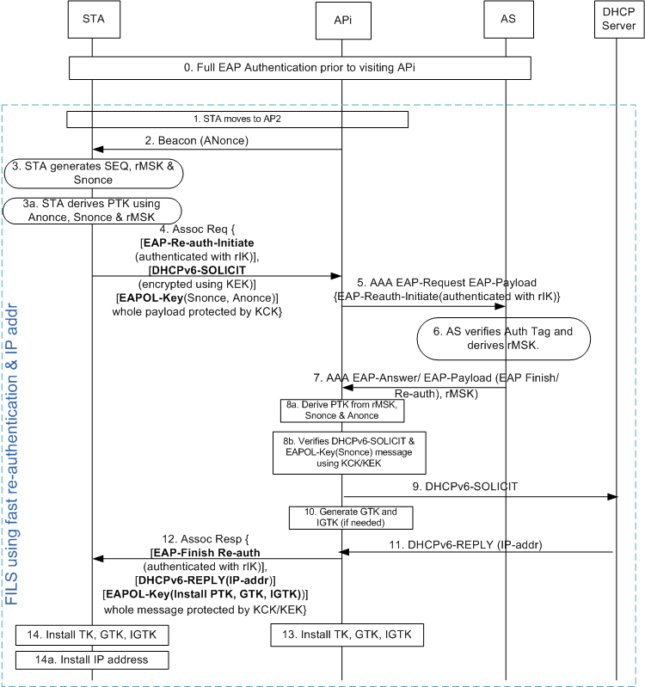
Qn. 8 How does IPv6 address assignment work?
Two options can be used
DHCPv6 (shown in the diagram)
Router Solicitation/Router Advertisement
DHCPv6 option (see diagram)
Similar to slide-12 except the following:
DHCPv6-SOLICIT message with “Rapid Commit Option” [See RFC 3315] is used instead of DHCP-Discover with Rapid Commit
DHCPv6-REPLY is used instead of DHCP-Ack
RS/RA Option
STA may send RS at step-4
AP sends RA at step-12
AP may obtain the IP address based on local configuration or from a centralized server based on RADIUS or proprietary methods
Interface ID will be based on EUI-64
Devices will use MAC identifier

Slide 27
Qn. 9 How does STA know the support of IP address type and IP address assignment method?
Beacon/Probe-Response sent from the AP includes the following information
IP address type supported
IPv4, IPv6, IPv4v6
IP address assignment method supported
DHCP, DHCPv6, RS/RA, etc.

