Slide 1
Fast Authentication in TGai
Date: 2011-11-07
Authors:
Name | Affiliations | Address | Phone | email
George Cherian Santosh Abraham Hemanth Sampath | Qualcomm | 5775 Morehouse Dr, San Diego, CA, USA | +1 (858)-651-6645 +1 (858)-651-6107 +1(858)-658-1848 | gcherian@qualcomm.com sabraham@qualcomm.com hsampath@qualcomm.com
Jouni Malinen | Qualcomm | Hermiankatu 6-8 D Tampere, Finland |  | jouni@qca.qualcomm.com
Menzo Wentink | Qualcomm | Straatweg 66-S, Breukelen, Netherlands | +31-346-259-656 | mwentink@qualcomm.com
Hitoshi MORIOKA | Allied Telesis R&D Center. | 2-14-38 Tenjin, Chuo-ku, Fukuoka 810-0001 JAPAN | +81-92-771-7630 | hmorioka@root-hq.com
Hiroshi Mano | Allied Telesis R&D Center. | 7-21-11 Nishi-Gotanda, Shinagawa-ku, Tokyo 141-0031 JAPAN | +81-3-5719-7630 | hmano@root-hq.com
Mark RISON | CSR | Cambridge Business Park, Cowley Road, Cambridge CB4 0WZ UK | +44-1223-692000 | Mark.Rison@csr.com
Marc Emmelmann | Fraunhofer FOKUS | Kaiserin-Augusta-Alle 31 10589 Berlin Germany | +49-30-3463-7268 | emmelmann@ieee.org

Slide 2
Abstract
This document proposes EAP-RP based Fast authentication and simultaneous IP address acquisition for FILS

Slide 3
Conformance w/ TGai PAR & 5C
Conformance Question | Response
Does the proposal degrade the security offered by Robust Security Network Association (RSNA) already defined in 802.11? | No
Does the proposal change the MAC SAP interface? | No
Does the proposal require or introduce a change to the 802.1 architecture? | No
Does the proposal introduce a change in the channel access mechanism? | No
Does the proposal introduce a change in the PHY? | No
Which of the following link set-up phases is addressed by the proposal? (1) AP Discovery (2) Network Discovery (3) Link (re-)establishment / exchange of security related messages (4) Higher layer aspects, e.g. IP address assignment | 3, 4

Slide 4
Background
Previous contributions such as 11/0976r3 to 11ai for FILS feature:
Single pair of messages of authentication
Use of Beacon/ProbeResp to send Anonce
Use of Association Req/Resp to send ULI
Other contributions such as 11/1047 have proposed using EAP framework for FILS
We propose EAP-RP based Fast authentication and simultaneous IP address acquisition for FILS

Slide 5
Introduction
Key principles followed in this contribution:
Use of DHCP
Use of DHCP Rapid commit
DHCP is widely used for obtaining the IP address (also see 1047r2)
DHCP exchanges must be protected
Use of EAP
Builds on existing EAP framework in 802.11
Retains currently standardized 802.1x security architecture
See additional advantages of using EAP in a later slide
STA will execute full EAP authentication as part of the initial setup/provisioning
Full EAP authentication can be considered as “out-of-the-box setup procedure”
EAP-RP based re-authentication is used for FILS when the STA visits that network
How to reduce the message rounds
Use of EAP-RP (EAP Reauthentication protocol)
Concurrent use of EAP-RP & DHCP Rapid Commit

Slide 6
An example of how the solution is applied for FILS
Use case: Hot-spot pass through:
A user passes by (several, non overlapping) publicly accessible WiFi hot-spots (e.g. ATTwifi at Starbucks)
While having connectivity, the user up-&downloads e-mails, twitter / facebook messages etc
Step-1: User buys an STA, performs full EAP authentication as part of initial setup with a network (say, ATTwifi )
In this example, let’s say, the network allows the EAP session to be maintained for one year
Step-2 [this step repeated afterwards]: The user passes by (several, non overlapping) publicly accessible WiFi hot-spots (e.g. ATTwifi at Starbucks)
STA will perform Fast-Initial-Link setup with the ATTwifi network using EAP-RP

Slide 7
High Level Concept*
Existing .11
.11ai
STA
AP
STA
AP
4-way handshake,
no security
Fast Authentication & Upper Layer Setup (DHCP)
.11i authentication
.11i key setup
4 phases into 1.
No need to process
sequentially. These
can be processed
simultaneously.
Upper Layer Setup
(i.e. DHCP)
* Slide merged from 11/0976r3

Slide 8
Advantages of using EAP
EAP allows multiple authentication protocols to be supported without having to pre-negotiate a specific one
Allows authentication server to control which authentication protocol is used without the authenticator being fully configured
Authenticator can act as a “pass through”
Authenticator acts only on the outcome of authentication (say, deny access etc.)
Simplifies credential management
Stored between authentication server and client
EAP is required for interworking with 3GPP EPC and WiMAX
Pointed out in 1047r2

Slide 9
Use of EAP for FILS
What is the issue in using EAP for FILS?
EAP authentication typically requires a minimum of two roundtrips
Proposed Solution
Use of EAP-RP (EAP Reauthentication protocol) for FILS
RFC 5295/5296
Preserves all the benefits of EAP
Re-authentication is completed using a single pair of messages
Can interwork with cellular technologies when single credential is used (for WiFi and cellular) to access the network

Slide 10
Overview of EAP-RP
STA
Auth1
Auth2
AS
EAP Req/Identity
Initial EAP Exchange
EAP Resp/Identity
Full EAP Method Exchange
MSK, EMSK
rRK, rIK
MSK, EMSK
rRK, rIK
EAP Success
EAP Success
MSK
(MSK)
EAP-RP Exchange
EAP Re-auth Initiate (authenticated with rIK)
rMSK
rMSK
EAP Re-auth Finish (authenticated with rIK)
EAP Re-auth Finish (authenticated with rIK)
rMSK
(rMSK)

Slide 11
Key Hierarchy for ERP
rRK, rIK is maintained by Authentication Server and STA (not passed to Access Point)
rMSK is passed to AP during ERP

Slide 12
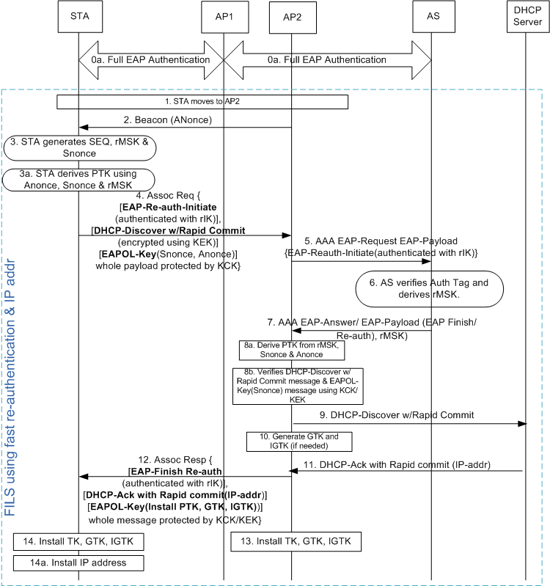
Fast Reauthentication with IP address assignment
[Step-0] Full authentication may happen using an AP or using a cellular system.
[step 2] AP transmits the Beacon/Probe Resp. which includes .11ai capability indicator for ERP & simultaneous IP addr assignment. AP changes Anonce frequent enough
[step-3] STA generates rMSK using [RFC 5296] before sending Assoc-Req
rMSK = KDF (K, S), where K = rRK and
S = rMSK label | "\0" | SEQ | length
[step-4] STA packs the following messages as IEs of Association-Request
EAP Re-auth Initiate [Message Integrity using rIK]
DHCP Discover with Rapid Commit [Encrypted using KEK]
EAPOL-Key (Snonce, Anonce)
[step-4] STA applies message integrity on the combined payload that include EAP-Re-Auth, DHCP-Discover & EAPOL-Key using KCK
[step-5] AP holds the DHCP & EAPOL-Key message until it receives rMSK from AS
[step 8b] AP performs MIC for DHCP & EAPOL Key messages and decrypt DHCP

Slide 13
Response to Questions

Slide 14
Question 1: How does the proposal compress the 4-way handshake for 11ai into just 1 round-trip, and still doesn’t compromise the security ?
The proposal reduces 4-way handshake to 3-way handshake
Steps | Current Message | New Message | Procedure upon receiving the message
Step-1: Anonce sent from AP to STA | EAPOL-Key | Sent in the beacon. | [same for both methods] STA calculates PTK using Anonce & Snonce
Step-2: Snonce sent from STA to AP | EAPOL-Key (protected using MIC) | EAPOL-Key as an IE of Association Request (protected using MIC) | [same for both methods] AP calculates PTK using Anonce & Snonce [New procedure] AP installs the keys
Step-3: Key-Install information sent from AP to STA | EAPOL-Key (protected using MIC) | EAPOL-Key as an IE of Association Response (protected using MIC) | [Current procedure]: STA installs the key. Also, STA sends EAPOL-Key message to AP confirming temporal key is installed [New procedure] STA installs the key.
Step-4: Send confirmation of key-install from STA to AP | EAPOL-Key (protected using MIC) | Not sent (servers no cryptographic purpose) | [Current procedure] AP installs the keys

Slide 15
Question-2: Are the IP address assignment messages protected?
Yes.
DHCP-Discover message (sent in Association Request message) and DHCP-Ack are protected by both encryption (using KEK) and message integrity (using KCK)
Question-3: What is the latency experienced for messages sent between AP & AS?
There is only one round of messaging between AP & AS. Depends on deployment.
Additional latency introduced by holding DHCP message can be reduced by performing address assignment and security validation simultaneously
See the call flow in the next page

Slide 16
Fast Reauthentication with simultaneous IP address assignment
Similar to slide-12 except the following:
Step-2: AP may advertise the capability that DHCP-request can be encrypted
Step-4: STA decides if the DHCP message should be encrypted or not. Several factors are taken into consideration by STA, such as if DHCP Discover contains any private information etc. If the STA decides to encrypt DHCP-discover request, then AP will hold the message [as described in option-2 & option-2a], Otherwise following steps are performed
Step-4: DHCP-Discover message IE is only Message-Integrity protected
Based on step-4, AP2 sends DHCP-Discover-With-Rapid-Commit (step 6) without waiting for response for EAP-Reauth-Initiate-Request (step-9)
This process makes the IP address assignment to take place in parallel to EAP-(re)authentication procedure
At step-7a, AP holds the DHCPACK that came from DHCP server until step-10b, where DHCP-Discover is validated
If the message integrity fails, then the AP initiates procedure to delete the IP address assigned using DHCP-Ack

Slide 17
Question-4: Can you transfer state information across networks so that you don’t have to repeat EAP, every time you switch networks?
STA may have a large interval (with no WiFi connectivity) after leaving the first AP (where the STA had a connectivity) before it connects to a new AP
Caching the information for a large number of STAs over a large period of time is not scalable
Question-5: What happens if EAP-RP fails?
Falls back to full-EAP
Question-6: What to do if AP has multiple AS’s? How does the STA know which key to use ?
Even though AP may be connected to multiple AS’s, only one AS should be used for an STA.
AP forwards EAP messages to the appropriate AS based on the identity sent by the STA in “keyName-NAI” sent in the ERP-Initiate/Re-auth message

Slide 18
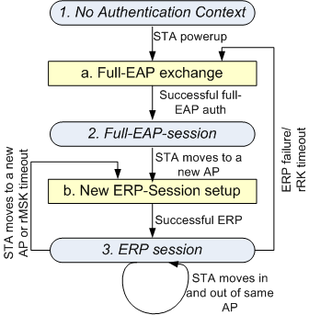
Question-7: What keys are stored at AP, AS & STA?
State-1: No Auth Context
AS: RK
AP: None
STA: RK
State-2: Full EAP session
AS: RK, EMSK, DSRK, rRK, rIK, MSK
AP: MSK
STA: RK, EMSK, DSRK, rRK, rIK, MSK
State-3: ERP session
AS: RK, EMSK, DSRK, rRK, rIK, rMSK
AP: rMSK
STA: RK, EMSK, DSRK, rRK, rIK, rMSK
Action-a:
A new rRK, rIK is generated
Action-b:
A new rMSK is generated

Slide 19
Question-8: How does STA know the full-authentication timer so that STA may proactively perform full authentication?
STA can include “lifetime flag” in the EAP-Initiate/Re-auth message to request rRK lifetime
rRK lifetime passed to STA in EAP-Finish/Re-auth message
RFC says: “The peer can use the rRK lifetime to know when to trigger an EAP method exchange and the rMSK lifetime to know when to trigger another ERP exchange”

Slide 20
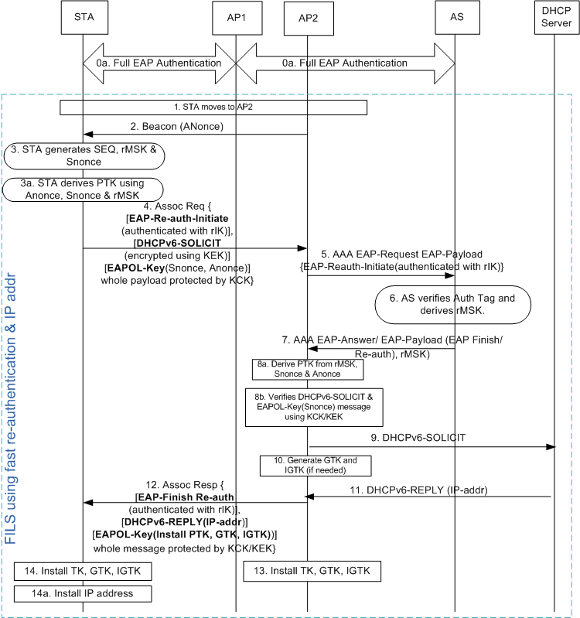
Qn. 9 How does IPv6 address assignment work?
Two options can be used
DHCPv6 (shown in the diagram)
Router Solicitation/Router Advertisement
DHCPv6 option (see diagram)
Similar to slide-12 except the following:
DHCPv6-SOLICIT message with “Rapid Commit Option” [See RFC 3315] is used instead of DHCP-Discover with Rapid Commit
DHCPv6-REPLY is used instead of DHCP-Ack
RS/RA Option
STA may send RS at step-4
AP sends RA at step-12
AP may obtain the IP address based on local configuration or from a centralized server based on RADIUS or proprietary methods
Interface ID will be based on EUI-64
Devices will use MAC identifier

Slide 21
Qn. 10 How does STA know the support of IP address type and IP address assignment method?
Beacon/Probe-Response sent from the AP includes the following information
IP address type supported
IPv4, IPv6, IPv4v6
IP address assignment method supported
DHCP, DHCPv6, RS/RA, etc.

