Slide 1
TGai FILS Proposal
Date: 2011-07-17
Authors:
Name | Affiliations | Address | Phone | email
Jihyun Lee | LG Electronics | LG R&D Complex 533, Hogye-1dong, Dongan-Gu, Anyang, Kyungki, 431-749, Korea | +82-31-450-1860 | Jihyun1220.lee@lge.com
Eunsun Kim | LG Electronics |  | +82-31-450-1860 | Esun.kim@lge.com
Yongho Seok | LG Electronics |  | +82-31-450-1947 | Yongho.seok@lge.com

Slide 2
Abstract
This presentation is an introductory material of a proposal on FILS (Fast Initial Link Setup) mechanisms.
In this presentation, new association mechanisms are suggested to handle a large number of users simultaneously entering an ESS.
And a neighbor discovery mechanism is suggested to parallelize DAD(Duplicated Address Detection) process with 802.11 association/authentication.

Slide 3
AP discovery and Association
Requirements[1]
[Req2.1.2.1] The TGai amendment shall support robustness in the presence of a large number of users. Solutions shall demonstrate that they scale with a high number of users simultaneously entering an ESS.
Solutions
Prioritized link setup
A mobile AP can take a representative role of multiple STAs in terms of association.
The more non-AP STAs it can serve or the shorter its coverage interval is, the higher priority it gets.
Light association response
Remove the redundancy in STA-independent information elements in multiple Association Response.

Slide 4
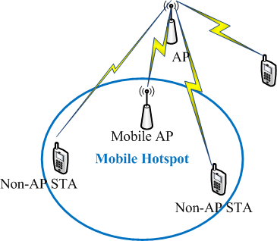
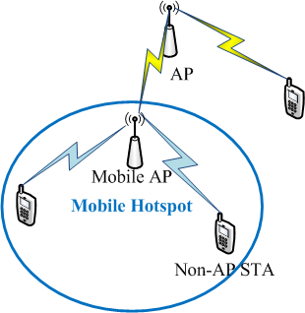
Prioritized link setup
AP can coordinate next association during network discovery. The STA most in need gets the opportunity to start the association the first.
(Mobile ) AP can request its non-AP STAs to cease individual link setup attempts , thus resulting in virtually less user load in terms of association.
AP detection/network discovery
Association

Slide 5
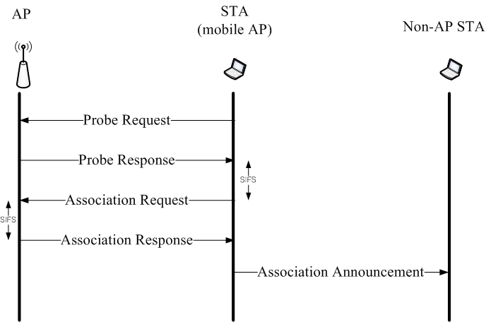
Prioritized link setup
Probe Request contains FILS parameters such as number of STAs it serves and its coverage interval
Probe Response initiates contention-free association process
Association announcement prohibits responding STAs from initiating or continuing association with a new AP for a certain period of time

Slide 6
Light association
Association Response contains both user-dependent and user-independent information elements.
Remove the possible redundancy in Association Response to multiple users to reduce total association time
Order | Information (length in octets)
2 | Status code (2)
3 | AID (2)
7 | RCPI (3)
8 | RSNI (3)
10 | Mobility domain (5)
11 | Fast BSS transition (84-257)
13 | Timeout Interval (Association Comeback time) (7)
User-specific information
1 | Capability (2)
4 | Supported rates (3-10)
6 | EDCA Parameter Set (20)
5 | Extended Supported Rates (3-257)
9 | RM Enabled Capabilities (7)
12 | DSE registered location (22)
14 | HT Capabilities (28)
15 | HT Operation (24)
16 | 20/40 BSS Coexistence (3)
17 | Overlapping BSS Scan Parameters (16)
18 | Extended Capabilities (3)
Last | Vendor Specific (3-257)
Common information :
Beacon and Probe Response frame also contains this.

Slide 7
Light association
Rather than unicast Association Response, AP broadcasts common information so that every STA can hear it and unicast user-specific information (it can be broadcast, but addressed to a specific STA).
AP transmits common information only when it is requested or needed.
Beacon
U-ARSP
U-ARSP
U-ARSP
AP
SIFS
SIFS
SIFS
AREQ
STA_1
DIFS
AREQ
STA_2
DIFS
AREQ
STA_n
DIFS
U-ARSP(User-specific Association Response)
contains user specific IEs only applicable to a specific requesting STA.

Slide 8
IP address configuration
Requirements[1]
[Req2.1.3.1] The TGai amendment shall support concurrency in information exchange. The solution shall provide mechanisms to exchange appropriate information during the link set-up phase. This information is usually contained in higher layer protocol messages.
Solution
IP configuration(Stateless auto-configuration) in parallel with 802.11 link setup
Neighbor discovery protocol for DAD(Duplicated Address Detection)

Slide 9
Neighbor discovery
Stateless auto-configuration
STA acquires one or more link prefixes from the Router Advertisement it receives. By adding the prefix to its previously determined Interface ID, STA can have a globally unique IPv6 address.
After auto-configuration of the address, STA needs to check if it is already used by others in the same subnet.
Neighbor discovery in advance using GAS protocol
In advance of (or during) association/authentication, a STA can send ANQP Query Request with neighbor discovery for the purpose of DAD. AP either respond the request using its local information or proxy it if needed.

Slide 10
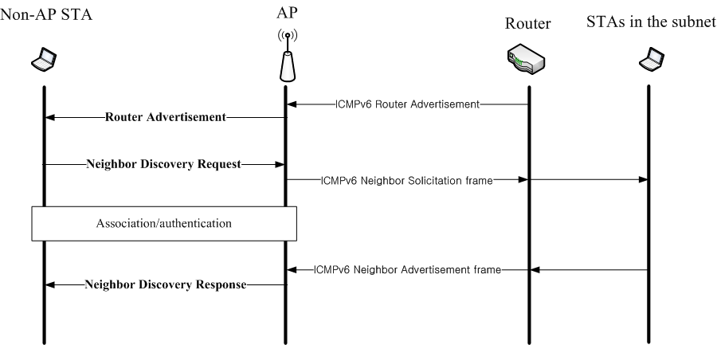
Neighbor discovery
Router Advertise contains IPv6 prefix and can be transmitted to non-AP STAs in Beacon or Probe Response
Neighbor Discovery Request contains auto-configured IP address and MAC address of requesting STA. Neighbor Discovery Response indicates whether duplicated address is detected or not.

Slide 11
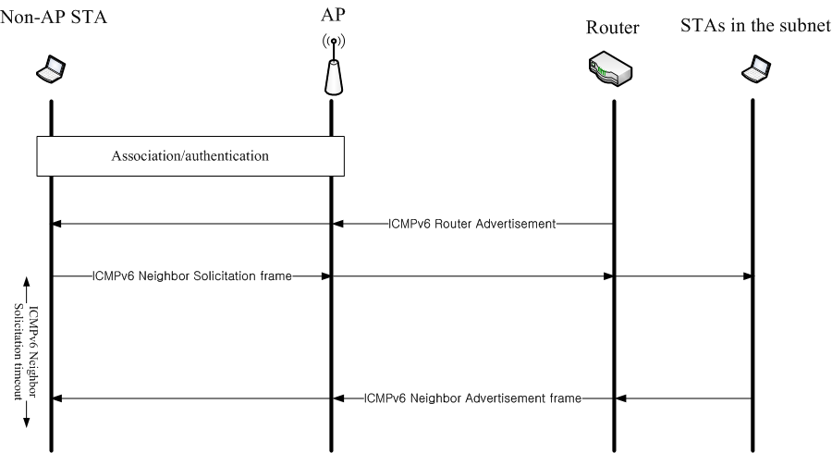
Conventional
Non-AP STA can hear Router Advertise after it successfully complete Association and authentication.
For DAD, Non-AP STA shall wait up until ICMPv6 Neighbor Solicitation timeout for the response after it sends out ICMPv6 Neighbor Solicitation frame to the STAs in the same subnet. If the non-AP STA gets no response within the timeout, it assumes there is no duplicated address.

Slide 12
Reference
[1] TGai Functional Requirement

