Slide 1
Discussion on 11ah Peak Throughput Requirements
Date: 2011-07-01
Authors:

Slide 2
Abstract
Discussion on Peak throughput Requirements for 11ah
Proposed Text for the Functional Requirements

Slide 3
Text from 11ac and 11ad Requirements
11ac has peak throughput requirements for single and multi-STA (DCN0451r16 “Functional requirements and evaluation methodology” )
2.1.1 Multi-STA throughput measured at the MAC SAP to be at least 1 Gbps.
2.1.2 Single-STA throughput measured at the MAC SAP to be at least 500 Mbps.
TGac R1(R2) – The TGac amendment shall provide at least a mode of operation capable of achieving a maximum Multi-Station (Single-Station) throughput of more than 1Gbps (500 Mbps) as measured at the MAC data service access point (SAP), utilizing no more than 80 MHz of channel bandwidth in 5GHz band.
11ad has data rate requirements for video (DCN0228r5)
2.1.3 Video Requirements
The TGad amendment provides a means of supporting uncompressed video requirements for rate, packet loss rate and delay, as measured at the MAC data SAP.

Slide 4
Summary of throughput requirements: User cases
Use Case 1d: Industrial Process Automation (Single-STA?
Use Case 3a : Outdoor Extended Range Hot Spot (Multi-STA)
Use Case 3b: Outdoor Wi-Fi for Cellular Offloading (Multi-STA)
Other cases: 100 kbps
4 | Data rate | < 1 Mbps *1
4 | Data rate (Aggregate BSS PHY rate) | Up to 10 Mbps
4 | Data rate (Aggregate BSS PHY rate) | 20 Mbps

Slide 5
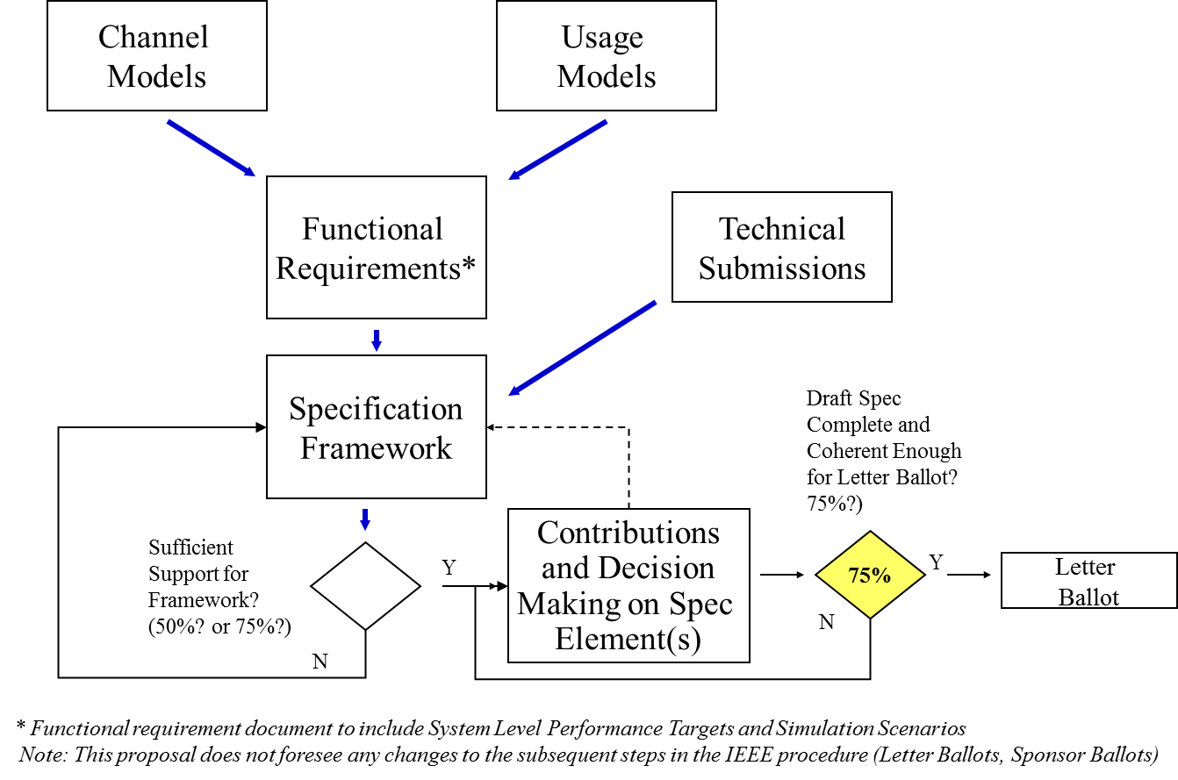
Should Peak Throughput be included in Functional Requirements
11-11-0239-01-00ah Proposed Selection Procedure, Dave Halaz and Rolf de Vegt
Note that a functional requirement does not mean it is a mandatory implementation

Slide 6
Examples of Achievable Throughput for 10 MHz
Modulation | Code Rate | Data Rate (Mbps)/S. Efficiency(Bps/Hz) | Data Rate (Mbps)/S. Efficiency(Bps/Hz)
 |  | Spatial Stream=1 | Spatial Stream=2
QPSK | 1/2 | 7.3/.7 | 14.6/1.5
 | 2/3 | 9.8/1 | 19.5/2.0
 | 3/4 | 11/1.1 | 21.9/2.2
 | 5/6 | 12.2/1.2 | 24.4/2.4
16 QAM | 1/2 | 14.6/1.5 | 29.3/2.9
 | 2/3 | 19.5/2.0 | 39/3.9
 | 3/4 | 21.9/2.2 | 43.9/4.4
 | 5/6 | 24.3/2.4 | 48.8/4.9
64 QAM | 1/2 | 21.9/2.2 | 43.9/4.4
 | 2/3 | 29.3/2.9 | 58.5/5.9
 | 3/4 | 32.9/3.3 | 65.8/6.6
 | 5/6 | 36.6/3.7 | 73.1/7.3
256 QAM | 1/2 | 29.3/2.9 | 58.5/5.9
 | 2/3 | 39/3.9 | 78/7.8
 | 3/4 | 43.9/4.4 | 87.8/8.8
 | 5/6 | 48.8/4.9 | 97.5/9.8
FFT Size:256
GI:6.4μS
Symbol Duration:32μS
Data Carriers:234
Payload: 32 bytes
(Entries in yellow box
meets the 20Mbps
requirement)

Slide 7
Examples of Achievable Throughput for 5 MHz
Modulation | Code Rate | Data Rate (Mbps)/S. Efficiency(Bps/Hz) | Data Rate (Mbps)/S. Efficiency(Bps/Hz)
 |  | Spatial Stream=1 | Spatial Stream=2
QPSK | 1/2 | 3.5/.7 | 7/1.4
 | 2/3 | 4.7/.9 | 9.3/1.9
 | 3/4 | 5.25/1.1 | 10.5/2.1
 | 5/6 | 5.8/1.2 | 11.7/2.3
16 QAM | 1/2 | 7/1.4 | 14/2.8
 | 2/3 | 9.3/1.9 | 18.7/3.7
 | 3/4 | 10.5/2.1 | 21/4.2
 | 5/6 | 11.7/2.3 | 23.3/4.7
64 QAM | 1/2 | 10.5/2.1 | 21/4.2
 | 2/3 | 14/2.8 | 28/5.6
 | 3/4 | 15.6/3.2 | 31.5/6.3
 | 5/6 | 17.5/3.5 | 35/7
256 QAM | 1/2 | 14/2.8 | 28/5.6
 | 2/3 | 18.7/3.7 | 37.3/7.5
 | 3/4 | 21/4.2 | 42/8.4
 | 5/6 | 23.3/6.7 | 46.7/9.3
FFT Size:128
GI:6.4μS
Symbol Duration:32μS
Data Carriers:112
Payload: 32 bytes
(Entries in yellow box
meets the 20Mbps
requirement)

Slide 8
Examples of Achievable Throughput for 1 MHz
Modulation | Code Rate | Data Rate (Mbps)/S. Efficiency(Bps/Hz) | Data Rate (Mbps)/S. Efficiency(Bps/Hz)
 |  | Spatial Stream=1 | Spatial Stream=2
QPSK | 1/2 | .7/.7 | 1.5/1.5
 | 2/3 | 1.0/1.0 | 2.0/2.0
 | 3/4 | 1.1/1.1 | 2.2/2.2
 | 5/6 | 1.2/1.2 | 2.5/2.5
16 QAM | 1/2 | 1.5/1.5 | 2.9/2.9
 | 2/3 | 2.0/2.0 | 3.9/3.9
 | 3/4 | 2.2/2.2 | 4.4/4.4
 | 5/6 | 2.5/2.5 | 4.9/4.9
64 QAM | 1/2 | 2.2/2.2 | 4.4/4.4
 | 2/3 | 3.0/3.0 | 5.9/5.9
 | 3/4 | 3.3/3.3 | 6.6/6.6
 | 5/6 | 3.7/3.7 | 7.4/7.4
256 QAM | 1/2 | 2.9/2.9 | 5.9/5.9
 | 2/3 | 3.9/3.9 | 7.9/7.9
 | 3/4 | 4.4/4.4 | 8.8/8.8
 | 5/6 | 4.9/4.9 | 9.8/9.8
FFT Size:32
GI:6μS
Symbol Duration:38μS
Data Carriers:28
Payload: 32 bytes

Slide 9
Summary of Throughputs
Candidate MCSs which support the MAC SAP Aggregate throughput of 20Mbps
5MHz BW → 2 SS/64 QAM (35MBPS/7BPS/Hz)
5MHz BW → 2SS/256 QAM (46.7MBPS/9.3 BPS/Hz)
10MHz BW → 1 SS/64QAM (36MBPS/3.7BPS/Hz )
10MHz BW → 1 SS/256QAM (48.8MBPS/4.9BPS/Hz )
10MHz BW → 2 SS/16 QAM (48.8MBPS/4.9BPS/Hz )
10MHz BW → 2 SS/64QAM (73.1MBPS/7.3BPS/Hz)
10MHz BW → 2 SS/256QAM (97.5MBPS/9.8BPS/Hz)

Slide 10
Proposed Text
To accommodate different bandwidths in different countries, it is advisable to use spectral efficiency for requirements
Proposed text:
The TGah amendment shall provide at least a mode of operation capable of achieving a maximum aggregate Multi-Station spectral efficiency of more than TBDbps/Hz as measured at the MAC data service access point (SAP) in S1G band.

