Slide 1
Issues with join and service discovery
Date: 2011-06-06
Authors:
Name | Affiliation | Address | Phone | email
Payam Torab | Broadcom Corp. | 5300 California Ave Irvine, CA 92617 | +1 949-926-6840 | ptorab@broadcom.com
Knut Odman | Broadcom Corp. | 16340 W Bernardo Dr. San Diego, CA 92127 | +1 858-521-5147 | kodman@broadcom.com

Slide 2
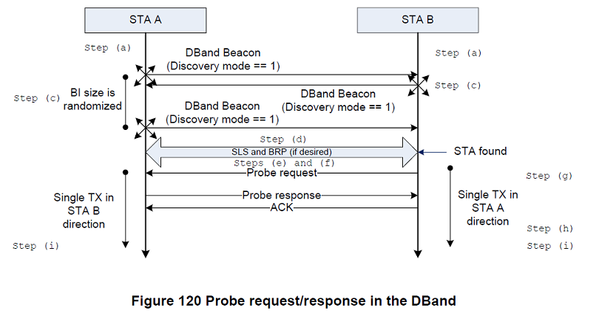
Active Scan method used for discovery
When a beacon or discovery beacon is received, perform sector sweep (RTXSS).
Discovery beacon must have A-BFT.
Need to make sure both STA receives DBand Capability element, even if both STA have not received a beacon. This is necessary for PCP selection.
Need to define where the discovery loop ends.

Slide 3
Proposed changes to D3.0
10.1.3.2b DBand Beacon generation before network initialization
<editor note: change P323L31 as indicated>
A DBand STA can transmit DBand Beacon frames before network initialization to discover and, possibly, perform beamforming (e.g., during the A-BFT) with another DBand STA…
<editor note: insert at the end of the paragraph at P323L37>
In addition, the STA shall set the A-BFT Length field to a value greater than 0 and the Next A-BFT field to a value equal to 0.
<editor note: insert paragraph at P324L1>
A DBand STA that is transmitting DBand Beacon frames with the discovery mode field equal to one shall cease transmitting these beacons when it has received a DBand Beacon frame from another STA, or when it has received acknowledgement of a transmitted Probe Response frame. If a network is not initialized, the DBand STA can resume transmitting DBand Beacon frames with the discovery mode field equal to one.

Slide 4
Proposed changes to D3.0, cont.
10.1.4.1 General
<editor note: insert paragraph at P329L1>
In the DBand, the Active Scan procedure (10.1.4.3) can be used for device discovery prior to initializing or joining a network.
10.1.4.3.3 Active scanning procedure
<editor note: change P330L6-10 as indicated>
e) Perform the Basic Access procedure as defined in 9.3.4.2 within a CBAP if the STA operates in the DBand;
f) Send a probe request to the broadcast destination address or, in the case of the DBand only, upon reception of an ScS Feedback frame send a probe request to the MAC address of the peer STA identified in step (d), with the SSID and BSSID from the MLME-SCAN.request primitive. When transmitted in the DBand, the transmitted probe request frame contains at least the DBand Capabilities element. When the SSID List…

