Slide 1
Discussion Review of TGah Functional Requirements and Evaluation Methodology
Date: 2011-05-10
Authors:

Slide 2
Abstract
This submission is a discussion review of TGah Functional Requirements and Evaluation Methodology.

Slide 3
Discussion History
Conference call on April 11
Document (0527r0) “Requirements Discussion” is presented by Dave
Document (0528r0) “Discussion for TGah Functional Requirements” is presented by Minho
About Requirements Section
Conference call on April 18
Document (0547r0) “802-11ah-coverage-requirement-of-industrial-process-automation-use-cases” by Mitsuru
Document (0550r0) “Requirements Discussion-Follow-Up” by Dave
Document (0552r0) “Link Budget” by Ron
Conference call on April 25
Document (0528r0) “Discussion for TGah Functional Requirements” is presented by Minho
About Evaluation Methodology Section

Slide 4
What is Next Step?
In this Palm Spring meeting, there are lots of submissions about potential functional requirements.
I have a plan to have straw polls on all the potential key requirements issues after all the presentations about requirements are done. Straw polls on approach for evaluation methodology will be also done.
I think in my mind that the meaningful threshold by which key functional requirements can be chosen is 75% agreement in TGah group.
With the use of those straw poll results, I will try to make a initial version of “TGah Functional Requirements and Evaluation Methodology (FR-EM) document” until the upcoming conference call after Palm Springs meeting.
In the long run, the mature version of that document (FR-EM) with which Tgah will have a first official motion may be ready until September 2011.

Slide 5
Meaning of Functional Requirements
11ah Functional requirements
These requirements are derived from the document “11-10-0001-13-0wng-900mhz-par-and-5c”.
TGah amendment must address the functional requirements defined in functional requirements document.
As defined in Selection Procedure document(0238r2), 11ah functional requirements document also include evaluation methodology (network simulation scenarios)
They are an small set of very essential and key requirements without which we cannot call the amendment TGah.
Each requirement in the FR-EM document had better be described as a normative text without any specific number as possible.

Slide 6
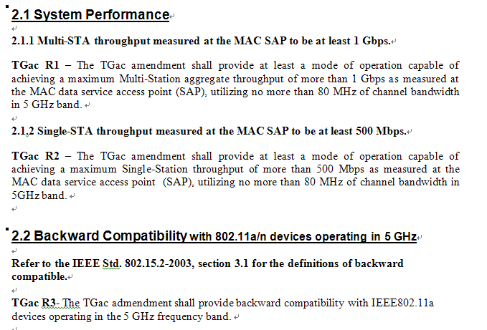
Examples of Functional Requirements
TGac FR (by Minho Cheong and Peter Loc)

Slide 7
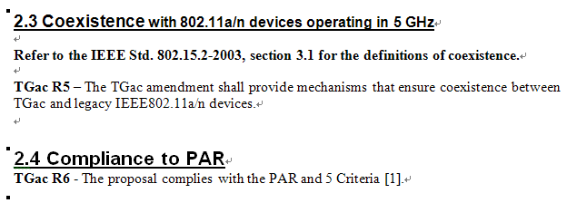
Examples of Functional Requirements (2)
TGac FR (by Minho Cheong and Peter Loc)

Slide 8
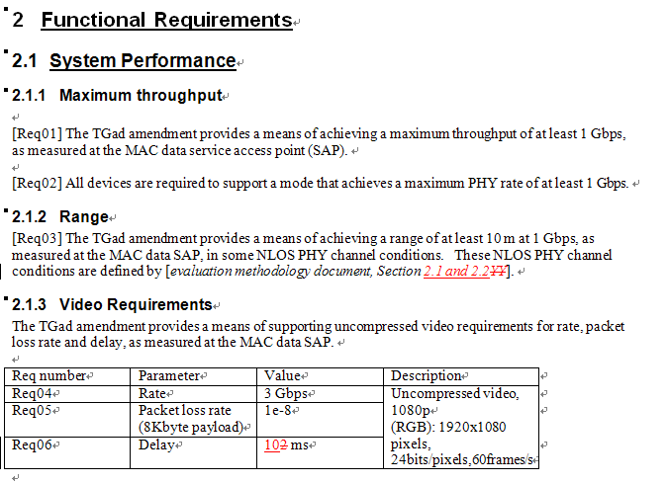
Examples of Functional Requirements (3)
TGad FR (Eldad Perahia)

Slide 9
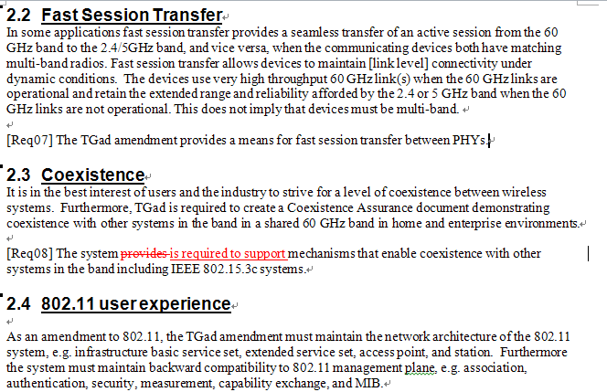
Examples of Functional Requirements (4)
TGad FR (Eldad Perahia)

Slide 10
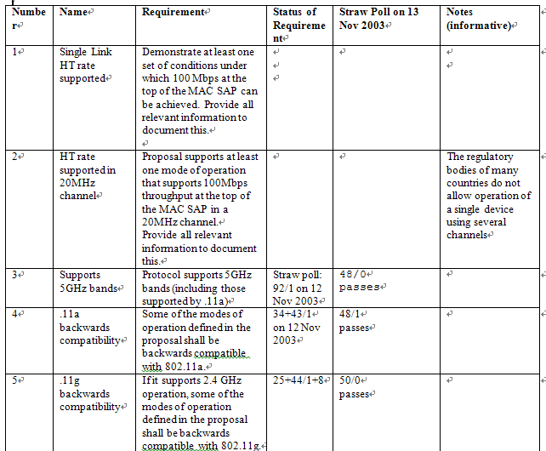
Examples of Functional Requirements (5)
TGn FR (Adrian P. Stephens)

Slide 11
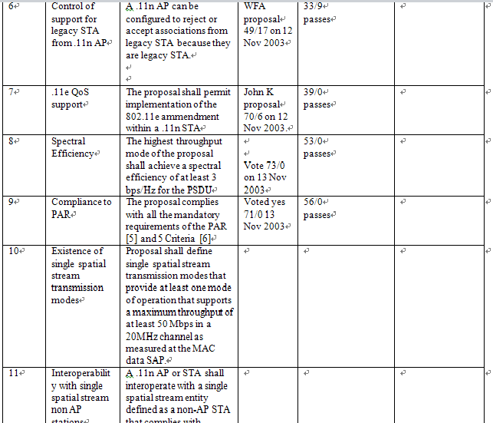
Examples of Functional Requirements (6)
TGn FR (Adrian P. Stephens)

Slide 12
Potential Contents of TGah FR-EM Documents
Requirements Section
Elements inherited from the TGah PAR document, such as coverage, data rate, WLAN experience, coexistence.
Other essential and key requirements element as a brief normative text, without which we cannot name it TGah.
Evaluation Methodology Section (depending on CM)
PHY performance
Comparison criteria
Traffic model
Network simulation scenarios
And so on.

Slide 13
Discussion Result of TGah FR Element
Bands
Discussions
Available bands are quite different for each country. e.g., 868-868.6 MHz (Europe), 950 MHz -958 MHz (Japan), 314-316 MHz, 430-434 MHz, 470-510 MHz, and 779-787 MHz (China), 917 – 923.5 MHz (Korea) and 902-928 MHz (USA)
And it is not possible to define common band which is applicable to all the countries
How to set a minimal supported band?
Minimal common band in 900MHz (e.g. Korea band)
US band
A set of multiples in 900MHz (US band & Japan band)
A set of multiples (US band & Europe band & one China band (700))
Discussion result
US band is appropriate for minimal supported band

Slide 14
Discussion Result of TGah FR Element (2)
Coverage
Discussions
While 1km range is enough for most of use cases, use case (1d) needs wider coverage up to 2km (it is based on 2km x 1km area with many metallic walls). In addition, wider coverage may be much more beneficial to use case (3a) and (3b). So, it is proposed by Yokogawa Industry to extend coverage up to 2km
But, most of TGah people attending the conferecall don’t want to change coverage requirements which is already described as 1km in the PAR document.
In addition, the original proposer (Mitsuru) of 2km coverage withdrew his proposal. In his subsequent submission (0547r0) , required coverage for used case (1d) in typical cases is less than 500m.
Ron justified that 1km coverage is reasonable checking link budget in his document (0552r1).
Discussion result
Coverage up to 1km as described in the PAR document is appropriate

Slide 15
Discussion Result of TGah FR Element (3)
Data rate
Discussions
PAR says data rates are supported > 100Kbps
100Kbps is applied to most of use cases
Only use cases (1d), (3a), (3b) specifies data rate over 100Kbps.
So, current description in PAR may be still valid in functional requirements document regarding aggregated throughput
How about per-link throughput?
Currently per-link throughputs have range as follows
Minimum available is about 17bps (=100Kbps/6000) , for use case (1a)
Maximum available is about 400Kbps(= 20Mbps/50), for use case (3b)
Do we need some description on maximum or minimum allowable per-link throughput in functional requirements document? => TGac people at the conference call don’t want to include these per-link throughput because per-link throughput can have very different value depending on traffic type. In addition, just averaged value for per-link throughput over time has not so much meaning
Discussion result
Aggregated data rates are supported > 100Kbps as described in the PAR document
Do not include the per-link throughput in the FR-EM document

Slide 16
Discussion Result of TGah FR Element (4)
Coexistence with IEEE802.15 and IEEE802.15.4g
Discussions
There is already a specific use case (2a) which needs coexistence with 15.4g. PAR document describes “provides mechanisms that enable coexistence with other systems in the bands including IEEE 802.15.4 and IEEE P802.15.4g”. 5C document describes need to make a coexistence assurance document which is meant for 15.4g as follows:
The working group will create a CA document and specifically reference IEEE P802.15.4g as part of the WG balloting process
So, coexistence with IEEE802.15 and IEEE802.15.4g is inevitable.
There was a debate on whether just a CA document is enough without any description about this in the FR-EM document.
After checking the FR document in other TGs in WG11, there is some other instances describing the coexistence with other, such as those of TGac and TGad.
In addition, it seems better for the FR document to inherit the PAR document
Discussion result
This description about coexistence with IEEE802.15 and IEEE802.15.4g is needed to be included in the FR-EM document.

Slide 17
Discussion Result of TGah FR Element (5)
WLAN user experience
Discussions
PAR says “maintaining the 802.11 WLAN user experience for fixed, outdoor, point-to-multi point applications.”
5C says “Compatibility with IEEE 802 requirements will result from keeping the MAC SAP interface the same as for the existing 802.11 standard. The proposed amendment shall introduce no 802.1 architectural changes. The MAC SAP definition shall not be altered, ensuring that all LLC and MAC interfaces are compatible to and in conformance with the IEEE 802.1 Architecture, Management and Internetworking standards. New managed objects shall be defined as necessary in a format and structure consistent with existing 802.11 managed objects.”
So, from current PAR & 5C, no changes on existing 802.11 standard is allowed
There have been agreement on this at the conference call.
Discussion result
It is needed to include the description that no changes on existing 802.11 standard is allowed in the FR document,.

Slide 18
Discussion Result of TGah FR Element (6)
Compatibility with 802.11i/w/s/k/v
Discussion
In PAR mentions “maintains 802.11 WLAN user experience”
There is a suggestion that compatibility with 802.11i/w/s/k/v and no 802.1 architectural changes.
Does this mean that 802.11i/w/s/k shall be used in all the applications? => No, just about compatibility.
Discussion result
It is needed to include compatibility with 802.11i/w/s/k/v in the FR-EM document.

Slide 19
Discussion Result of TGah FR Element (7)
Number of associations
Discussions
While most of use cases only need 50~100 STAs, use case (1a) needs 6000 STA/AP capacity. Currently from WG11 standards, number of associations available is limited to 2007. With 2007 associations, the max size of the TIM is 251 octets.
Since number of associations will have an impact on the system design it should be reflected in the functional requirements document.
There is also a comment that extending the number of associations is inevitable if we support 11i.
So, it needs to be changed into over 6000 to cover smart grid use case, which is one of the original 11ah applications.
There is no opposing comments on this need to be included in the FR-EM document
Discussion result
It is needed to include this requirements that with the specific number of associations TBD (larger than 2007) until TGah agrees on some value, that is, “include 6000 associations per AP ” or “indicate beyond 2007)”

Slide 20
Discussion Result of TGah FR Element (8)
Power saving
Discussions
Low throughput devices may desire larger sleep time, generally 15 minutes and in some extreme cases less a day. Most of 11ah devices may be expected to have very long battery duration time.
Do we need some description about power saving features (e.g., battery life, duty cycle) in functional requirements documents?
In my opinion, while duty cycle or battery life is quite a important topic in further discussions for TGah draft, it is undesirable and not easy to give a specific number for duty cycle in the FR-EM document because it definitely needs so detailed explanatory paragraph due to so diverge groups of TGah applications.
Discussion result (tentative)
It may not a bad idea just to describe in the FR-EM document that efficient power saving feature is expected in TGah devices.

Slide 21
Discussion Result of TGah FR Element (9)
OBSS
Discussions
With larger number of clients, especially in an outdoor environments, it is more probable to have hidden nodes and overlapped BSS effect.
To take into consideration these, do we need some description in functional requirements document?
e.g.) 11ah BSS shall not degrade performance of existing OBSSs
There can be multiple alternative in terms of description
(1) include in Requirements section in the FR-EM document
(2) just include s a simulation scenario in Evaluation Methodology section
(3) not include in the FR-EM document
For your information, Tgac selected option (2) after long-time debate
Discussion result (tentative)
It is not a bad idea to include it as a simulation scenario considering OBSS deployment.

Slide 22
Discussion Result of TGah FR Element (10)
Others
Data rate requirement for Wi-Fi offloading
Large number of STAs
Network management
Consideration of power saving
Regulatory requirements
Station group management of TGah

Slide 23
Discussion Review of Approach for Evaluation Methodology
This will be added in 11ah functional requirements document as a chapter
Including PHY performance, comparison criteria, traffic models and network simulation scenarios as in 11ac functional requirements document
In 11ah, we have 11 use cases. It is not possible to define simulation scenarios case-by-case because it is too burdensome.
So, network simulation scenarios are chosen to represent 11ah-specific applications well and have a detailed information for network simulation (coordinates of every STAs, applied channel models, applied rate distributions, MSDU size, and so on)
It should be taken to represent 11ah-specific application very well.
For simplicity in simulation work, not more than 4 scenarios are appropriate

Slide 24
Discussion Review of Approach for Evaluation Methodology (2)
Discussions
Imposing impact factor on each detailed use cases to define simulation scenarios (similar to 11n method) may be too burdensome.
If we can agree, setting 3~4 simulation scenarios may be desirable: (tentative)
Use Case category 1 (sensors and meters)
Outdoor (or mixture of indoor/outdoor) with extremely large number of nodes
Indoor with moderately large number of nodes
Use Case category 2 (backhaul sensor and meter data)
Backhaul network is not easy to simulate because it also needs 15.4g devices needs to be taken into consideration
Use Case category 3 (extended range Wi-Fi)
Outdoor with moderately high data rate
OBSS scenarios for outdoor environments may be needed
Backhaul scenario consisting only TGah devices may be needed
Discussion result
It seems appropriate to have a basic sets (as above 3 scenarios) + 1 or 2 additional scenarios for outdoor OBSS or TGah-only backhaul seems appropriate.

Slide 25
Summary
This is a discussion review of TGah functional requirements and evaluation methodology.

Slide 26
References
11-10-0001-13-0wng-900mhz-par-and-5c
11-11-0457-00-00ah-potential-compromise-of-802-11ah-use-case-document
11-11-0239-02-00ah-proposed-selection-procedure
11-09-0451-16-00ac-tgac-functional-requirements-and-evaluation-methodology
11-09-0228-05-00ad-functional-requirements
11-03-0813-13-000n-functional-requirements
11-09-0376-00-00ac-proposal-for-tgac-evaluation-methodology
11-10-1045-00-0s1g-possible-mac-changes
11-03-0802-23-000n-usage-models

Slide 27
Appendix
Revisit TGah PAR & 5C
Revisit TGah Use Cases
Revisit TGn Simulation Scenarios
Revisit TGac Simulation Scenarios

Slide 28
Revisit 11ah PAR&5C
5.2 Scope of Proposed Standard:
an Orthogonal Frequency Division Multiplexing (OFDM) Physical layer (PHY) operating in the license-exempt bands below 1 GHz, e.g., 868-868.6 MHz (Europe), 950 MHz -958 MHz (Japan), 314-316 MHz, 430-434 MHz, 470-510 MHz, and 779-787 MHz (China), 917 – 923.5 MHz (Korea) and 902-928 MHz (USA)
and enhancements to the IEEE 802.11 Medium Access Control (MAC) to support this PHY, and provides mechanisms that enable coexistence with other systems in the bands including IEEE 802.15.4 and IEEE P802.15.4g.
The data rates defined in this amendment optimize the rate vs. range performance of the specific channelization in a given band.
This amendment also adds support for:
transmission range up to 1 km
data rates > 100 kbit/s
while maintaining the 802.11 WLAN user experience for fixed, outdoor, point-to-multi point applications.

Slide 29
Revisit 11ah PAR&5C (2)
5.4 Purpose of Proposed Standard:
The purpose of this amendment defines operation of license-exempt 802.11 wireless networks in frequency bands below 1 GHz excluding the TV White Space bands.
5.5 Need for the Project:
Equipment ships today that utilize the IEEE 802.11 protocols in frequency bands below 1 GHz, primarily used in outdoor applications. However, the IEEE 802.11 standard does not specify channel width and center frequencies for these bands. This amendment will establish standard channel widths and center frequencies for OFDM PHY operations below 1 GHz. The changes primarily will be done in new regulatory classes (requiring extending annex I and J of IEEE 802.11-2007).

Slide 30
Revisit 11ah PAR&5C (3)
17.5.2 Compatibility
IEEE 802 defines a family of standards. All standards shall be in conformance with the IEEE 802.1 Architecture, Management, and Interworking documents as follows: 802 Overview and Architecture, 802.1D, 802.1Q, and parts of 802.1f. If any variances in conformance emerge, they shall be thoroughly disclosed and reviewed with 802.
Each standard in the IEEE 802 family of standards shall include a definition of managed objects that are compatible with systems management standards.
Compatibility with IEEE 802 requirements will result from keeping the MAC SAP interface the same as for the existing 802.11 standard. The proposed amendment shall introduce no 802.1 architectural changes. The MAC SAP definition shall not be altered, ensuring that all LLC and MAC interfaces are compatible to and in conformance with the IEEE 802.1 Architecture, Management and Internetworking standards. New managed objects shall be defined as necessary in a format and structure consistent with existing 802.11 managed objects.

Slide 31
Revisit 11ah PAR&5C (4)
17.5.4 Technical Feasibility
For a project to be authorized, it shall be able to show its technical feasibility. At a minimum, the proposed project shall show:
a) Demonstrated system feasibility. Equipment that utilizes IEEE 802.11 OFDM radio modulations running at 20 MHz, 10 MHz and 5 MHz are in use today in the 902-928 MHz ISM band.

Slide 32
Revisit 11ah PAR&5C (5)
17.5.4.1 Coexistence of 802 wireless standards specifying devices for unlicensed operation
A working group proposing a wireless project is required to demonstrate coexistence through the preparation of a Coexistence Assurance (CA) document unless it is not applicable. The Working Group will create a CA document as part of the WG balloting process. If the Working Group elects not to create a CA document, it will explain to the EC the reason the CA document is not applicable.
The working group will create a CA document and specifically reference IEEE P802.15.4g as part of the WG balloting process

Slide 33
Revisit 11ah Use Cases
Use Case 1 : Sensors and meters
1a: 11/17r5, slide 7 Smart Grid - Meter to Pole
1c: 11/253, Environmental/Agricultural Monitoring
1d: 11/260r1, slid 4 Industrial process sensors
1e: 11/17r5, slid 17 Healthcare
1f: 11/241r0, slide 3 Healthcare
1g: 11/241r0, slid 5 Home/Building Automation
1h: 11/242r0, slid 2 Home sensors
Use Case 2 : Backhaul Sensor and meter data
2a: 11/14r2, slide 5 Backhaul aggregation of sensors
2b: 11/260r1, slide 4 Backhaul aggregation of industrial sensors
Use Case 3 : Extended range Wi-Fi
3a: 11/243r0 Outdoor extended range hotspot
3b: 11/244r1 Outdoor Wi-Fi for cellular traffic offloading

Slide 34
Revisit 11ah Use Cases (2)
Data rate (aggregated)
100Kbps(others), <1Mbps(1d), <10Mbps(3a), <20Mbps(3b)
STA/AP capacity
6000(1a), 300(1c), 500(1d), 100(1g), <50(others)
Other features
Stronger Reliability (1d) : PER<1%
Real time comm. (1d) : latency < hundreds of milliseconds
Large outdoor coverage (1d) : < 2km
Coexistence with 15.4g (2a) : performs without degradation of throughput and reliability, even if co-existing with 15.4g.
Battery operation (2b) : battery operation over 5 years

Slide 35
Revisit 11n simulation scenarios
It was not possible to define simulation scenarios for every use cases
So, usage model was derived from multiple use cases as a mixture of use cases to represent its 11n-specific applications well
During this mapping process, by imposed impact factor (derived by many straw polls), there’ve been discussions on which use case is more appropriate for a member of specific defined usage model

Slide 36
Revisit 11n simulation scenarios
The score relates to the results reported in [4] from the vote on 21 July 2003. This scores 3 for high, 2 for medium and 1 for low priority. The "Dev^{n}" column shows the weighted absolute deviation in the votes (0 shows complete agreement and 1 shows complete disagreement).
Part of Table 5 - Use Case Definitions (in 11-03-0802-23-000n-usage-models)
Number | Covered by model # | Use case | Application | Environment | Score | Dev^{n}.
1 | 1, 3, 4, 5, 6, 7 | One personal phone everywhere – home, office. Each person has a phone that works everywhere, home, office – same number. An extension of the cell phone into the office building. This includes cordless phone over VoIP. | VOIP integrated with other wireless WAN technologies | Residential, Enterprise – large and small, conference room | 2.12 | 0.84
2 | 1 | Multiplayer Internet gaming anywhere within the home / Internet Café. | Interactive gaming (console to internet), internet gaming (controller to console) | Residential/small enterprise (internet cafes) | 1.69 | 0.77
3 | 1 | Multiple TVs running throughout the home getting their content from a single remotely located AV-server/AP/set top box. Local control of the content (changing channels, etc). | HDTV, SDTV, VoD control channel | Residential | 2.87 | 0.23

Slide 37
Revisit 11n simulation scenarios (from 802.11-09/0096r0)
11n developed typical usage models and objective comparison criteria to ensure that all technical solutions met certain standard
11n usage model defined environments, applications, uses cases, usage models, represented by simulation scenarios
There were 9 environments, 21 applications, 39 use cases, 17 usage models, 11 simulation scenarios
Simulations were important in quantifying the performance of a feature
But in the end the task group focused on only three (or four) simulation scenarios
And it was up to those performing simulations to modify the applications to saturate the system
11n comparison criteria document included many categories requiring detailed documentation by the proposal teams
Categories include marketability, backward compatibility and coexistence with legacy devices, performance measurements at the MAC SAP, MAC changes, PHY rates and preambles, channelization, spectral efficiency, PHY performance and changes
In the end the task group focused mainly on throughput simulations
Physical layer impairment scenarios were very useful in adding realism to PHY simulations

Slide 38
Revisit 11n simulation scenarios (from 802.11-08/1323r0)
Application – a source or sink of wireless data that relates to a particular type of user activity.
Examples: Streaming video. VOIP.
Environment – The type of place a WLAN system is deployed in. Initial examples: home, large office.
Use case – A use case is a description of how an end user uses a system that exercises that system’s deployment of WLAN. A use case includes an application in a deployment environment with details regarding the user activity and both sides of the link.
Examples: Watching television remote from the cable or set-top box within the home. Talking on the telephone remote from one’s desk at work.
Usage Model – A specification of one or more applications and environments from which a simulation scenario can be created once the traffic patterns of the applications are known. Usage models are created to "cover" use cases.
Simulation Scenario – A simulation scenario is a description of a usage model that supports simulation. A simulation scenario includes details needed for simulation. Types of details to be included are descriptions that link the usage model to the simulation scenario: environment linked to a channel model, position of the AP (console or ceiling mounted), position of STAs w.r.t. AP, uplink and downlink traffic (# packets, size of packets, interference (number and types of users on the same WLAN channel – adjacent cells, the same cell, number and types of users on alternate channels, BT, baby monitors, GPRS or other systems). A simulation scenario is created from a Usage Model by characterizing the traffic profile of the applications and possibly merging multiple applications together to reduce simulation time.
Slide 38

Slide 39
Revisit 11n simulation scenarios (from 802.11-08/1323r0)
Understanding and defining the application, environment, channel model, use case, usage model and simulation scenario are all necessary to create comparative results from 802.11 TGn proposals.
Channel models have been defined in TGn channel modeling documents, with 6 channel models. Each environment will map to a pair of channel models..
Each use case involves the use of one or more applications and is defined for one or more environments. It represents a single type of use of a system using the technology.
Each application reflects a source or sink of data. They will eventually be characterized in terms of a traffic profile that allows a simulation of the application to be created.
Each usage model contains a representative mixture of applications and channel models designed to adequately cover the important use cases. There is a many to many mapping between use cases and usage models (i.e., the same use case may contribute to multiple usage models and the same usage model may include applications from multiple use cases).
There will be a one-to-one mapping between usage models and simulation scenarios. The usage model is a marketing-oriented description of a "reasonable mixture" covering the important use cases. The simulation scenario fills in any technical details necessary to fully define the simulation inputs not present in the usage model.
Slide 39

Slide 40
Revisit 11ac simulation scenarios
New Demand in TGac evaluation (from that of 11n)
TGac Evaluation shall satisfy these
Compliance to VHTL6 PAR
Point-to-point (500Mbps) & point-multipoint link test (1Gbps)
Source and sink
UDP traffic, with infinite offered load
select PHY channel model for each system performance functional requirement
Compliance to VHT-specific Usage models

Slide 41
High-Quality Video Service Requirements (from 802.11-09/0161r2)
Video Compression |  | Description | Rate, Mbps | Packet Error Rate | Jitter, ms | Delay,ms
Uncompressed | 720p | (RGB): 1280x720 pixels, 24bits/pixels,60frames/s | 1300 | 1e-8 | 5 | 5
 | 1080i | (RGB): 1920x1080/2pixels, 24bits/pixels,60frames/s | 1300 | 1e-8
 | 1080p | (YCrCb): 1920x1080 pixels, 12bits/pixels,60frames/s | 1500 | 1e-8
 | 1080p | (RGB): 1920x1080 pixels, 24bits/pixels,60frames/s | 3000 | 1e-8
Lightly Compressed |  | Motion JPEG2000 H.264 | 150 70 - 200 | 1e-7 1e-7 / 8 | 10 20 | 10 20
Compressed |  | Blu-ray™ | 50 | 1e-7 | 20 | 20
 |  | HD MPEG2 | 20 | 3e-7 | 20 | 20
Slide 41
Notes:
doc.: IEEE 802.11-yy/xxxxr0
Month Year
John Doe, Some Company
Page 41

Slide 42
Usage Model Mapping to Operating Bands (from 802.11-09/0161r2 and 08/0451r0)
Category | # | Usage model
1. Wireless Display | 1a | Desktop Storage & Display
 | 1b | Projection to TV or projector in conf room (lightly compressed video)
 | 1c | In room gaming (lightly compressed video)
 | 1d | Streaming from camcorder to display (lightly compressed video)
 | 1e | Broadcast TV field pick up
2. Distribution of HDTV | 2a | Lightly compressed video streaming around the home
 | 2b | Compressed video streaming around home
 | 2c | Intra large vehicle (e.g. airplane) applications
 | 2d | Wireless networking for small office
 | 2e | Remote medical assistance
3. Rapid upload/download | 3a | Rapid sync-n-go file transfer
 | 3b | Picture by picture viewing
 | 3c | Airplane docking
 | 3d | Movie content download to car
 | 3e | Police / surveillance car upload
4. backhaul | 4a | Multi-media mesh backhaul
 | 4b | Point-to-point backhaul
5. Outdoor campus / auditorium | 5a | Video demos / tele-presence in auditorium
 | 5b | Public safety mesh
6. Manufacturing floor | 6a | Manufacturing floor automation
This table is from TGac usage model document (09/0161r2)
Usage model mapping to operating bands
by 08/0451r0
Red mainly matches to TGac usages.
Orange mainly matches to both TGac and TGad usages.
Black mainly matches to TGad usages.
Slide 42
Notes:
doc.: IEEE 802.11-yy/xxxxr0
Month Year
John Doe, Some Company
Page 42

Slide 43
Usage Model Mapping to Operating Bands
It is seen that TGac usage models are mainly focused on
lightly-compressed video in a residential environment
P2MP compressed video (e.g. blue-ray) in a large office
P2P high-speed backhaul
Slide 43

Slide 44
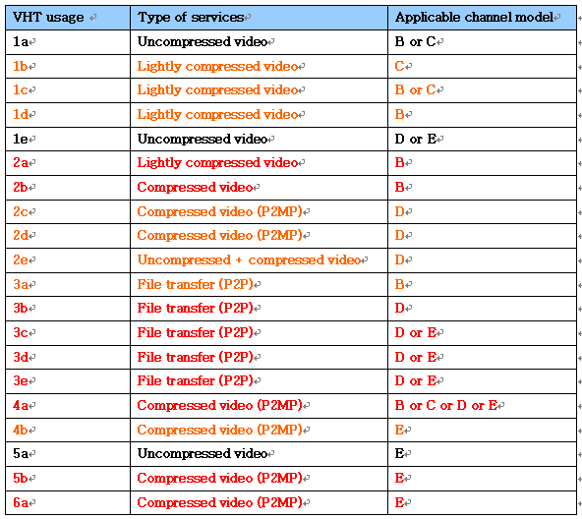
Usage Model Mapping to Channel Model (for reference)
Slide 44
Notes:
doc.: IEEE 802.11-yy/xxxxr0
Month Year
John Doe, Some Company
Page 44

Slide 45
Revisit 11ac simulation scenarios
It can be seen that theses scenarios can easily be derived
lightly-compressed video with the use of channel B
P2MP compressed video (e.g. blue-ray) with the use of channel D
P2P high-speed backhaul with the use of channel E
Slide 45

Slide 46
Revisit 11ac simulation scenarios
It is also possible for these scenarios to be derived with minimum modifications to one of conventional TGn simulation scenarios.
Locations of AP and STAs : modification is not needed
High-speed data services supporting high-quality video : only items which need to be modified
For example, HDTV, SDTV => light-compressed video (MPEG2000)
Residual services with low data rate such as Internet access, MP3 audio, VoIP and so on : modification is not needed
Slide 46

