Slide 1
COST231 Walfish Ikegame Model for for 11ah
Date: 2011-04-25
Authors:
Slide 1

Slide 2
Path Loss Model
LTE macro model 11-11-552-01-00 Link Budget was presented 4/18/11 by Ron (Broadcom)
Deficiencies with LTE macro model:
Antenna cannot be below the building
e.g. meter to pole Use Case 1
How about AP to AP and STA to STA ?
where h is base station antenna height above building

Slide 3
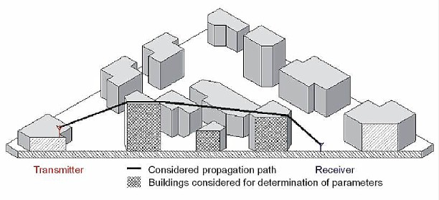
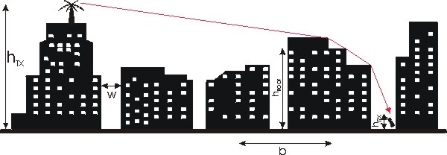
Walfisch-Ikegami Path Loss Model
Frequency f (800...2000 MHz)
Height of the transmitter h_{tx} (4...50 m)
Height of the receiver h_{rx} (1...3 m)
Distance d (20...5000 m)
Mean value of building heights h_{roof}
Mean value of widths of streets w
Mean value of building separation b

Slide 4
Case 1 AP to STA (AP Ant. above Building)
Building Height = 12 m
AP Antenna = 17 m
STA height = 1.5 m
Note: It might not be realistic to assume AP antenna is 15 meter above roof. It can be costly and AP can see lots of interference. In practice, you want to have antenna just high enough.
Input Parameters
Distance | 1000 | meter
Unit PA P1dB @Antenna | 30.0 | 30.0 | dBm
Total Transmit Power | 30.0 | 30.0 | dBm
TX Antenna Gain | 1.5 | 1.5 | dBi
EIRP | 31.5 | 31.5 | dBm
Propagation Mode | Walfish-Ikegami | Walfish-Ikegami
 | LOS | Metropolitan
Path Loss, Free Space, dB | 101.83 | 91.63 | dB
Diffraction Loss (Rooftop L_{rts}), dB | 0.0 | 23.8 | dB
Multi-Screen Diffraction Loss, dB | 0.0 | 12.4 | dB
Total Path Loss | 101.8 | 127.8
RX Antenna Gain | 1.5 | 1.5 | dBi
Polarization Loss | 0.0 | 0.0 | dB
Rcvr Signal Power | -68.83 | -94.78 | dBm
Symbol Rate | 200.0 | 200.0 | kHz
RX NF | 7.0 | 7.0 | dB
Required Eb/No | 4.5 | 4.5 | kbps
Fading Margin | 3.0 | 3.0 | dB
Implementation Loss | 3.0 | 3.0 | dB
Received Sensitivity | -103.5 | -103.5 | dB
Shadowing Std Dev | 8.00 | 8.00 | dB
Margin based on Received Power | 26.7 | 0.7 | dB

Slide 5
Case 2 AP to STA (AP Ant. below Building)
Building Height = 12 m
AP Antenna = 8 m
STA height = 1.5 m
Input Parameters
Distance | 420 | meter
Unit PA P1dB @Antenna | 30.0 | 30.0 | dBm
Total Transmit Power | 30.0 | 30.0 | dBm
TX Antenna Gain | 1.5 | 1.5 | dBi
EIRP | 31.5 | 31.5 | dBm
Propagation Mode | Walfish-Ikegami | Walfish-Ikegami
 | LOS | Metropolitan
Path Loss, Free Space, dB | 92.03 | 84.09 | dB
Diffraction Loss (Rooftop L_{rts}), dB | 0.0 | 23.8 | dB
Multi-Screen Diffraction Loss, dB | 0.0 | 20.2 | dB
Total Path Loss | 92.0 | 128.0
RX Antenna Gain | 1.5 | 1.5 | dBi
Polarization Loss | 0.0 | 0.0 | dB
Rcvr Signal Power | -59.03 | -95.00 | dBm
Symbol Rate | 200.0 | 200.0 | kHz
RX NF | 7.0 | 7.0 | dB
Required Eb/No | 4.5 | 4.5 | kbps
Fading Margin | 3.0 | 3.0 | dB
Implementation Loss | 3.0 | 3.0 | dB
Received Sensitivity | -103.5 | -103.5 | dB
Shadowing Std Dev | 8.00 | 8.00 | dB
Margin based on Received Power | 36.5 | 0.5 | dB

Slide 6
AP to AP and STA to STA
Do we need to consider the path loss for these two cases ?
COST231 Walfisch-Ikegami model is limited to antenna height (base station) >= 4 meters, antenna height ( handset) < 3 meters

