Slide 1
Selective Segment Retransmission of VHT Compressed Beamforming
Date: 2011-03-16
Authors:

Slide 2
Motivation
Segmentation of VHT Compressed Beamforming Report
“If it would otherwise result in an MMPDU that exceeds the maximum MPDU size, the VHT Compressed Beamforming Report field may be split into up to TBD segments. Each segment shall contain an equal number of octets except for the last segment, which may be smaller. All segments shall be sent within the same A-MPDU.” (in Draft P802.11ac_D0.1)
Feedback can grow up to about 26kbytes
For 11454 octet MPDU limit: Maximum 3 segments
For 7991 octet MPDU limit: Maximum 4 segments
For 3895 octet MPDU limit: Maximum 8 segments
An error of each segment can be individually detected using CRC.
The efficiency of sounding protocol can be improved if selective segment retransmission is enabled.

Slide 3
Selective Segment Retransmission
For typical initial VHT devices, we do not expect selective segment retransmission to be very effective
Feedback size is relatively small resulting in only a few segments
Re-computation of feedback could be a burden to STAs
For high-end VHT devices, we believe selective segment retransmission can improve sounding protocol
Feedback size would be large (due to large antenna dim.) resulting in many segments
Hardware complexity is less restricted than as in low-end STAs.

Slide 4
Segmentation Examples
7991 octet MPDU limit case:
No Segmentation under 4x4 (e.g. 4x4, 4x3, 4x2, 4x1, 3x3, etc)
3895 octet MPDU limit case:
For SU CB feedback with (2,4) quantization no segmentation
For SU CB feedback with (4,6) quantization segmentation with following parameter
160MHz, Ng = 1, matrix dimension 7x5 or higher (e.g. 7x6, 7x7, 8x4, 8x5,etc)
For MU CB feedback with (5,7) quantization segmentation with following parameter
160MHz, Ng = 1, matrix dimension 7x4 or higher
For MU CB feedback with (7,9) quantization segmentation with following parameter
160MHz, Ng = 1, matrix dimension 6x4 or higher
160MHz, Ng = 2, matrix dimension 8x5 or higher
80MHz, Ng = 1, matrix dimension 8x5 or higher

Slide 5
Segment Identification
VHT MIMO Control field
Reserved bits can be used.
Remaining Segments: Indicate the remaining segment number for the associated VHT Compressed Beamforming frame. Set to 0 for the last segment of a segmented frame or the only segment of an unsegmented frame.
First Segment: Set to 1 for the first segment of a segmented frame or the only segment of an unsegmented frame; set to 0 otherwise
Combination of two subfields identifies each segment.
B0-B2 | B3-B5 | B6-B7 | B8-B9 | B10 | B11 | B12-B14 | B15 | B16-B17 | B18-B23
Nc Index | Nr Index | Channel Width | Grouping | Codebook Information | Feedback Type | Remaining Segments | First Segment | Reserved | Sounding Sequence
Bits: 3 | 3 | 2 | 2 | 1 | 1 | 3 | 1 | 2 | 6

Slide 6
Selective Segment Indication
Beamforming Report Poll
The Segment Retransmission Bitmap field indicates the segments to be polled in a VHT Compressed Beamforming frame. The bit in position n (n=0 for LSB and n=7 for MSB) is set to 1 when the segment with the Remaining Segment subfield in VHT MIMO Control field set to n is requested. The bit in position n is set to 0 when the segment with the Remaining Segment subfield in VHT MIMO Control field set to n is not requested.
Frame Control | Duration | RA | TA | Segment Retransmission Bitmap | FCS
Octets: 2 2 6 6 1 4

Slide 7
Selective Segment Retransmission Protocol
Beamformer behavior
In its first attempt to retrieve a VHT Compressed Beamforming frame from a beamformee that is not the one indicated by the first STA Info field, a beamformer shall transmits a Beamforming Report Poll frame to poll all possible segments of the VHT Compressed Beamforming frame from the beamformee, by setting all the bits in the Segment Retransmission Bitmap field of the Beamforming Report Poll frame to 1.
If a beamformer fails to receive some or all segments of a VHT Compressed Beamforming frame, the beamformer may request a selective retransmission of missing segments by sending a Beamformgin Report Poll frame with the Segment Retransmission Bitmap field set as described in 7.2.1.12 to indicate the segments requested for retransmission. If the beamformer fails to receive the segment with the First Segment field set to 1, it may request a selective retransmission of missing segments assuming the VHT Compressed Beamforming frame is split into 8 segments. The beamformer may also request the retransmission of all segments by setting all the bits in the Segment Retransmission Bitmap field of the Beamforming Report Poll frame to 1.

Slide 8
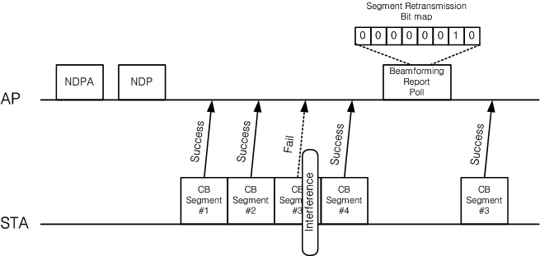
Selective Segment Retransmission Protocol
Beamformee behavior
A beamformee shall reply to a Beamforming Report Poll frame by either sending only the segments indicated in the Segment Retransmission Bitmap field in the Beamforming Report Poll fame or sending all the segments disregarding the Segment Retransmission Bitmap field in the Beamforming Report Poll fame

