Slide 1
Resolutions to Static RTS CTS Comments
Date: 2011-03-14
Authors:

Slide 2
Abstract
The presentation describes Probing reservations to improve static RTS CTS reservation mechanism
In probing reservations the CTS duration is calculated from short RTS duration
The presentation and normative text in 11-11-384r0 provides solution for CIDs: 683, 698 and 1236

Slide 3
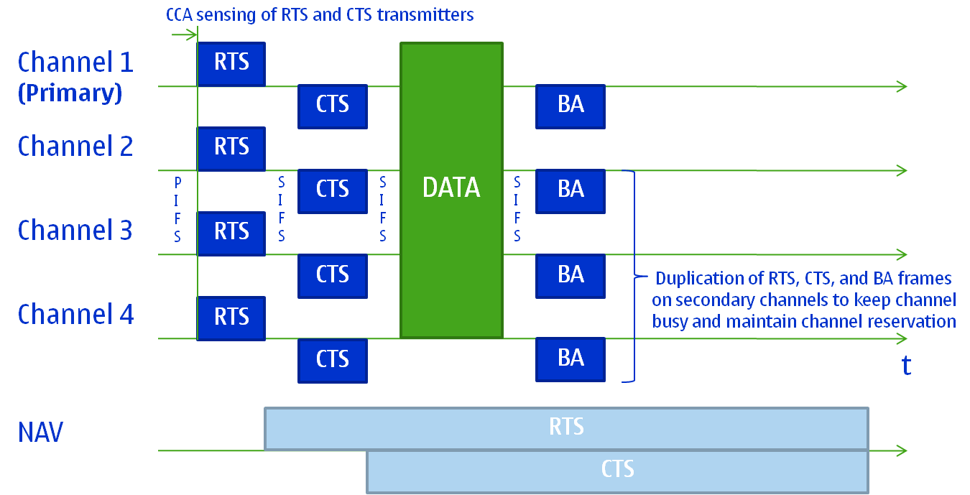
Recap, RTS/CTS in 802.11ac
Please note, the total duration of the TXOP is between [0…TXOPlimit]

Slide 4
Recap, RTS/CTS in 802.11ac
RTS is transmitted to all channels that are requested to be reserved
CTS is transmitted to all channels that are reserved
RTS and CTS are received only on the primary channel
802.11ac includes information to RTS and CTS:
Provides static/dynamic BW reservation mode (1 bit)
Channel BW (2 bits) is indicated in both RTS and CTS frames
The 802.11ac introduces CCA to all bandwidths
CCA is performed by RTS and CTS transmitters a PIFS before RTS transmission
Highest transmission bandwidth is used if possible, otherwise the lower option is used (Minimum is 20 MHz)

Slide 5
Recap, Reservation Control in RTS CTS
Static reservation :( All or nothing)
CTS reserves the whole requested bandwidth
Any busy channel avoids the CTS transmission, i.e. signaling fails easily
Dynamic reservation :( Anything will do)
CTS reserves any available bandwidth
The RTS transmitter does not know the bandwidth of the reservation which complicates the estimation of reservation duration
Reservation of small bandwidth may reduce the throughput of BSS

Slide 6
Recap, RTS transmission
9.2.5.4 Setting and resetting the NAV [802.11 2007]:
“A STA that used information from an RTS frame as the most recent basis to update its NAV setting is permitted to reset its NAV if no PHY-RXSTART.indication is detected from the PHY during a period with a duration of (2 × aSIFSTime) + (CTS_Time) + aPHY-RX-START-Delay + (2 × aSlotTime) starting at the PHY-RXEND.indication corresponding to the detection of the RTS frame.”
Any PLCP preamble that is received within CTS_Timeout sets the NAV

Slide 7
Recap, CTS Procedure
9.2.5.7 CTS procedure [802.11 2007]:
”A STA that is addressed by an RTS frame shall transmit a CTS frame after a SIFS period if the NAV at the STA receiving the RTS frame indicates that the medium is idle. If the NAV at the STA receiving the RTS indicates the medium is not idle, that STA shall not respond to the RTS frame.”
When the NAV is set, CTS cannot be send
802.11ac and 802.11 Mb 6.05 sets an exception, CTS will be responded to RTS received from saved TXOP holder, this is explained in the following slide

Slide 8
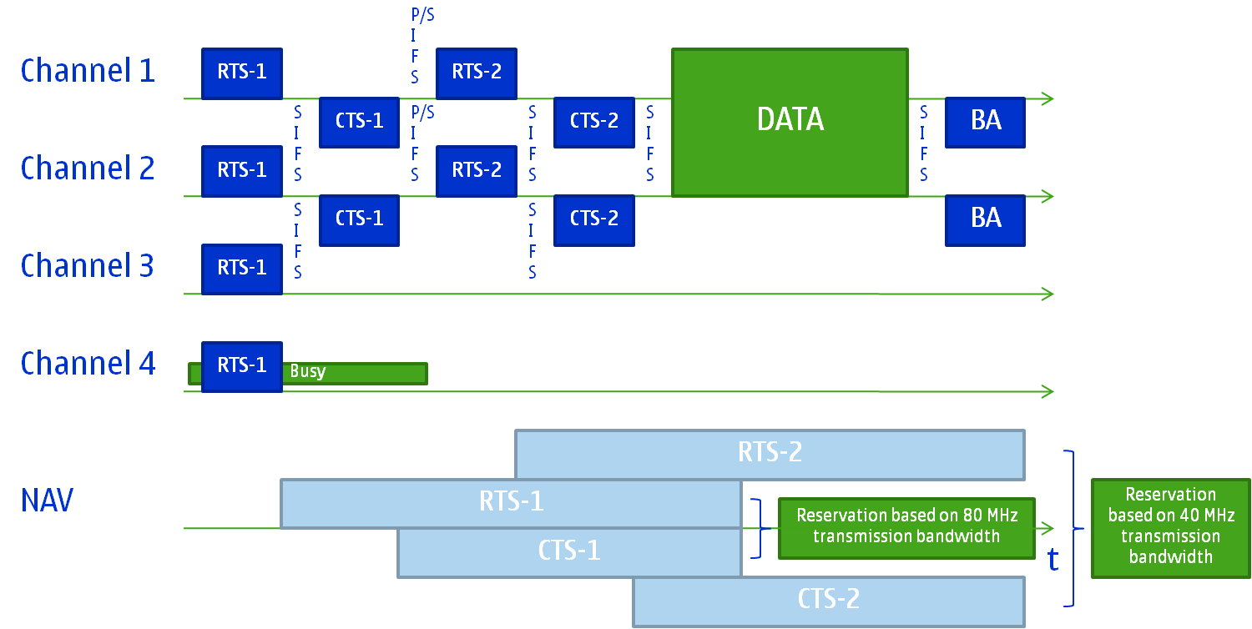
Recap, Double RTS CTS Signaling
Dual RTS CTS signaling is possible based on the following additional rules [802.11-REVmb/D6.05, 9.19.2.2]:
Receiving STA stores the address of TXOP holder after receiving RTS-1 during the initial frame exchange sequence
Receiving STA shall reply with CTS frame if RA address of RTS-2 equals its MAC address and TA address of RTS-2 equals saved TXOP holder’s address, without regard for, and without resetting, its NAV

Slide 9
Probing RTS CTS in Brief
RTS transmitter uses static reservation and short duration field to indicate probing reservation
CTS transmitter decides:
If the requested resources may be reserved, then the CTS transmitter calculates the NAV duration from the duration in RTS frame
If the requested resources may not be reserved, then the CTS transmitter sets short NAV duration
If CTS contains long NAV, the RTS transmitter may transmit CTS_to_self to extend the NAV in its coverage

Slide 10
Duration Field Handling
The duration field of the RTS signals the use of probing operation:
802.11ac RTS having duration field set to value between 72 and 132 indicates probing,i.e RTS setting NAV for 72 – 132 µs
The CTS transmitter sets the duration field:
When all resources were not reserved, the duration of the CTS is set to Value of the RTS duration field – (SIFS + CTS)
When all resources were reserved, the duration of CTS is set to (Value of the RTS duration field - 72) * 32µs
72µs is ~ duration for 2*SIFS + CTS
Maximum value of CTS duration field is 60 * 32µs = 1,92ms

Slide 11
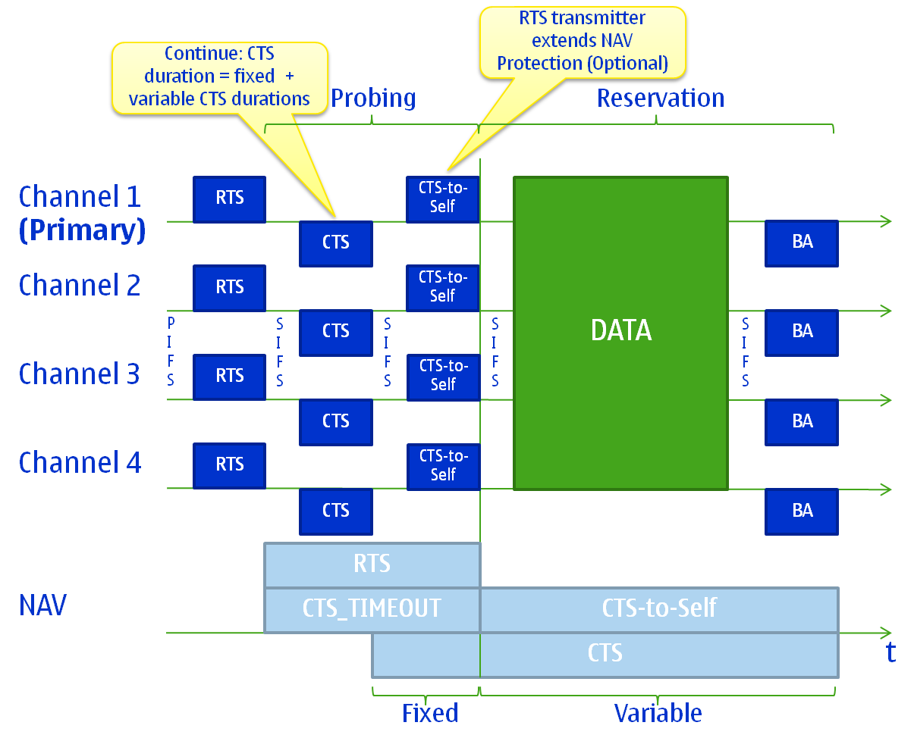
March 2011
March 2011
Example of Probing Reservation
Slide 11
Kneckt & Ong (Nokia)

Slide 12
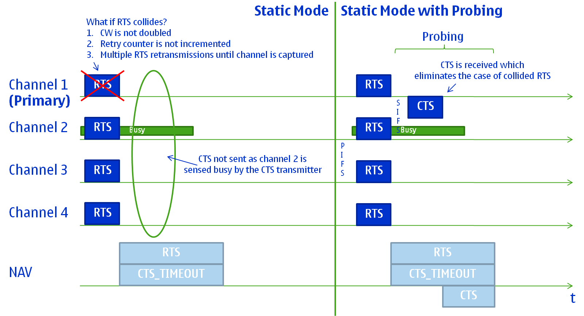
March 2011
March 2011
Comparison of Static Reservations with and without Probing
Slide 12
Kneckt & Ong (Nokia)

Slide 13
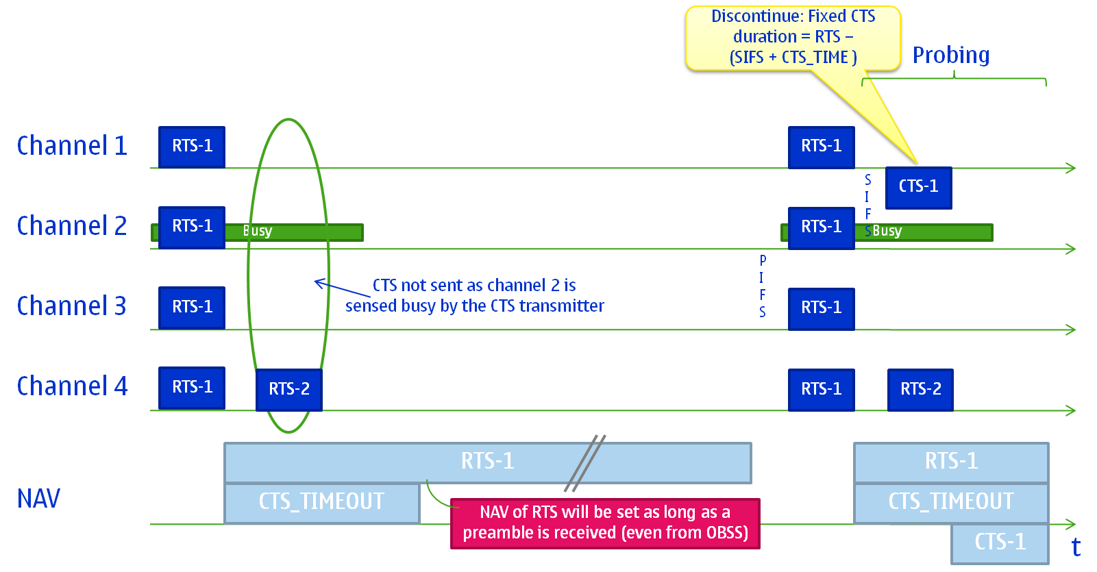
March 2011
March 2011
Preamble during “CTS Timeout”
The CTS timeout duration is 110 µs, i.e. 10 Slots + Preamble.
TXOP obtaining within 10 slots is likely.
Slide 13
Kneckt & Ong (Nokia)

Slide 14
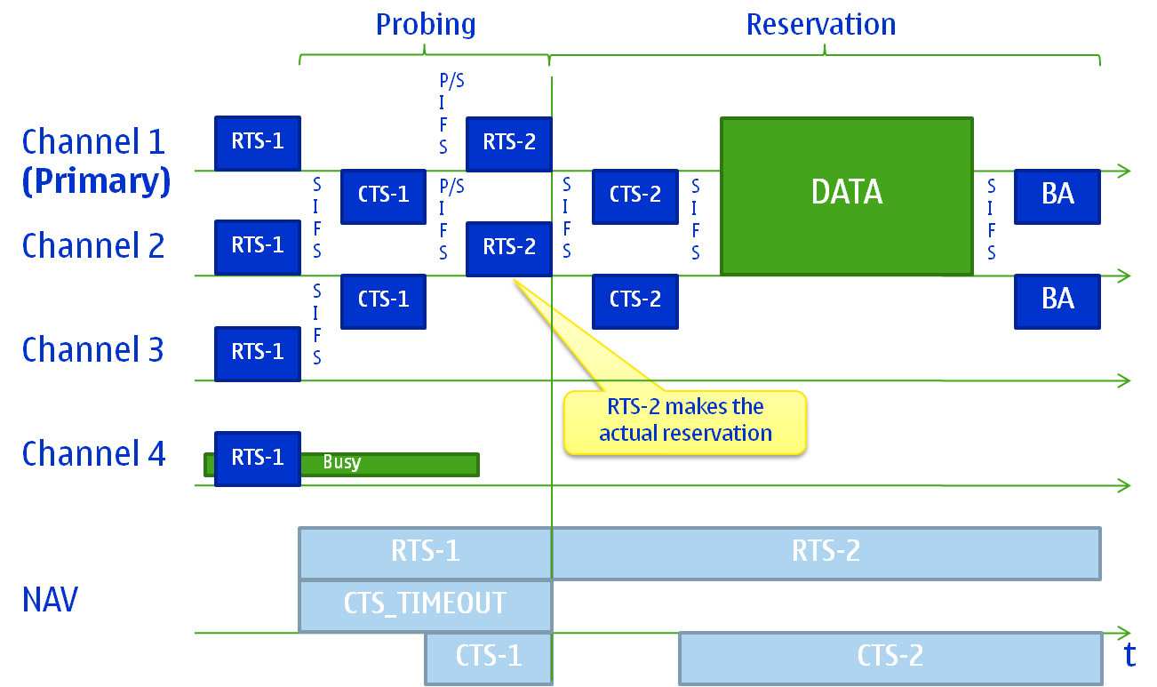
March 2011
March 2011
Check of Available BW and Duration Adjustment
Slide 14
Kneckt & Ong (Nokia)

Slide 15
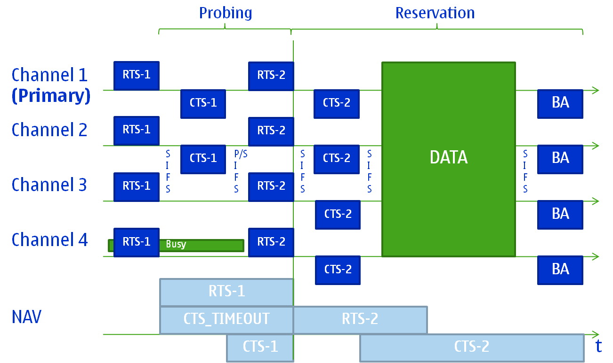
March 2011
March 2011
Double Probing for AP
Slide 15
Kneckt & Ong (Nokia)

Slide 16
Double Probing for AP, Improved Resource Use
As shown in previous slide AP has 80 MHz available, but receives discontinuing CTS1
The NAV is short after RTS1 and CTS1, just enough to protect the following RTS CTS transmission
If the CCA of AP still indicates 80 MHz to be possible, then AP may transmit new RTS to other receiver address
Other STA is close-by the AP or at the other side of the BSS
The AP has opportunity to use the whole bandwidth
Improves the AP efficiency and system capacity

Slide 17
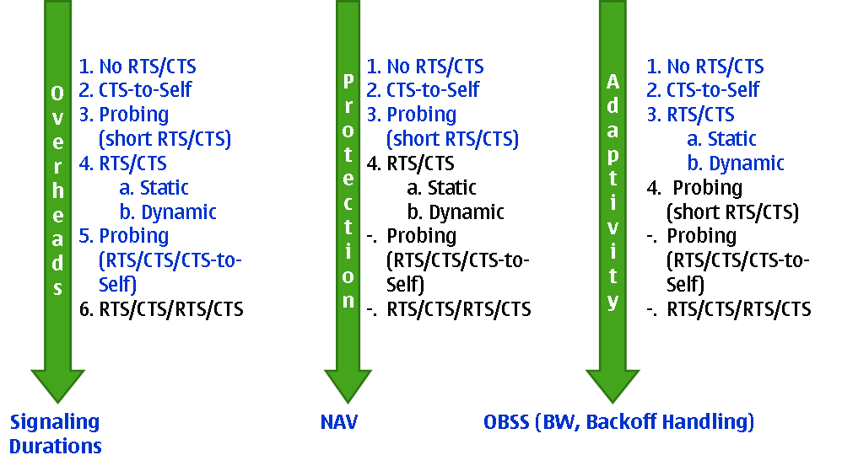
Comparison of Reservation Alternatives

Slide 18
Overhead of Reservation Alternatives
Successful RTS CTS signaling or probing reservation without optional CTS-to-self:
RTS + CTS + SIFS = 104 µs
48 µs + 40 µs + 16 µs = 104 µs
Succesful probing reservation with CTS-to-self:
1*RTS + 2*CTS + 2*SIFS =160 µs
1*48 µs + 2*40 µs + 2*16 µs = 160µs
Short dynamic reservation and actual reservation (2*RTS CTS signaling):
2* RTS + 2*CTS + 3*SIFS = 224 µs
2*48 µs + 2*40 µs + 3*16 µs = 224 µs

Slide 19
Overhead of Reservation Alternatives
Consider the case when there are 3 consecutive reservations failures:
Static mode without probing
3*(TXOP obtaining + RTS + CTS_TIMEOUT) = 780 µs
3*(102 µs + 48 µs + 110 µs) = 780 µs
Static mode with probing
TXOP obtaining + 3*RTS + 3*CTS + 5*SIFS = 446 µs
102 µs + 3*48 µs + 3*40 µs + 5*16 µs = 446 µs
Overhead reduced = 334 µs, (~43%)
TXOP obtaining = DIFS + 7.5*SLOT

Slide 20
Adaptivity of Reservation Alternatives
In the case, when all the requested bandwidth was not available:
Dynamic reservation: CTS is transmitted at available channels
Dynamic reservation sets the proposed NAV to available channels
The Dynamic reservation easily sets duration field to the TXOPlimit and uses CF-End to release unused resources
The challenges in the CF-End use are shown in back-up slides
Static reservation without Probing: no CTS is transmitted
No knowledge of the error, i.e. failure due to collision or unavailable resources
Static reservation with Probing: CTS with ”short NAV” is transmitted at available channels
The RTS transmitter may decide to continue reservation
Single rule for backoff:
Currently the static reservations have exception in backoff maintenance, i.e. the CW (backoff) is not increased after transmission error

Slide 21
Conclusions
The presentation defined the static reservation with probing:
System and AP resource utilization is improved
RTS transmitter has more control to the medium reservation
Static reservation with probing is more error tolerant and minimize the impacts of unsuccessful reservations

Slide 22
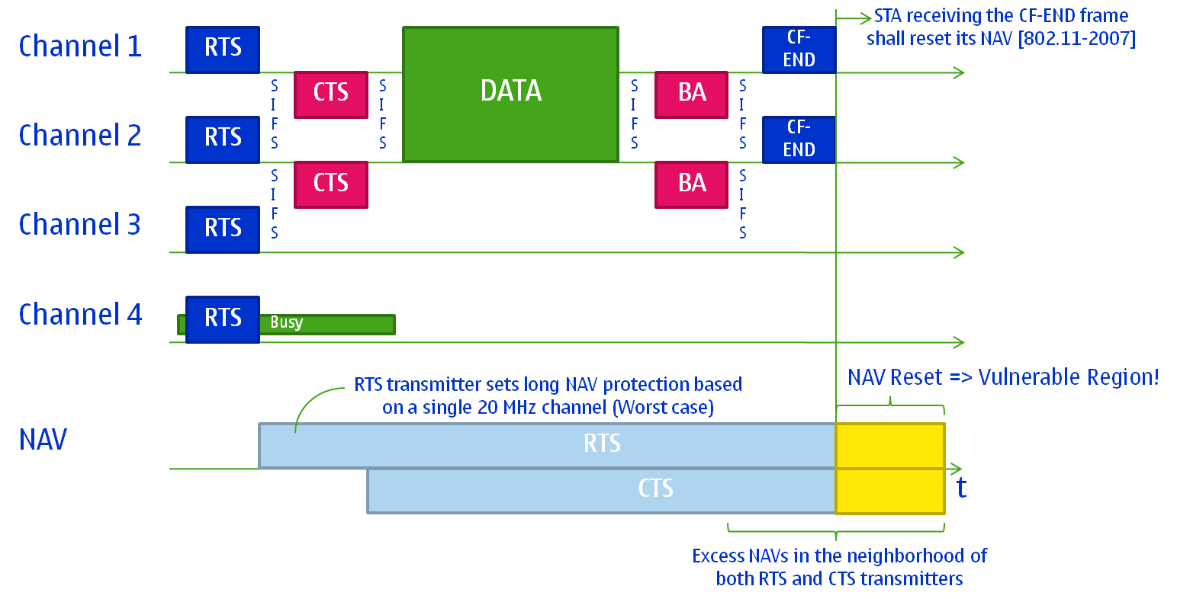
Back-up: Greedy Reservation
RTS transmitter sets long NAV protection
CF-END is a vulnerable operation

Slide 23
Back-up: Extending vs. Resetting the NAV
The CF-End resets the NAVs (NAV is set to zero) at all receiving devices
Case1: STA3 may be hidden terminal to TXOP between STA1 and STA2
Case2: STA 3 is not getting the CF-End and does not reset the NAV. STA 3 starts the calculation of backoff after NAV expires
Adaptive NAV avoids both problems
Adaptive NAV is more compatible with TXOP Power save, in which the STAs in the Doze state have similar challenges as described for case 1
STA 1
RTS
CF-End
CTS
STA 2
CTS
STA 3
STA 4
STA 1
RTS
CTS
STA 2
STA 3
STA 4
CTS
CF-End

Slide 24
Pre-motion
Do you accept to include the normative text as described in 11-11-0384-00-00ac-resolutions-to-static-RTS-CTS-comments.doc to the spec framework document and to solve CIDs 683, 698 and 1236 ?
Y
N
A

