Slide 1
Path Loss and Delay Spread Models for 11ah
Date: 2011-03-14
Authors:
Slide 1

Slide 2
Summary
Part 1
Discussion of Walfisch-Ikegami Path Loss Model
Example Path Loss Calculation
Conclusions
Part 2
Simple Channel Models for PHY link evaluation

Slide 3
Part 1

Slide 4
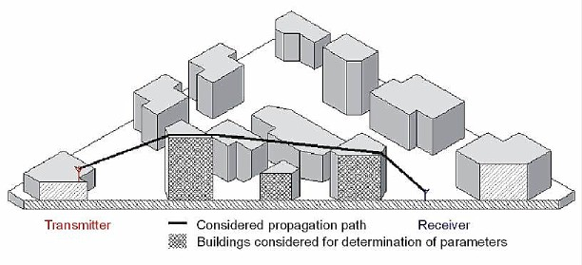
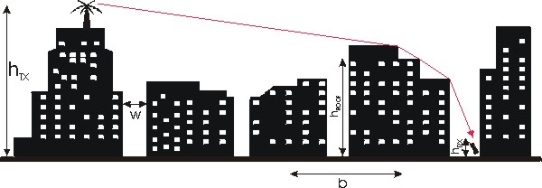
Walfisch-Ikegami Path Loss Model
Frequency f (800...2000 MHz)
Height of the transmitter h_{tx} (4...50 m)
Height of the receiver h_{rx} (1...3 m)
Distance d (20...5000 m)
Mean value of building heights h_{roof}
Mean value of widths of streets w
Mean value of building separation b

Slide 5
WI Model NLOS Path Loss
NLOS path loss consists of
Free space loss
Rooftop-to-street diffraction
Multi-screen loss – consider antenna is below/above building height
Multi-screen loss
Rooftop-to-street diffraction

Slide 6
Example Path Loss Calculation (Medium Size City, Suburban Center)
Path loss more sensitive to height when distance is long
10~20 dB additional loss if antenna below roof
To reach 1 km, antenna gain, lower sensitivity phy, etc required
Above Roof
Below Roof
1 Watt EIRP -(-88dBm) Sensitivity
AP Antenna height from 4 to 16 m
Client Antenna height from 2 to 8 m

Slide 7
Conclusion Part 1
WI path loss model is discussed
An example path loss, and sensitivity to antenna heights is presented
Antenna gain, lower sensitivity phy, other improvements are required to reach1 km

Slide 8
Part 2

Slide 9
Introduction
Contribution 11/251r0 (Outdoor Channel Models for 802.11ah) recommends re-using 3GPP Channel Models in IEEE 802.11ah.
3GPP models are valid for most frequency ranges being considered for 11ah
Similar outdoor usage scenarios
Leveraging on 3GPP’s channel modeling approach has a number of advantages
Saves time and effort in 11ah
Well tested/verified and used in extensive amount of simulations
In this contribution
provide a further discussion on path loss and
propose to adopt a further set of simple channel models for PHY design/verification
Again following 3GPP’s approach

Slide 10
System vs. Link Evaluation
The proposal made in 11/251r0 was to adopt 3GPP channel model used for “system-level” evaluation
Spatial aspect of the channel are modeled in detail
Path-loss modeled using extended COST 231 model
Model based on a very large number of parameters
In 11ah the above model will be useful to evaluate system throughout, latency, MU-MIMO performance etc.
However for the purpose of designing and evaluating the PHY (preambles, coding and modulation, repetition etc) simple channel models should be adopted
to evaluate single links (between BS and STA)
capturing multi-path delay, fading and Doppler spread
This approach will speed up PHY design and allow us to easily ensure simulations are consistent

Slide 11
Our Proposal
PHY link simulations for 11ah use channel models used by 3GPP (for WCDMA link simulations):
Pedestrian A (Ped-A)
Pedestrian B (Ped-B) and
Vehicular A (Veh-A)
Above models have following characteristics
Models SISO links
Number of paths and path delay are fixed for each model
Path assumed to be mutually independent and Rayleigh distributed
Doppler spread applied
Advantages
sufficiently models fundamental channel characteristics
easy to generate
few parameters means models are easily reproduced consistently

Slide 12
Channel Model Summary
Path # | Ped-A |  | Ped-B |  | Veh-A
 | Delay [ns] | Rel. Pow [dB] | Delay [ns] | Rel. Pow [dB] | Delay [ns] | Rel. Pow [dB]
1 | 0 | 0 | 0 | 0.0 | 0 | 0,0
2 | 110 | -9.7 | 200 | -0.9 | 310 | -1.0
3 | 190 | -19.2 | 800 | -4.9 | 710 | -9.0
4 | 410 | -22.8 | 1200 | -8.0 | 1090 | -10.0
5 | -- | -- | 2300 | -7.8 | 1730 | -15.0
6 | -- | -- | 3700 | -23.9 | 2510 | -20.0
Speed: Limit to 3 km/h and/or 30 km/h

