Slide 1
March 2018 802.11ak Non-Agenda
Date: 2018-03-02
Authors:
Name | Affiliations | Address | Phone | Email
Donald Eastlake | Huawei Technologies | 155 Beaver Street, Milford, MA 01757 USA | +1-508-333-2270 | d3e3e3@gmail.com

Slide 2
IEEE 802.11ak/GLK: Enhancements For Transit Links Within Bridged Networks
Rosemont, Illinois
March 2018
Chair & Editor: Donald E. Eastlake 3rd (Huawei)
d3e3e3@gmail.com +1-508-333-2270
Vice Chair: Mark Hamilton (Ruckus Wireless/ARRIS)
Vice Editor: Norm Finn (Huawei)
Secretary: Vacant
Mailing list: STDS-802-11-TGAK@listserv.ieee.org

Slide 3
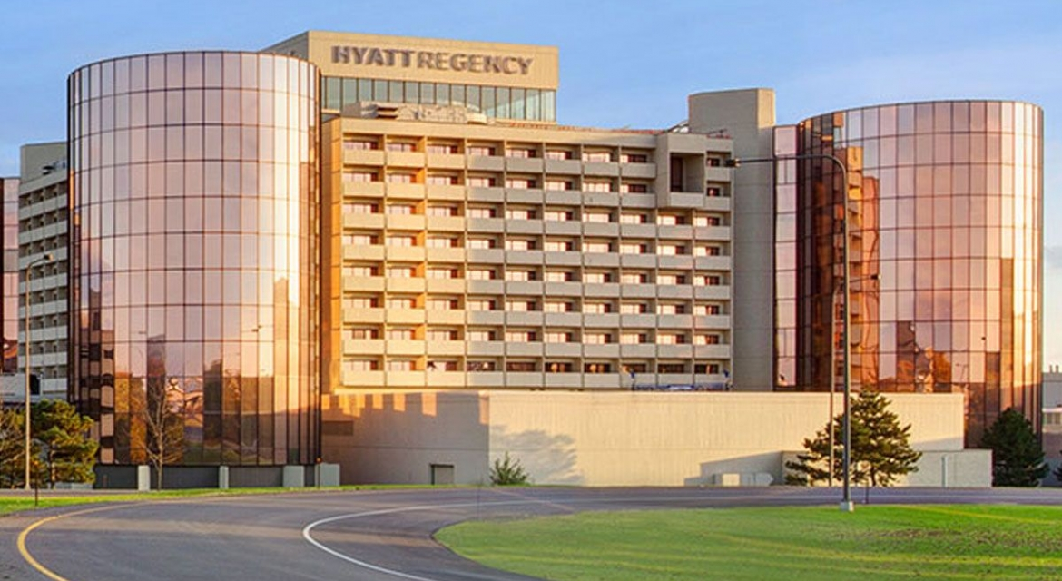
Venue
Hyatt Regency O’Hare, Rosemont, Illinois

Slide 4
TGak Timeline
March 2015 – Initial WG Letter Ballot
February 2016 – WG Recirculation
January 2017 – Sponsor Ballot Pool Formation Start
January 2017 – MEC/MDR Initiated
(March 2017 – Sponsor Ballot Pool Formation and MEC/MDR Completed)
May 2017 – Initial Sponsor Ballot
October 2017 – Sponsor Recirculation
Dec 2017 – Sponsor Recirculation (x2)
January 2018 – Final WG & ExecComm
March 2018 – RevCom Approval

Slide 5
Sessions
No 802.11ak Session are scheduled.
Day | Time | Room
N/A | N/A | N/A

Slide 6
Participants have a duty to inform the IEEE
Participants shall inform the IEEE (or cause the IEEE to be informed) of the identity of each holder of any potential Essential Patent Claims of which they are personally aware if the claims are owned or controlled by the participant or the entity the participant is from, employed by, or otherwise represents
Participants should inform the IEEE (or cause the IEEE to be informed) of the identity of any other holders of potential Essential Patent Claims
Early identification of holders of potential Essential Patent Claims is encouraged

Slide 7
Ways to inform IEEE
Cause an LOA to be submitted to the IEEE-SA (patcom@ieee.org); or
Provide the chair of this group with the identity of the holder(s) of any and all such claims as soon as possible; or
Speak up now and respond to this Call for Potentially Essential Patents
If anyone in this meeting is personally aware of the holder of any patent claims that are potentially essential to implementation of the proposed standard(s) under consideration by this group and that are not already the subject of an Accepted Letter of Assurance, please respond at this time by providing relevant information to the WG Chair

Slide 8
Other guidelines for IEEE WG meetings
All IEEE-SA standards meetings shall be conducted in compliance with all applicable laws, including antitrust and competition laws.
Don’t discuss the interpretation, validity, or essentiality of patents/patent claims.
Don’t discuss specific license rates, terms, or conditions.
Relative costs of different technical approaches that include relative costs of patent licensing terms may be discussed in standards development meetings.
Technical considerations remain the primary focus
Don’t discuss or engage in the fixing of product prices, allocation of customers, or division of sales markets.
Don’t discuss the status or substance of ongoing or threatened litigation.
Don’t be silent if inappropriate topics are discussed … do formally object.
---------------------------------------------------------------
For more details, see IEEE-SA Standards Board Operations Manual, clause 5.3.10 and Antitrust and Competition Policy: What You Need to Know at http://standards.ieee.org/develop/policies/antitrust.pdf

Slide 9
Patent-related information
The patent policy and the procedures used to execute that policy are documented in the:
IEEE-SA Standards Board Bylaws (http://standards.ieee.org/develop/policies/bylaws/sect6-7.html#6)
IEEE-SA Standards Board Operations Manual (http://standards.ieee.org/develop/policies/opman/sect6.html#6.3)
Material about the patent policy is available at
http://standards.ieee.org/about/sasb/patcom/materials.html
If you have questions, contact the IEEE-SA Standards Board Patent Committee Administrator at patcom@ieee.org

Slide 10
[Reference Information]
802.11ak PAR and Five Criterion
https://development.standards.ieee.org/get-file/P802.11ak.pdf?t=77398400003
11-12/1207r1, “802.11 GLK Draft PAR”
11-12/1208r0, “802.11 GLK Draft 5C”
Draft 6.0 of 802.11ak:
http://www.ieee802.org/11/private/Draft_Standards/11ak/Draft P802.11ak_D6.0.pdf
802.1Qbz and 802.1AC-REV are published as IEEE Std 802.1Qbz-2016 and IEEE Std 802.1AC-2016
Last Drafts:
http://www.ieee802.org/1/files/private/bz-drafts/d2/802-1Qbz-d2-4.pdf
http://www.ieee802.org/1/files/private/ac-rev-drafts/d4/802-1ac-rev-d4-0.pdf
(Note: you can use 802.1 or 802.11 credential to access either members site.)

