Slide 1
Performance evaluation of MU-RTS under OBSS environment
Date: 2010-11-10
Authors:
Name | Affiliations | Address | Phone | email
B. A. Hirantha Sithira Abeysekera | NTT | 1-1, Hikarino-oka, Yokosuka-shi, Japan | +81-46-859-8266 | hirantha.abeysekera@lab.ntt.co.jp
Shoko Shinohara | NTT | 1-1, Hikarino-oka, Yokosuka-shi, Japan | +81-46-859-5107 | shinohara.shoko@lab.ntt.co.jp
Yusuke Asai | NTT | 1-1, Hikarino-oka, Yokosuka-shi, Japan | +81-46-859-3494 | asai.yusuke@lab.ntt.co.jp
Yasuhiko Inoue | NTT | 1-1, Hikarino-oka, Yokosuka-shi, Japan | +81-46-859-5097 | inoue.yasuhiko@lab.ntt.co.jp
Takeo Ichikawa | NTT | 1-1, Hikarino-oka, Yokosuka-shi, Japan | +81-46-859-3079 | ichikawa.takeo@lab.ntt.co.jp
Masato Mizoguchi | NTT | 1-1, Hikarino-oka, Yokosuka-shi, Japan | +81-46-859-3758 | mizoguchi.masato@lab.ntt.co.jp
Philippe Christin | Orange lab | 4, rue du clos courtel 35512 Cesson-Sévigné | +33 2 99 12 47 93 | philippe.christin@orange-ftgroup.com
Laurent Cariou | Orange lab | 4, rue du clos courtel 35512 Cesson-Sévigné | +33 2 99 12 43 50 | laurent.cariou@orange-ftgroup.com

Slide 2
Name | Affiliations | Address | Phone | email
Yuichi Morioka | Sony Europe Ltd. | Jays Close, Viables, Basingstoke, Hampshire, RG22 4SB, UK | +44 (0) 1256 828114 | Yuichi.Morioka@eu.sony.com
Ted R. Booth III | Sony Electronics Inc. | 16530 Via Esprillo Building 7, MZ7021 San Diego, CA 92127 | +1 858 942 8044 | ted.booth@am.sony.com
André Bourdoux | IMEC | Kapeldreef 75, 3001 Leuven, Belgium | +32-16-288.215 | bourdoux@imec.be

Slide 3
Abstract
In this document, we first present some results of a statistical analysis of housing conditions in Japan, and show that more than 40% among all dwellings are the apartment houses.
Then, we show the numerical results of the number of OBSSs that can be happen in such an apartment environment.
Finally, we present simulation results of a simple OBSS scenario, and as an operator, we show the importance of a MAC protection mechanism for TGac.

Slide 4
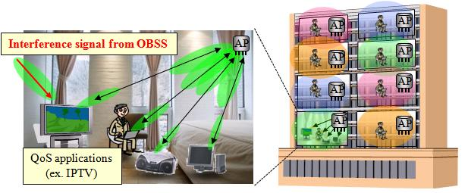
Statistical analysis for the number of OBSSs according to “Housing and Land Survey*” in Japan
The Japanese governmental survey shows:
More than 40% houses are apartment houses (about 20 million in all of 49.6 million dwellings).
The average area of floor space per dwelling in apartment house is about 520 ft² (= 48 m²).
About 75% apartment houses are made of reinforced steel-framed concrete.
Operators’ perspective:
It is expected that 11ac standard will extend capacity of wireless home network which conveys network services (ex. on-demand video streaming services) to subscribers not only detached house but also apartment house users.
It is important to examine the wireless environment in apartment house users
*“Housing and Land Survey in 2008” done by
Statistics Bureau in Ministry of Internal Affairs and Communications, Japan. http://www.stat.go.jp/english/data/jyutaku/index.htm

Slide 5
Statistical analysis for the number of OBSSs according to “Housing and Land Survey*” in Japan
* Based on the “Housing and Land Survey, 2008.”
Evaluation conditions:
Ave. dimensions of each apartment*: W / L / H = 16.5 / 33 / 10 [ft]
Tx power: 17 dBm@5GHz
Power loss of room wall and floor [1]: 13 [dB]
APs location: Each AP is placed at the center of each apartment house
Carrier sense level (which is equal to interference threshold):
-82dBm@20MHz / -79dBm@40MHz / -76dBm@80MHz / -73dBm@160MHz
Bandwidth expansion to more than 40MHz causes one or more OBSSs in above apartment environment.
Some kinds of techniques to reduce the influence of OBSSs should be considered.
** IEEE 802.11n channel model B – Residential.
Bandwidth per channel | The # of interfering BSSs | The # of available channels | The # of OBSSs in expectation
20MHz | 12 | 19 | 0
40MHz | 10 | 9 | 0.22
80MHz | 10 | 4 | 1.75
160MHz | 10 | 2 | 4.50
Interference level [dBm] in each apartment because of the AP in the top left apartment**.
(AP)
-56.33
-79.87
-48.72
-71.71
-93.53
-72.25
-89.20
-108.2
-91.42
-106.4
-123.2

Slide 6
OBSS issue
Consider frame transmissions using 80MHz (or 160 MHz) channel bandwidth.
As shown in previous slide, OBSS is likely to happen due to lack of channels when using 80MHz (or 160MHz) bandwidth.
This increases the frame collision probability at STAs which are placed in OBSS environment (especially, when APs are hidden to each other).
Moreover, TGac allows transmitting very large (up to 1 MB) A-MPDUs in one transmission attempt.
Therefore, the duration of a frame transmission tends to be longer.
This also may increase the frame collision probability especially at STAs in OBSS environment.

Slide 7
TGac background
DL MU-MIMO, which allows simultaneous frame transmissions to different STAs, is a key feature in TGac.
Multi-RTS [2], Multiple CTSs [3] schemes (hereafter called MU-RTS scheme) were presented in September 2010 meeting, and showed qualitatively the importance of MAC protection mechanism [4] for TGac.
Straw Poll results are summarised in page 3 of Ref. [5].
Even though OBSS scenarios are complicated [6], TGac agrees to see how 11ac devices behave in OBSS environment [7, 8].
So far, however, not that much evaluation results were presented.
In next slides we show some OBSS simulation results.

Slide 8
Frame sequence for MU-RTS scheme
AP sends DATA frame only to STAs who replied with CTSs.
The length of an A-MPDU depends on the current number of MSDUs buffered at the AP.
AP can transmit A-MPDUs to up to 4 STAs simultaneously using DL MU-MIMO technique.
When AP accesses to medium, it first transmits a CTStoSelf followed by MU-RTS [2, 3].
DATA (AP STA-1)
DATA (AP STA-2)
…
max (N) = 4
CTStoSelf
MU-RTS
SIFS
DATA (AP STA-N)
AP
STA-1
CTS
BA
STA-2
CTS
…
BA
…
…
STA-N
CTS
BA
Each STA responds with a CTS frame if it is ready to receive DATA frame from the AP.
All BAs are scheduled and transmitted in the same order as CTSs.

Slide 9
Simulation conditions and scenarios
Consider only downlink UDP traffic
Two overlapping BSSs
Each BSS consists of one AP and 4 STAs
xSTAs (x=1,2,…,4) hear signal of the other
AP
APs are hidden or non-hidden to each other
STAs can receive any frames correctly unless there
are collisions (bit errors caused by thermal noise and
channel fading are not considered)
MPDUs for each STA are generated at the corresponding
AP by i.i.d.
AP-1
AP-2
AP-1
AP-2
BSS-1
BSS-2
BSS-1
BSS-2
hidden AP
non-hidden AP

Slide 10
2
2
1
1
3
3
2
2
3
3
AP-1
AP-2
AP-1
AP-2
1
1
4
4
4
4
BSS-1
BSS-2
BSS-1
BSS-2
hidden AP; 1STA
hidden AP; 2STAs
1
1
3
3
2
4
2
2
2
AP-1
1
AP-2
AP-1
1
4
AP-2
4
3
3
4
BSS-1
BSS-2
BSS-1
BSS-2
hidden AP; 3STAs
hidden AP; 4STAs

Slide 11
Parameter values
Parameter | Value
Bandwidth per channel | 80 [MHz]
The # of subcarrier per spatial stream | 216
MCS | 64QAM, 5/6
Data rate | 270 [Mbps]
Basic rate | 6 [Mbps]
The # of APs | 2
The # of STAs per AP | 4
The # of antennas per AP | 8
The # of antennas per STA | 2
The # of streams towards STA in a single transmission | 2
Parameter | Value
MU-RTS length | 37[B]=76 [usec]
CTS length | 14[B]=44 [usec]
BA length | 28[B]=52 [usec]
SIFS | 16 [usec]
DIFS | 34 [usec]
SlotTime | 9 [usec]
ACK timeout interval | 58 [usec]
MSDU size | 1,500 [B]
Max. A-MPDU size | 65,535 [B]
CWmin | 15
CWmax | 1,023
Retry Limit (Long, Short) | (4, 7)
Simulator: OPNET 15.0.A

Slide 12
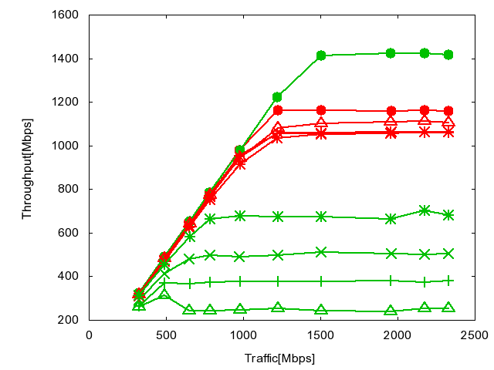
Simulation results
no hidden nodes, without MU-RTS
no hidden nodes, with MU-RTS
hidden AP; 0STA, with MU-RTS
hidden AP; xSTAs, with MU-RTS
x=1,2,…,4
hidden AP; 1STA, without MU-RTS
hidden AP; 2STAs, without MU-RTS
hidden AP; 3STAs, without MU-RTS
hidden AP; 4STAs, without MU-RTS

Slide 13
Summary
We evaluate the performance of MU-RTS scheme.
MU-RTS scheme slightly degrades the system throughput when APs are known (non-hidden) to each other, because of the additional overhead due to MU-RTS and multiple CTSs.
When APs are hidden, MU-RTS greatly improves the system throughput.
Needs some sort of protection mechanism for TGac.
Frame sequences, Frame formats, and ACK mechanism (polled or scheduled) are TBD.
An example of frame format is described in [2]

Slide 14
References
[1] Rec. ITU-R P.1238-3, "Propagation data and prediction methods for the planning of indoor radio communication systems and radio local are networks in the frequency range 900MHz to 100GHz," ITU-R Recommendation P Series, 2003.
[2] Y. Morioka et al., “Multi-RTS Proposal,” Doc.: IEEE 802.11-10/1124r2.
[3] T. Kaibo et al., “Multiple CTSs in MU-MIMO Transmission,” Doc.: IEEE 802.11-10/1067r0.
[4] Y. J. Kim et al., “Considerations on MU-MIMO Protection in 11ac,” Doc.: IEEE 802.11-10/0335r1.
[5] B. Hart et al., “TGac MU-MIMO Ad Hoc Minutes,” Doc.: IEEE 802.11-10/1161r0.
[6] A. Ashley et al., “OBSS Requirements,” Doc.: IEEE 802.11-08/0944r7.
[7] Y. Takatori, “Importance of Overlapped BSS issue in 802.11ac,” Doc.: IEEE 802.11-09/0630r1.
[8] P. Loc et al., “TGac Functional Requirements and Evaluations Methodology Rev. 15,” Doc.: IEEE 802.11-09/0451r15.

Slide 15
Annex

Slide 16
Will it work with single legacy RTS/CTS?
Upon receiving the CTS, AP starts transmitting DATA frame to multiple STAs using MU-MIMO.
If AP does not receive CTS, it postpones the frame transmission and starts backoff.
Retransmission procedure is TBD.
AP sends a legacy RTS to one of STAs that the AP intends to transmit DATA frame. STA selection procedure is TBD.
DATA (AP STA-1)
DATA (AP STA-2)
…
max (N) = 4
RTS
DATA (AP STA-N)
BAR
BAR
AP
STA-1
CTS
BA
STA-2
BA
…
…
STA-N
BA
The STA responds with a CTS frame if it is ready to receive DATA frame from the AP.
The STA which replied with CTS first acknowledges with BA.
Other STAs do upon the reception of BAR from the AP

Slide 17
Will it work with single legacy RTS/CTS?
Apartment environment
Room #0
Room #1
Room #2
No!
“Single legacy RTS/CTS” may not protect all STAs!!
3
1
3
2
1
3
2
AP-0
AP-1
AP-2
1
2
4
4
4
BSS-0
BSS-1
BSS-2

Slide 18
Will it work with single legacy RTS/CTS?
Pros:
No modifications to legacy Dot11 RTS/CTS mechanism
Less overhead
Backward compatibility
Cons:
Cannot protect all STAs within a single RTS/CTS exchange
DATA frame collisions still may occur

Slide 19
How about multiple legacy RTSs/CTSs with a round-robin manner?
AP transmits DATA frame, using MU-MIMO, only to STAs who replied with CTS.
AP exchanges legacy RTS/CTS with all STAs that it intends to transmit DATA.
The order is TBD.
Need to modify the Dot11 NAV settings. Because, STA-2 sets NAV and prevent transmitting frames if it receives third part RTSs or CTSs.
DATA (AP STA-1)
DATA (AP STA-2)
…
max (N) = 4
AP
RTS#1
RTS#2
RTS#3
DATA (AP STA-N)
STA-1
CTS#1
BA#1
STA-2
CTS#2
…
BA#2
…
…
STA-N
CTS#4
BA#2
Each STA responds with a legacy CTS frame if it is ready to receive DATA frame from the AP.
All BAs are scheduled and transmitted in the same order as CTSs.

Slide 20
How about multiple legacy RTSs/CTSs with a round-robin manner?
Pros:
Works with least modification
Ensures full protection
Backward compatibility
Cons:
Needs some modifications on Dot11 default NAV settings
Large overhead

