Slide 1
[Intra-cluster response model and parameter for channel modeling at 60GHz (Part 3)]
Date: 2010-1-19
Authors:

Slide 2
Abstract
This paper will give all intra-cluster parameters for 3 different environments defined by TGad
To align intra-cluster channel models, this paper has adopted K-factor and ready to be integrated with inter-cluster channel models given by doc. 09/334r4 by Alexander
For simpler PHY simulations:
Single channel model for each living, conference, and cubicle room environment is good preferable rather than too many channel models
We suggest to use the channel model with 30 degree HPBW antennas and vertical polarization for simulation scenarios for directional antenna communications.

Slide 3
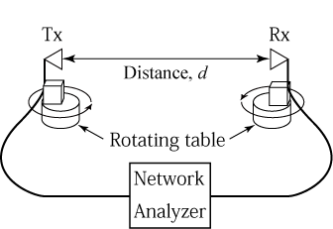
Measurement system
θ
φ
Instrument: Vector network analyzer
Antenna: Conical horn antenna

Slide 4
Measurement set up
Parameter | Value
Center frequency | 62.5 GHz
Band width | 3 GHz
Number of frequency points | 801
Frequency step | 3.75 MHz
HPBW of antenna (Gain) | 30degree(STA), 90 degree(AP)
Polarization | Vertical(STA), Circular(AP)
Calibration | Direct port connection without antennas

Slide 5
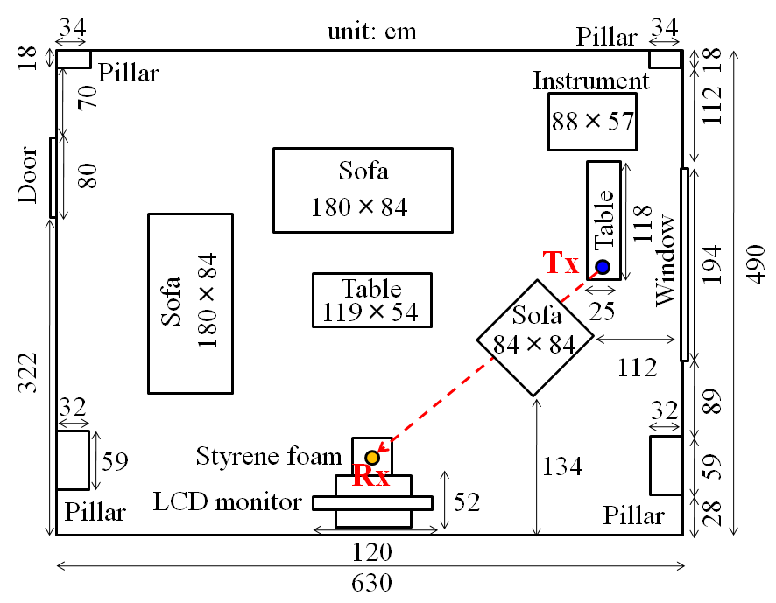
Living room environment ‘defined by TGad’
Antenna height:
1.5m (LoS scenario)
1.0 m (NLoS scenario)
D = 3m

Slide 6
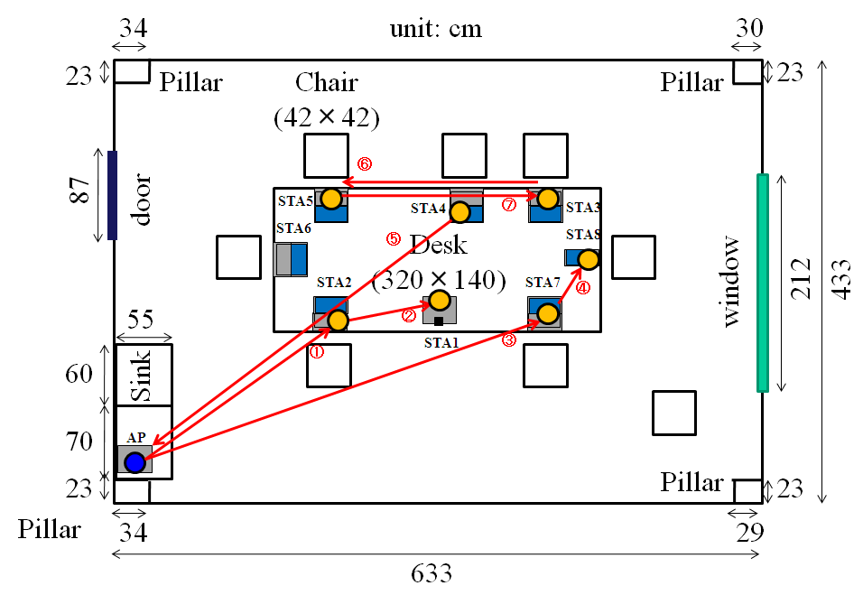
Conference room environment “defined by TGad”

Slide 7
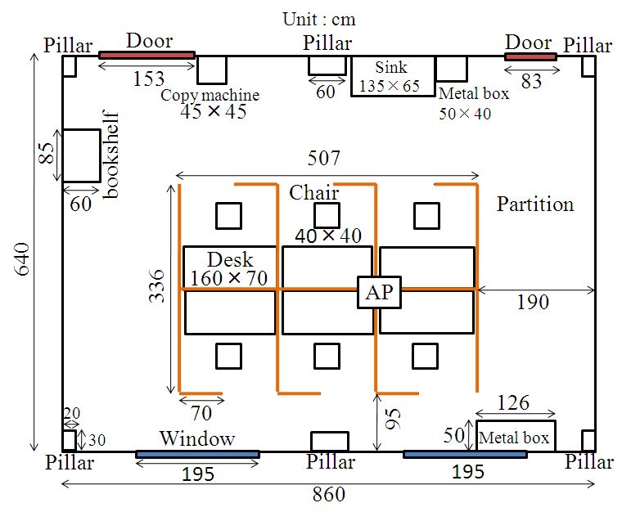
Floor plan of cubicle office

Slide 8
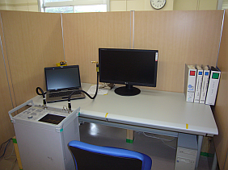
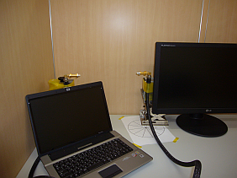
STA-STA link
Rx
Tx
Rx
Tx
N.A.
Measurement set up
Manually rotation (30deg step)
This is a very short transmission scenario.

Slide 9
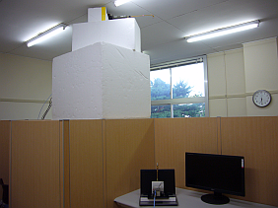
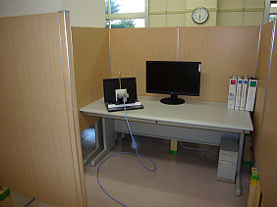
AP-STA link
Tx
Rx
AP-STA Link
Inside of a cubicle
This is a vertical transmission link scenario.

Slide 10
Circular polarization is adopted for AP antenna
AP antenna
AP antenna
C Pol.
C Pol.
E
Rotation
E
Polarization mismatch is generated by rotation of PC
Circular polarized signal wave has adopted for AP antenna

Slide 11
Intra-cluster parameters for all environments (Ant. HPBW: 30deg, V pol.)
Environments |  | k_{f} [dB] | k_{b} [dB] | γ_{f} [ns] | γ_{b} [ns] | λ_{f} [ns⁻¹] | λ_{b} [ns⁻¹] | Distribution | Distribution
Living room |  | 11.5 | 10.9 | 1.25 | 8.7 | 0.277 | 0.996 | Rayleigh | Rayleigh
Conference room |  | 16.8 | 18.4 | 6.13 | 6.29 | 0.547 | 0.501 | Rayleigh | Rayleigh
Cubicle | STA-STA LOS | N/A | N/A | N/A | N/A | N/A | N/A | N/A | N/A
 | AP-STA | N/A | 24.5 | N/A | 0.690 | N/A | 1.13 | N/A | Rayleigh
Central ray of intra-cluster
k_{f}
kb
Rayleigh distribution
Rayleigh distribution
Ray decay factor, γ_{f}
Ray decay factor, γ_{b}
t = 0
Time of arrival
Arrival rate, λ_{b}
Arrival rate, λ_{f}

Slide 12
Summary of Intra-cluster Parameters for Conference Room Environment
Proposal; Averaged intra-cluster parameters are used for conference room channel model –two measured environments (Doc.09/433r4 and Doc.10/112r1)
Parameter | Notation | Value Doc.09/433r4 | Averaged Value
Pre-cursor rays K-factor | K_{f} | 5 dB | 10 dB
Pre-cursor rays power decay time | γ_{f} | 1.3 ns | 3.7 ns
Pre-cursor arrival rate | λ_{f} | 0.20 ns⁻¹ | 0.37 ns⁻¹
Pre-cursor rays amplitude distribution |  | Rayleigh | Rayleigh
Number of pre-cursor rays | N_{f} | 2 | 6
Post-cursor rays K-factor | K_{b} | 10 dB | 14.2 dB
Post-cursor rays power decay time | γ_{b} | 2.8 ns | 4.5 ns
Post-cursor arrival rate | λ_{b} | 0.12 ns⁻¹ | 0.31 ns⁻¹
Post-cursor rays amplitude distribution |  | Rayleigh | Rayleigh
Number of post-cursor rays | N_{b} | 4 | 8

Slide 13
Summary of Intra-cluster Parameters for Living Room Environment
Proposal; Intra-cluster parameters extracted from measured data (Doc.10/112r1)
Parameter | Notation | Value
Pre-cursor rays K-factor | K_{f} | 11.5 dB
Pre-cursor rays power decay time | γ_{f} | 1.25 ns
Pre-cursor arrival rate | λ_{f} | 0.28 ns⁻¹
Pre-cursor rays amplitude distribution |  | Rayleigh
Number of pre-cursor rays | N_{f} | 6
Post-cursor rays K-factor | K_{b} | 10.9 dB
Post-cursor rays power decay time | γ_{b} | 8.7 ns
Post-cursor arrival rate | λ_{b} | 1.0 ns⁻¹
Post-cursor rays amplitude distribution |  | Rayleigh
Number of post-cursor rays | N_{b} | 8

Slide 14
Conclusion
Intra-cluster channel models for two environments are integrated and proposed (Doc.09/433r4 and Doc.10/112r1): 30 degree HPBW antennas for both Tx/Rx and vertical polarization
Ready to merge with inter-cluster channel models
Preliminary intra-cluster parameters for cubicle environment are presented

