Slide 1
LAN Technology Directions and Opportunities for Managed Services
Paul Congdon
September 2019

Slide 2
The Forces Driving Change in the Campus LAN
Digital Transformation
The Interactive Cloud
Mobility
IoT
Security
Notes:
Digital transformation:
DT is about increasing organizational efficiency and agility for business processes. Enterprises are digitizing workflows for higher productivity, lower operating costs and competitive advantage. As more business processes become digital, networks, including campus LANs, have to support the shift in scale and complexity. Digital transformation is the adoption of digital processes and tools to achieve strategic business goals. This is really the umbrella force that is enabled by cloud, mobility, IoT and security below – the other forces are really all about digital transformation.
Interactive Cloud:
The need to interact with the cloud in real-time is more important - augmented reality, voice recognition, all the work in the DC can’t be dropped in the LAN
Enterprises are augmenting internal, on-premise IT with cloud, including on-premise private cloud, colocated private cloud or public cloud services. Campus networks have to meet user expectations of application performance and administrator needs around security and policy in a consistent way.
Mobility:
Wireless and mobility are shaping enterprise network infrastructure. Users accessing corporate data from smartphones create challenges for back-end IT infrastructure and greater demand for enterprise mobility. But it is a demand that has to be met: mobile devices are already the predominant means of network access for all users. Improvements in wireless communications are impacting the wired network and convergence between LTE/5G and WiFi in unlicensed bands will likely require additional innovations to support fair coexistence.
IoT:
The internet of things (IoT) journey is well underway, but billions of machine-to-machine connections will emerge in the next few years that require machine learning intelligence based on analytics and business policy. Enterprise campus networks need the bandwidth and flexibility to support this influx of machine connectivity. Most enterprises will undertake IoT data aggregation, filtering and analysis at the network edge, usually for the purposes of security and speed data analysis. Headless on-boarding and isolation of IoT from other campus LAN use cases may be beneficial for many reasons.
Security:
All these developments – digitisation, cloud, mobility and IoT – have security implications. Each new connection is a potential attack vector, and attacks are becoming increasingly sophisticated and obscured via encryption and various deceptions. Campus networks have to secure these new connections by detecting anomalies – even encrypted ones – and recognising potentially malicious behaviours and patterns in real time and at scale.

Slide 3
Change Brings New Requirements the need for more…
More Scale
More Coordination
More Performance
More Reliability
More Synchronization
More Security
More Please
Notes:
More Scale – more stuff on network
IoT, Mobile – Not just bandwidth, but number of devices on the network stresses tools, reports, etc…
More north/south communication
Everything to/from cloud – coordinated SD-LAN, SD-WAN becomes an interesting use-case and requirement. Means management tools can’t focus on silos of the solution – Wired, Wireless and WAN gateway in a single view
More bandwidth, faster links
Faster WiFi, digital transformation – use of video – just the insatiable consumption of bandwidth.
More reliability
The interactive cloud needs low latency and nothing impacts latency more than packet loss, so need more reliability and congestion management
More timing and synchronization
LAN technologies and Etherrnet are finding their way into more verticals – this can be an interesting service diversification. Automotive and industrial markets, wireless coordination is an interesting future
More security
The new requirements brings need for additional security. more things on network, public comms to the cloud, regulation - compliance, privacy

Slide 4
Technical Trends and Innovation in the LAN
LAN Management Architectures
Virtualization in the LAN
Multi-Gigabit PoE
WiFi6 and Beyond
Timing and Synchronization
Virtual Networking
Overlay
Underlay
Network Management
Notes:
Each will be discussed in detail, but these are some recent technical innovations and especially an industry focus on standards

Slide 5
LAN Management Architectures
NMS
Trends
Programmable
Outsourceable
Service Oriented
Simplified Scaling
Adapting to the business pressures on traditional IT
Control
Control
Forwarding
Forwarding
Data
Data
Control
Control
Control
Forwarding
Forwarding
Forwarding
Data
Data
Data
…
…
NFV
…
NFV
App
App
NMS
NMS
App
App
NMS
NFV
App
App
NMS
NFV
Forwarding
NFV
Forwarding
NFV
Data
Data
Control (ler)
Control (ler)
Forwarding
Control (ler)
Forwarding
Data
Data
Forwarding
Forwarding
Data
Data
Control
Control
Control
Control
Control
Control
Forwarding
Forwarding
Forwarding
Forwarding
Forwarding
Forwarding
Forwarding
Forwarding
Data
Data
Data
Data
Data
Data
Control
Control
Control
Control
Control
Control
Forwarding
Forwarding
Forwarding
Forwarding
Forwarding
Forwarding
Forwarding
Forwarding
Forwarding
Data
Data
Data
Data
Data
Data
Data
Data
Data
Data
Data
Data
Early SDN
Cloud-Based
SDN + Cloud-Based
Centralized Forwarding

Slide 6
Virtualization in the LAN
Founded on standards-based technologies – but, no interoperability, so no standards!
VxLAN encapsulation, LISP auto-provisioning, 802.1X authentication
Benefits for a Managed LAN
Link the SD-LAN -> SD-WAN -> Cloud Services
Multi-tenant infrastructure
Secure isolation of slices
Service Level Agreements
Implications
Encapsulation HW likely requires upgrades
Orchestration SW needs to be vendor agnostic
Orchestration
Overlay
Purpose built network slices
Policy assured Corporate LAN
Quality of Service VoIP
Secure video surveillance
Energy efficient IoT
…
Underlay
Common physical underlay

Slide 7
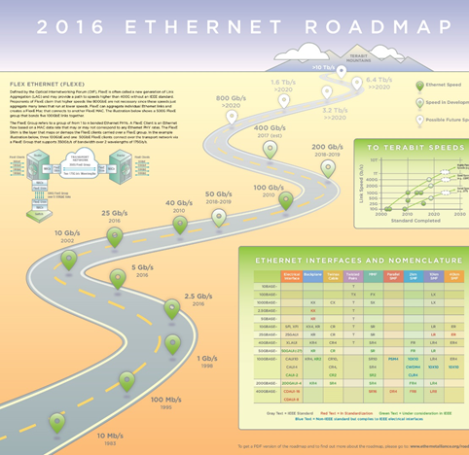
Multi-Gigabit PoE Driven by WiFi innovation
10G
IEEE Std 802.3bt-2018
1G-PoE has had a long run…
First introduced in 802.1af-2003
Billions of ports and existing cables
WiFi keeps getting…
Faster
More power hungry
More sophisticated (see next slide)
What does this mean?
Upgrade Cycle!
Faster access => Faster fiber uplinks
Door opener for Managed Services
5G
IEEE Std 802.3bz-2016
2.5G

Slide 8
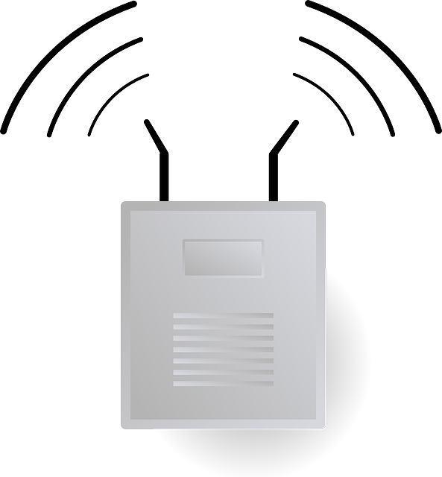
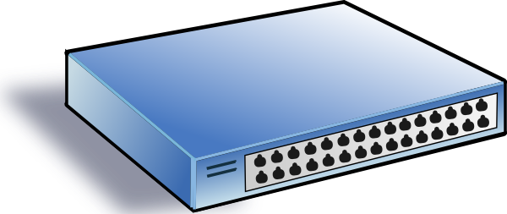
WiFi 6 and beyond
More capacity, more density, more coordination
IEEE Std 802.11ax-2019
9.6 Gbps via 8 streams
Mu-MIMO and OFDMA
Higher density and higher throughput
IEEE Std 802.11be-2024(?)
320MHz bands, 16 streams
Lower latency and higher throughput
Multi-Ap Coordination
Is it time for time synchronization in the backhaul?

Slide 9
Timing and Synchronization on the LAN
Trending from niche to mainstream
IEEE 802.1
Time Sensitive Networking (TSN)
Reliability
Redundant Transmissions (802.1CB)
Path Control (802.1Qca)
Reservations (802.1Qat)
Stream Filtering (802.1Qci)
Resource Allocation (802.1Qdd)
Time Sync
Timing and Sync (802.1AS)
IEEE 1588 Profile
Synchronization
Reliability
Manageability
YANG (802.1Qcp, etc)
QoS Provisioning (802.1DC)
Registration (802.1CS)
Profile for SPs (802.1DF)
Profile for Automotive (802.1DG)
Stream Filtering (802.1Qci)
Bounded Latency
Credit Based Shaper (802.1Qav)
Frame Preemption (802.3br & 802.1Qbu)
Scheduled Traffic (802.1Qbv)
Cyclical Queuing (802.1Qch)
Asynchronous Traffic Shaping (802.1Qcr)
Latency Control
Manageability
2005
2021
Pro Audio
Industrial
Automotive
Mobile Fronthaul
WiFi Backhaul?

Slide 10
Never Forget About Security
Scaling up with IoT and Mobile means… a great attack surface
Everything in the cloud means… more exposure to threats
World markets and increased regulation mean… more compliance requirements
Implications
Top consultative engagement with the customer
Use case for LAN virtualization
Use case for Service Provider analytics

Slide 11
Why Now is the time for Service Providers
The upgrade cycle is now!
WiFi impacts the wired LAN
Embedded virtualization in the access layer
Timing and synchronization enablement
Management architectures trends enable managed services
SDN standardized and abstracted the network
Cloud-based management enables outsourcing and multitenancy
New LAN technologies are complex
Unlicensed interplay with 5G and WiFi
Aligning SD-LAN with SD-WAN
End-to-end SLA assurance
Security demands continue to grow
A bigger attack surface brings the need for policy enforced isolation
Increased compliance and vulnerability for business

Slide 12
Success Factors for Managed LAN Service
Managed LAN Service is about replacing or augmenting existing IT
You must have a customer relationship
You must take advantage of upgrade cycles
You must have an aligned business focus (small, medium, large Enterprise)
You must have the correct tools
Tools
Cloud driven remote management – scalable and cost effective
Standards based virtualized LAN infrastructure
Deployable next generation WiFI
Multi-tenant analytics platforms to curate data
Security and compliance solutions for the LAN
Means for defining and delivering SLAs on the LAN

