Slide 1
Testing LOSSLESS Network for RDMA
Liang Guo, ODCC(Chair of test WG)
Feng Gao, Baidu
Liyang Sun, Huawei
Jun Liu, Cisco
Qingchun Song, Mellanox
IEEE 802 Nendica
Vienna, Austria
July 2019

Slide 2
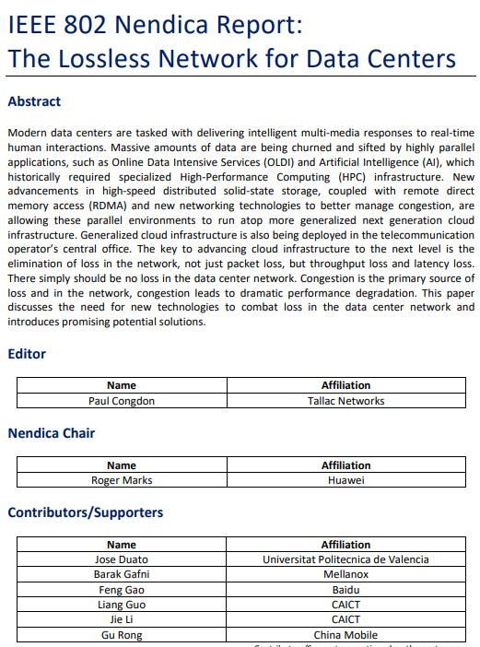
Achievements
The overall achievements of the Lossless network project
Typical Scenario Testing Method for Lossless Network in Data Center
General Technical Requirements for Lossless Network in Data Center
Technology and Application White Paper
IEEE Nendica Lossless Network white paper
Three ODCC specifications

Slide 3
Participants of Lossless Network Tests

Slide 4
Lossless Network tests for HPC
Test steps:
1、Install OpenFoam (version V1606+) and OFED (version 3.4-1.0.0.0) on each server (Huawei 2288 v3, operating system redhat7.1), and configure all nodes to log in without password.
2、Select one server as master (the leftmost one in the figure above) and the other servers as slave. IB network, lossless network and traditional Ethernet network are respectively configured. The IB and lossless networking configurations for 16 sets are as follows.
3、Pre-execution processing;
Execute. / run 1. sh on Master to complete preprocessing.
4、Perform operations;
Execute. / run 2. sh on Master for parallel computing
5、Record execution time
Expected results:
There was no packet loss and the task completion time was comparable.
Test1：Lossless Network VS. IB
Test2：Lossless Network VS. Traditional Eth

Slide 5
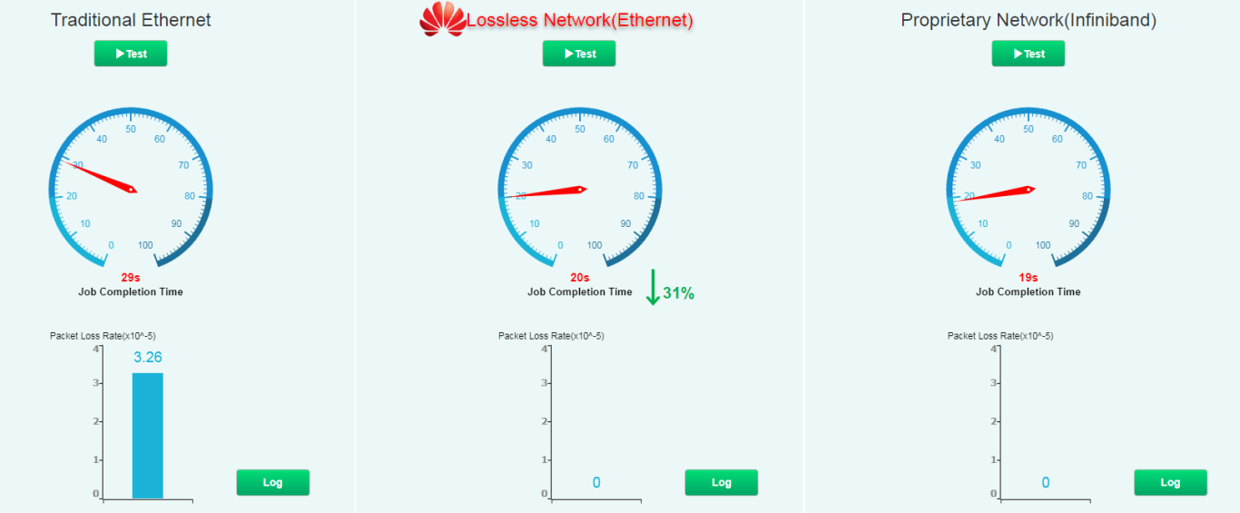
Test Results
0 packet loss, the lossless network helps HPC JCT reduced by 31% than traditional Eth, equal to IB

Slide 6
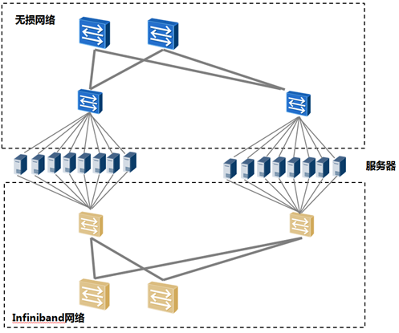
Lossless Network tests for NVMe over Fabric
Test 1：Lossless Network vs IB
Test 2：Lossless Network vs traditional Eth
Configurations:
1、Test the IOPS and tail latency of NOF services. The network topology, port rate, and node configuration are the same.
2、Configure target and client servers. For example, Huawei RH2288v3 server can be used.
3、Using standard tool FIO to test, client accesses NVMe SSD under target and carries out reading and writing tests respectively.
4、Statistical FIO test results.
5、Recording IOPS and tail delay performance.
Expected results:
Lossless network IOPS greatly improved, no packet loss, low tail delay

Slide 7
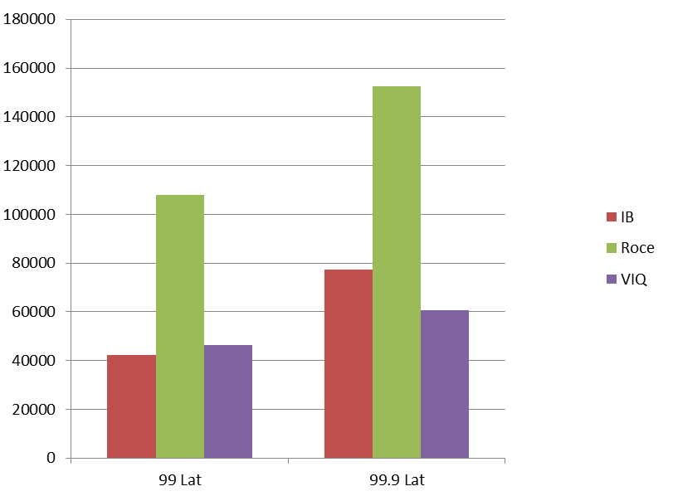
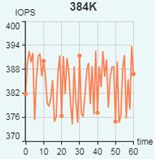
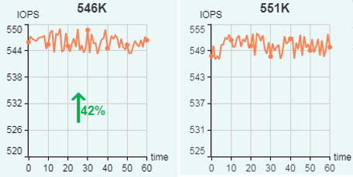
Test Results
US
Traditional Eth
Lossless Network
Infiniband
IB
Traditional Eth
Lossless network
write@128K, 3v1
Lossless network: zero packet loss and low latency, and IOPS improved by 42% compared with traditional Ethernet. The tail delay is better than that of the IB, and the IB can be replaced.

Slide 8
To be continued: More considerations
Network scalability for more latency sensitive RDMA applications deployed in data center networks, such as HPC/AI computing.
More effective congestion control mechanisms for RDMA switching when step into the era of 100G servers with 400G switches or higher.
Easy to deploy new congestion control algorithms on the server.
Effects of the mixture of RDMA traffics and normal TCP traffics.
More study should be done for better RDMA switching over IP networks!

Slide 9
THANKS！

