Slide 1
Reselect 2027 March IEEE 802 Plenary Venue
Jon Rosdahl
IEEE Executive Secretary
jrosdahl@ieee.org
Notes:
R1 was presented
R2 was corrected after the call and the motion results added.

Slide 2
2027 March Venue Selection History
Sept 2
  802 LMSC selects Osaka as 2027 March Venue
Sept 18
  Conference call with Osaka provided us enough information to know that it would not technically work.
Sept 26
  Revisit Decision for 2027 March

Slide 3
Singapore
Meeting Room Space/Rental:
* Space: 33 meeting rooms (in the host hotel)
AV/Power Costs: basics AV, LCD, Screen, WM – in each meeting room
*Additional AV/Power to be supplied match current requirements at additional cost - $57,000 USD
Network: 800 Mbps - $18,650 USD
Visas: currently, all countries, no restrictions
Guest Room Rates: Grand Copthorne Waterfront (Host) and M Social and Copthorne Kings
Grand Copthorne Waterfront Grand Deluxe: $255++ SGD - $200++ USD
Premier Room: $280++ SGD - $220++ USD
M Social (ROH): $220++ SGD - $175++ USD
Subject to 10% service charge & 9% GST. Includes: Internet access & daily buffet breakfast
DDR (Day Delegate Rate): $155++ SGD/P-$122++ USD, includes: AM/PM Coffee Svs & Lunch
* Subject to 10% service charge & 9% GST.

Slide 4
Draft Budget – 2027 March Singapore
Income: | NextGen Banking Codes:
 | 1.10.0|Individual Registration | $526,300.00
 | 3.70.2|Hotel Commissions | $52,800.00
 | 3.70.1|Hotel Credits Income | $13,200.00
 | Total Income: | $592,300.00
 | average registration: | $526.30
Expense:
 | 4.10.6|Financial Fees | $19,309.00
 | 4.10.5|Venue | $517,437.03
 | 4.10.12|AV Services | $0.00
 | 4.10.9|Network Services | $80,569.38
 | 4.10.8|Food & Beverage | $474,667.25
 | 4.10.1|Social-ENT | $80,000.00
 | 4.10.7|Meeting Planner | $136,500.00
 | 4.10.10|Shipping | $15,000.00
 | 4.10.11|Miscellaneous | $21,320.00
 | 4.10.2|Site Survey | $5,500.00
 | Total Expense: | $1,350,302.66
 | per attendee: | $1,350.30
Attendees: 1000 (527/473)
Fees: $600/$800/$1000
Net Session Surplus/(Loss): ($-670,355.36)

Slide 5
Alternatives:
Singapore was the runner up in the selection discussion.
Find another Venue
2027 March Singapore Proposed Budget Summary
Total Session Income/Credits $679,947.30 per attendee: $ 526.30
Total Session Expenses: ($-1,350,302.66) per attendee: $1,350.30
Net Session Surplus/(Loss): ($-670,355.36)

Slide 6
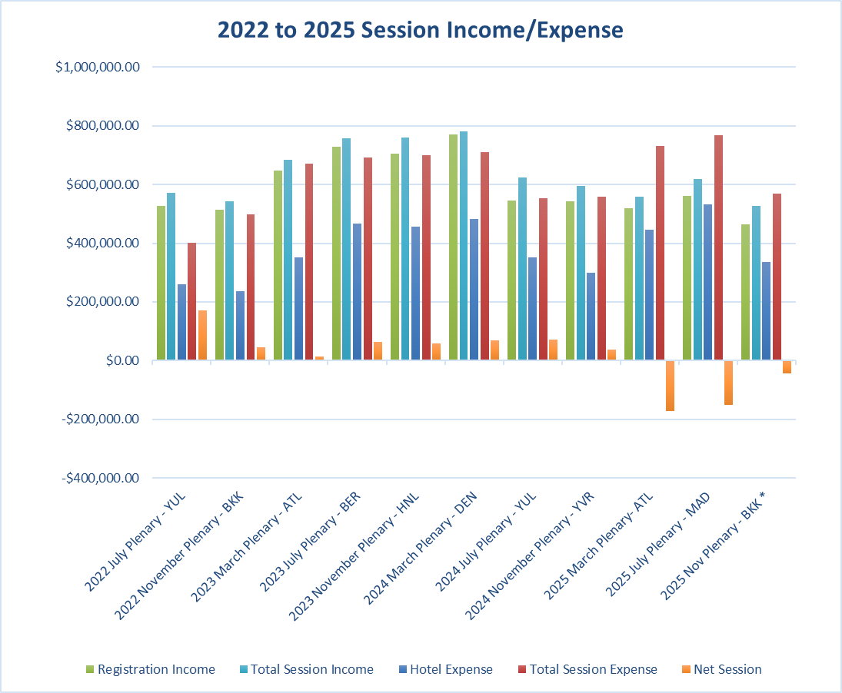
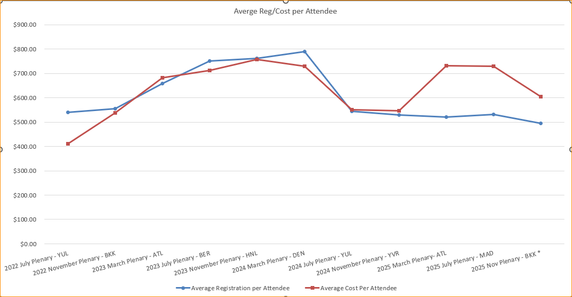
History of Income/Expense Budgets

Slide 7
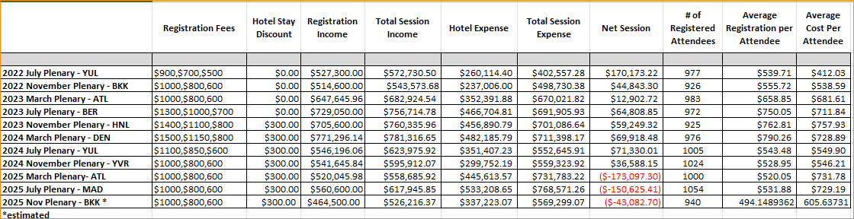
Data for Graphs – 2022-2025 Income/Expense

Slide 8
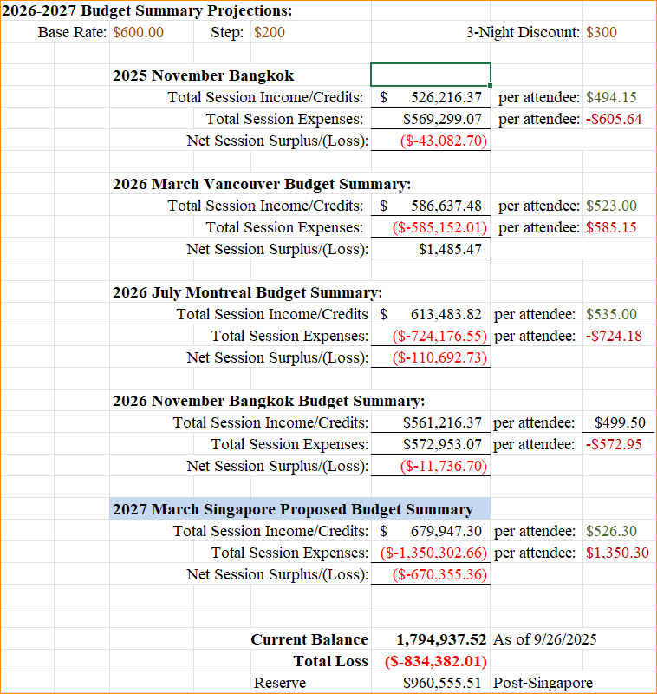
Projected Budgets 2026/2027

Slide 9
Motion to reselect the 2027 March Venue
Move to approve the Grand Copthorne Waterfront Hotel in Singapore for the 2027 March Venue, and to authorize a site visit for Face To Face Events, Linespeed and 802 LMSC Exec Sec to validate the Venue.
Moved: Jon Rosdahl
Second: Clint Powell
Results: Unanimous (12 of 13 on call).
Notes:
This supersedes Motion #8 on Sept 2 telecon- Reference Agenda Item #3.01, Time: 12:52 pm

