Slide 1
Reselect 2027 March IEEE 802 Plenary Venue
Jon Rosdahl
IEEE Executive Secretary
jrosdahl@ieee.org

Slide 2
2027 March Venue Selection History
Sept 2
  802 LMSC selects Osaka as 2027 March Venue
Sept 18
  Conference call with Osaka provided us enough information to know that it would not technically work.
Sept 26
  Revisit Decision for 2027 March

Slide 3
Alternatives:
Singapore was the runner up in the selection discussion.
Find another Venue
2027 March Singapore Proposed Budget Summary
Total Session Income/Credits $679,947.30 per attendee: $ 526.30
Total Session Expenses: ($-1,350,302.66) per attendee: $1,350.30
Net Session Surplus/(Loss): ($-670,355.36)

Slide 4
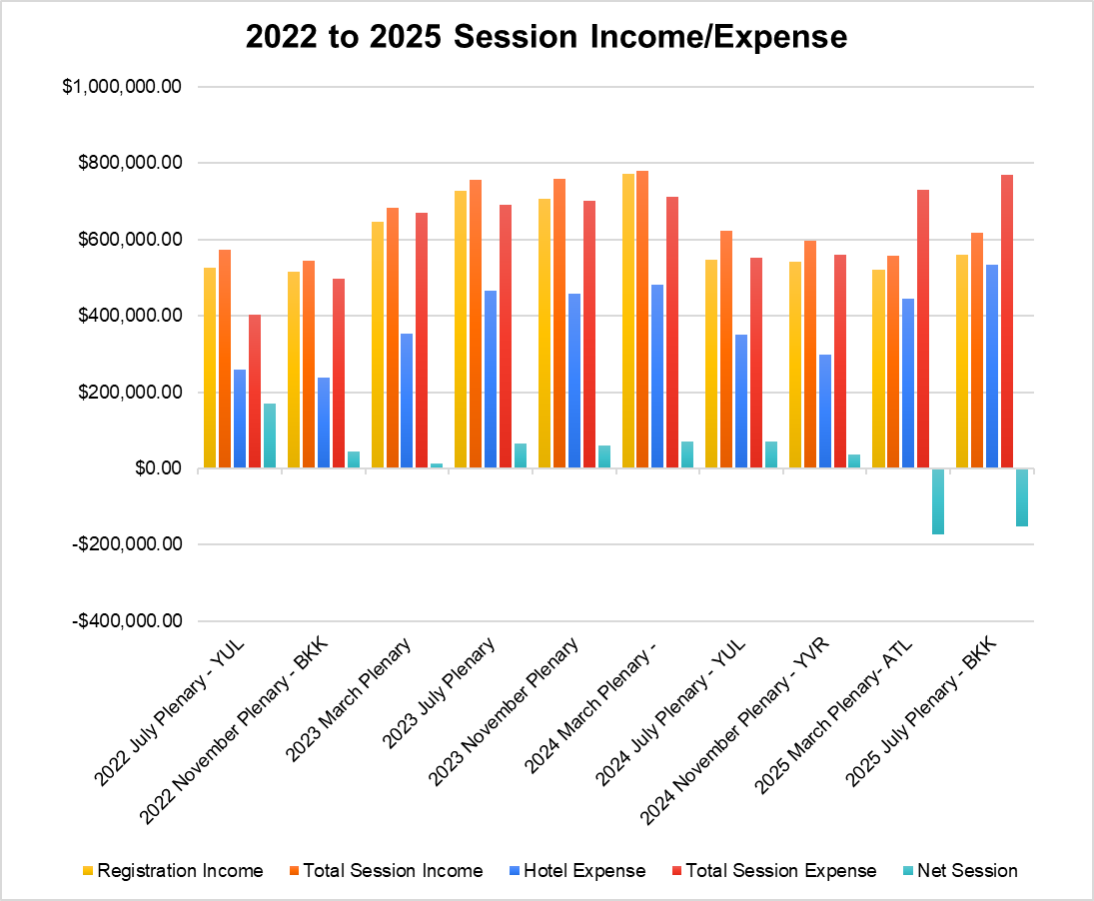
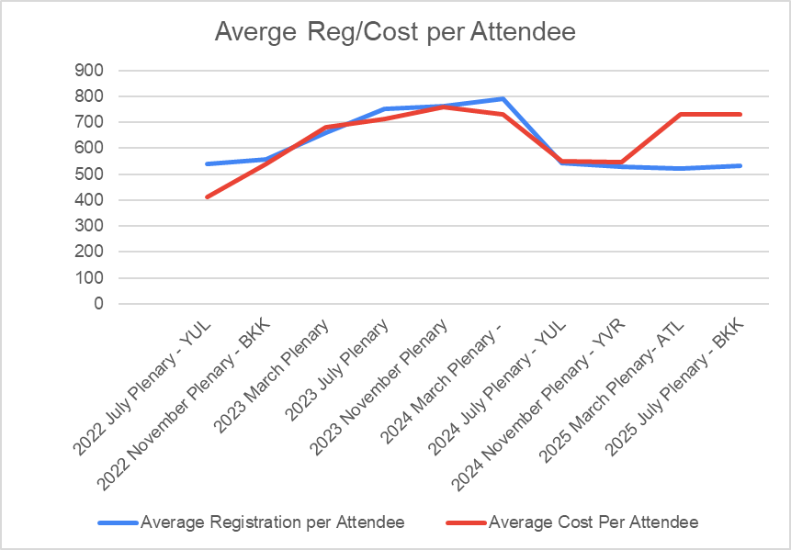
History of Income/Expense Budgets

Slide 5
Data for Graphs – 2022-2025 Income/Expense

Slide 6
Projected Budgets 2026/2027

Slide 7
Motion to reselect the 2027 March Venue
Move to approve the Grand Copthorne Waterfront Hotel in Singapore for the 2027 March Venue, and to authorize a site visit for Face to Face Events, Linespeed and 802 LMSC Exec Sec to validate the Venue.
Moved:
Second:
Results:
Notes:
This supersedes Motion #8 on Sept 2 telecon- Reference Agenda Item #3.01, Time: 12:52 pm

