Slide 1
IEEE 802 September 2025 Public Visibility Standing Committee Updates
September 2025

Slide 2
802 Public Visibility SC Scope, Duties, Membership
Scope and Duties
To raise public visibility and industry awareness in timely fashion of IEEE 802 WG / TAG activities
Develop social media content based on IEEE 802 WG / TAG activities
LinkedIn – https://www.linkedin.com/company/ieee802
IEEE-SA 802 - https://standards.ieee.org/featured/802/index.html
Content
Review Pre 802 Plenary meetings for social media messaging: PARs to be considered, Tutorials, [802.3] Call-for-Interests, New Task Force formations
Review Post 802 Plenary meetings for social media messaging: Study Group formations, IEEE 802 Position Approvals
Other 802 related material for social media messaging: Press Releases, White Paper publications, Other 802 approved news, 802 WG / TAG Activities with IEEE-SA
IEEE-SA Standards Board Related - PAR Approvals, Standards Approval, Standards Publication
Membership
Membership in the Standing Committee is open to anyone that wishes to participate (ideally at least one participant from each 802 WG and TAG)

Slide 3
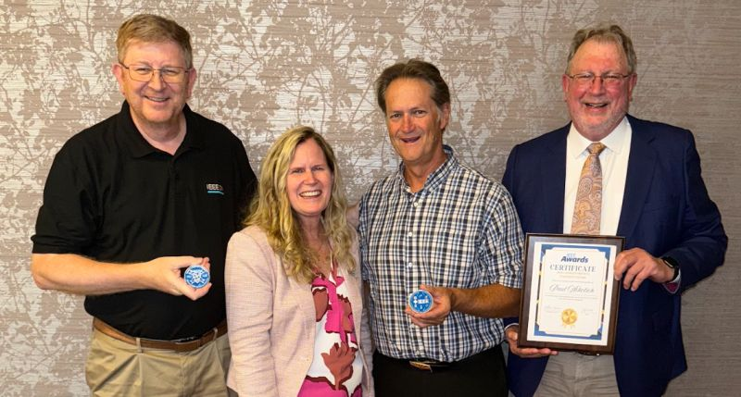
Linkedin Report
https://www.linkedin.com/company/ieee802
6022 total followers
Last 365 days
106,000 Impressions
2136 Reactions
Latest Posts
September Meetings
Group Updates
Kathleen Kramer
Antonio Luque

Slide 4
Linkedin Posts for WGs
WG/TIGs can post their short meeting reports.
Please provide your reports at the end of September meeting.
In additon IEEE 802 LSMC and IEEE 802 can provide reports as well.

