Slide 1
IEEE 802 LMSC Plenary
March 14-19, 2027
Final Proposals
Asia Pacific (APAC)
Presented and Prepared By:
Dawn Slykhouse, Face to Face Events Inc
September 2, 2025

Slide 2
IEEE 802 LMSC Plenary
March 14-19, 2027
FINAL Recommendations
Singapore
Osaka, Japan

Slide 3
Singapore
Grand Copthorne Waterfront
Venue Type: Meeting Rooms and Guest Rooms
Venue Description: Premier deluxe conference hotel and sister property, located on the Singapore River, near the Central Business District and along with multiple subway stations for short journeys away to key attractions.
Total Venue Expenses $USD 1,010,753.53 $SGD 1,299,670.22
Per Attendee Cost $USD 1,684.59 $SGD 2,166.13
(Based on 600 Attendees)
Incentives and Support $USD 77,000.00 $SGD 100,000.00
Singapore Tourism Board $USD 129.62 $USD 166.67
Total Expenses - Incentives $USD 944,173.16 $SGD 1,214,058.33
Per Attendee Cost $USD 1,554.97 $SGD 1,999.45

Slide 4
Singapore
Meeting Room Space/Rental:
* Space: 33 meeting rooms (in the host hotel)
AV/Power Costs: basics AV, LCD, Screen, WM – in each meeting room
*Additional AV/Power to be supplied match current requirements at additional cost - $57,000 USD
Network: 800 Mbps - $18,650 USD
Visas: currently, all countries, no restrictions
Guest Room Rates: Grand Copthorne Waterfront (Host) and M Social and Copthorne Kings
Grand Copthorne Waterfront Grand Deluxe: $255++ SGD - $200++ USD
Premier Room: $280++ SGD - $220++ USD
M Social (ROH): $220++ SGD - $175++ USD
Subject to 10% service charge & 9% GST. Includes: Internet access & daily buffet breakfast
DDR (Day Delegate Rate): $155++ SGD/P-$122++ USD, includes: AM/PM Coffee Svs & Lunch
* Subject to 10% service charge & 9% GST.

Slide 5
IEEE 802 LMSC Plenary March 14-19, 2027 |  |  |  | Sept. 2, 2025
Venue: Grand Copthorne Waterfont-Singapore |  |  |  | D.Slykhouse
Location: Singapore
Based on 600 Attendees
Summary of Estimated Costs: | USD | Singapore (SGD) | Cost/Person in Local Currency | Cost/Person in USD
Meeting Space Rental | $460,398.40 | $592,000.00 | $986.67 | $ 767.33
F&B DDP for 4 days - 600 + 1 day-150 | $474,667.25 | $610,347.50 | $1,017.25 | $ 791.11
AV Svs/Equipment & Power | $57,038.63 | $73,342.72 | $122.24 | $ 95.06
Hotel Network | $18,649.25 | $23,980.00 | $39.97 | $ 31.08
Sub-Total of Estimated Expenses | $1,010,753.53 | $1,299,670.22
Per Attendee Cost | $1,684.59 | $2,166.12
Includes all taxes
Incentives and Suppport
Current Offer - Singapore Tourism | $77,770.00 | $100,000.00
Per Attendee Cost | $129.62 | $166.67
Total Estimated Expenses | $932,983.53 | $1,199,670.22
Per Attendee Cost | $1,554.97 | $1,999.45
Includes all taxes
Exchange Rate as of August 29, 2025
Singapore Dollar to US Dollar | 0.7777
Note:
Does not include: Meeting Planner (FTF) & Network Services (LS) fees & expenses, Social
Includes all taxes

Slide 6
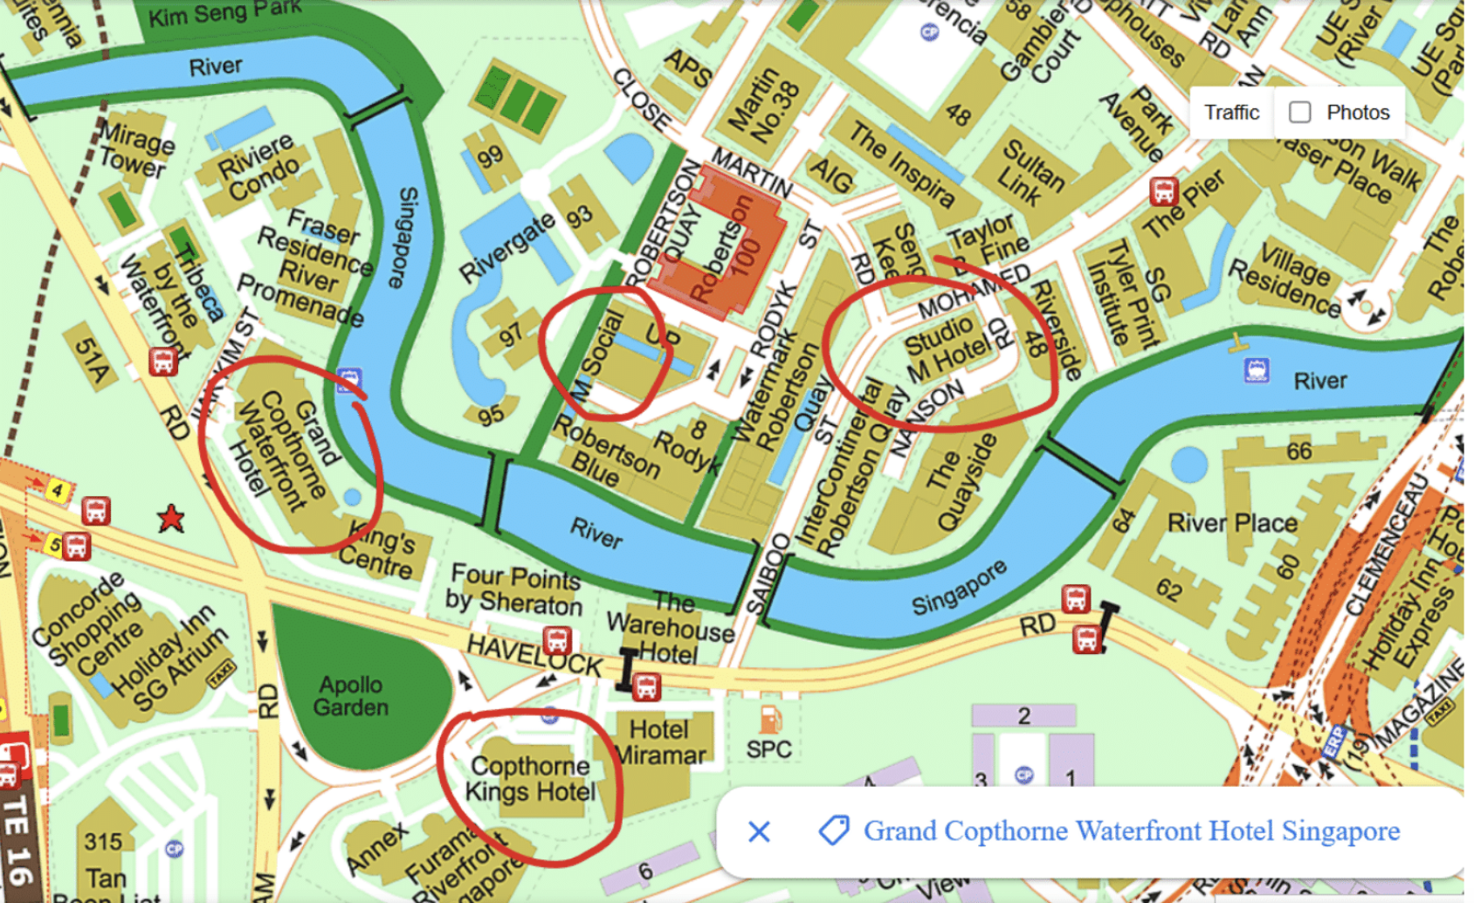
Singapore

Slide 7
Osaka, Japan
Royal Hotel Osaka
Venue Type: Meeting Rooms and Guest Rooms
Venue Description: A distinguished and historic hotel nestled in the heart of Osaka Nakanoshima district.
Estimated Total Venue Expenses $USD 854,043.79 ¥125,594,675
Per Attendee Cost $USD 1,423.41 ¥209,324
(Based on 600 Attendees, M-TH: lunch)
(Based on 150 Attendees, F: lunch)
Incentives and Support
Current Offer: OCTB $USD 10,200.00 ¥1,500,000.00
Per Attendee Cost $USD 17.00 ¥2500
Estimated Total Expenses - Incentives $USD 843,843.79 ¥124,094,675
Per Attendee Cost $USD 1,406.41 ¥20,824

Slide 8
Osaka, Japan
Meeting Room Space/Rental:
* Space: All meeting rooms (in the hotel)
* Rental: 74,747,525 JPY -$508,300 USD
( includes all taxes)
AV: basics AV, LCD, Screen, WM - $82,209 USD Power: $23,800 USD
Hotel Network Costs: $20,400 USD
Airport: 30 minutes by taxi and 1 hour train
Visas: some will require Visas
Financial Support: Osaka Convention and Tourism Bureau would be in a position to offer a financial subsidy. This subsidy is applicable to international conferences that meet the following conditions: Organized by academic or industry associations, held over a minimum of 3 days If the total number of attendees is 500 persons or more, they can offer JPY1,500,000/$10,200 USD
.
Guest Room Rate:
* Cosy Room (ROH): 29,000 JPY- $196 USD *Standard Room (ROH): 35,000 JPY-$240 USD
* Premium Room (ROH): 40,000 JPY-$270 USD *King Corner Suite: 50,000 JPY- $335 USD
All taxes are inclusive in the rates noted above, buffet breakfast included in the guest room rate.

Slide 9
IEEE 802 LMSC Plenary March 14-19, 2027 |  |  |  | Sept. 2, 2025
Venue: RIHGA Royal Hotel Osaka |  |  |  | D.Slykhouse
Location: Osaka, Japan
Based on 600 Attendees
Summary of Estimated Costs: | USD | Local Currency - Japanese Yen | Cost/Person in Local Currency | Cost/Person in USD
Meeting Space Rental | $508,283.17 | ¥74,747,525 | ¥124,579 | $ 847.14
Food and Beverage DDP for 1 day - 150 | $12,903.00 | ¥1,897,500 | ¥12,650 | $ 86.02
Food and Beverage DDP for 4 days -600 | $206,448.00 | ¥30,360,000 | ¥50,600 | $ 344.08
AV | $82,209.62 | ¥12,089,650 | ¥20,149 | $ 137.02
Hotel Network | $20,400.00 | ¥3,000,000 | ¥5,000 | $ 34.00
Power | $23,800.00 | ¥3,500,000 | ¥5,833 | $ 39.67
Sub-Total of Estimated Expenses | $854,043.79 | ¥125,594,675
Per Attendee Cost | $1,423.41 | ¥209,324
Includes all taxes
Incentives and Suppport
Current Offer - OCTB | $10,200.00 | $1,500,000.00
Per Attendee Cost | $17.00 | ¥2,500
Total Estimated Expenses | $843,843.79 | ¥124,094,675
Per Attendee Cost | $1,406.41 | ¥206,824
Exchange Rate as of August 29, 2025
Japanese Yen to US Dollars | 0.0068
Note:
Does not include: Meeting Planner (FTF) & Network Services (LS) fees & expenses, Social
Includes all taxes

Slide 10
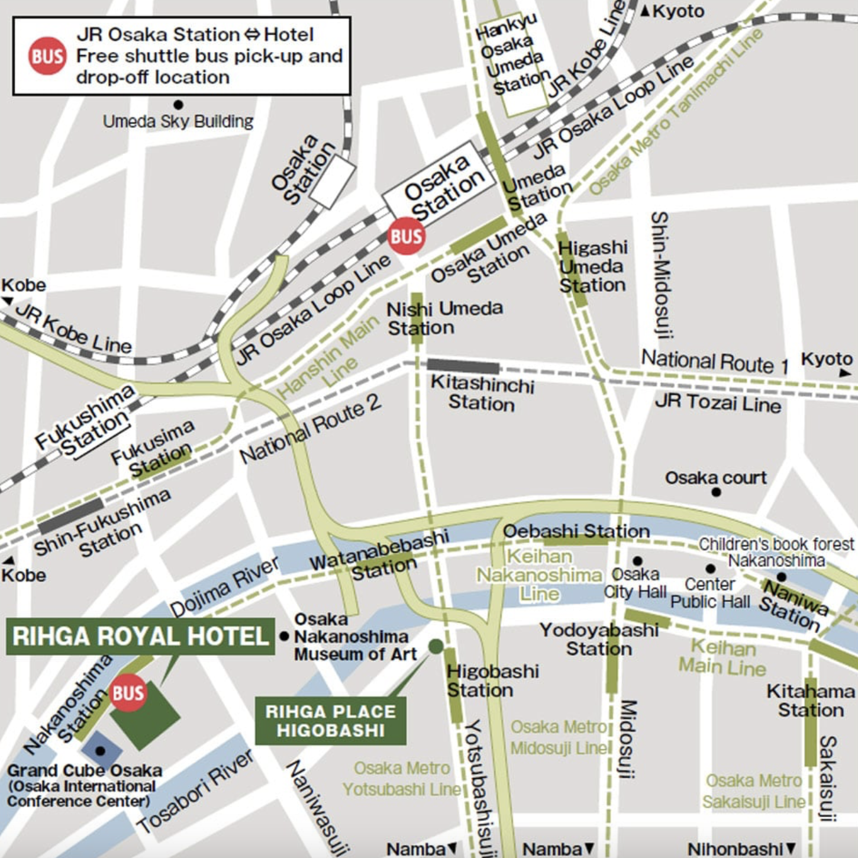
Osaka, Japan

