Slide 1
IEEE 802 LMSC Plenary
March 14-19, 2027
Proposals
Asia Pacific (APAC)
Presented By: Dawn Slykhouse, Face to Face Events Inc
August 1, 2025
R1 – update to slide 12 and add slide 18

Slide 2
Destinations Considered
March 2027 LMSC Plenary
Japan: Tokyo, Kyoto, Yokohama, Osaka
Singapore
Bangkok, Thailand
Manilla, Philippines
South Korea: Seoul
Dubai
Qatar
Abu Dhabi
New Zealand: Auckland and Wellington
Australia: Sydney

Slide 3
IEEE 802 LMSC Plenary
March 11-19, 2027
Top Four Recommendations
Singapore
Wellington, New Zealand
Osaka, Japan
Sydney, Australia

Slide 4
Singapore
Grand Copthorne Waterfront
Venue Type: Meeting Rooms and Guest Rooms
Venue Description: Premier deluxe conference hotel and sister property, located on the Singapore River, near the Central Business District and along with multiple subway stations.
Total Venue Expenses $USD 893,621.58 $SGD 1,160,547.50
Per Attendee Cost $USD 1,489.37 $SGD 1,934.25
(Based on 600 Attendees)
Incentives and Support
Singapore Tourism Board $USD 77,000.00 $SGD 100,000.00
Total Expenses - Incentives $USD 816,621.58 $SGD 1,060,547.50
Per Attendee Cost $USD 1,361.04 $SGD 1,767.58

Slide 5
Singapore
Meeting Room Space/Rental:
* Space: 33 meeting rooms (in the host hotel)
AV Costs: basics AV, LCD, Screen, WM – each room
*Additional AV to be supplied match current requirements at additional cost
Network: 1 GB
Airport: located 30 minutes to the hotel
Visas: currently, all countries, no restrictions
Guest Room Rates: Grand Copthorne Waterfront (Host) and M Social and Copthorne Kings
Grand Copthorne Waterfront Grand Deluxe: $255++ SGD - $200++ USD
Premier Room: $280++ SGD - $220++ USD
M Social (ROH): $220++ SGD - $175++ USD
Subject to 10% service charge & 9% GST. Includes: Internet access & daily buffet breakfast
DDR (Day Delegate Rate): $155++ SGD/P-$122++ USD, includes: AM/PM Coffee Svs & Lunch
* Subject to 10% service charge & 9% GST.

Slide 6
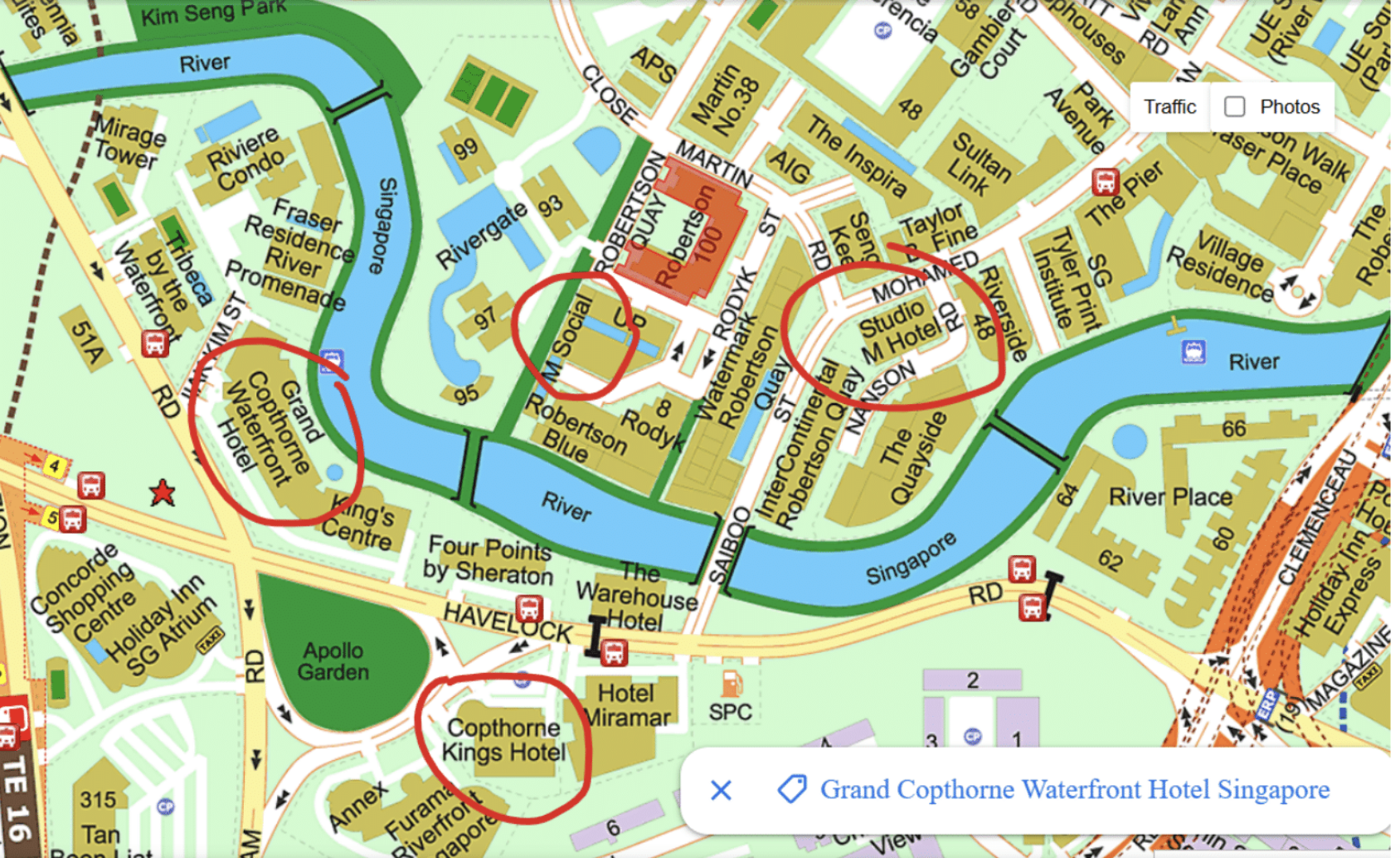
Singapore

Slide 7
Wellington New Zealand
Takina-Wellington Convention & Exhibition Centre and
Museum of New Zealand Te Papa Tongarewa
Venue Type: Meeting Rooms at Convention Centre and Museum
Guest Rooms at Nearby Hotels (Attendee Choice - No Room Block)
Total Venue Expenses $USD 318,895.00 $NZD 540,500.00
Per Attendee Cost
(Based on 600 Attendees) $USD 531.49 $NZD 900.83
Incentives and Support
Tourism New Zealand $USD 62,540.00 $NZD 106,000.00
    Total Expenses - Incentives $USD 256,355.00 $NZD 434,500.00
Per Attendee Cost $USD 427.26 $NZD 724.17

Slide 8
Wellington, New Zealand
Destination/Location: Wellington, New Zealand
Venue Name: Takina-Wellington Convention & Exhibition Centre and Museum of New Zealand Te Papa Tongarewa (across the street – 2 minutes)
Hotels: over 4000 hotel rooms available within 30 minutes of Centre
Guest Room Rates: between $190 NZD ($115 USD) to $350 NZD ($215 USD)
- includes taxes and fees, but no breakfast
DDR (Day Delegate Rate): $80 NZD ($50 USD)
- AM/PM Breaks and lunch daily
- includes NZ GST (15%)

Slide 9
Wellington, New Zealand
Meeting Room Rental: (both Venues)
All space – $221,517 NZD = $132,894 USD inclusive
AV Costs: To be confirmed
Network Costs: To be confirmed, Note: no charge to use or access existing infrastructure
Airport: 15 minutes to Centre
Visas: New Zealand is Visa free for over 60+ countries.
Financial Support: Maximum of $106,000 NZD = $64,247 USD
Map (see next slide)

Slide 10
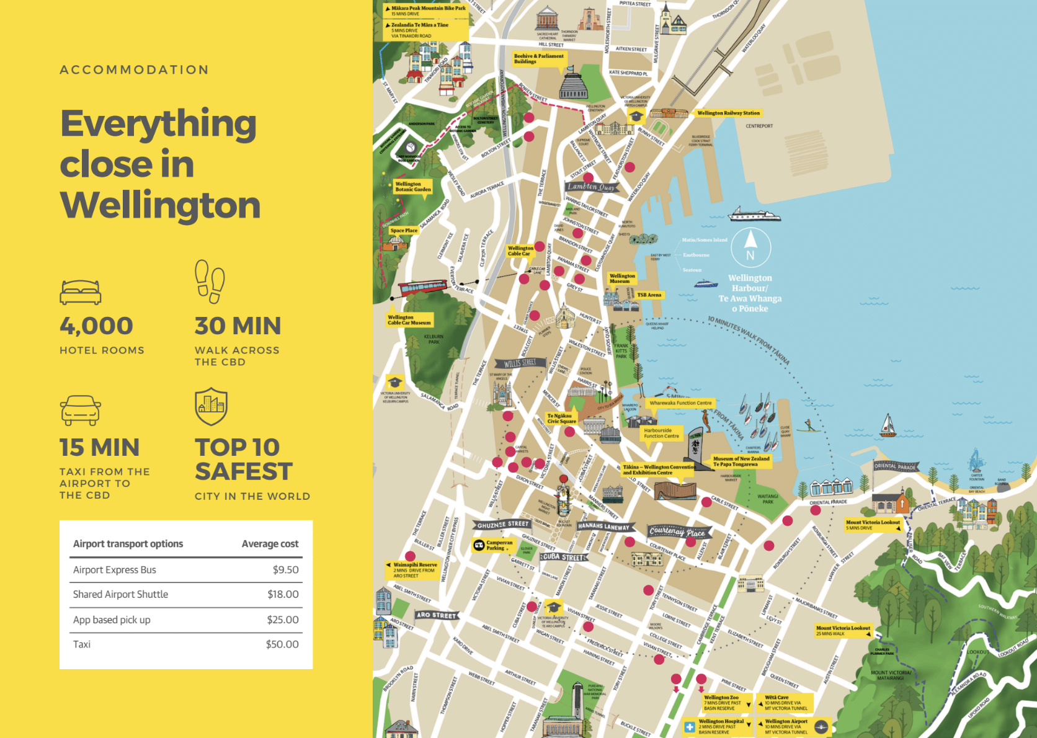
Wellington, New Zealand

Slide 11
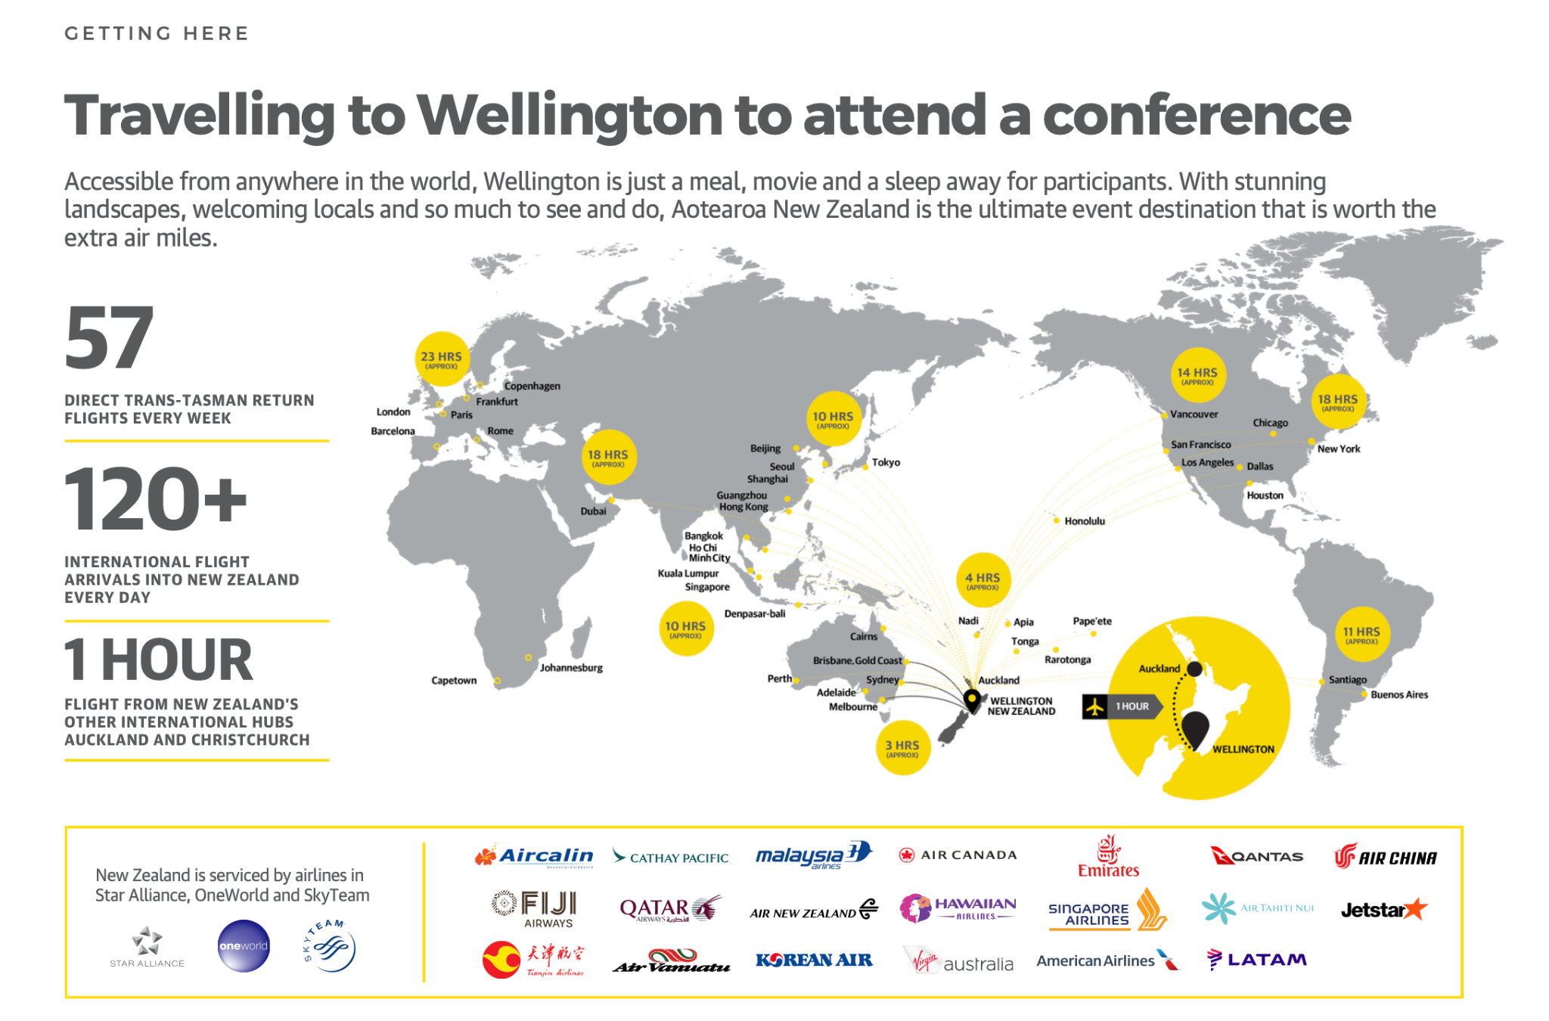

Slide 12
Osaka, Japan
Royal Hotel Osaka
Venue Type: Meeting Rooms and Guest Rooms
Venue Description: A distinguished and historic hotel nestled in the heart of Osaka Nakanoshima district.
Total Venue Expenses $USD 875,620.42 ¥109,899,760
Per Attendee Cost $USD 1,459.37 ¥183,166
(Based on 600 Attendees)
Incentives and Support
To Be Confirmed
    Total Expenses - Incentives $USD 875,620.42 ¥109,899,760
Per Attendee Cost $USD 1,459.37 ¥183,166

Slide 13
Osaka, Japan
Meeting Room Space/Rental:
* Space: All meeting rooms (in the hotel)
* Rental: 100,412,260 JPY -$ 680.000 USD
( includes all taxes)
AV Costs: basics AV, LCD, Screen, WM – each room *any additional costs TBC
Network Costs: to be confirmed
Airport: 30 minutes by taxi and 1 hour train
Visas: some will require Visas
Financial Support: Osaka Convention and Tourism Bureau would be in a position to offer a financial subsidy. This subsidy is applicable to international conferences that meet the following conditions: Organized by academic or industry associations, held over a minimum of 3 days If the total number of attendees is 500 persons or more, they can offer JPY1,500,000.
Guest Room Rate:
* Cosy Room (ROH): 29,000 JPY- $196 USD *Standard Room (ROH): 35,000 JPY-$240 USD
* Premium Room (ROH): 40,000 JPY-$270 USD *King Corner Suite: 50,000 JPY- $335 USD
All taxes are inclusive in the rates noted above, buffet breakfast included in the guest room rate.

Slide 14
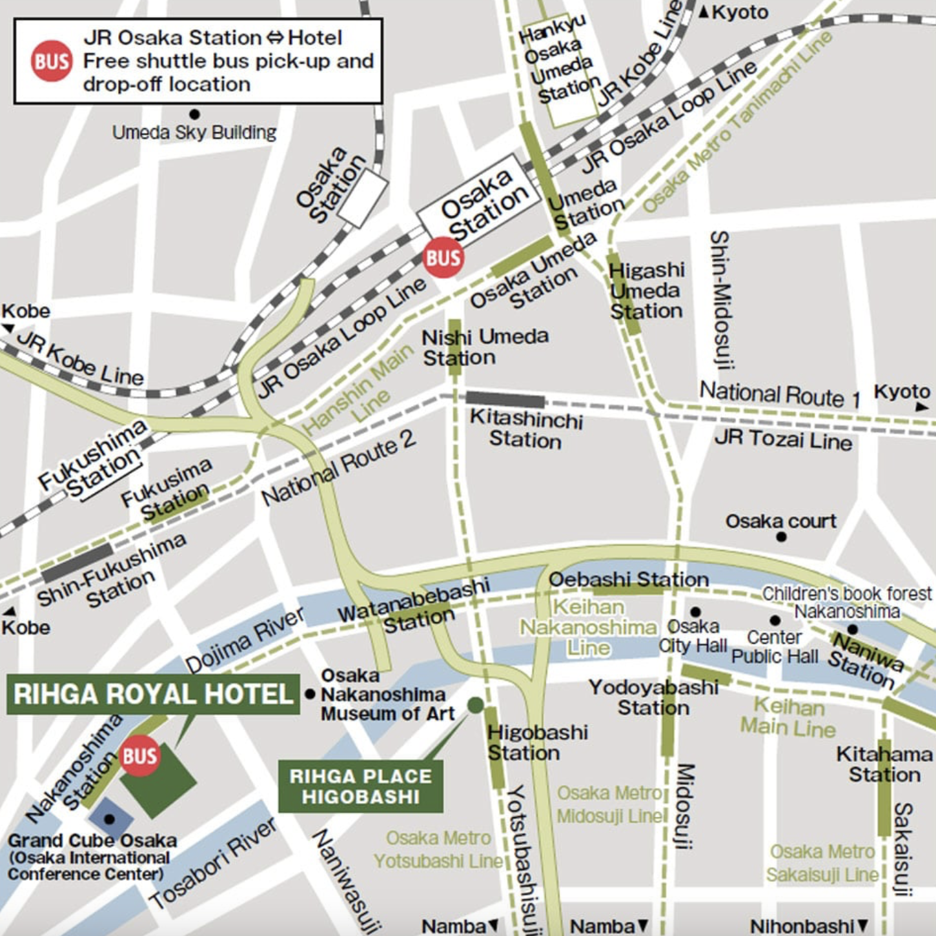
Osaka, Japan

Slide 15
Sydney, Australia
Hyatt Regency Sydney
Venue Type: Meeting Rooms and Guest Rooms
Venue Description: The hotel offers a relaxing retreat in the heart of the central business district by Darling Harbour, featuring award-winning dining and expansive meeting and event space.
Total Venue Expenses $USD 465,280.00 $AUD 727,000.00
Per Attendee Cost $USD 775.47 $AUD 1,211.67
(Based on 600 Attendees)
Incentives and Support
BeSydney*
*Negotiations in Progress
        Total Expenses - Incentives $USD 465,280.00 $AUD 727,000.00
Per Attendee Cost $USD 775.47 $AUD 1,211.67

Slide 16
Sydney, Australia
Guest Room Rate:
*Single/Double: $380++ AUD - $246++ USD, plus all taxes
*Staff: $340++ AUD -$220++ USD, plus all taxes
- guest room rate does not breakfast
- 10% commission
DDR (Day Delegate Rate): $140 AUD (includes taxes)/person - $100 USD
- Minimum F&B $400,000 AUD - $260,000 USD, + 10% F&B
Meeting Space: located in the hotel, space may tight, and Meeting Rental: $175,000+ AUD/$114,000+ USD
AV Costs: to be confirmed
Network Costs: Linespeed to connect IT Hyatt to discuss in more detail.
Airport: 20 minutes to Hyatt, 8 miles, $35-$60 AUD/$23-$40 USD
Visas: ETA or eVistor Visa for all countries

Slide 17
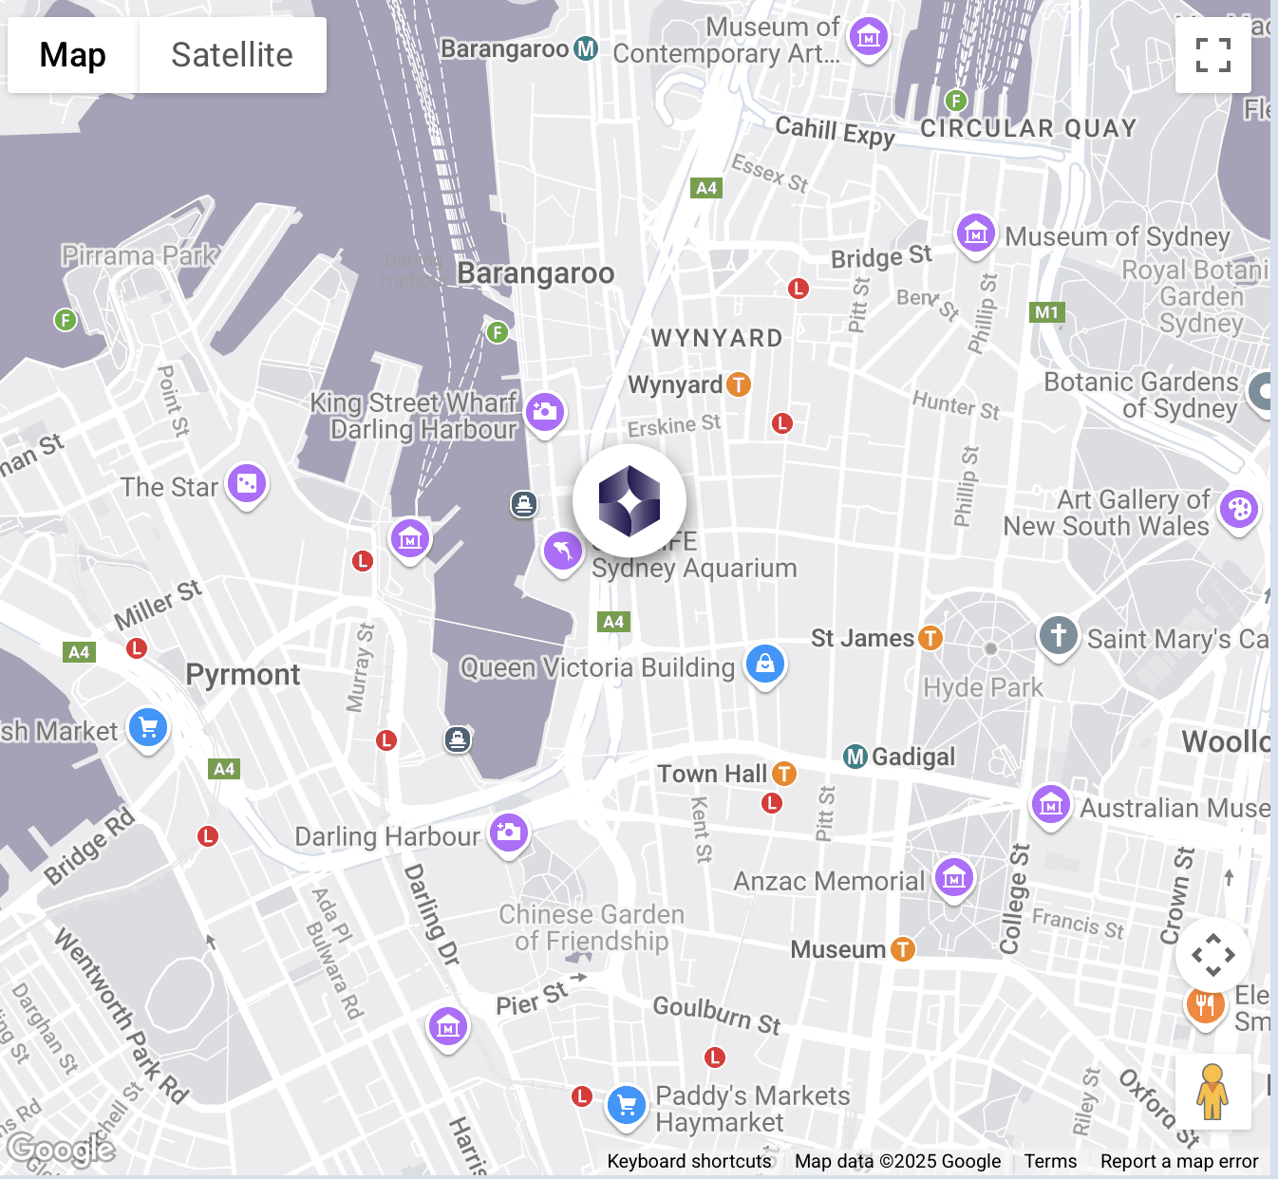
Sydney, Australia

Slide 18
