Slide 1
Executive Secretary Report for 2025 July 802 Plenary - Madrid
Jon Rosdahl
IEEE Executive Secretary
jrosdahl@ieee.org
Notes:
R0: Draft prepared for the 802 LMSC Opening Meeting
R1: updated List of 4 top bids for 2027 March

Slide 2
Event Conduct and Safety Statement
IEEE believes that science, technology, and engineering are fundamental human activities, for which openness, international collaboration, and the free flow of talent and ideas are essential. Its meetings, conferences, and other events seek to enable engaging, thought-provoking conversations that support IEEE’s core mission of advancing technology for humanity. Accordingly, IEEE is committed to providing a safe, productive, and welcoming environment to all participants, including staff and vendors, at IEEE-related events.

Slide 3
Event Conduct and Safety Statement
IEEE has no tolerance for discrimination, harassment, or bullying in any form at IEEE-related events. All participants have the right to pursue shared interests without harassment or discrimination in an environment that supports diversity and inclusion. Participants are expected to adhere to these principles and respect the rights of others.
IEEE seeks to provide a secure environment at its events. Participants should report any behavior inconsistent with the principles outlined here, to onsite staff, security or venue personnel, or toeventconduct@ieee.org.

Slide 4
Executive Secretary Agenda Items
IEEE 802 LMSC Monday Opening Meeting:
  6.02: Current / Future Venues
  Know –
    Things to Know
    Request for 802 WGs – Venue Straw Poll
    Registration Status – 2025 March 802 Plenary
    802 Venue Contract Status update
    Notes for Madrid

Slide 5
1. Things to Know - Madrid
Things to Know - Madrid:
  https://mentor.ieee.org/802-ec/dcn/25/ec-25-0133-03-LMSC-mad-802-0725-things-to-know-madrid.pptx

Slide 6
2. Request for 802 WG Item for Closing Plenaries:
Request to WG Chairs,
Please Conduct the following Straw Poll in your Closing Plenaries:
  1. How many people would like to come back to this venue?
  Yes –
  No –
  2. Did you go to the social?
  Yes –
  No –
  3. If you attended the Social, did you like the social?
  Yes –
  No –

Slide 7
2025 July IEEE 802 Mixed-mode Plenary - Madrid
Registration opened April 8, 2025:
  1036 registered – 585 in person and 438 remote (6 Students)
  Hotel Pickup –97% of block reserved (2514/2585 as of July 25, 2025)

Slide 8
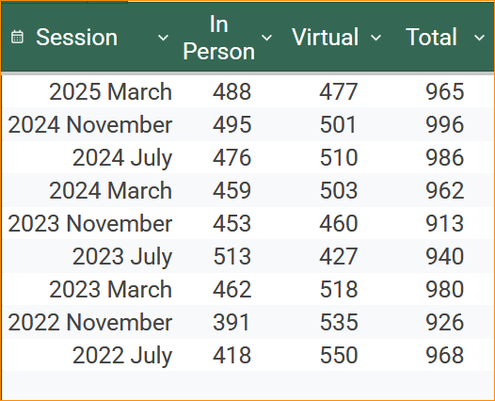
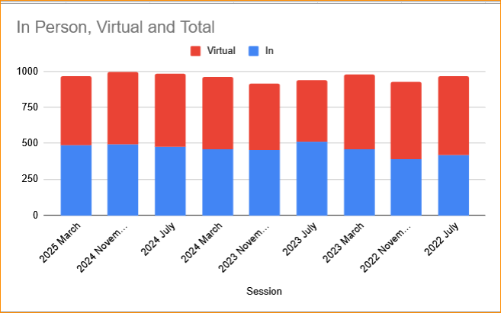
IEEE 802 Mixed-mode Plenary Attendance

Slide 9
Future 802 Plenary Venue Contract Status
2025 July 27-August 1 –Melia Castilla Madrid, Madrid, Spain (NOTE: Week of July 27)
2025 November 9-14 – Marriott Marquis Queen’s Park, Bangkok, Thailand
2026 March 8-13 - Hyatt Regency Vancouver, Vancouver, Canada (Changed from Chicago)
2026 July 12-17 – Le Centre Sheraton Montreal, Montreal (July 2022 attrition offset)
2026 November 8-13 - Marriott Marquis Queen’s Park, Bangkok, Thailand
2027 March 14-19 – Hilton Atlanta, Atlanta, GA, United States (New Asia Location)
2027 July 11-16 - Gothia Towers, Gothenburg, Sweden
2027 November 14-19 – Hawaiian Village, Oahu, Hawaii, United States
2028 July 9-14 – Sheraton Le Centre Montreal, Montreal, Quebec, Canada
802 EC Approved – Contract is in negotiations and will be sent to IEEE CEE and IEEE Legal.
Contracts Executed
As of July 27, 2025
Notes:
Dark Blue – Covid Rebooks Yellow – Special Date change
Green – 2023 RFP Assignments Light blue – 2024 Sept Telecon Approved Location
White – Booked Prior to Covid.
-----------------------------------------------------------------------------------------------------------------------
2025 July - Melia Castilla Madrid – July 27-Aug 1 - Contract and amendment executed.
2025/2026 November – Marriott Marquis Queen’s Park – Executed Oct 28, 2024
2026 July – Hosting ITU WG15 – Sheraton le Centre Montreal -- Executed 26 Feb
Error found after signing – Amendment signed 3 April 2025
2 Amendments in process 1 for ITU week and 1 for IEEE week
2027 March – APAC – Asia Pacific Australia Coast
– 802 LMSC Changed venue region to APAC
-- 20 Proposals reduced to 4 for discussion in 2025 July.
2027 July – Gothia Towers
– Site Visit 21-22 Aug 2024 - Was successful.
– Contract still in negotiation. – Target end of August.
2028 July 9-14 – Sheraton Le Centre Montreal – Executed.
Error found after signing – Amendment signed 3 April 2025
Addendum to extend Room Block.

Slide 10
Notes for Madrid
2025 July 27 – Aug 1– Madrid
  Social – Award presentation for Paul
  IETF/IEEE 802 Leadership Meeting 2025 July 26 Saturday 9am-1pm
  Reminder – Schedule moved 1 hour (start 9 am) add PM3 before dinner
  Nominal Time Blocks CET:
      AM0=08:00-09:00;
      AM1=09:00-11:00;
      AM2=11:30-13:30;
      Lunch 13:00-14:30
      PM1=14:30-16:30;
      PM2=17:00-19:00;
      PM3=19:30-21:30
  Note: 802 LMSC Opening is 08:00-10:30 CEST
  802 LMSC Closing is 13:00-18:00 CEST

Slide 11
Agenda for Future AdHoc on Thursday
Proposed Agenda:
  Start time 8:00 am
  Review Meeting Space Summary for 2025 November 9-14 – Marriott Marquis Queen’s Park, Bangkok, Thailand
  Adjourn 8:30am

Slide 12
IEEE 802 LMSC Future AdHoc Venues: Futures
Proposed Future Venues AdHoc Agenda:
  Start time – 8:30 am
    Review Contract Status
    Review Bids for 2027 March IEEE 802 Plenary
      30 Proposals were received in a variety of completeness.
      Top 4 Candidates:
        Singapore, Singapore
        Wellington, New Zealand
        Osaka, Japan
        Sydney, Australia
  End time – 9:30am

Slide 13
Future Venue AdHocs --

Slide 14
Future Venue AdHoc – Resource review/planning
– Thurs 7:30 am
Proposed Agenda:
  Start time 8:00 am
  Review Meeting Space Summary for 2025 November 9-14 – Marriott Marquis Queen’s Park, Bangkok, Thailand
  Adjourn 8:30am

Slide 15
Future Venues AdHoc – Future Venues– Thurs 8:30 am
Proposed Future Venues AdHoc Agenda:
  Start time – 8:30 am
    Review Contract Status
    Review Bids for 2027 March IEEE 802 Plenary
      30 Proposals were received in a variety of completeness.
      Top 4 Candidates:
        Singapore, Singapore
        Wellington, New Zealand
        Osaka, Japan
        Sydney, Australia
  End time – 9:30am

Slide 16
Future 802 Plenary Venue Contract Status
2025 July 27-August 1 –Melia Castilla Madrid, Madrid, Spain (NOTE: Week of July 27)
2025 November 9-14 – Marriott Marquis Queen’s Park, Bangkok, Thailand
2026 March 8-13 - Hyatt Regency Vancouver, Vancouver, Canada (Changed from Chicago)
2026 July 12-17 – Le Centre Sheraton Montreal, Montreal (July 2022 attrition offset)
2026 November 8-13 - Marriott Marquis Queen’s Park, Bangkok, Thailand
2027 March 14-19 – Hilton Atlanta, Atlanta, GA, United States (New Asia Location)
2027 July 11-16 - Gothia Towers, Gothenburg, Sweden
2027 November 14-19 – Hawaiian Village, Oahu, Hawaii, United States
2028 July 9-14 – Sheraton Le Centre Montreal, Montreal, Quebec, Canada
802 EC Approved – Contract is in negotiations and will be sent to IEEE CEE and IEEE Legal.
Contracts Executed
As of July 27, 2025
Notes:
Dark Blue – Covid Rebooks Yellow – Special Date change
Green – 2023 RFP Assignments Light blue – 2024 Sept Telecon Approved Location
White – Booked Prior to Covid.
-----------------------------------------------------------------------------------------------------------------------
2025 July - Melia Castilla Madrid – July 27-Aug 1 - Contract and amendment executed.
2025/2026 November – Marriott Marquis Queen’s Park – Executed Oct 28, 2024
2026 July – Hosting ITU WG15 – Sheraton le Centre Montreal -- Executed 26 Feb
Error found after signing – Amendment signed 3 April 2025
2 Amendments in process 1 for ITU week and 1 for IEEE week
2027 March – APAC – Asia Pacific Australia Coast
– 802 LMSC Changed venue region to APAC
-- 20 Proposals reduced to 4 for discussion in 2025 July.
2027 July – Gothia Towers
– Site Visit 21-22 Aug 2024 - Was successful.
– Contract still in negotiation. – Target end of August.
2028 July 9-14 – Sheraton Le Centre Montreal – Executed.
Error found after signing – Amendment signed 3 April 2025
Addendum to extend Room Block.

Slide 17
Ranking of Choices by Future Venues AdHoc
        1. Singapore, Singapore
        2. Osaka, Japan
        3. Sydney, Australia
        4. Wellington, New Zealand
  We Had a long discussion on the merits of each venue choice. Concerns were expressed for each of the options.
  We did not have an estimated total cost of any of the options to make an equitable comparison of the options.

Slide 18
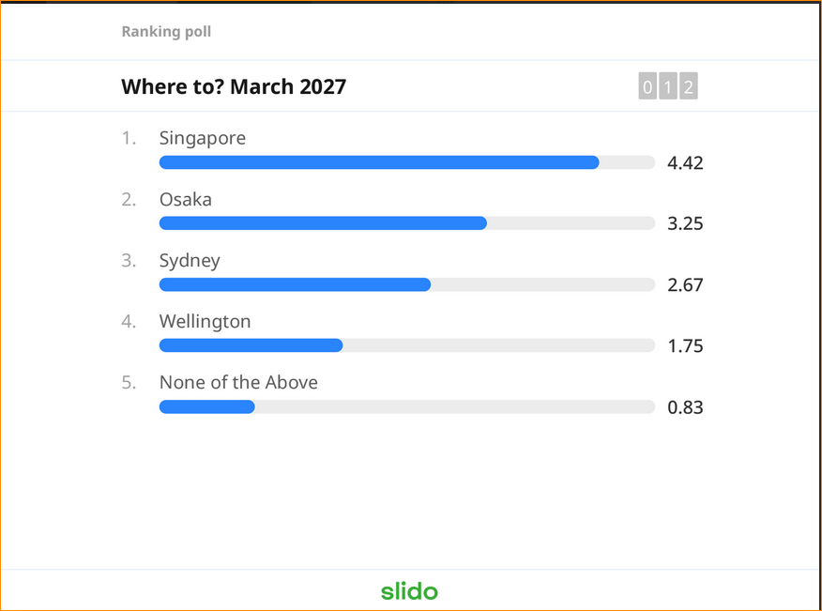
Slido Ranking Taken during Future Venue AdHoc Mtg

Slide 19
Executive Secretary Agenda Items
Friday Closing Plenary:
  4.02: Future Meetings (30 Minutes)
    1. Straw poll results on This Venue
    2. 802 Contract Status
    3. 2027 March Venue Selection -
    4. Registration Information Update –
  8.033 Executive Secretary Report
  8.04 Announcement of 802 EC Interim Telecons
  8.05 Call for Tutorials for Nov 2024 Plenary

Slide 20
4.02 – 1. Straw Poll: Return to This Venue:
(Melia Castilla, Madrid– 2025 July)
1. How many people would like to come back to this venue?
Yes No
  .1 27 7
  .3 76 1
  .11 55 5
  .15 23 0
  .18 19 1
  .19 7 0
Totals: 207 14

Slide 21
4.02 – 1. Venue Polls (continued)
(Melia Castilla, Madrid– 2025 July)
2. Did you go to the social? (Award Reception)
    Yes No
  .1 28 7
  .3 65 10
  .11 54 18
  .15 21 5
  .18 22 1
  .19 8 1
3. If you attended the Social, did you like the social?
        Yes No
  .1 25 5
  .3 57 0
  .11 53 2
  .15 18 3
  .18 22 0
  .19 8 0
Notes:
802.1 did not respond: 16 – (45 in DVL)

Slide 22
Future 802 Plenary Venue Contract Status
2025 July 27-August 1 –Melia Castilla Madrid, Madrid, Spain (NOTE: Week of July 27)
2025 November 9-14 – Marriott Marquis Queen’s Park, Bangkok, Thailand
2026 March 8-13 - Hyatt Regency Vancouver, Vancouver, Canada (Changed from Chicago)
2026 July 12-17 – Le Centre Sheraton Montreal, Montreal (July 2022 attrition offset)
2026 November 8-13 - Marriott Marquis Queen’s Park, Bangkok, Thailand
2027 March 14-19 – Hilton Atlanta, Atlanta, GA, United States (New Asia Location)
2027 July 11-16 - Gothia Towers, Gothenburg, Sweden
2027 November 14-19 – Hawaiian Village, Oahu, Hawaii, United States
2028 July 9-14 – Sheraton Le Centre Montreal, Montreal, Quebec, Canada
802 EC Approved – Contract is in negotiations and will be sent to IEEE CEE and IEEE Legal.
Contracts Executed
As of July 27, 2025
Notes:
Dark Blue – Covid Rebooks Yellow – Special Date change
Green – 2023 RFP Assignments Light blue – 2024 Sept Telecon Approved Location
White – Booked Prior to Covid.
-----------------------------------------------------------------------------------------------------------------------
2025 July - Melia Castilla Madrid – July 27-Aug 1 - Contract and amendment executed.
2025/2026 November – Marriott Marquis Queen’s Park – Executed Oct 28, 2024
2026 July – Hosting ITU WG15 – Sheraton le Centre Montreal -- Executed 26 Feb
Error found after signing – Amendment signed 3 April 2025
2 Amendments in process 1 for ITU week and 1 for IEEE week
2027 March – APAC – Asia Pacific Australia Coast
– 802 LMSC Changed venue region to APAC
-- 20 Proposals reduced to 4 for discussion in 2025 July.
2027 July – Gothia Towers
– Site Visit 21-22 Aug 2024 - Was successful.
– Contract still in negotiation. – Target end of August.
2028 July 9-14 – Sheraton Le Centre Montreal – Executed.
Error found after signing – Amendment signed 3 April 2025
Addendum to extend Room Block.

Slide 23
Ranking of Choices by Future Venues AdHoc
        1. Singapore, Singapore
        2. Osaka, Japan
        3. Sydney, Australia
        4. Wellington, New Zealand
  We Had a long discussion on the merits of each venue choice. Concerns were expressed for each of the options.
  Face to Face Events provided a More Detail in file: 802-EC-25/0189r1

Slide 24
Slido Ranking Taken during LMSC Closing

Slide 25
2027 March IEEE 802 Plenary
Face To Face Events and the Exec Sec will work to get more solid information from both options.
Plan to discuss further on Sept 2, 2025, Interim Telecon.
More research on options in APAC region.

Slide 26
2025 July IEEE 802 Plenary Registration Report
Registration Income: $559,000
July 31, 2025 6pm ET | Column Labels
Primary WG | In-Person Attendee | IEEE Guest | IEEE Student | Supporter Partner Guest | Virtual Attendee | Grand Total
802.1 | 40 | 2 | 1 | 2 | 21 | 66
802.11 | 325 | 2 | 6 |  | 276 | 609
802.15 | 44 |  |  | 1 | 45 | 90
802.18 | 4 |  |  |  | 1 | 5
802.19 | 5 |  |  |  | 2 | 7
802.24 | 4 |  |  |  |  | 4
802.3 | 153 |  |  |  | 117 | 270
(blank) | 2 | 1 |  |  |  | 3
Grand Total | 577 | 5 | 7 | 3 | 462 | 1054

Slide 27
8.033 - Call for Interest – 802 Executive Secretary –
Venue Preparation, Selection, and Contracting
The IEEE 802 LMSC Chair, James Gilb, has asked all appointed LMSC members to prepare a succession plan. The preparation of someone to step into the roles that need orientation and training so that they would be ready to take over the role and responsibilities.
One Role that I have is the IEEE 802 Executive Secretary.
The next 2 slides outlines the role and responsibilities required.
If you or someone you know would be interested in taking an active part in this role in the future, please have them contact me.

Slide 28
8.033 Executive Secretary Report
3.4.6 Executive Secretary
  The responsibilities of the Executive Secretary include:
    a) Scheduling meetings in coordination with the Standards Committee Chair and distributing a meeting notice at least 30 days before the meeting
    b) Oversee all activities related to Standards Committee sponsored meeting facilities and services
    c) With the Treasurer, ensure that Standards Committee sponsored sessions are compliant with IEEE financial policies
    d) Present summaries of venue options to the Standards Committee, select venues with approval of the Standards Committee, and sign approved proposals on behalf of IEEE 802
    e) Coordinate with conference service providers and Standards Committee Chair on major decisions
    f) Oversee maintenance of Standards Committee registration database
    g) Carry out the duties of the Treasurer if the Treasurer is unavailable.
Notes:
IEEE 802 LMSC Policies and Procedures -- ec-20-0124-05-00EC

Slide 29
IEEE 802 LMSC Chair's Guidelines and Standards Committee Policy Decisions, v39 6/17/2023
2.10.6 Executive Secretary Responsibilities
  1) IEEE 802 sessions: Efficiency improvement
    a) Ensure existing automated tools are operating properly (e.g., registration database,
    attendance monitoring, document handling, IEEE 802 web page, etc.) in conjunction with
    the Recording Secretary
    b) Develop requirements for additional meeting services to improve IEEE 802’s efficiencies in
    developing standards (e.g., combined live and virtual meetings, purely virtual meetings,
    improved registration, attendance and document systems, etc.)
    c) Prototypes, deploys, tests, evaluates and summarizes test results of new systems.
    d) When appropriate work closely with IEEE SA staff to evaluate and/or implement new
    systems.
    e) Manage the introduction of new systems until they are operating smoothly.
    f) Provide guidance to IEEE SA Standards Committees, Working Groups and Staff outside of
    IEEE 802 in deploying new smoothly operating systems
  2) IEEE 802 plenary sessions: Facilities and services
    a) Oversee activities related to meeting facilities and services in conjunction with the Treasurer
    b) Assist in identification of future site choices/locations
    c) Coordinate with Conference Service Provider and the Standards Committee Chair on major
    decisions
  3) IEEE 802 registration database
    a) Responsible for database maintenance
    b) Oversee conference service staff on updates and additions
    c) Protection against loss/corruption of data
  4) Assist IEEE 802 Treasurer
    a) Review of expenditures and future budget preparations
    b) Identify meeting deadbeats and report to treasurer for collection

Slide 30
8.04 Monthly IEEE 802 LMSC Telecons
Announcement of 802 LMSC Interim Telecons
Tuesday 5 August 2025 – Next week Canceled
Tuesday 2 Sept 2025, 19:00-21:00 UTC
Tuesday 7 Oct 2025, 19:00-21:00 UTC
Tuesday 3 June 2025, 19:00-21:00 UTC
Call Time: Tuesday, 3:00 PM - 5:00 PM (UTC-04:00) Eastern Time (ET)
Recurrence: Occurs Generally the first Tuesday of every month.
From 7:00 PM to 9:00 PM, (UTC+00:00) Reykjavik, Iceland time zone.
Calls after November Plenary to be Scheduled during 2025 November IEEE 802 LMSC Closing Plenary meeting.
Notes:
802 Interim Telecons – 1st Tuesday of the following Months: January/February/April/May/June/August/September/October
Jan 7 , Feb 4, April 1, May 6, June 3, August 5, Sept 2, Oct 7

Slide 31
8.05 Call for Tutorials for November 2025
Tutorials may be held electronic: TBA
In person/Mixed-mode Tutorials: November (Mon/Tues)
Tutorial Request form – 2025 Version:
  https://mentor.ieee.org/802-ec/dcn/25/ec-25-0130-00-LMSC-802-tutorial-request-form-2025.docx
As a reminder, please refer to Chair's Guidelines section 2.5 Tutorials for the logistics for participating in sponsoring/presenting a Tutorial.
Note that Tutorial times are limited to 80 minutes with 10 minutes to allow for presenters to setup and depart. (Starting at 18:15).
All requests for Tutorials must be made by 26 September 2025
Notes:
All official tutorial request forms must be submitted no later than 45 days in advance of the Plenary Session.
Approved Tutorial Requests will be assigned a time slot based on the order in which they were received.
The Final Tutorial Schedule will be posted at http://802world.org/plenary and http://ieee802.org no less than 30 days in advance of the Plenary Session.
Mentor Link to 2025 Tutorial Request form: https://mentor.ieee.org/802-ec/dcn/25/ec-25-0130-00-LMSC-802-tutorial-request-form-2025.docx

Slide 32
Approved 2025 Session Registration Fees
To allow for Attendees to plan for 2025 expenses, and to accommodate the direction from the Reserve Plan Proposal:
Moved to Set the 2025 Session Registration Fees:
  Early-Bird $600
  Standard $800
  Late/Onsite $1000
  $300 discount with 3-night stay
Moved: Jon Rosdahl
2nd: Glenn Parsons
July 19, 2024, Motion #3: Approved by unanimous consent

Slide 33
2024 November 802 LMSC Closing Plenary:
Motion to Host ITU-T SG15 2026 July
Approve hosting of ITU-T SG15 July 2026 Plenary Session adjacent to IEEE 802 plenary including the hosting of a joint workshop, with cost not to exceed US$175,000
Proposed: David Law
Second: Robert Stacey
Results: Unanimous – Motion Passes

Slide 34
Motion to Replace 4.5 in 802 Chair’s Guideline (#2)
  Motion: Move to replace paragraph 4.5 IEEE 802 LMSC Chairs Guidelines: 802-EC-17/0120r37 with the following Text:
  4.5 Length of hotel stay for discounted registration
  (LMSC Motion XXX on Nov 15, 2024 – IEEE 802 LMSC Closing Meeting)
  In the November 2024 802 LMSC Closing meeting, the LMSC passed the motion that provides for a discount of $300 to the registration fee for those attendees booking and staying in the IEEE 802-contracted hotel for at least 3 nights. Proof of hotel stay will be required to earn the discount.
    The result of the motion was that a hotel stay was defined as at least three nights booking and staying in the IEEE 802 contracted hotel in order to be granted a discount of $300.
  Effective beginning with the 2025 March IEEE 802 Session.”
Moved: Rosdahl
2nd: Zimmerman
Results: passes by Unanimous Consent.

