Slide 1
2025 July
IEEE 802 LMSC Plenary
Things to Know
Madrid, Spain
Prepared by: Face To Face Events
IEEE 802 Plenary Meeting Planner
Email: 802info@facetoface-events.com

Slide 2
Meeting Planner Contact Information
Dawn Slykhouse, Face to Face Events
Mobile: +1 (408) 594-1342
Email: dawns@facetoface-events.com
Lisa Ronmark, Face to Face Events
Mobile: +1 (604) 316-4947
Email: lisa@facetoface-events.com
Stephanie Williams, Face to Face Events
Mobile: +1 (408) 497-9613
Email: stephanie@facetoface-events.com
Event Office
Neptuno
Planta 1/Lower Floor
Office Dates
Sunday July 27th through
Friday August 1st
General Email Inquiries
802info@facetoface-events.com

Slide 3
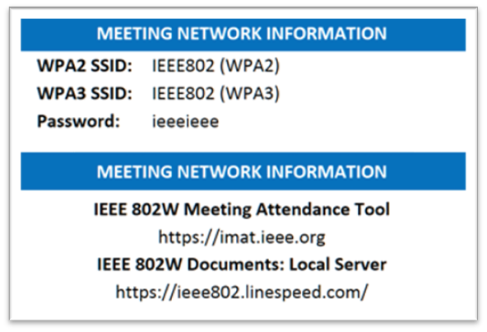
Network Vendor Contact Information
Onsite Network Support
Members of the Linespeed team can be dispatched by contacting the Meeting Planner directly or by placing a request at the event registration desk.
Linespeed Events Contact Information
Richard Alfvin
Mobile: +1 (585) 781-0952
Email: rick@linespeed.io
Network Vendor Office
Cibeles
Planta 1/Lower Floor
Office Dates
Sunday July 27th through
Friday August 1st
Local Document Server
http://ieee802.linespeed.com/

Slide 4
Audio Visual Equipment – Onsite Support
WHO TO CONTACT IF AUDIO VISUAL EQUIPMENT ISN’T WORKING IN YOUR ONSITE MEETING ROOM
Please contact the Meeting Planner directly if you have any issues with the audio-visual equipment in your meeting room. The Meeting Planner will contact support, and the appropriate technician will be sent to assist as soon as possible.
Meeting Planner can be reached at:
Registration and Information Desk: Hall Tapices, Planta 1/Lower Floor
Registration Office: Neptuno, Planta 1/Lower Floor
Via Text or Call: Lisa Ronmark: +1 (604) 316-4947, Stephanie Williams +1 (408) 497-9613
WEBEX AUDIO IN THE ONSITE MEETING ROOM
If you are a local participant, PLEASE, select “Don’t connect to audio” when joining WebEx.
Connecting to the audio, may cause an audio interference or a feedback loop that will disrupt the meeting.

Slide 5
Name Badge Requirements & Pick Up
Name Badge Requirements
Photo ID Required for Pick Up
Session attendees must keep their attendance badges visible in the meeting and food and beverage break service spaces.
Hotel and security staff may request that an individual show a badge.
If an attendee does not have a badge, they can collect one at the event registration desk.
Name Badge Pick Up
Badges can be picked up at the Registration and Information desk located in the Hall Tapices area on Planta 1/Lower Floor of the Melia Castilla.
Sunday 15:00 – 19:00
Monday 7:30 – 19:00
Tuesday and Wednesday 8:30 – 18:00

Slide 6
IEEE 802 LMSC Mixed Mode Officer Training
WHO: IEEE 802 WG Session Leaders (and all others interested)
WHAT: IEEE 802 Mixed Mode Meeting Office Training
How to run and participate in a mixed mode meeting.
WHEN: Sunday 27 July, 14:30 Madrid Time
ONSITE MEETING ROOM: El Jardin, Planta 1/Lower Floor
WEBEX: WebEx Link:
  https://ieeesa.webex.com/ieeesa/j.php?MTID=m372880d7a8de0fbf08fc7f1607c0d102
  WebEX Meeting Number (access code): 2332 812 2539
  Meeting password: training
IEEE 802 CALENDAR https://ieee802.org/802tele_calendar.html
REGISTRATION FEE: Registration for the IEEE 802 Plenary Session (with fee) is required, whether attending in-person or remotely.
Registration Link: https://cvent.me/B9X8ML

Slide 7
IEEE 802 LMSC Tutorial
WHO: IEEE 802 Plenary Session Attendees
WHAT: Tutorial Session: Your IEEE 802 LMSC and You!
WHEN: Monday July 28, 19:15 Madrid Time
ONSITE MEETING ROOM: Tapices/Lower Floor
WEBEX: WebEx Link: https://ieeesa.webex.com/ieeesa/j.php?MTID=m19c3538b4831a5c75bc05bdf1a29db2a
Meeting number (access code): 2337 289 1149
Meeting password: 802lmsc
ABSTRACT: An introduction to the IEEE 802 LMSC. And why you should be involved.
REGISTRATION FEE: Registration for the IEEE 802 Plenary Session (with fee) is required, whether attending in-person or remotely.
Registration Link: https://cvent.me/B9X8ML

Slide 8
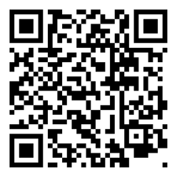
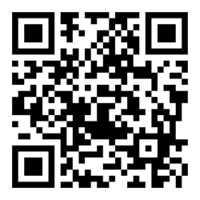
Schedule & Attendance
Schedule
Attendance
Onsite Meeting Rooms
Schedule QR codes posted outside each meeting room and on back of your badge.
http://schedule.802world.com/schedule/
Virtual Meeting Rooms
https://ieee802.org/802tele_calendar.html
IMAT Attendance Tool
Remember to log your attendance using the IMAT Attendance Tool.
https://imat.ieee.org/my-site/home
Registration Fee Reminder
Payment of the session registration fee is required for all individuals who participate in any meetings associated with the IEEE 802 Plenary Session.

Slide 9
Meeting Times
REGIONAL OFFSET
Session times have been offset by 1 hour from previous IEEE 802 Plenary Sessions to accommodate for daily afternoon break and later evening meal periods in Spain.
Please check online for the most up to date schedule. http://schedule.802world.com/schedule/
Session Schedule
AM 1 9:00 – 11:00
AM 2 11:30 – 13:30
PM 1 14:30 – 16:30
PM 2 17:00 – 19:00
PM 3 19:30 – 21:30
Exceptions
IEEE 802 LMSC
Opening Meeting
  8:00 – 10:30, Monday July 28th
Closing Meeting
  13:00 – 18:00, Friday August 1st

Slide 10
Meeting Room Assignments
802 LMSC
Planta 1/Lower Floor
Shared WG Room El Jardin
Opening/Closing El Prado
802 LMSC Board Room Roceletos
802.1
Planta 1/Lower Floor
WG Room #1 El Escorial
802.3
Planta Baja/Ground Floor
WG Room #1 Castilla
WG Room #2 Hildago
WG Room #3 Patio 3
WG Room #4 Segovia
WG Room #5 Toledo
802.11
Planta 1/Lower Floor
WG Room #1 Tapices
Planta Baja/Ground Floor
WG Room #2 Patio 2
WG Room #3 Comendador
WG Room #4 Patio 1
WG Room #5 Escudo
802.15
Planta 1/Lower Floor
WG Room #1 El Escorial
WG Room #2 La Galleria
WG Room #3 Retiro
Subject to Change
While our goal is to keep the listed meeting room assignments throughout the session changes may occur based on WG requirements. Please check online for the most up to date schedule. http://schedule.802world.com/schedule/

Slide 11
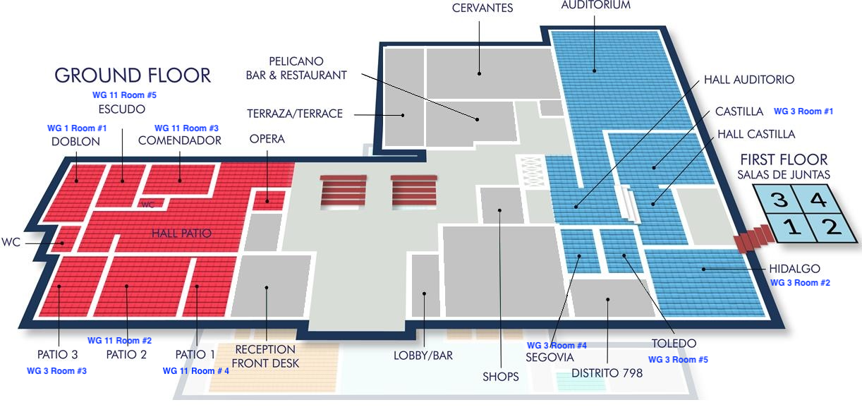
Meeting Room Map Ground Floor

Slide 12
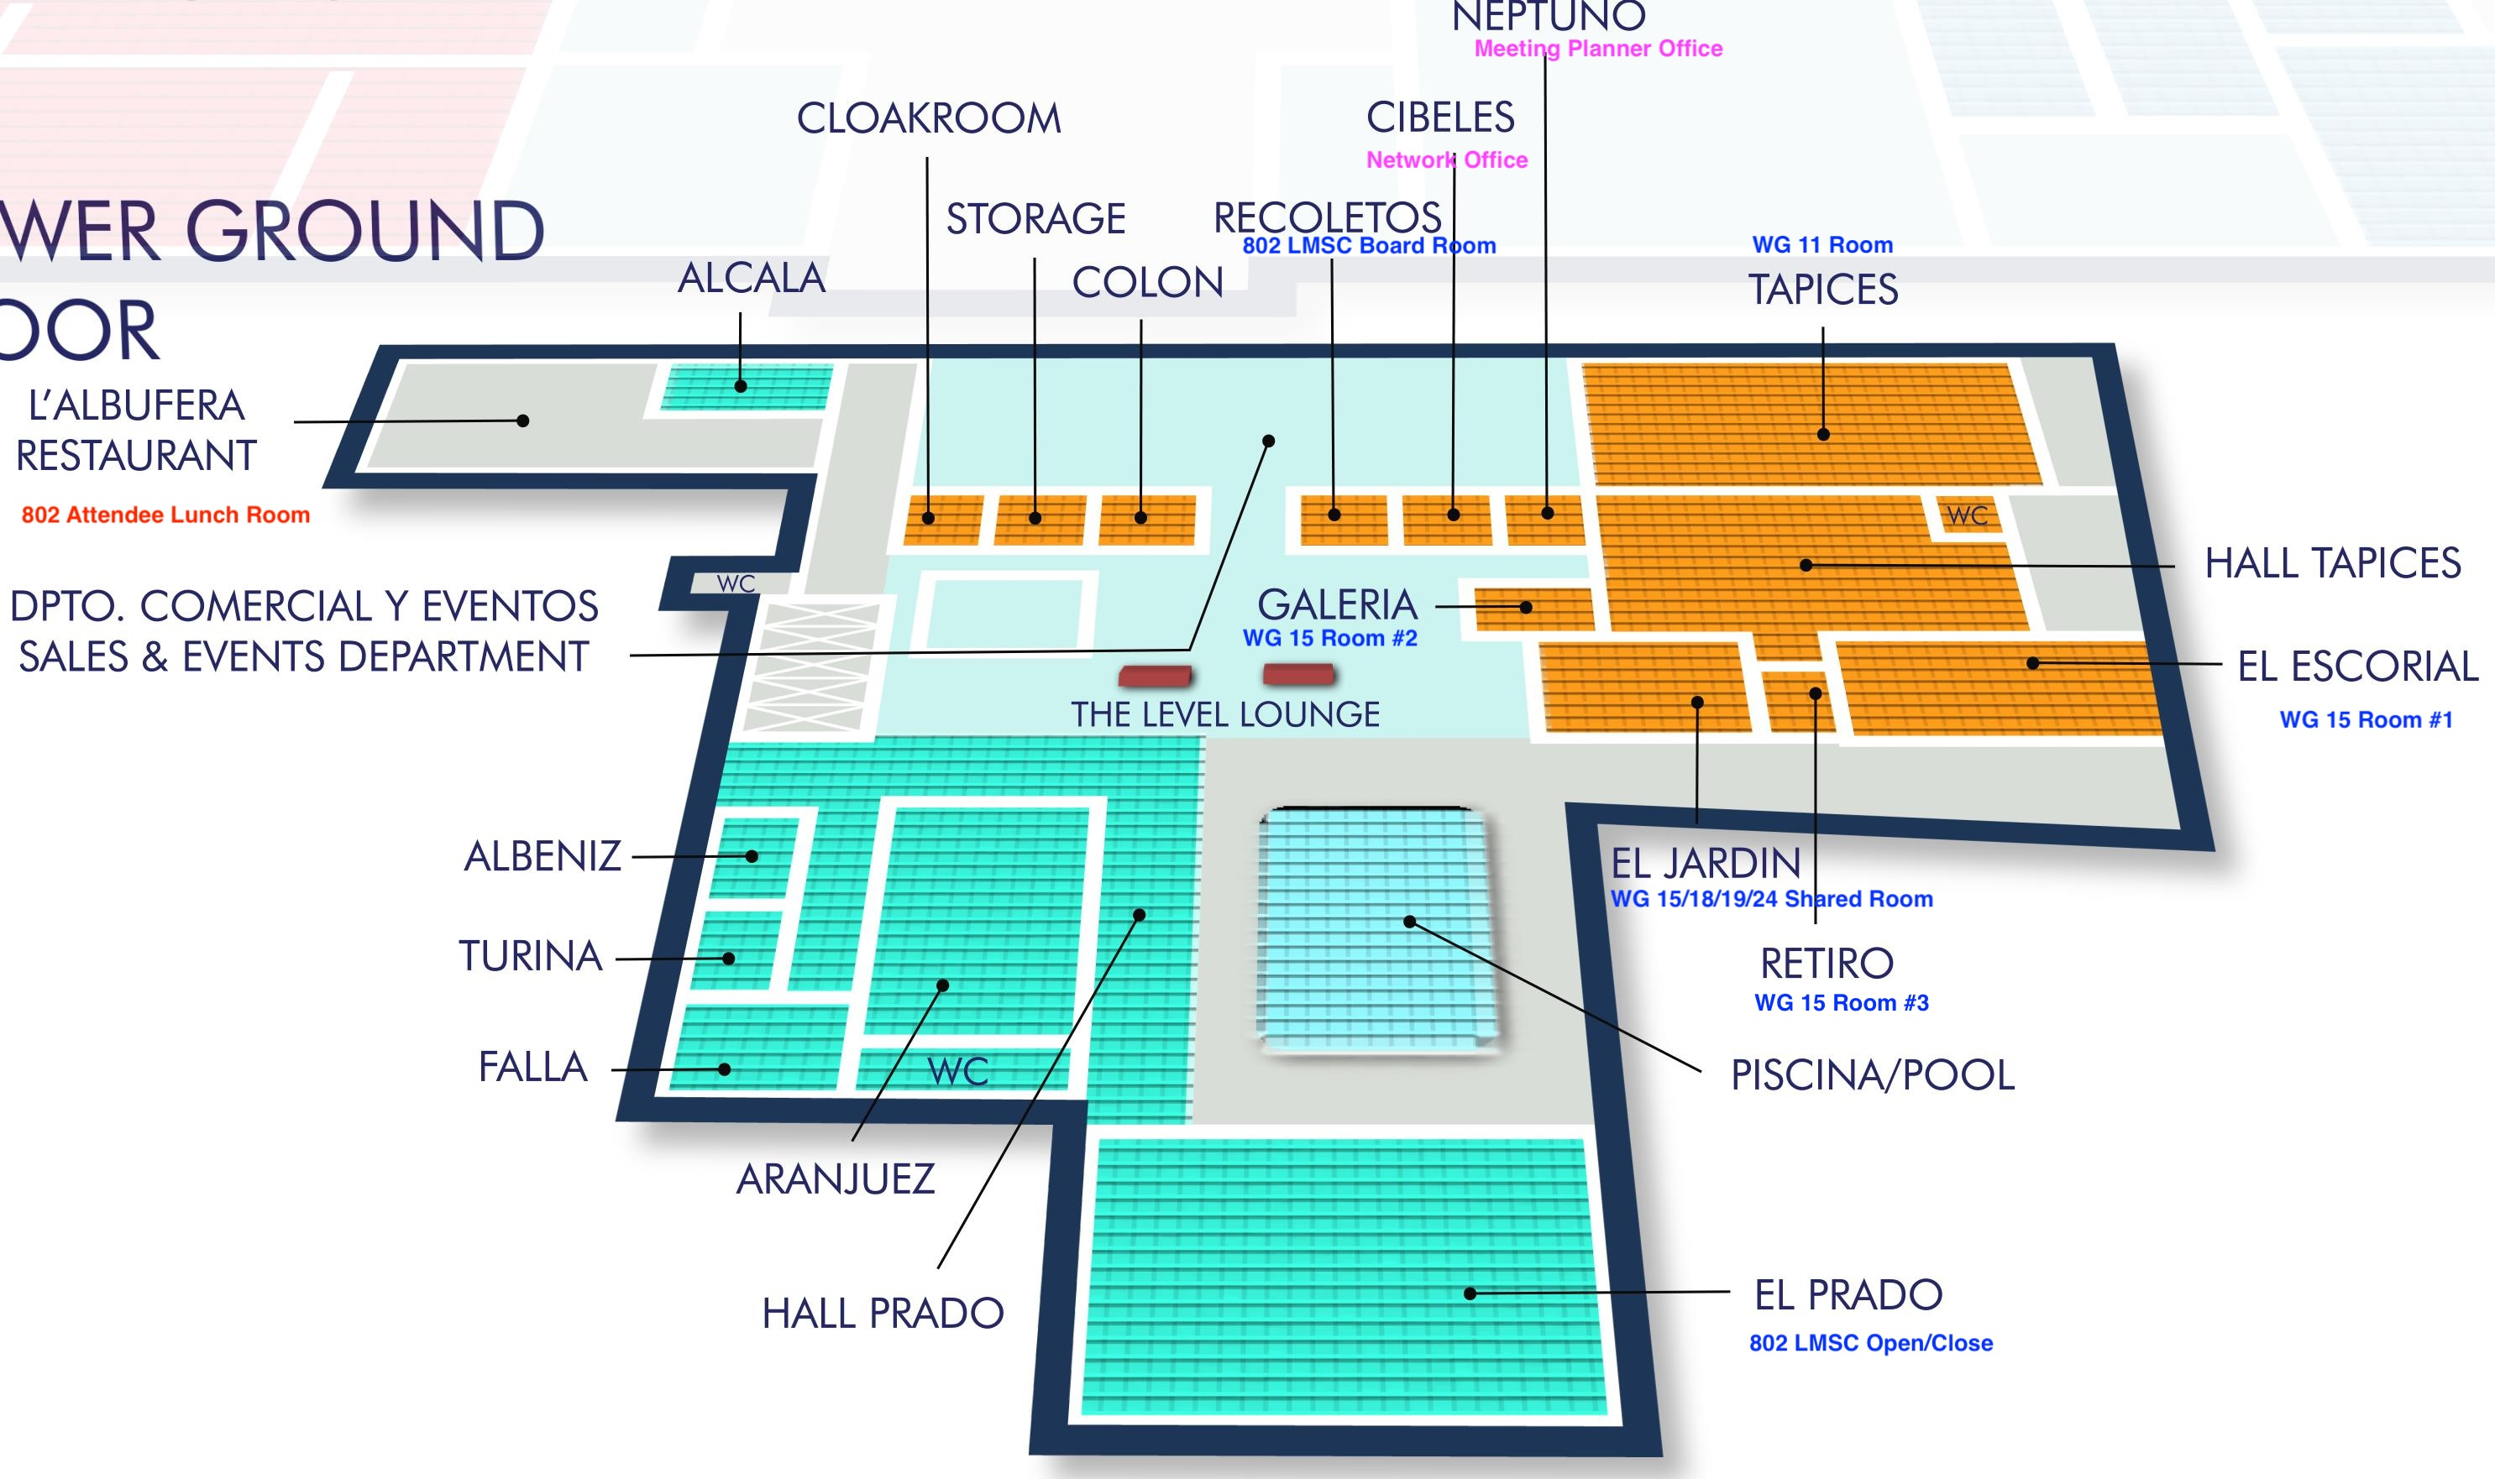
Meeting Room Map Lower Floor

Slide 13
Attendee Food & Beverage Breaks
Break Service
  Shall be served in the main common areas near all meeting spaces.
Hall Tapices, Hall Auditorium, Hall Patio
  AM Beverage Break 10:50 – 11:35
  PM Food & Beverage Break 16:15 – 17:00
Lunch Service
  Shall be served in the hotel restaurants Cervantes & L'Albufera.
Designated areas for IEEE 802 attendees will be clearly marked.
  Lunch 13:00 – 14:30 Monday, Tuesday, Wednesday, Thursday

Slide 14

Social Event & Award Presentation
Wednesday July 30, 2025
  El Prado & Picina Pool
  20:00 – 22:00
  Reception Style Food and Beverage
  Award Presentation
Name Badge Required
  No charge, but please confirm your plans to attend with the registration staff.
  Guest Badges available at the Plenary Registration and Information desk.
NO OUTSIDE FOOD OR DRINK
Award Presentation
IEEE Charles Proteus Steinmetz Award recipient, IEEE 802 LMSC Past Chair, Mr. Paul Nikolich
Award presented by IEEE President and CEO, Kathleen Kramer

Slide 15
Quick Guide to Madrid, Spain
Use this link to get started or select some of the links listed below for more specific information. Essential Madrid - Official Tourism Madrid Site
Maps
The following links provide access to maps of the city including bus and metro services in the Madrid area surrounding the IEEE 802 LMSC venue.
Tourist Map of Madrid (2.9 MB) (Spanish/English)
Metro Map (1.4 MB) (Spanish/English)
Tourist Metro Map (1.4 MB) (Spanish/English)
Online Bus Map (interactive) (Spanish/English)
Tourist Bus Map (2.4 MB) (Spanish/English)
Airport Transportation
Metro
Taxi
The most efficient method to reach the IEEE 802 Plenary venue from the Madrid Airport is by Taxi or rideshare service.
Metro
The Madrid Airport is connected to the city of Madrid via the Pink Metro Line 8. This line ends at the Nuevos Ministerios Station, where you would need to transfer to Metro Line 10 is required. The total journey is estimated to be about 45 minutes in travel time and will cost between 4.50€ to 5€.
The airport has two metro stations; one at Terminal 2 (T2), floor 1, and the other one at Terminal 4 (T4), floor -1. Both are part of the pink line 8. These lines run 06:00 to 01:30.
Taxi
Madrid airport taxis are white taxi vehicles, with red stripes and the city’s emblem on their sides. They are lined up at the airport taxi ranks, no matter the time or day. Each terminal is equipped with two taxi ranks, one at the departures and one at the arrivals level, while passengers are highly advised to hire their cabs exclusively from the official ranks to avoid getting overcharged.
Madrid taxis are metered. However, the ride from the airport to the city center is set at 30€, even if the transfer takes place during the night or on public holidays. Additionally, luggage isn’t an extra charge. The travel time is about 25-30 minutes, however, could spike up to 40-50 during peak traffic hours.
Language
Spain's official language: Spanish
Money Conversion €
The official (cash) currency of Spain is the Euro (international abbreviation EUR€).
XE Currency Conversion Website
Electrical Plug / Outlet
Electrical Plug and Voltage Information for Spain
In Spain, power plugs and sockets (outlets) of type F are used. The standard voltage is 230 V at a frequency of 50 Hz.
Weather
Current weather conditions in Madrid, Spain
Emergency Assistance
In case of an emergency situation, the emergency number in Spain is 112.

Slide 16
2025 November 802 Plenary Session
Thanks for helping us make this session a success, we look forward to working with you again for the 2025 November Plenary!
Mariott Queen’s Park Bangkok, Thailand
Session Dates: Sunday November 9th through Friday November 14th , 2025
Participating Working Groups: 802.1, .3, .11, .15, 18, .19, .24
Hotel Reservations and Registration are available after the 2025 July Session
Registration will open the first week of September 2025

