Slide 1
IEEE 802 June 2025 Public Visibility Standing Committee Updates
June 2025

Slide 2
802 Public Visibility SC Scope, Duties, Membership
Scope and Duties
To raise public visibility and industry awareness in timely fashion of IEEE 802 WG / TAG activities
Develop social media content based on IEEE 802 WG / TAG activities
LinkedIn – https://www.linkedin.com/company/ieee802
IEEE-SA 802 - https://standards.ieee.org/featured/802/index.html
Content
Review Pre 802 Plenary meetings for social media messaging: PARs to be considered, Tutorials, [802.3] Call-for-Interests, New Task Force formations
Review Post 802 Plenary meetings for social media messaging: Study Group formations, IEEE 802 Position Approvals
Other 802 related material for social media messaging: Press Releases, White Paper publications, Other 802 approved news, 802 WG / TAG Activities with IEEE-SA
IEEE-SA Standards Board Related - PAR Approvals, Standards Approval, Standards Publication
Membership
Membership in the Standing Committee is open to anyone that wishes to participate (ideally at least one participant from each 802 WG and TAG)

Slide 3
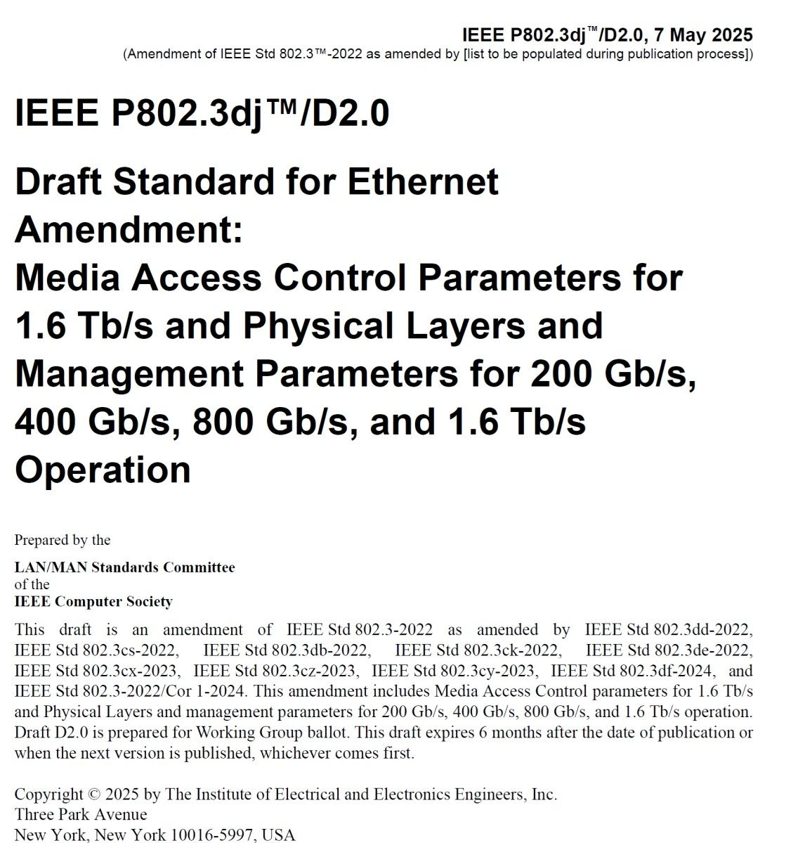
Linkedin Report
https://www.linkedin.com/company/ieee802
5390 total followers
Last 365 days
79671 Impressions
1681 Reactions
Latest Posts
July Meeting
IEEE P802.3dj
Robert Stacey’s presentation

Slide 4
Linkedin Posts for WGs
WG/TIGs can post their short meeting reports.
I received reports from 802.11, 802.18, 802.18 and 802.24 after March meeting.

Slide 5
IEEE SA Standards Awards Nominations
Submit your nominations of deserving honorees today
https://standards.ieee.org/about/awards/nominate/
The nomination period is now open and will run until 31 July 2025.
IEEE SA CONFORMITY ASSESSMENT AWARD IEEE SA CORPORATE AWARD
IEEE SA STANDARDS BOARD DISTINGUISHED SERVICE AWARD
IEEE SA LIFETIME ACHIEVEMENT AWARD
IEEE SA INTERNATIONAL AWARD IEEE SA STANDARDS COMMITTEE AWARD FOR OUTSTANDING CONTRIBUTION TO ENTITY STANDARDS IEEE SA STANDARDS MEDALLION

Slide 6
CSCN 2025
IEEE Conference on Standards for Communications and Networking
15–17 September 2025 // Bologna, Italy
Submission deadline: 15 June 2025

